Slide 1
Analytics Project Presentation - Spring 2015
Analytics Project: Correlation of weather with the number of accidents in New Jersey
Team: Ashish Yadav, Ashwin Thobbi,Ritu Sirkanungo
Abstract: The impact of weather on accidents that happen on road is examined in detail. Both the weather data and accident data are analyzed thoroughly to check the degree of causal relationship that might exist.This would be advantageous in informing travelers about making decisions to travel on certain days where there might be higher risk of accidents. Also,the Highway Agencies might be more alert during days of bad weather and regulate traffic in a more efficient manner. Hadoop and MapReduce framework is used in conjunction with HiveQL to analyze the large data sets.

Slide 2
Correlation of weather with the number of accidents in New Jersey
Background:
We are using two data sources. One source is NCDC which would give us the measurements of rain that take place on each day for each county in New Jersey. The second source is New Jersey State Police data which would give us the number of accidents on each day for each county in New Jersey. We are finding out the average rain during days in which accidents happen and average rain during days in which accidents don’t happen.This would help us correlate accidents with the amount of rain for each county in New Jersey

Slide 3
Correlation of weather with the number of accidents in New Jersey
Motivation:
This analytic will help Highway Agencies pump up the number of personnel required to manage security. They can also restrict use of certain highways. People with visibility issues can be warned not to drive during fog, rain as it might increase the risk of accidents. It can also be used by insurance companies to charge the clients taking weather into consideration.
This analytic will benefit drivers on road who can take more precautions or in some cases might avoid traveling during inclement weather conditions. This will also help them to take alternate modes of transport like subway in case traveling on road proves to be a risky deal. This analytic is important because it allows us to know the impact of weather on accidents that happen on road. The project will help us to quantify the impact and helps to reduce the number of accidents by making drivers take more precautions.

Slide 4
Correlation of weather with the number of accidents in New Jersey
Data Sources:
Name: National Climatic Data Center
Description: National Climatic Data Center is the world's largest provider of weather and climate data.The data that we got from this source is static data.We are doing daily analysis of rain data provided by them in the State of New Jersey.
Size : in GB’s

Slide 5
Correlation of weather with the number of accidents in New Jersey
Name : New Jersey State Police
Description : New Jersey State Police Departments has huge amount of data sets related to accidents which occur on roads and highways. From here, we are getting the day-wise data for the accident and crash statistics which occur in various counties in New Jersey. This is also static data.
Size : in GB’s

Slide 6
Correlation of weather with the number of accidents in New Jersey
Design Diagram :

Slide 7
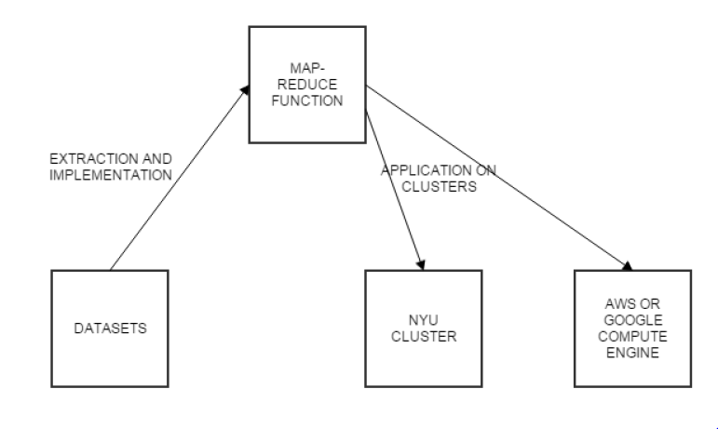
Correlation of weather with the number of accidents in New Jersey
High Level Component Architecture:

Slide 8
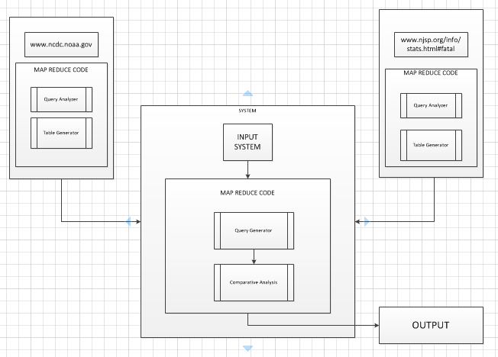
Correlation of weather with the number of accidents in New Jersey
System:

Slide 9
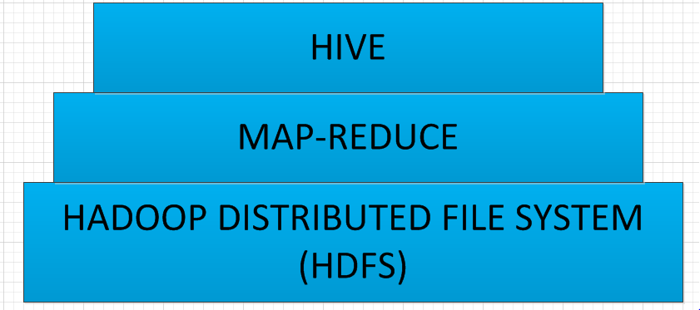
Correlation of weather with the number of accidents in New Jersey
Components of System Architecture:

Slide 10
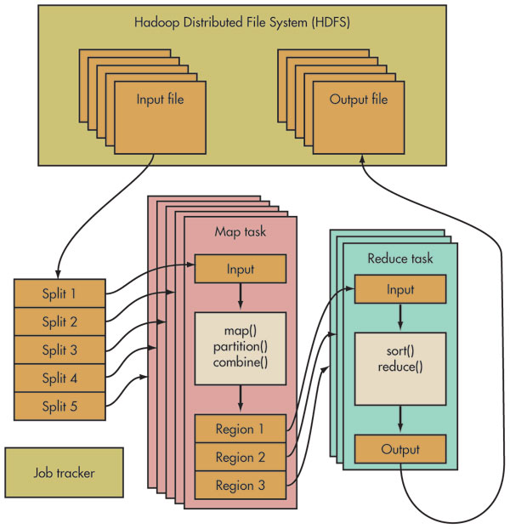
Correlation of weather with the number of accidents in New Jersey
HDFS Architecture:

Slide 11
Correlation of weather with the number of accidents in New Jersey
Platform:
Quickstart VM, NYU HPC Cluster,Amazon Web Services

Slide 12
Correlation of weather with the number of accidents in New Jersey
Results:
YEAR | AVERAGE PRECIPITATION ON DATES WITH NO ACCIDENTS | AVERAGE PRECIPITATION ON DATES WITH ACCIDENTS | TOTAL NUMBER OF ACCIDENTS | ACCIDENTS ON THE DAYS WHEN RAIN OCCURRED | ACCIDENT PERCENTAGE IN RAINFALL(%)
2008 | 0.3037797589897222 | 0.1566666672627131 | 30 | 12 | 40
2009 | 0.2545871576379745 | 0.9663157820897667 | 39 | 16 | 41.0
2010 | 0.2045058110339004 | 0.0609523818961211 | 21 | 18 | 85.71
2011 | 0.2366564399991299 | 0.0416216222519004 | 40 | 20 | 50
2012 | 0.1404216855046260 | 0.0786206892466750 | 30 | 10 | 33.33

Slide 13
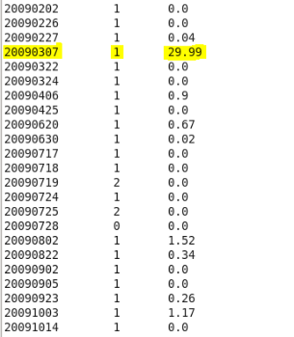
Correlation of weather with the number of accidents in New Jersey
Anomaly Analysis of
Year 2009:
Maximum precipitation
in year 2009: 29.99
affects the average and
results in the anomaly

Slide 14
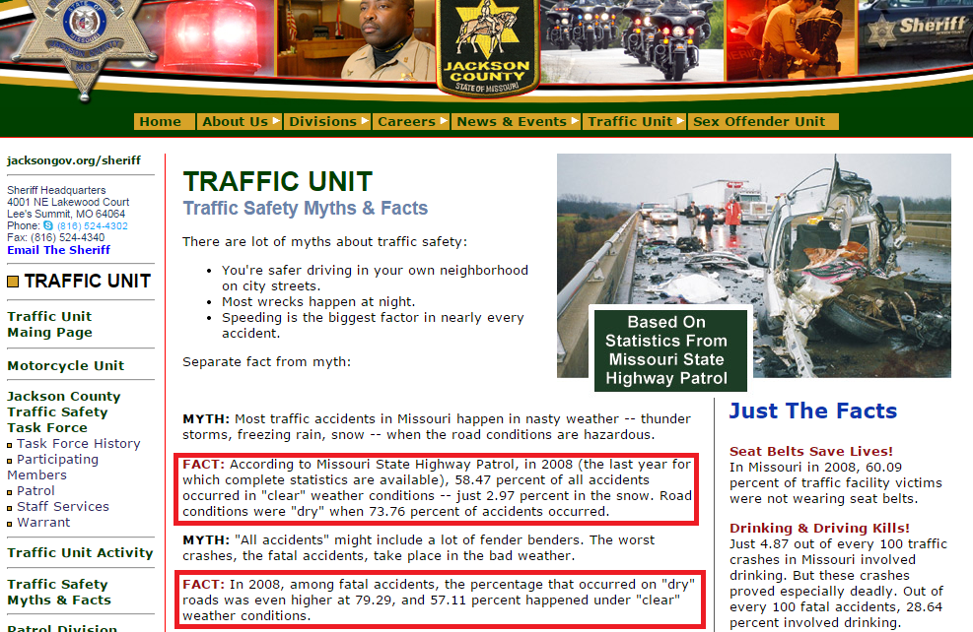
Correlation of weather with the number of accidents in New Jersey
Supporting Argument:
Missouri State
Jackson County
http://www.jacksongo
v.org/content/4847/57
65/5807/default.aspx

Slide 15
Correlation of weather with the number of accidents in New Jersey
Obstacle:
NHTSA data was not sufficient to support the analysis so we used a third data source, New Jersey State Police that provided us with the relevant information to aid the analysis.

Slide 16
Correlation of weather with the number of accidents in New Jersey
Key Observation:
It has been observed from the table generated average precipitation on dates with accidents is not in direct proportion with total number of accidents that have occurred in the county

Slide 17
Correlation of weather with the number of accidents in New Jersey
Conclusion:
The analysis disproves the general belief which states that there exists a proportional relationship between weather and accident rates in all areas.

Slide 18
Correlation of weather with the number of accidents in New Jersey
Acknowledgements
We would like to thank National Climatic Data Center(NCDC) and New Jersey State Police for providing us with the relevant data sources for the project. We would like to thank Professor Suzanne McIntosh for her guidance throughout the project and her expeditious replies to all our emails. Lastly, We would also like to thank NYU, Amazon Web Services and Cloudera for providing us with the environment to analyze our dataset.

Slide 19
Correlation of weather with the number of accidents in New Jersey
References:
[1] T. White. Hadoop: The Definitive Guide. O’Reilly Media Inc., Sebastopol, CA, May 2012.
[2] A. Gates. Programming Pig. O’Reilly Media Inc.,Sebastopol, CA, October 2011.
[3] J. Dean and S. Ghemawat. MapReduce: Simplified data processing on large clusters. In proceedings of 6th Symposium on Operating Systems Design and Implemenation, 2004.
[4] S. Ghemawat, H. Gobioff, S. T. Leung. The Google File System. In Proceedings of the nineteenth ACM Symposium on Operating Systems Principles – SOSP ‘03, 2003.

Slide 20
Thank You

