Slide 1
Customer Churn Prediction
In Telecommunications

Slide 2
Introduction
Customer churn occurs when customers or subscribers stop doing business with the company or unsubscribe the service is also known as customer attrition.
The signals can be plenty like not replying to email marketing, not logging in, not searching for new otlets, by filing a complaint on the website, etc
Research paper motivation:
In the last few years, there have been many changes in the telecommunications industry, such as, the liberalisation of the market opening up competition in the market, new services and new technologies. The churn of customers causes a huge loss of telecommunication services and it becomes a very serious problem.

Slide 3
Why Feature Extraction is clumsy?
Data extracted from different departments of a telecommunication industry like marketing, sales, finance etc.
Identification of all the features which can be useful to predict customer churn.
Demographic profiles: age, social class, bands, gender
Information of grants: customers with a disability or are over 80 are more like to continue the services.
Service orders: select the information of last 3 orders.

Slide 4
Why Feature Extraction is clumsy? [continued]
Requires explicit business understanding and domain expertise of the telecommunication industry to understand the data to a business context.
A Rookie who does not have the understanding of the telecommunication industry, cannot identify the right features for this business problem,
Telephone line information: no of telephone lines, line types, district codes.
Complaint Information: email, posted letter, more generally by telephone to different departments.
The historical information of bills and payments

Slide 5
Why Feature Extraction is clumsy? [continued]
Call details: call duration, price and types of call.
Incoming call details: duration of received calls, a no of received calls, respected fees.
Customer account information: types of service packages, junk mail indicators, creation date, bill frequency, account information etc
But with Data Mining/data science, we will make these departments talk to solve business problem like Customer churn prediction with data.
“The major bottleneck of the data is data itself.”

Slide 6
Data Normalisation
A variable called 'duration of received call’ that ranges between 100 and 150 mins carries more weightage as compared to a variable i.e. number of calls that in general ranges between 0 and 30. Hence, it is required to transform the data to comparable scales
The idea is to rescale an original variable to have equal range and/or variance.
Normalizing such selective features can be good for a better predictive model.

Slide 7
Real World data is messy Data Cleaning
Noisy: containing errors (data entry/collection) or outliers.
Inconsistent: containing discrepancies in codes or names
Eg
[Mumbai, Bombay, mumbai, bombay] are all same.
Data cleaning removes the irrelevant information which includes wrong spelling words caused by human errors, special mathematical symbols, missing values, strings ‘‘NULL’’, duplicated information, and so on
“The Data is not going to clean itself…”

Slide 8
Class imbalance problem Churners/non-churners
Class imbalance problem is very common for this type of data mining algorithm where no on non-churners are more than no of churners.
Most data mining algorithms works best when the number of instances of each classes are roughly equal. When the number of instances of one class far exceeds the other, problems arise.
A small case study:
If there is a dataset consisting of 10,000 non-churners and 10 churners.
Model 1 classified 7 out of 10 churners as non-churners and 10 out of 10,000 non-churners.
Model 2 classified 2 out of 10 churners as non-churners and 100 out of 10,000 non-churners.as churners.

Slide 9
Class imbalance problem Churners/non-churners[Continued]
Confusion Matrix at the rescue
True Positive (TP): churn and is classified correctly as churn
True Negative (TN): not-churn and is classified correctly as not-churn
False Positive (FP): not-churn but is classified wrongly as churn
False Negative (FN): churn but is classified wrongly as not-churn
If the classifier’s performance is determined by the number of mistakes, then clearly Model 1 is better as it makes only a total of 17 mistakes while Model 2 made 102 mistakes.
However, as we want to minimize the number of churners, we should pick Model 2 instead which only made 2 mistakes classifying churners.

Slide 10
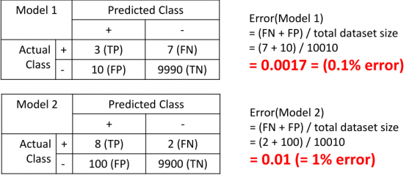
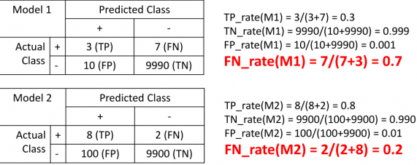
Class imbalance problem Churners/non-churners[Continued] [Continued]
Model 1 looks like it has lower error (0.1% error) than Model 2 (1.0% error) but we know that Model 2 is the better one.
Magic happens here:
Now, we can see that the false negative rate of Model 1 is at 70% while the false negative rate of Model 2 is just at 20%, which is clearly a better classifier. This is what we should educate the machine learning algorithm (or us) to use in order to allow it to pick a better algorithm.

Slide 11
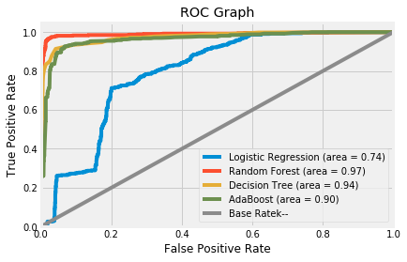
Class imbalance problem Churners/non-churners[Continued]
How to deal with class Imbalance problem:
Up-sample the minority class
Down-sample the majority class
Penalize algorithms (in svm, give an additional parameter : class_weight = ‘balanced’)
We make use of ROC curve and AUC( area under the graph) to come on the conclusion to select the best algorithm.
Finally evaluating all the model performance in one go:

Slide 12
Data mining algorithms
Choosing parameters for each of the models which is known as hyperparameters.
Hyperparameters cannot be learnt by fitting the model.
Eg:
Number of leaves or depth of a tree. Learning rate in different models. Choosing k in k-means algorithm. ……
How is it done?
Try a bunch of different hyperparameters.
Fit all of them separately. See how well each performs. Choose the best performing values.
Doing so in this fashion is the current standard.
Now when fitting different values of a hyperparameter, it is essential to use cross-validation to avoid overfitting.

Slide 13
Data mining algorithms
List of data mining algorithms used:
Decision Trees
Naive Bayes
Support Vector Machines
Logistic Regressions
Linear Classifications
Neural networks
Already discussed to describe each model.
ROC/AUC values [Checking performance]
Tuning hyperparameters [Model at it’s best]
Avoid overfitting [ Model is on the right track; Performance on the unseen data(test data) won’t be surprising.]

Slide 14
Not so important [important]
Python
pandas, numpy and scipy for data manipulation/wrangling stuff.
seaborn, matplotlib and Bokeh are available for data visualization.
scikit_learn, xgboost, gradient boosting, keras, h2o, tensorflow etc are used for different machine learning/data mining algorithms.
R
dplyr, data.table, plyr, tidyr for data manipulation/wrangling stuff.
ggplot2, corrplot are available for data visualization.
caret, xgboost, gradient boosting, keras, h2o, tensorflow etc are also used for different machine learning/data mining algorithms.

Slide 15
Conclusion [From the research paper study]
From simple data cleaning to the addition of new features, or removing unimportant features, scaling or normalising features, a data mining project stands and a lot of research are done to develop the techniques to deal with the data at each level.
In summary, from our business/research problem, “Customer Churn Prediction”, clean the data, explore the data with different visualizations, model our data with different data mining algorithms, interpret our results by several evaluation metrics and update our model are the typical processes involved.

