Slide 1
AI Finance Agent Data analysis report
Prepared by: Ritu Verma AI & Finance Professional
April 2026

Slide 2
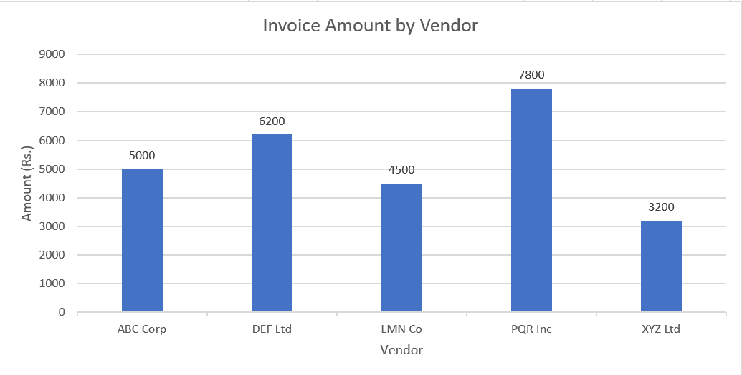
Invoice Analysis
- Total Invoices: 5 | Total Amount: Rs. 26,700
- Paid: 3 invoices (Rs. 19,000) ✅
- Unpaid: 2 invoices (Rs. 7,700) ❌
- Highest Invoice: PQR Inc — Rs. 7,800
- Vendors needing follow-up: XYZ Ltd, LMN Co

Slide 3
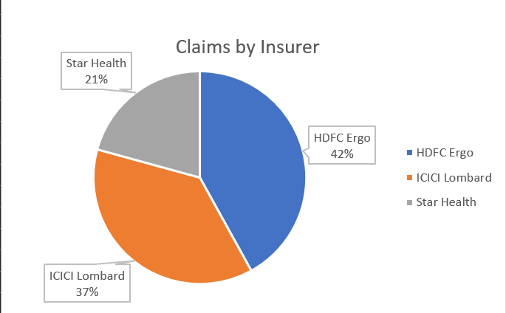
INSURANCE Claims Analysis
- Total Claims: 5 | Total Claimed: Rs. 1,93,000
- Settled: 3 claims (Rs. 67,000) ✅
- Pending: 2 claims (Rs. 1,20,000) ❌
- Highest Risk: Sunita Rao — Rs. 72,000 pending
- Top Insurer: HDFC Ergo — 41.97% of claims

Slide 4
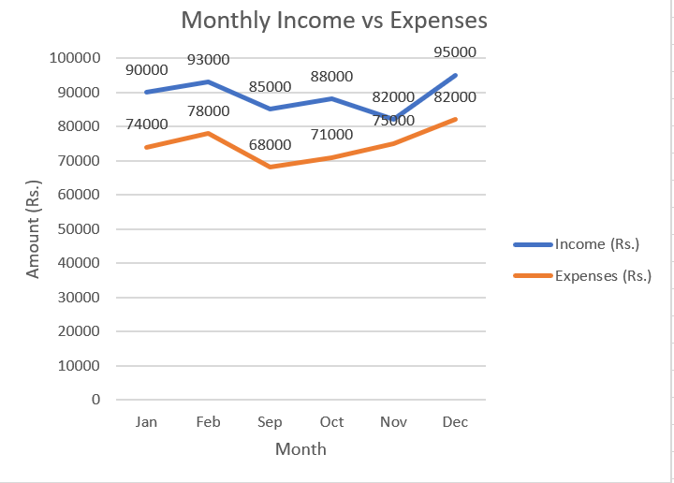
Budget & EXPENSES Analysis
- 6 months of data: Sep 2023 — Feb 2024
- Average Income: Rs. 88,833/month
- Average Expenses: Rs. 74,667/month
- Average Net Surplus: Rs. 14,167/month
- Highest Expense Ratio: Nov 2023 — 91.5% ⚠️
- Best Month: Sep 2023 — 80% expense ratio ✅

Slide 5
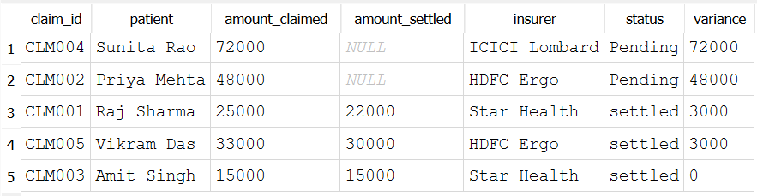
SQL DATA ANALYSIS INSIGHTS
- Tool Used: SQLite via DB Browser
- 5 tables created: invoices, payments, claims, settlements, budget
- Query 1: Vendor ranking — PQR Inc highest at Rs. 7,800
- Query 2: LEFT JOIN — identified 2 unpaid invoices
- Query 3: Claims variance — Rs. 72,000 highest pending
- Query 4: Expense ratio — avg 83.8% across 6 months

Slide 6
Summary $ Recommendations
- Tool Used: SQLite via DB Browser
- 5 tables created: invoices, payments, claims, settlements, budget
- Query 1: Vendor ranking — PQR Inc highest at Rs. 7,800
- Query 2: LEFT JOIN — identified 2 unpaid invoices
- Query 3: Claims variance — Rs. 72,000 highest pending
- Query 4: Expense ratio — avg 83.8% across 6 months

