Slide 1
WORDZONE
Capstone Project
Presenter –
Ritveak dugar – 16bit0407

Slide 2
What is WordZone?
It is a place where one can find, understand and know more words.
The idea is to give user a playground where users can explore and improve their vocabulary

Slide 3
What does it have?
It has three parts:
Findzone - Where user can find words like :
Find Similar words
Find Opposite words
Find Rhyming words (with and without a particular meaning)
Crossword Helper
UnderstandZone – Where user can understand their word.
KnowledgeZone – Where user can know more words related to the entered word.

Slide 4
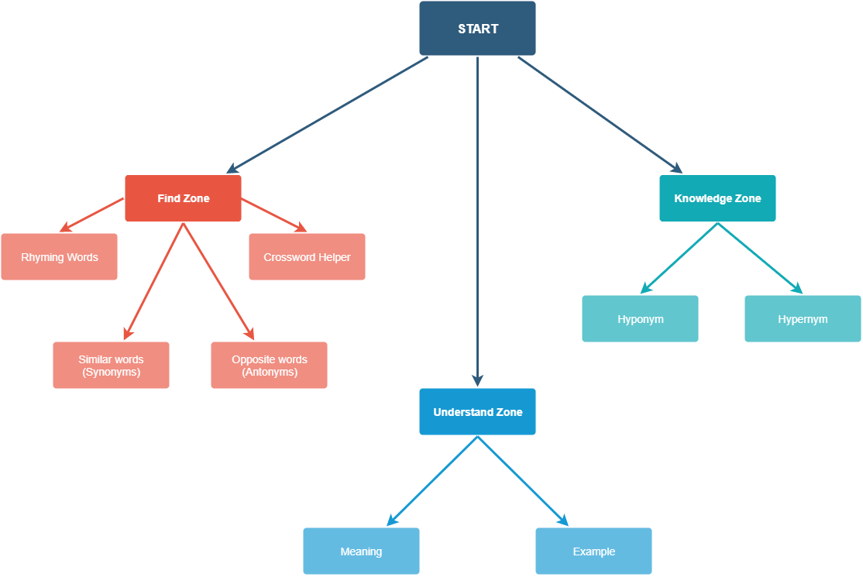
Modules :

Slide 5
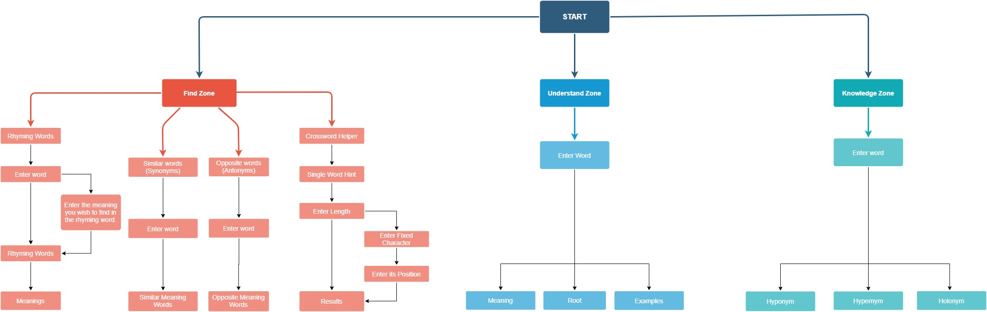
Detailed workflow

Slide 6
Tech Stack
Python – Base Language.
NLTK – For NLP related operations like stemming, lemmatizing and for corpus.
Wordnet – The Lexical Database.
Adobe XD – For UI development.
Kivy – Python GUI.

Slide 7
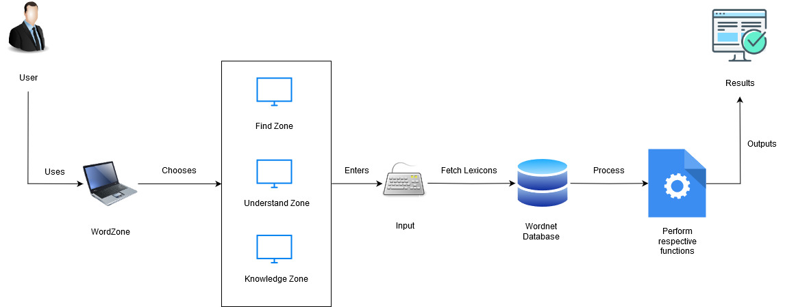
System Architecture:

Slide 8
The Link for wireframe
https://xd.adobe.com/view/d214429e-8809-458a-6d4b-6627d385a3fe-a425/

Slide 9
Review 2
Added Crossword Helper
Added New section Scrabble helper
Redefined the zones
Added ScrollView in output
Added Spell Checker and suggestions for other words.

Slide 10
Crossword Helper
User can enter a word nearest to their description
And the length of the word
The user receives a list of words, which they can narrow down by defining a particular character and its position.

Slide 11
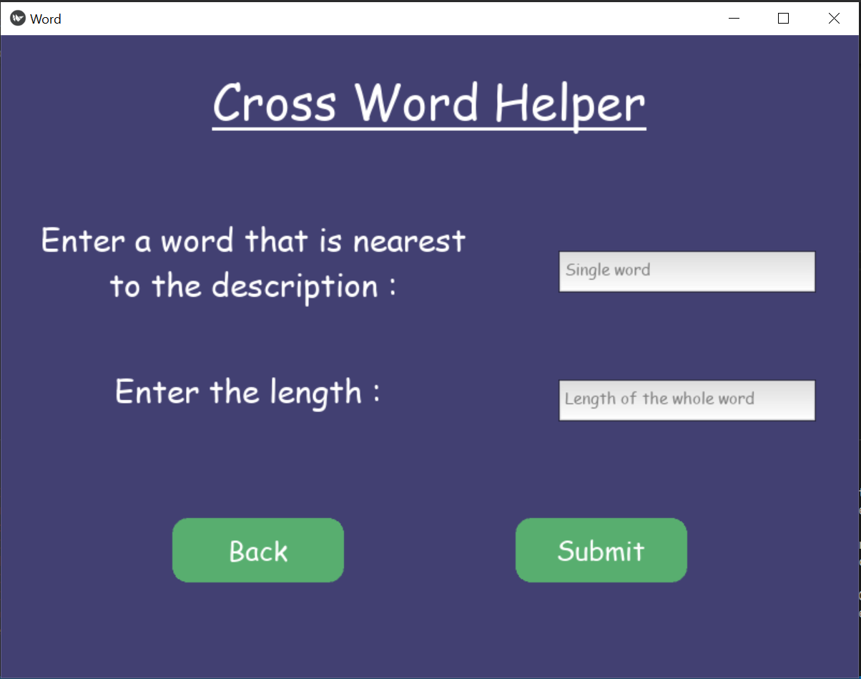
Crossword Helper
Notes:
https://www.boatloadpuzzles.com/playcrossword for solving crossword

Slide 12
Scrabble Helper
User can enter a word fragment they need in their word
They can also enter its position and length.

Slide 13
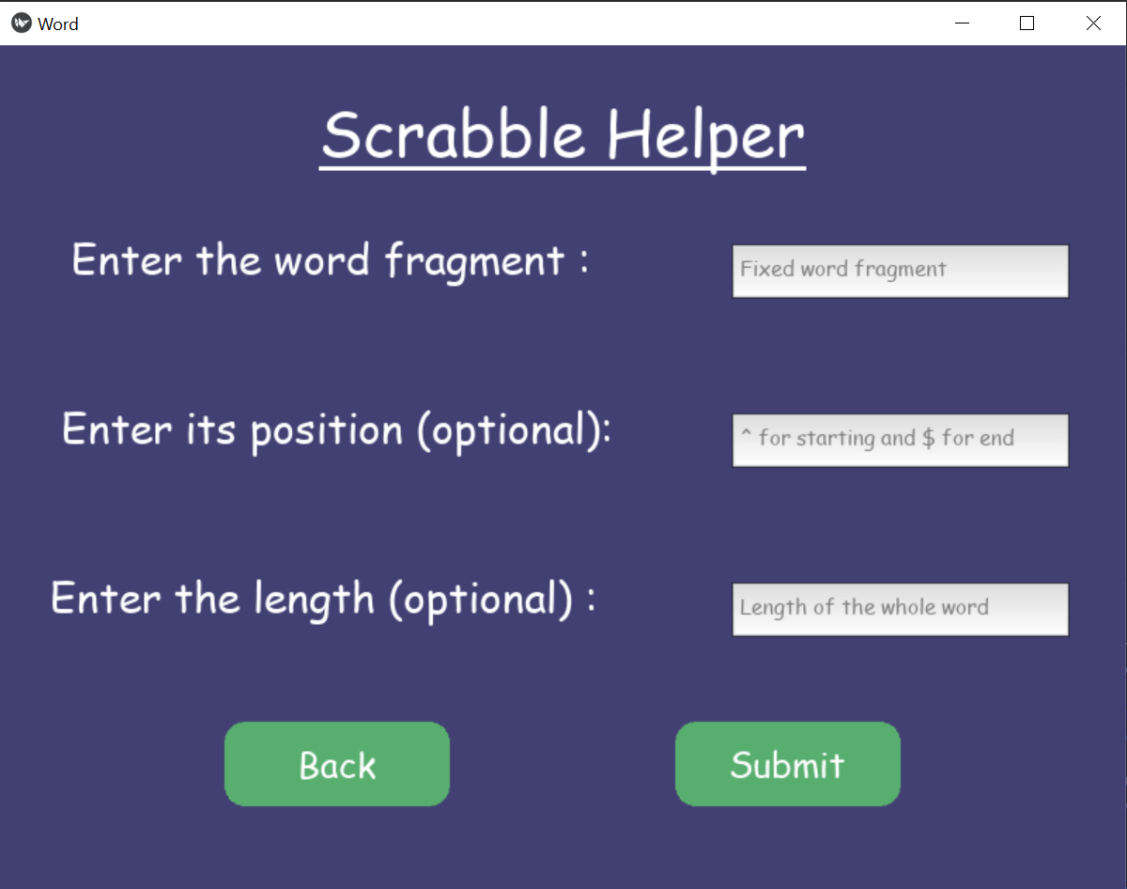
Scrabble Helper

Slide 14
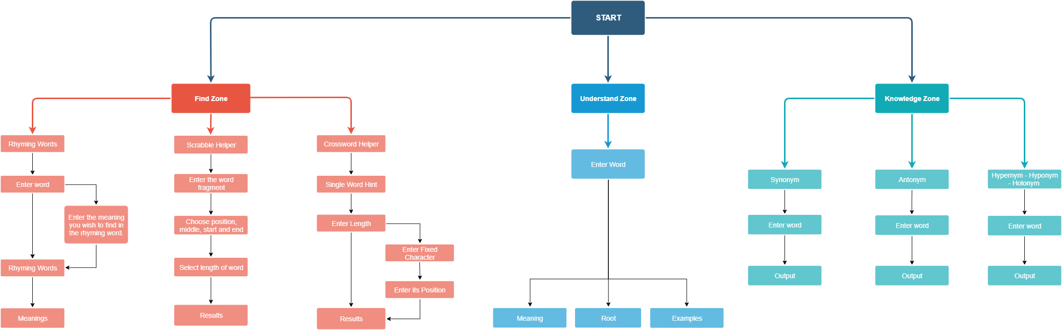
Redefined Zones:

Slide 15
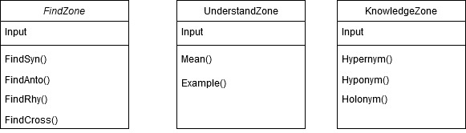
Redefined Zones:

Slide 16
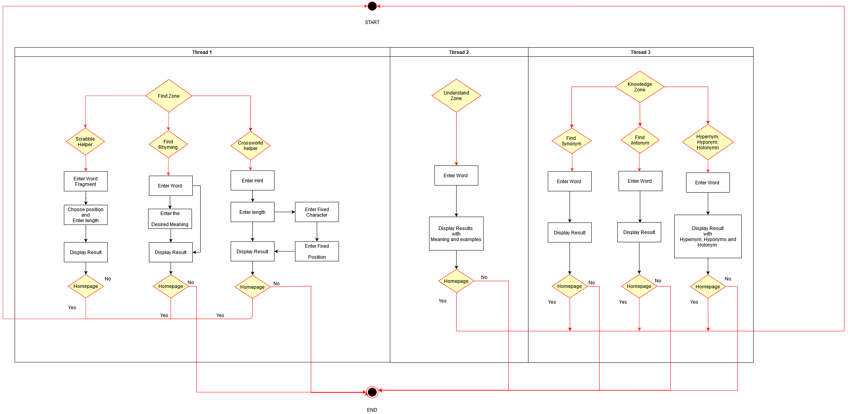
Redefined Zones:

Slide 17
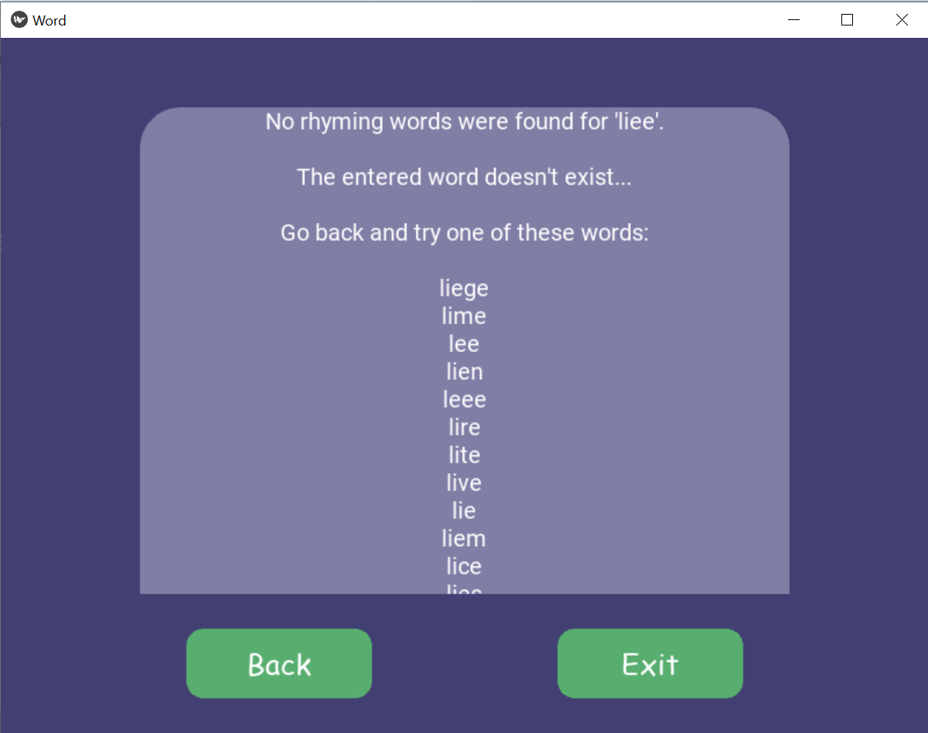
Spell Checker and suggestion for words

Slide 18
THANK YOU

