Slide 1
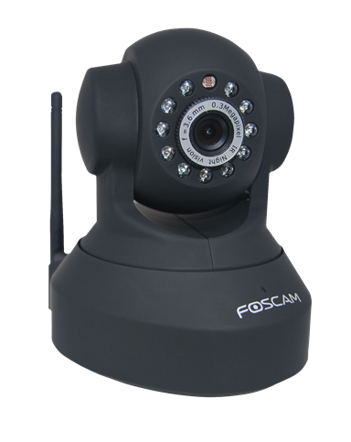
Face Recognition And Following Using OpenCV
Project based learning-2 (5th Sem)
Name: Ritvik Mahapatra
Reg. No.: 199403001

Slide 2
Acknowledgement
The success and outcome of this project required a lot of guidance and assistance from many people, and I am extremely fortunate to have got this all along the completion of our project work. Whatever I have done is only due to such guidance and assistance and we would not forget to thank them. I respect and thank Dr. Manish Rawat (Associate Professor Mechatronics Engineering) for giving we an opportunity to do this project work and providing all the support and guidance which made me complete the project on time, His dynamism, vision, sincerity and motivation have deeply inspired me. He has taught me the methodology to carry out the research and to present the research works as clearly as possible. It was a great privilege and honor to work and study under his guidance. I am extremely grateful to him for providing such a nice support and guidance. I am grateful because I managed to complete this project within the time given by my professor. I am extending my thanks to the Department of Mechatronics, Manipal University, Jaipur for their support during my research work. I also thank all the staff of the university for their kindness. I am extremely grateful to my parents for their love, prayers, caring and sacrifices for educating and preparing me for my future. Finally, I would like to express our gratitude to our friends and respondents for support and willingness to spend some time with us.

Slide 3
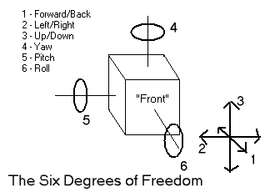
INTRODUCTION-The Problem, Need or Requirement.
In today’s world, mankind has various needs and requirements. These may range from one to other. But various needs in the domain of manufacturing, production or security purposes are fulfilled by the implementations of machines and their integrations with software advancements like python programs, to a certain extent.
During production process which is automated we may need a certain machine element to move in certain direction or rotate about a particular axis. This is where concept of Degree Of Freedom comes. And to find the direction in which they have to move. We can use various Cameras or sensors to make the resultant direction.

Slide 4
Manufacturing is just an example, concept of DOF + Image recognition is applicable on most of the machines around us, may it be a fridge’s door, a table fan, AC’s which have controllable swing area {they may cool the area around by following you through a motion sensor and setting the swing of AC at that angle only} or a CCTV camera which can rotate itself at any angle by following the motion of an object or person.
We will here discuss a Face following camera which detects the face from USB camera connected to the pc, then the landmarks of the face are feeded to the Arduino program and the camera moves in the direction defined by the coordinates.

Slide 5
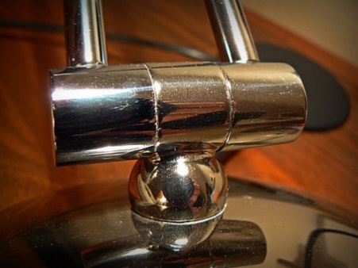
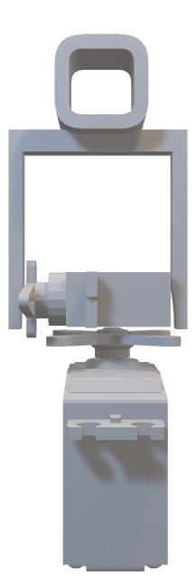
Degree Of Freedom
In physics, the degrees of freedom (DOF) of a mechanical system is the number of independent parameters that define its configuration or state. It is important in the analysis of systems of bodies in mechanical engineering, structural engineering, aerospace engineering, robotics, and other fields.
The formulae for DOF is given by 6(n-1)-5p1-4p2-3p3-2p4-p5
For our case we have 3 links (n=3)(2 servos and 1 camera link) and p1=2(pair of links whose DOF is 1(reduced by 5) i.e., about x and y axis), therefore our DOF comes out to be 12-2*5=12-10=2
3
2
1

Slide 6
Using Arduino for implementation of 2 DOF face tracking camera
Construction and 3-D model
Firstly, we have a camera installed above the servos and the base and the usb cable is connected to the pc.
Then we have two servos, one is fixed with ground (giving 360 view about x axis, we will consider for 180 degree only). The other servo fixed on the rotator of 1st servo, such that their axis are perpendicular to each other (this can rotate about 270 degrees about y axis; however, we will limit it to 180 degree only).
We have connected/fixed the camera with the help of connections as shown in the figure (initially, along the axis of the first servo). The camera faces the front direction. The DOF of the setup is 2 as it rotates about x-axis and y-axis.

Slide 7
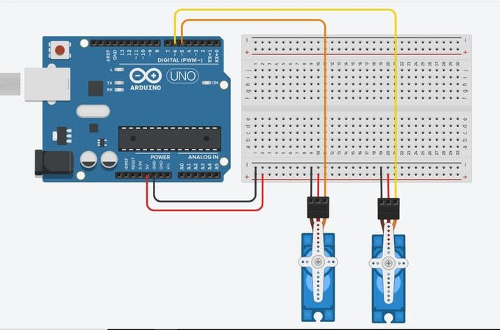
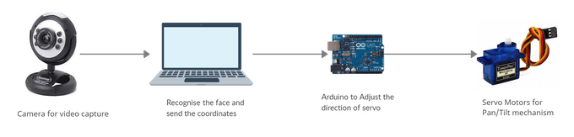
Circuit
The Circuit is pretty simple. Just attach two servos to Arduino.
Vertical to Pin 5
Horizontal to Pin 6
Power to +5V
Ground to GND
Check the circuit diagram for reference.

Slide 8
Working
Facial detection identifies and localizes human faces and ignores any background objects such as curtain, windows, trees, etc. OpenCV uses Haar cascade of classifiers where each frame of the video is passed through stages of classifiers and if the frame passes through all the classifiers, the face is present else the frame is discarded from the classifier i.e the face is not detected.
The OpenCV returns the cartesian coordinates of the image upon detection along with the height and width. From these coordinates, the center coordinates of the image can be calculated using x+width/2 and y+height/2.
These coordinates are passed to the Arduino UNO using the pyserial library when the face is detected. The servo's connected to the Arduino provides a pan/tilt mechanism where the camera is connected to one of the servo. When the co-ordinates of the face is away from the center, then the servo will align by 2 degrees (increment or decrement) to bring it towards the center of the screen.
I have used 'haarcascade_frontalface_default.xml' which is a pre- trained model for detecting human faces. This project requires pyserial and OpenCV libraries.

Slide 9
Code Explanation
Arduino Code:
• Firstly, we have included the servo library for controlling the angle of rotation and declared to two servo’s objects (horizontal and vertical).
• Declare all the required variables by the whole code.
• Void setup () – here we setup the servo signal pins and write initial angles. We also declare
• Void loop () • First, it takes the serial inputs of the landmarks of the face from the python program via pyserial library and some serial communication function included in the serial library of the Arduino program.
• Then it calculates the angle which must be fed to both the servos by using the relation between the landmarks received and the angle of the required. The max range of the angle of rotation of the servo motor has been set to 180 degrees.
• Then it also checks for the angle greater than that of 180 degrees or less than 0 degrees and if those conditions are set to be true then the position of the servo is to be set 0 degrees.
• Then finally after calculating the position/angle of the servo the angle is fed to both the servos with a delay of 100 milliseconds for some required stability.

Slide 10
Python code:
• Firstly, import all the required libraries like OpenCV (cv2) and pyserial.
• Then, the Arduino serial connection is set up and the pretrained face recognition model is imported, and the video capturing is started.
• Inside while loop the frame is extracted from the captured video and the image flipped to avoid the mirror effect. Finally, the cascade model is applied or implemented to each frame with the selected algorithm and some modified parameters.
• Inside the for loop the coordinated are calculated and sent to the Arduino program serially via the afore mentioned library – pyserial, using arduinoSerial.write command.
• Then the video camera’s output is displayed frame by frame on a new window and there is also an option of quitting the program by pressing q once.

Slide 11
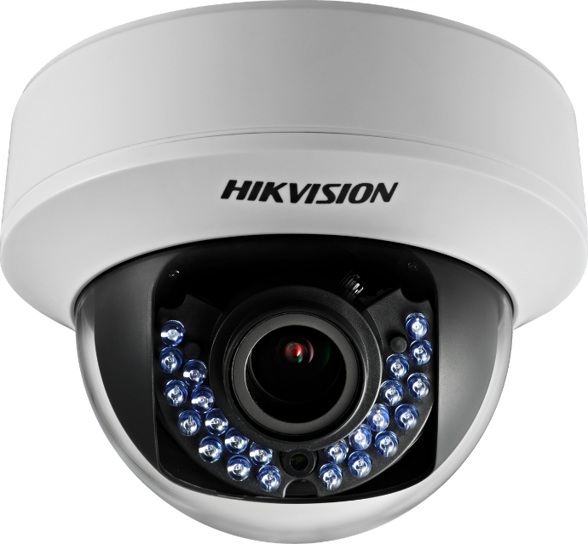
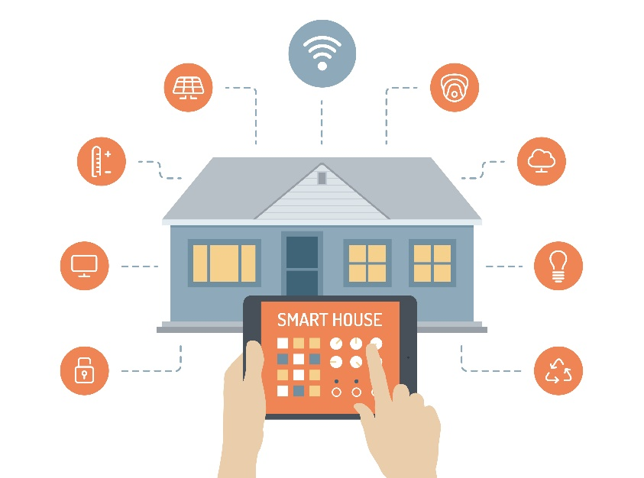
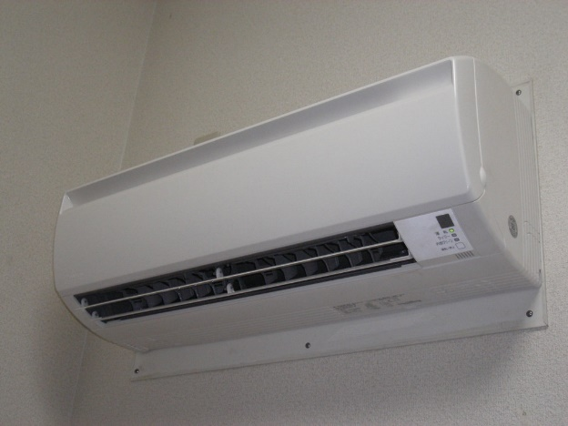
Applications Of The Motion Follower System
Security / CCTV cameras and system.
Smart lighting system- lights following the person.
AC swing control- supplying the cool air where more people are there.
Environmental sensing.
Automation of manufacturing and production processes.

Slide 12
Links, Bibliograph and Citations
Doxygen overview. (n.d.). Retrieved from https://docs.opencv.org/4.x/d4/db1/tutorial_documentation.html
Face Tracker Using OpenCV and Arduino. (n.d.). Retrieved from https://create.arduino.cc/projecthub/shubhamsantosh99/face-tracker-using-opencv-and-arduino-55412e
Face Tracking OpenCV, Python, & Arduino. (2020, July 09). Retrieved from https://www.learnrobotics.org/blog/face-tracking-opencv/
Face Tracking Using Arduino. (n.d.). Retrieved from https://create.arduino.cc/projecthub/WolfxPac/face-tracking-using-arduino-b35b6b
From mind to design in minutes. (n.d.). Retrieved from https://www.tinkercad.com/dashboard?type=circuits&collection=designs

