Slide 1

VEHICLE ROUTING PROBLEM
MAXIMIZING PROFITS WITH DISTANCE CONSTRAINTS
Team Name : ByteMe
Team Members : Ritvik Pandey, Atul Kumar
College : IIT Kharagpur

Slide 2
PROBLEMS SOLVED / TARGET INDUSTRIES
Planning of the visits of a salesperson
Design of tourist trips to maximize the value of the visited attractions in a limited period
Delivery of home heating fuel, where the urgency of a customer request for fuel is treated as a score
Identification of suppliers to visit to maximize the recovered claims with a limited number of auditors
Taxi rentals can prioritize the pickup of passengers based on potential profit

Slide 3

Originality of Proposed Solution
Extent of Usability of the Solution
Scalability of the Proposed Solution
Far Sighted Marketing Possibilities
MapMyIndia API Adoption

Slide 4
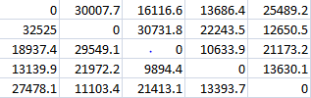
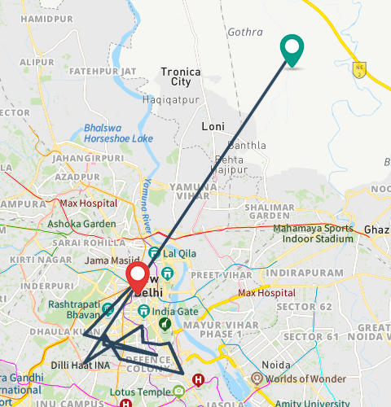
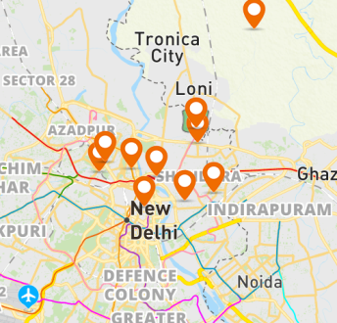
Driving Distance Matrix API
Travelled Route Image API
Snap to Road API
Still Map Image API

Slide 5
FITNESS
Total Profit while travelling in a route
FITNESS =
PROFIT COLLECTED AT EACH STORE
2*(DISTANCE TRAVELLED)
Note - 2*Distance travelled is subtracted in order to compensate the travelling cost

Slide 6
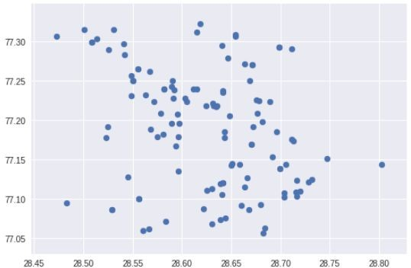
Latitudes and Longitudes of 130 Petrol Pumps in and around New Delhi

Slide 7
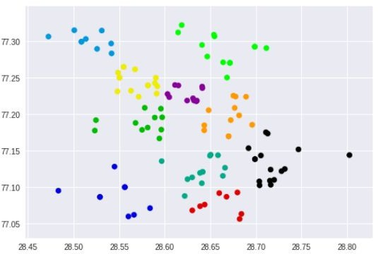

Number of Clusters - Customer Generally number of clusters is equal to number of salesmen
Starting Point Every Salesman begins from this point and at the end of day has to return back to this point
DBScan Clustering to divide the Latitudes and Longitudes into ‘N’ Clusters

Slide 8
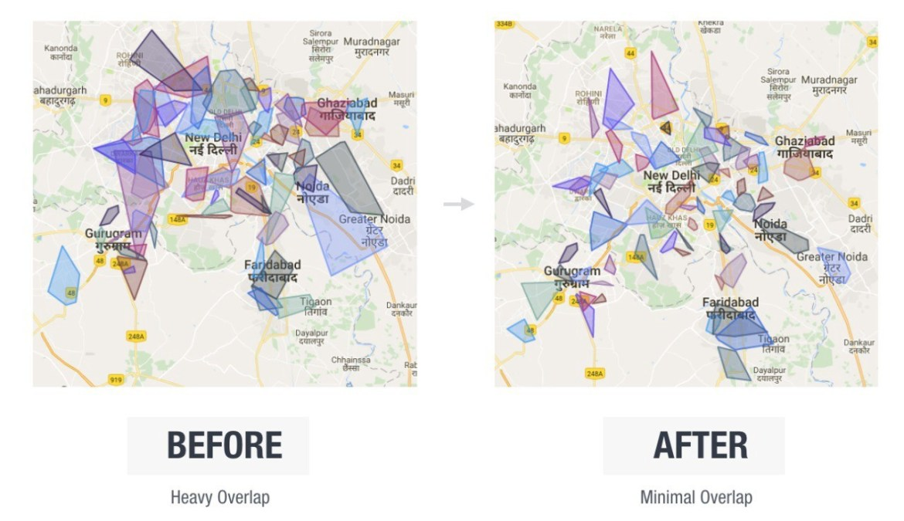
CLUSTER OPTIMIZATION
Silhouette Method and Rounding of Cluster Edges to reduce cluster overlap

Slide 9

Taking any Random Cluster to start with the Algorithm

Slide 10
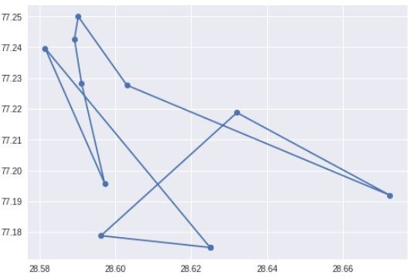
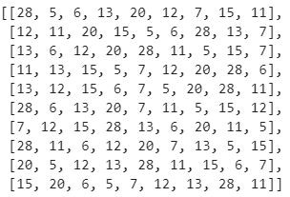

POPULATION GENERATION(Not necessarily gives the fittest population)
Generate a random set of 1000 populations from the points inside the clusters.
These populations must have their total route distance less than the maximum distance a salesman is allowed to travel in one day
Distance travelled along any generated population is less than Maximum Distance
Randomly generated Populations with distance constraints
Starting/Ending Point

Slide 11
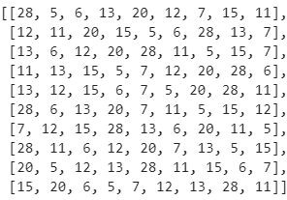
TOURNAMENT SELECTION
Specify a T_SIZE
Taking the fittest out of a particular T_SIZE and forwarding it to a NEW POPULATION.
This will give rise to a Fitter Population than the previous one

Slide 12
CROSSOVER
PARENT 1
PARENT 2
CROSSOVER
CHILD 1
CHILD 2
Randomly select two Routes from the population generated after Tournament Selection and Replacing few Nodes in the Parent Nodes and Creating two Child Nodes.
After this, Forward the fittest of these Four Routes to get the Fittest Population

Slide 13
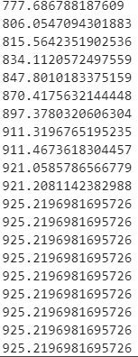
Repeat the Crossover for many iterations so that we get a Fitter Population with every step
Profit Converges to a saturated value giving us the route with maximum profit and constrained distance

Slide 14
Starting/Ending Point
Route within a Cluster with maximum profit and constrained distance

Slide 15
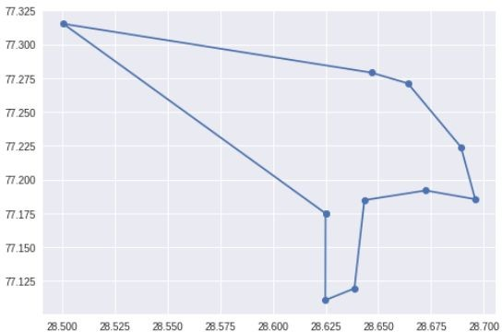
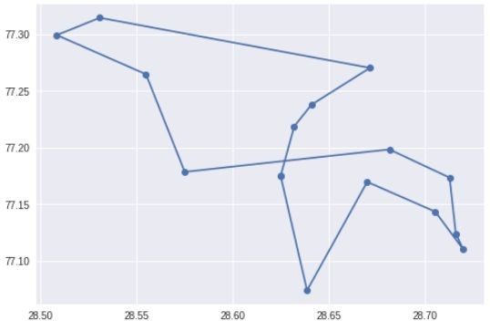
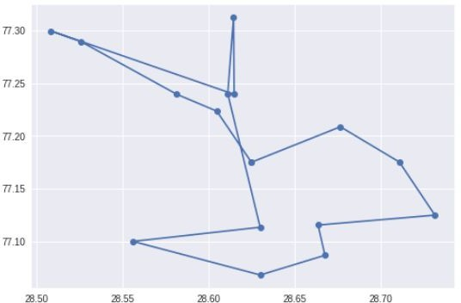
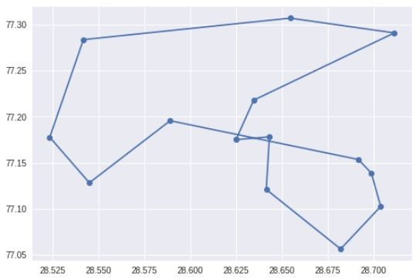
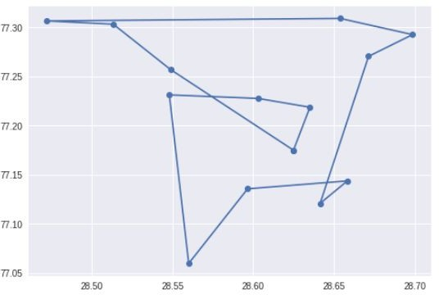
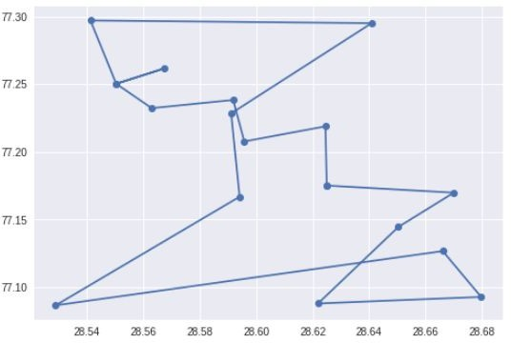
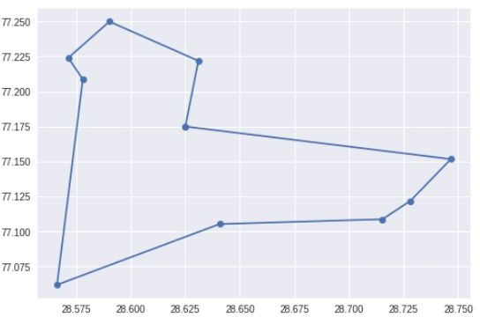
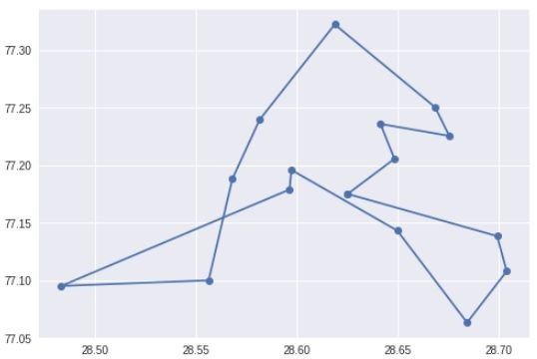
Fittest Routes within every Cluster

Slide 16
