Slide 1
Calendroid
Submitted by :
Ritvik Khattar
Piyush Kalra
Inderjeet Khurana
Submitted to :
Ms. Neha Sharma

Slide 2
Objective
The objective of software product ‘Calendroid’ is to let the user store data specific to a particular date.

Slide 3
introduction
Calendroid is an Android based application developed using Java in Eclipse, with the help of Android Development Tools plugin.

Slide 4
Select Application
Access Calendar
Select a Date
Write Diary/
Take Photographs/
Shoot Video
Save
Revisit same date to review content

Slide 5
The application has two main functions:
Providing Calendar Dates.
Allowing data saving with timestamp.

Slide 6
Use as Calendar
Current month’s calendar opens.
User can switch between the months using arrow heads.

Slide 7
Timestamping
User can choose a particular date, corresponding to which any type of data (text, photographs or videos) can be saved.

Slide 8
TECHNOLOGY USED
Eclipse Indigo Version 2.0
Android Development Tools Plugin.

Slide 9
ECLIPSE
Eclipse is a multi-language software development environment comprising a base workspace and an extensible plug-in system for customizing the environment.

Slide 10
ADT Plugin
Android Development Tools (ADT) is a plugin for the Eclipse IDE that is designed to give a powerful, integrated environment in which it is easy to build Android applications.

Slide 11
VIRTUAL ENVIRONMENT
480 x 800 hdpi
Android 2.3.3
API Level – 10
Back Camera - Emulated

Slide 12
HARDWARE REQUIREMENTS
Android phone
Version : 2.3.3
API level – 10 or above

Slide 13
ADVANTAGES
Helps in saving any type of data as a timestamp in phone.

Slide 14
APPLICATIONS
The application is a Calendar which allows the user to check any date.
The user can either write diary, take pictures or shoot videos on any particular date.
The application helps the user in maintaining a to-do list, diary, reminders, photographs, videos, etc.

Slide 15
Screen shots
The following slides show screen shots of every step of the project.

Slide 16
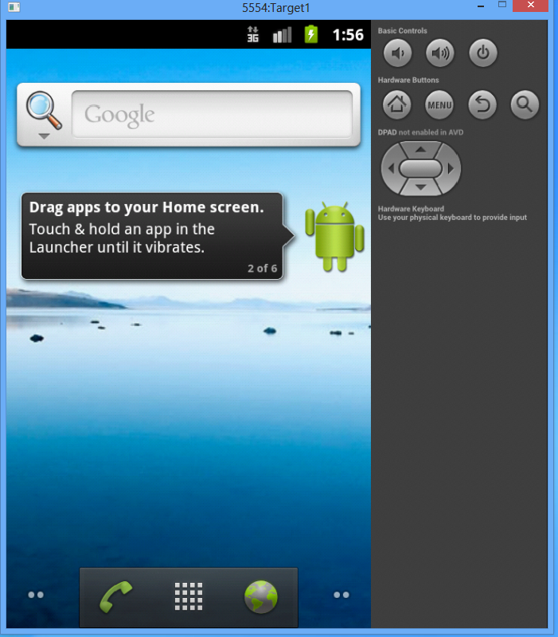

Slide 17
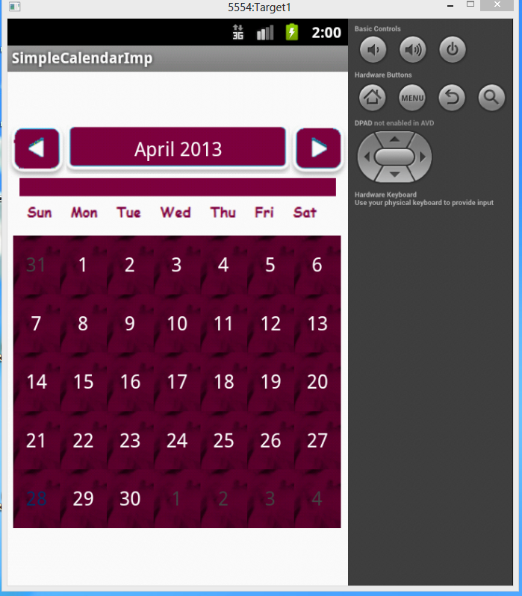

Slide 18
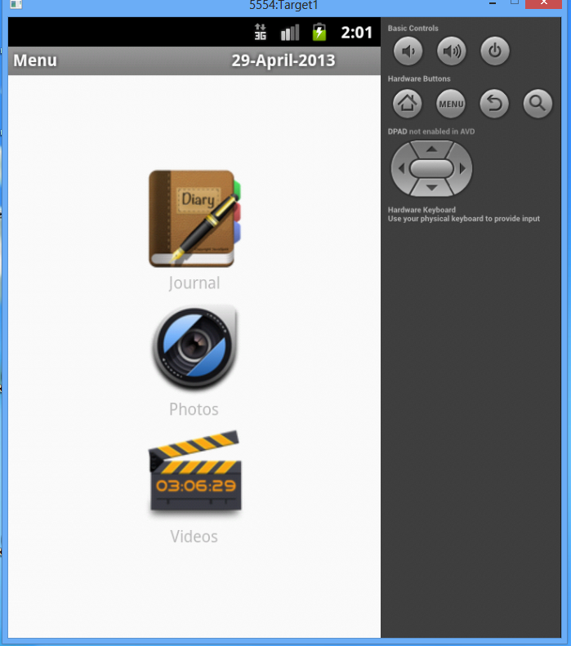

Slide 19
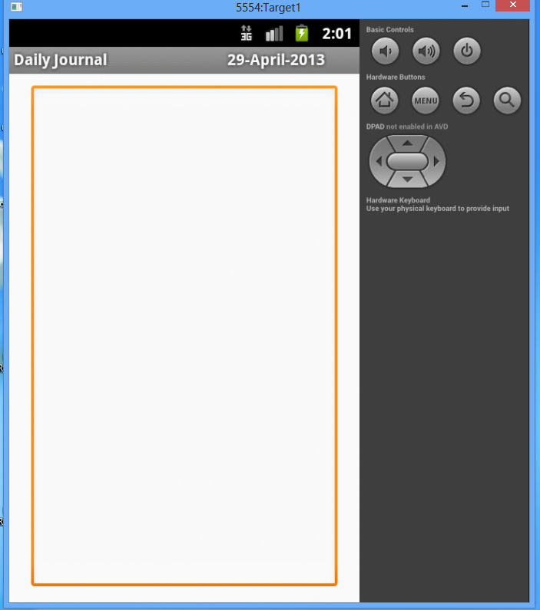

Slide 20
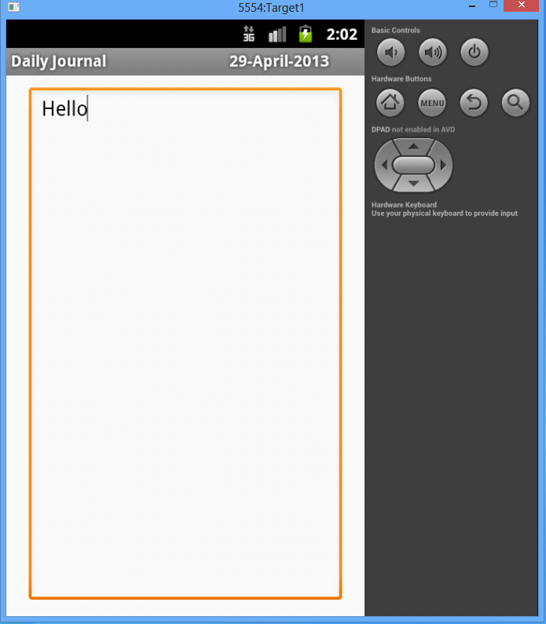

Slide 21
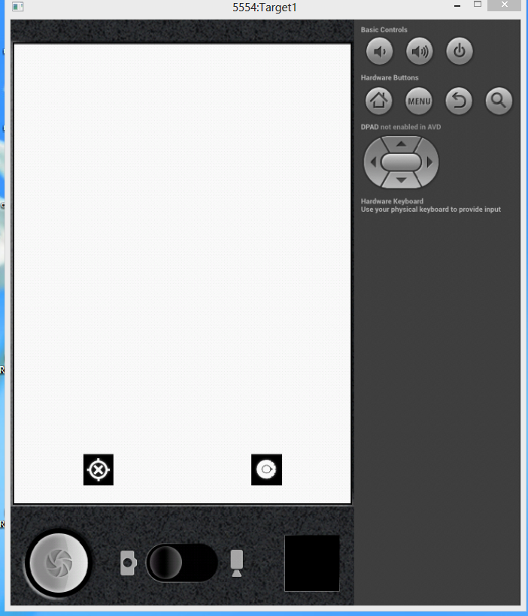

Slide 22
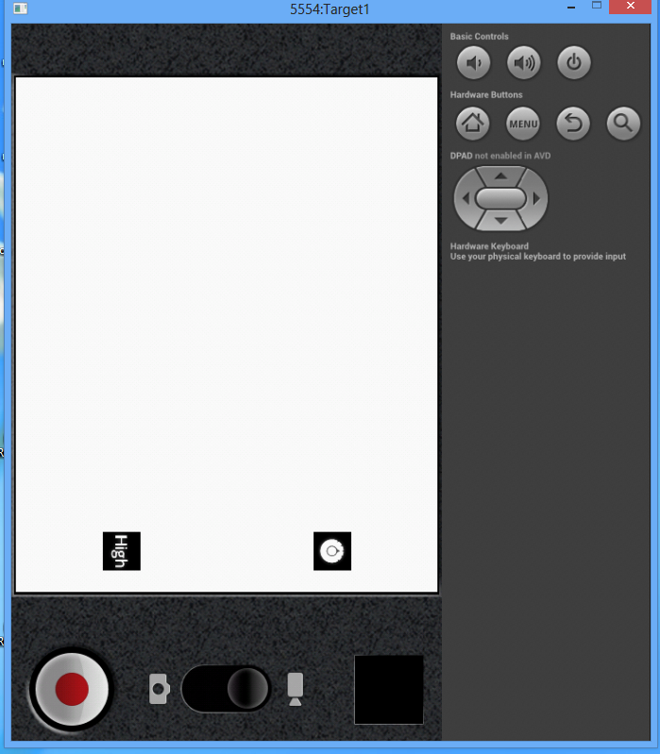

Slide 23
THANK YOU

