Slide 1
PEER-TO-PEER CONSUMER DEBT PORTFOLIO
Constructing a peer-to-peer consumer debt portfolio through Mean-VaR Portfolio Optimization
HYG Ltd. Team:
Gary Lee Finkelstein, CEO
Maximilien Lamberti, CIO
Yashoraj Tyagi, COO
Ritvik Goyal, CRO
3 October 2019

Slide 2
Disclaimer
All materials presented henceforth are proprietary to HYG Ltd. Any distribution of materials outside of this presentation is explicitly prohibited.
The information contained in this presentation is considered highly speculative.
We do not recommend trading on your own. At HYG these trades are executed and monitored by financial experts.
Notes:
Just kidding.

Slide 3
General framework
Aim
To develop an optimization routine for a consumer debt portfolio through Mean-VaR portfolio optimization
PD Model Assumptions
Data
Lending club Loan-Level Data
Borrower defined as defaulted if a registered recovery payment has been made.
Mean-VaR portfolio optimization attempts to replicate Mean-Variance portfolio optimization by choosing loan weights that maximises a custom ‘Sharpe Ratio’ defined as: $\frac{Expected Return }{VaR}$
Mean-VaR portfolio optimization attempts to replicate Mean-Variance portfolio optimization by choosing loan weights that maximises a custom ‘Sharpe Ratio’ defined as: (𝐸𝑥𝑝𝑒𝑐𝑡𝑒𝑑 𝑅𝑒𝑡𝑢𝑟𝑛 )/𝑉𝑎𝑅
Recovery Rate = 0
Model Training Dates: 2015/01/01- 2017/12/31
Portfolio Construction Date: Q1 2018.
VaR Monte Carlo Assumptions
Logistic regression PD model
All loans can be bought at expected value/price | No liquidity constraint
VaR horizon and CI: 99% 1 year portfolio VaR
Simulate 10000+ states of the world
S&P 500 ~ GBM | Personal Savings rate ~ Seasonal ARIMA | Hull-White Spot Rate Model
Notes:
Notes:
The aim of this project was to construct a consumer debt portfolio through Mean-VaR optimization from a hedge funds perspective.
The consumer debt portfolio is a portfolio of lending club loans.
In order to achieve our objective, lending clubs loan data was used to create a ‘Probability of default’ model at the loan level which provides loan default probabilities through time.
A portfolios VaR is calculated through simulating many states of the world and hence simulating varying borrower default rates and then calculating the portfolio value distribution 1 year from time 0.

Slide 4

PD MODEL: LOGISTIC REGRESSION
Model:
156 Features in Categories:
Borrower personal attributes
Borrower financial attributes
Market parameters
Notes:
Logistic regression model was to predict default probabilities through time.
Features include personal attributes of the borrower, financial attributes and market parameters which are known for model training but then simulated from portfolio construction date onwards to arrive at simulated default probabilities in different states of the world.

Slide 5
Simulation ROUTINE : CASHFLOW SIMULATIONS
Training Regime:
In our training regime, we split up every loan into individual cashflow payments, with the values of features used dated to respective time instances
CF 1
CF 2
CF 3
Loan X (36 periods)
CF 35
CF 36
Predictive Simulations:
While calculating VaR of a loan basket, the individual future cashflows of every loan are simulated. Consequently the PD model is used for determining default measures for the individual cashflows.
Notes:
Breaking up training dataset into individual cashflows allows for training of the PD model on a time series of repayment patterns with market variables dated to respective timelines.
In the prediction regime, simulated values of market variables with higher order paths are used for arriving at multiple time series of cash flow defaults for every loan.

Slide 6
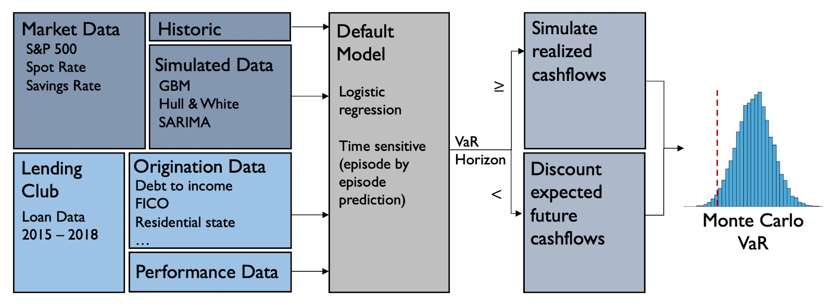
Methodology PART I
Notes:
This figure shows our modeling pipeline to fit a PD model and create the Monte Carlo VaR.
We train the PD (logistic regression) model on historic loan data between 2015 and 2018.
We perform episode-by-episode prediction (1 month = 1 episode) and therefore use monthly market data for the S&P500, 3 year yields and the savings rate. For the borrower data we use a range of variables like FICO, DTI, etc, these tend to remain constant between episodes.
Our empirical model captures user and market dynamics which lead to varying levels of default. Since this is an empirical model trained on the loan level the default correlations between loans are backed into the model (as opposed to a copula approach). For our Monte Carlo VaR, we form a portfolio of loans originated in Q1 2018. To create the forward looking market data we assume a geometric Brownian motion model for the S&P500, a Hull and White short rate model of interest rates, and a SARIMA model for the savings rate. These are modelled independently from one another and used to create >10000 sample paths for future states of the world.
We choose a VaR horizon of 1 year. Within that one year we simulate realized cashflows by sampling from a normal distribution and applying these samples to the per episode default probabilities. A loan that defaults on a given path within the VaR horizon terminates all remaining cashflows for that loan on the path. Past of the VaR horizon we calculate the present value of the cashflows discounted by the sampled short rates and probabilities of default. We end up with portfolio value distribution at time 1 and calculate the 99% 1 year VaR.

Slide 7
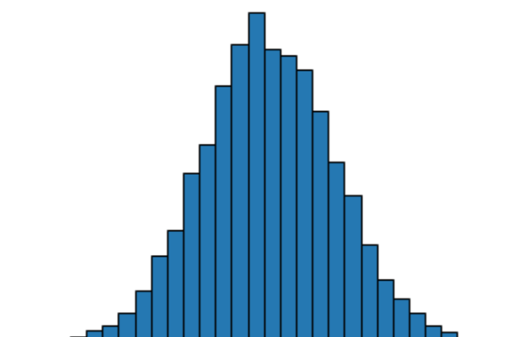
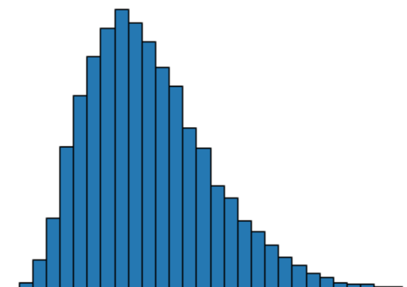
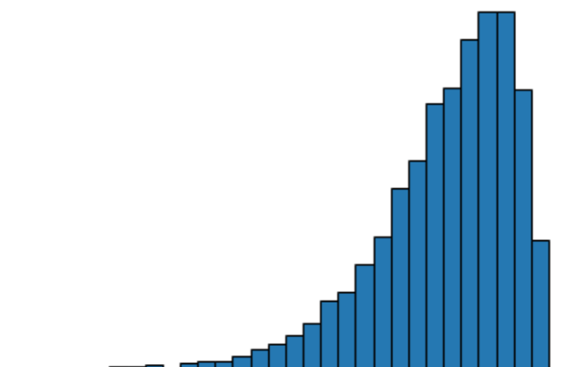
Methodology PART Ii
Portfolio Optimization:
Portfolio 1
OPTIMAL PORTFOLIO:
Max return, Min VaR
Portfolio 2
Portfolio 3
Notes:
Portfolio optimization methodology plays on the idea of Mean Variance portfolio theory except that now, we are only concerned with worst case tail risk and hence pick loans that optimize the portfolios mean return - VaR trade off.
In the example above, portfolio 2 is chosen as it is positively skewed, has lowest VaR and highest Expected return.
The portfolio optimization was performed through grid search and elimination of loans.

Slide 8
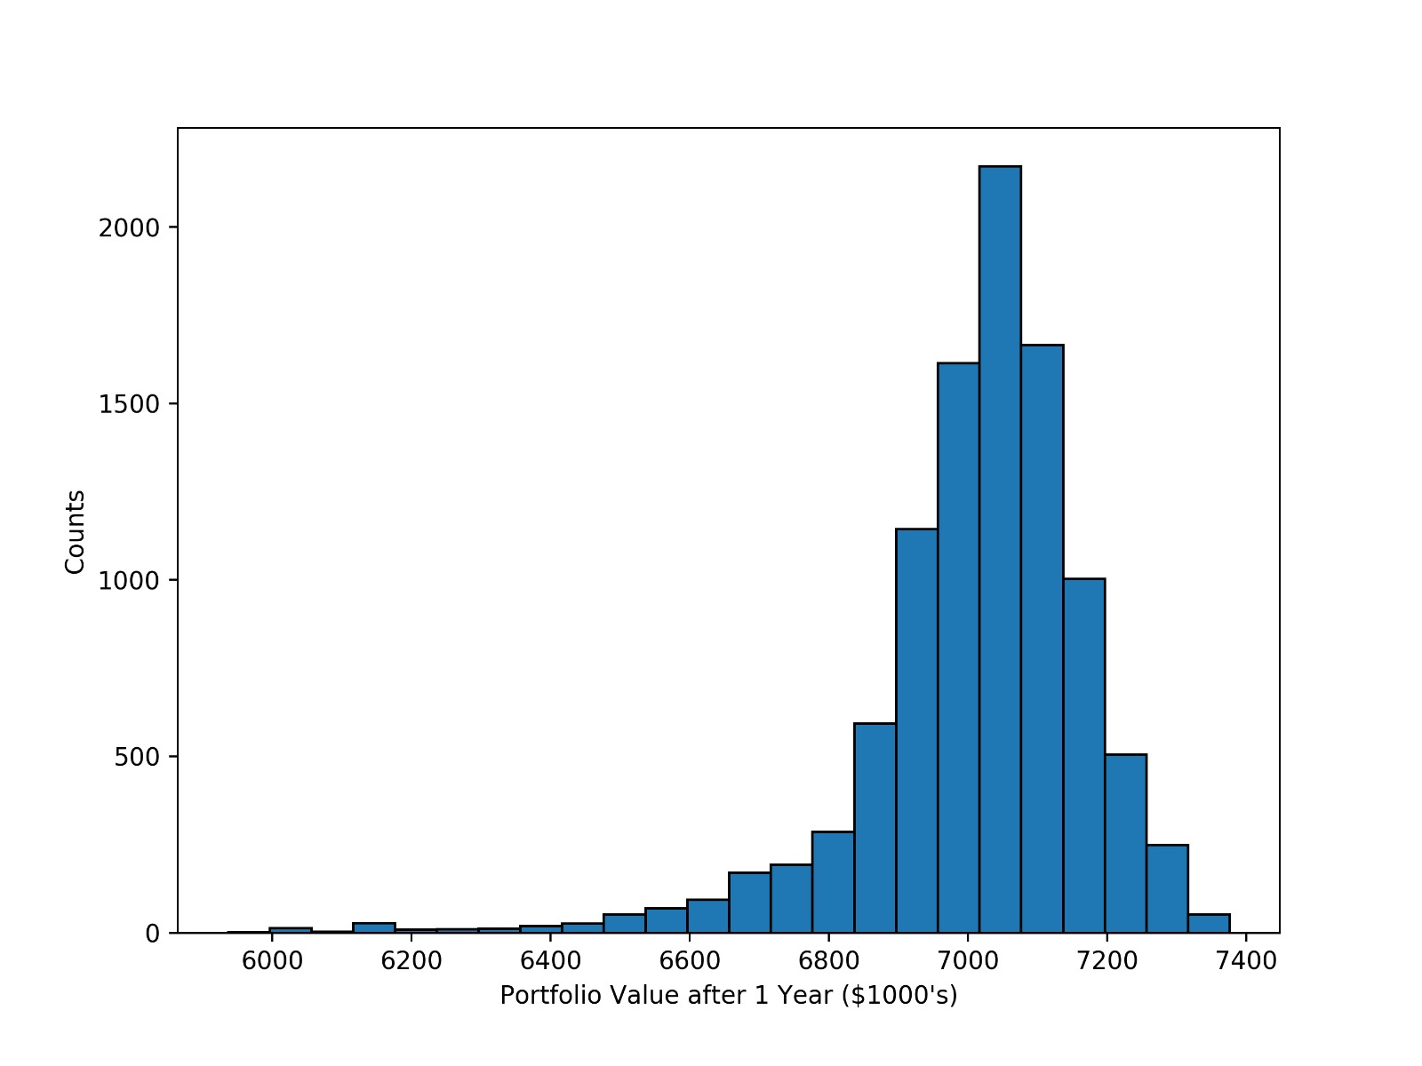
Results
Optimal Portfolio Characteristics:
 | Market Portfolio | Optimal Portfolio
Today’s Value | $ 6,883,061.31 | $ 3,612,207.34
Expected Return | 1.87% | 1.87%
99% 1-Year VaR | $ 902,519.00 (13.11%) | $ 200,867.66 (5.56%)
Exposure | 100% | 50.8%

Slide 9
Thank you for your time. Questions?

