Slide 1
SPOTIFY CHARTS ANALYSIS
Project Proposal
Group-12

Slide 2
Our Agenda
Motivation
Introduction of the Dataset
Data Analytics
Visual encodings

Slide 3
Motivation
Our Goal is to visualize the various trends among the artists across different regions. We can also find the discrete patterns in the Spotify analysis dataset.
Which locations have the highest song streaming rates?
Which artists produced a highest number of songs?
Display trends for the most popular songs by The Chainsmokers and Marama.
Highest times streamed song in top 20 songs?
Which artist appeared highest number of times in top 50?
Number of songs released in each year?

Slide 4
What is Spotify?
Spotify is one of today’s leading music streaming service providers.
Spotify is the digital music service that gives it users access to millions of song across the globe.
Users can browse through music collection curated by any singer, musicians.
The Spotify application is very easy to find the right music for everyone.
Spotify gives brands the power to understand the target audience through music, as their listening habits gives the context as to how businesses can reach them with the right message.

Slide 5
Description of the Dataset
"This is a complete dataset of all the "Top 200" and "Viral 50" charts published globally by Spotify.
Spotify publishes a new chart every 2-3 days. This is its entire collection since January 1, 2017.”
The dataset contains the interesting trends in the diversity of artists in the Spotify Top 200 charts and how it varies by country and time.
It has 26,173,514 observations and 9 columns, including title, rank, date, artist, url, region, chart, trend, and stream.

Slide 6
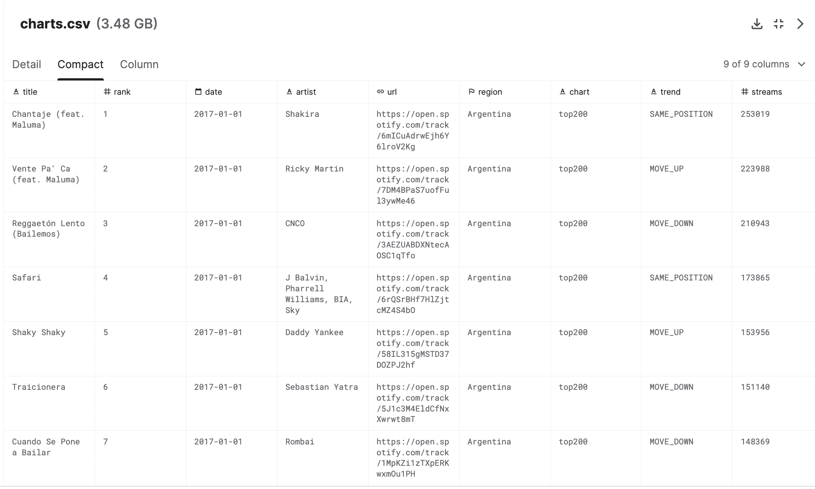

Slide 7
Dataset Attributes
There are 9 columns in this dataset and their description are as follows:
title: Title of the song.
rank: Rank from 1 - 200 (1 is the most streamed track that day)
date: Release date of the song.
artist: Name of the artist.
url: URL of the song
region: Country
trend: Position of that song on the chart compared to previous day. It has 3 values: MOVE_UP, MOVE_DOWN or SAME_POSITION
chart: top200 or viral50
streams: Total number of global streams of that song in one day

Slide 8
Data PREPARATION
We will clean the dataset by:
Removing the URL Column as it serves no purpose to us
We will transform the dataset by:
Excluding the rows with viral50 charts as we are analyzing on the top200 chart
Changing the data type of the date column to datetime64[ns] from the normal string format.
Filtering rows with only date 01

Slide 9
Visual encoding

Slide 10
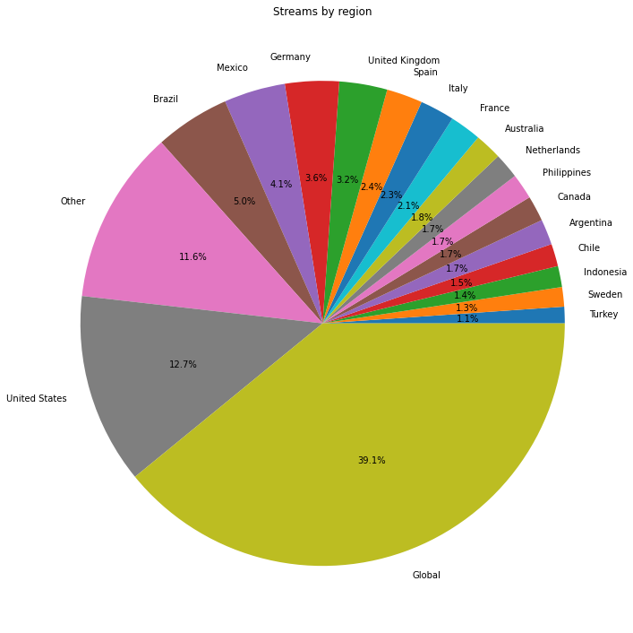
sketch

Slide 11
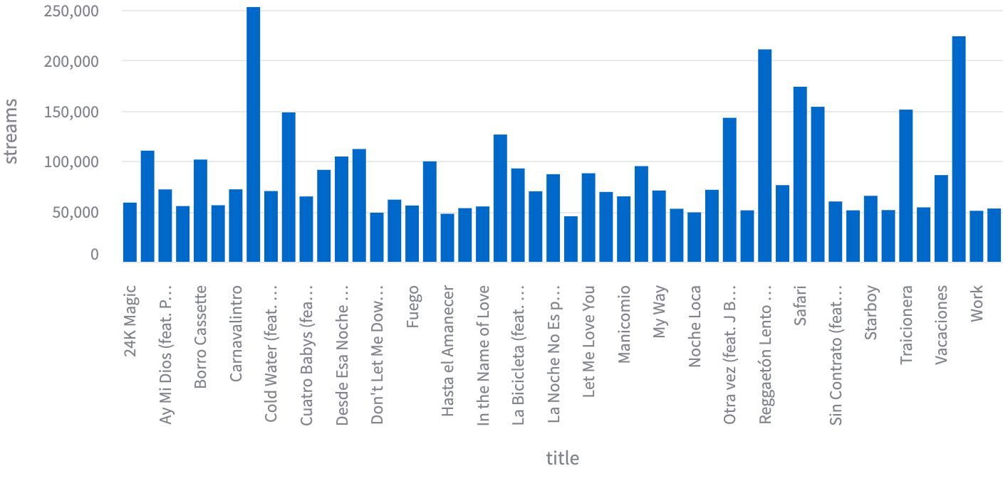
sketch

Slide 12
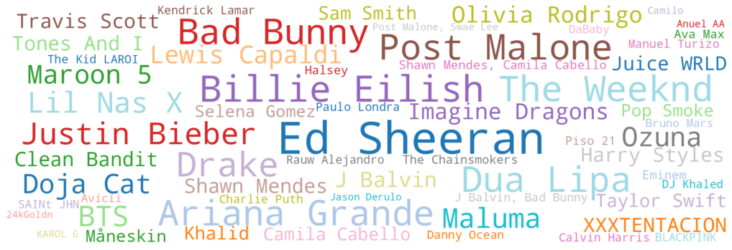
Sketch

