Slide 1
BARTER APP

Slide 2
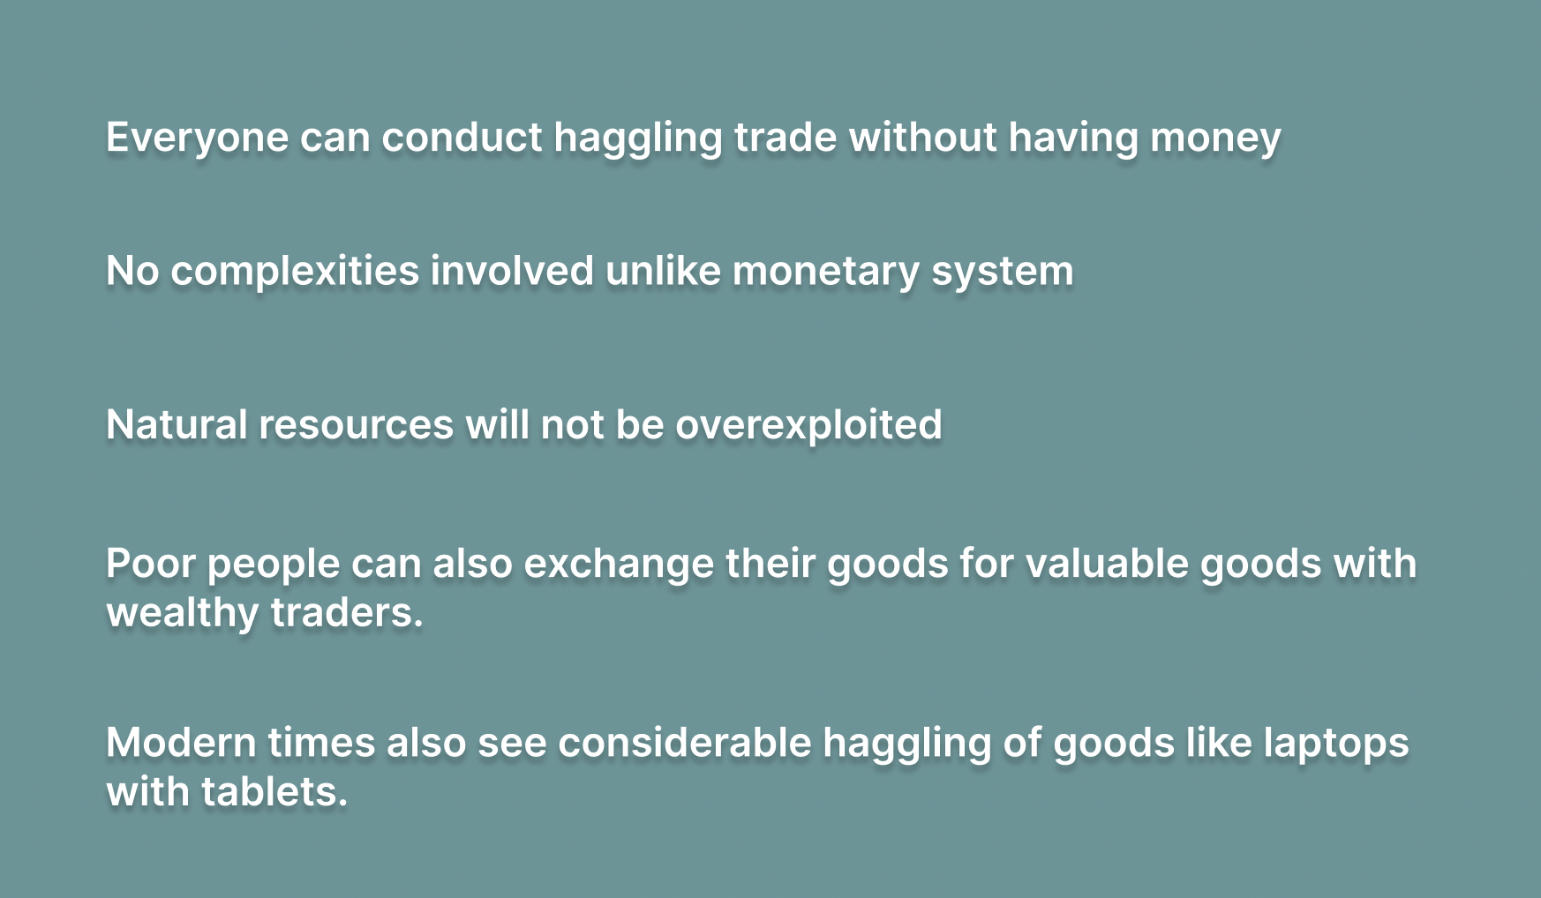
PURPOSE

Slide 3
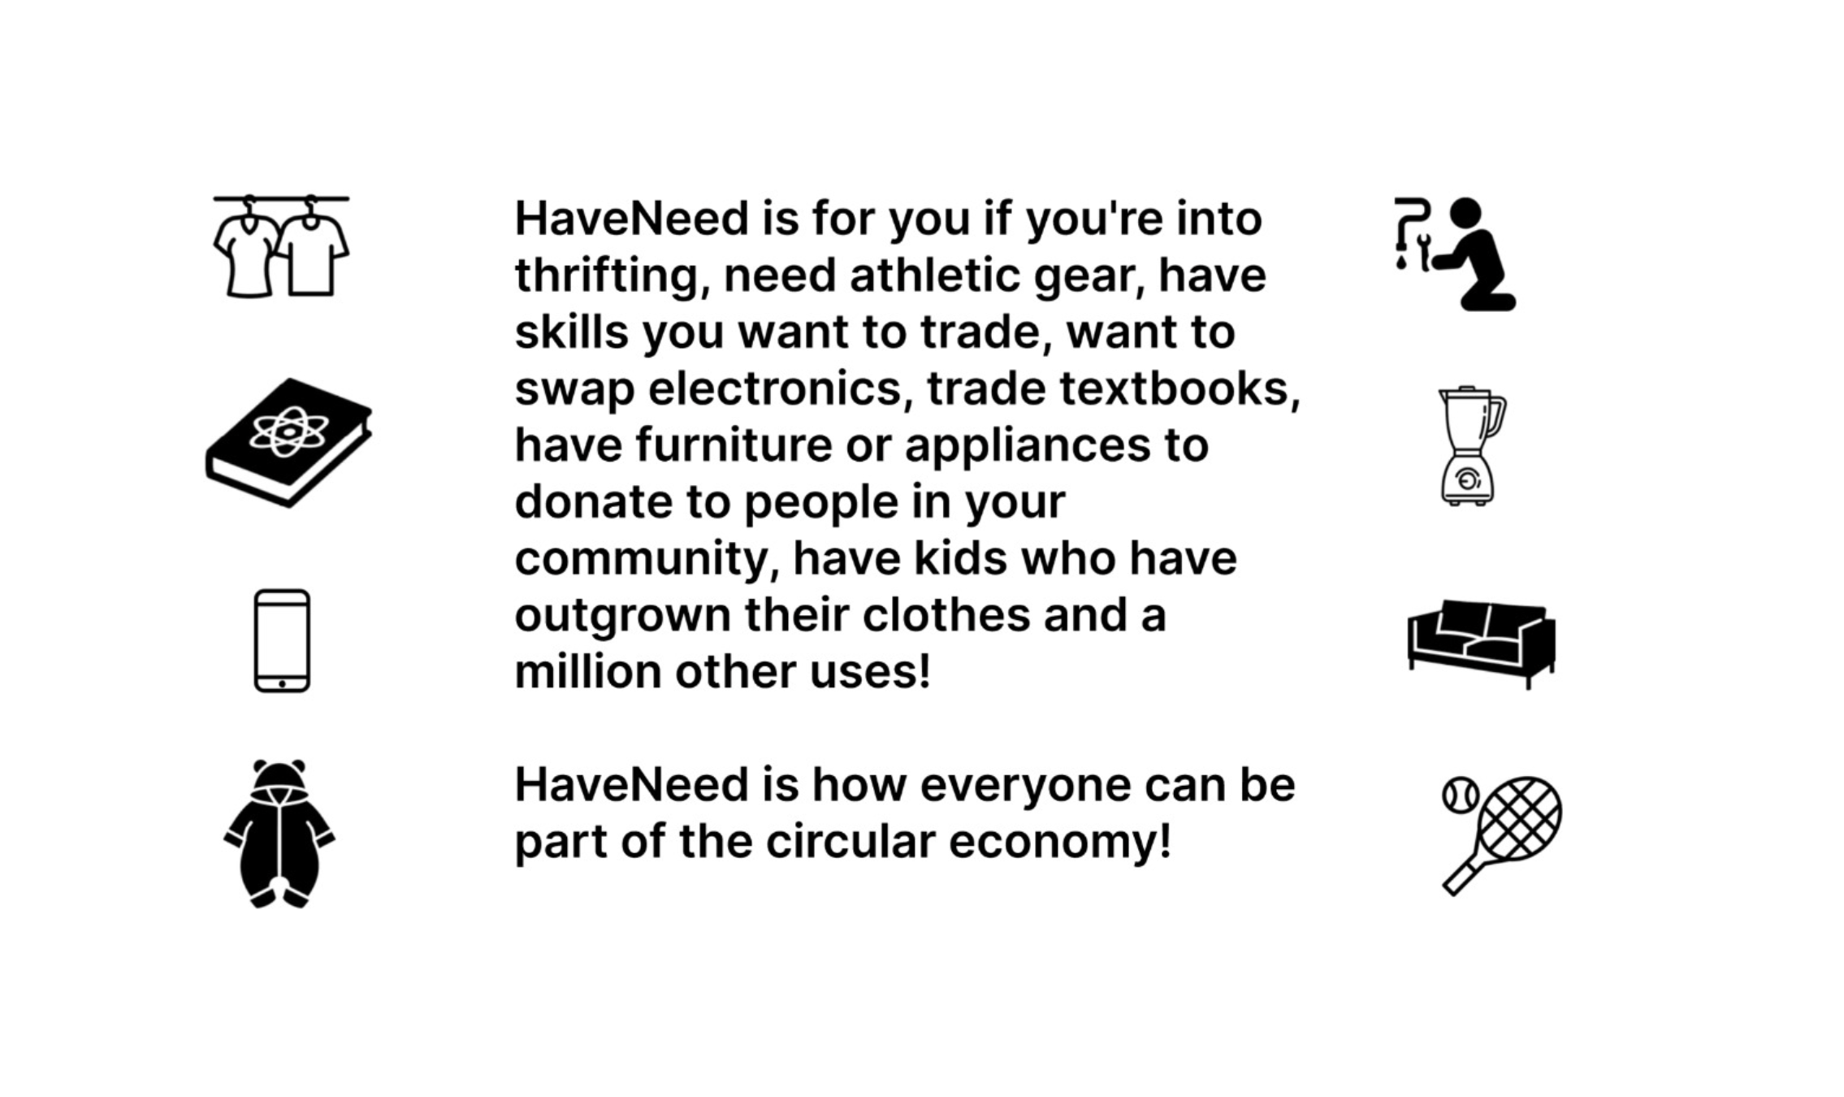
DESCRIPTION

Slide 4
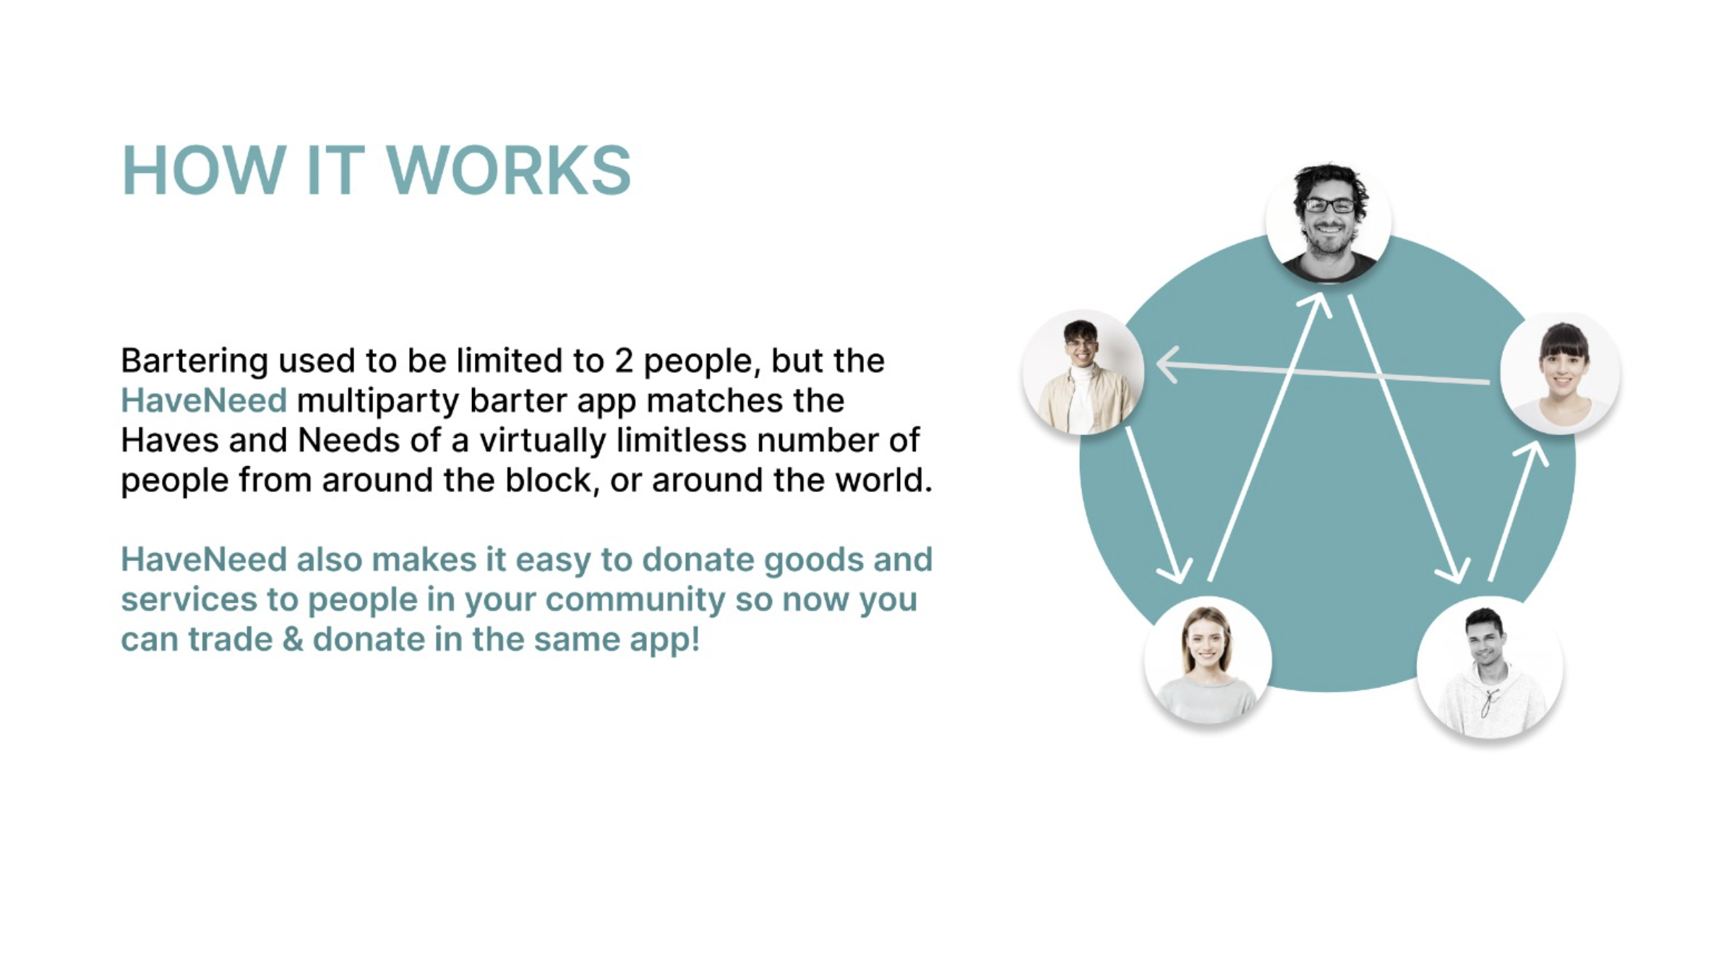

Slide 5
TECH-STACK
ReactJS & React-Bootstrap
React Router Dom(for routing)
Redux Toolkit
ExpressJS (for backend)
MongoDB atlas (database)
Cloudinary(For File upload)
Firebase(for authentication)
MUI and Sass (for styling)
Firebase Chat
React Charts
NodeJS (as a package manager)

Slide 6
Thank you!
Ritvik Paramkusham - 002742704
Preksha Chandrashekar Yadav - 002787954
Ishita Sanjay Janwale - 002743825
Vraj Himanshu Reshamdalal - 002927484

