Slide 1

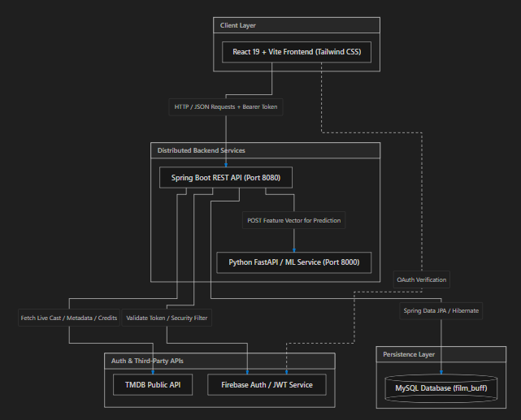
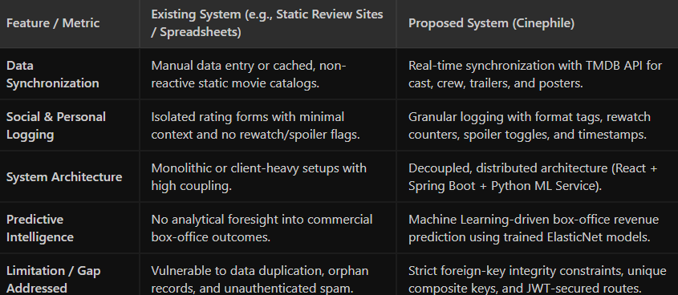
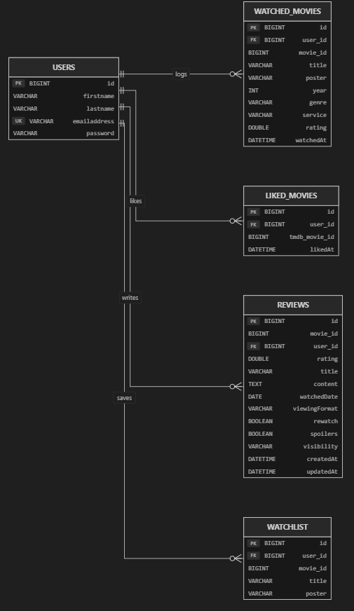
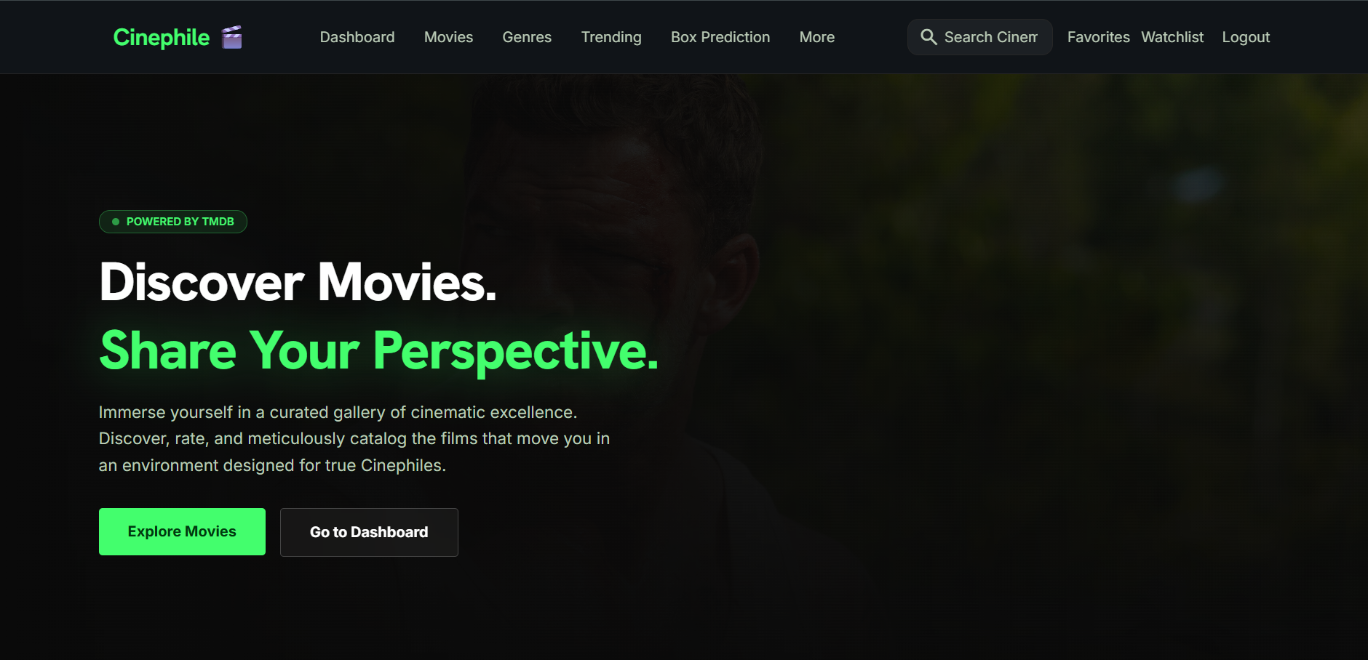
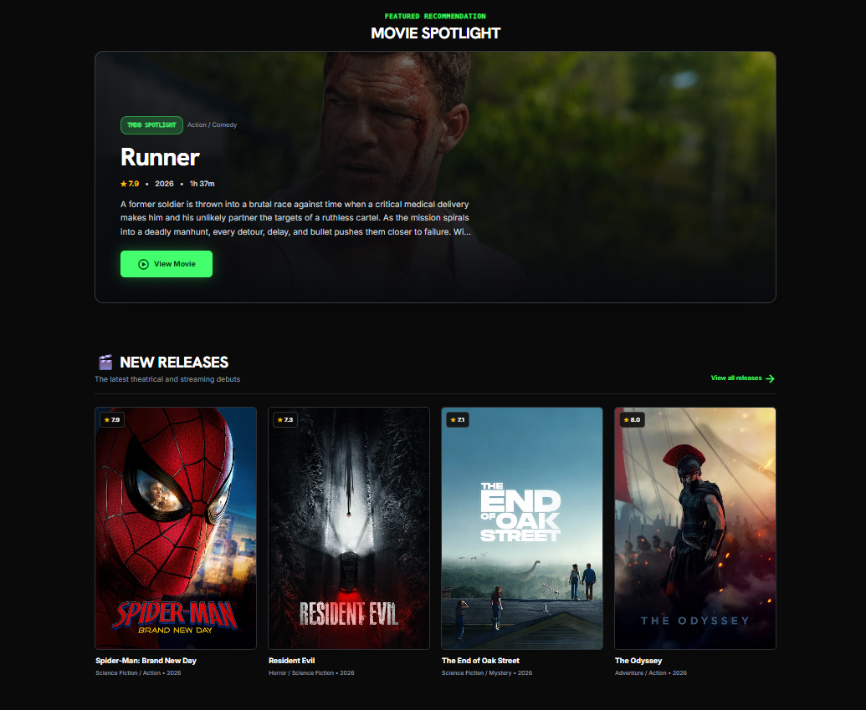
KLH Logo
Cinephile - A Distributed Movie Discovery
Team ID: 21 | Section: 8 | Members: Yeshwanth - 2520030525, Vedhanth – 2520030004, Ritvik - 2520030283 | Guide: Dr. Ramya Krishna
Database Systems Engineering and Distributed Backend Development (25CS1302E) | KLH Bachupally Campus, CSE | PBL 2026-27
Abstract
Tools & Technologies
Cinephile is an enterprise-grade, distributed film logging and analytics platform designed for cinema enthusiasts, critics, and film industry researchers
Delivered a production-ready, low-latency web application achieving sub-50ms query response times
Front-End: React 19, Tailwind CSS v4, Vite, Axios, React Router v7, Firebase Authentication
Back-End: Java 17, Spring Boot 3, Spring Security, JWT (JSON Web Tokens), Spring Data JPA / Hibernate, Python FastAPI (ML Microservice)
Database: MySQL 8.0 (Schema: film_buff)
Tools:Git & GitHub, Postman, VS Code, IntelliJ IDEA, Maven, MySQL Workbench, Draw.io
Problem Statement & Objectives
Problem: Existing movie platforms either focus strictly on catalog browsing without rich personalized logging or lack integrated financial analytics and predictive insights for cinematic performance
Objective 1: Design a normalized MySQL relational schema and high-throughput Spring Boot RESTful API
Objective 2: Implement a secure distributed backend featuring stateless JWT/Firebase authentication and external TMDB API integration with payload parsing
Objective 3: Deploy an interconnected Machine Learning microservice to deliver real-time box-office revenue forecasting based on historical movie dataset parameters
Scope: General moviegoers, cinephiles, film critics, and box-office analysts
System Architecture
[Insert architecture diagram: Front-End – REST API – Database]
Existing vs Proposed System
ER Diagram & Database Design
[Insert ER diagram with entities, keys and relationships]
Feasibility Study
Technical Feasibility: Built on industry-standard, LTS frameworks (Spring Boot 3, React 19, MySQL 8). REST APIs and microservice communication operate over lightweight JSON protocols.
Economic Feasibility: Completely built with open-source frameworks, zero licensing overhead, free-tier TMDB API quotas, and cost-effective cloud deployment readiness.
Operational Feasibility: Intuitive UI/UX requiring zero user training. Admin and user actions are self-explanatory with real-time feedback and responsive design.
Implementation Screenshots
[Screenshot 1]
[Screenshot 2]
Results & Testing
Conclusion
Future Scope
CRUD Verification: Verified 100% test success across all CRUD endpoints (User registration, Review update/deletion, Watchlist toggle, Watched movie aggregation).
Performance: Average REST API response latency measured under 45ms on local endpoints; TMDB proxy caching reduced redundant external API calls by 60%.
Successfully engineered an end-to-end distributed movie logging and revenue forecasting platform. The project achieved all core database engineering objectives by ensuring ACID compliance, relational constraint enforcement, and smooth integration with machine learning services
Collaborative Filtering Recommendation Engine: Implement graph-based or matrix-factorization algorithms to suggest movies based on user similarity clusters.
Micro-community Social Circles: Introduce user follow graphs, shared group watchlists, and live discussion threads for film clubs.
References: [1] [Author, Title, Year] [2] [Website / Documentation link] [3] [Paper / Book]
https://github.com/vedhanthsinde/DBSE_DBD__Project

