Slide 1
Data Structures and Algorithms -3 (25CS2103E)
MovieFlix
Team Members
M. Yeshwanth: 2520030525
Varshith Raja : 2520030283
Ritvik: 2520030283
Under the Esteemed Guidance of
Name of the DSA-3 faculty name with designation and department

Slide 2
Contents
Abstract
Introduction
Literature survey
Problem Statement and Objectives
Hardware and Software requirements
Results
Conclusion
Future Scope

Slide 3
Abstract
MovieFlix is a movie search and discovery system developed to provide fast and efficient retrieval of movie information from a large dataset. The system uses the TMDB movie dataset and applies Data Structures and Algorithms to improve searching, sorting, filtering, and data retrieval. Movie records are organized using suitable data structures such as arrays, hash tables, and tries. String-matching algorithms such as KMP, Rabin-Karp, and Z-Function are used for efficient movie title and keyword searching, while Binary Search, Merge Sort, and Quick Sort support fast searching and organization of movie records. The system also supports prefix-based searching and efficient movie lookup. The performance of different algorithms can be compared using execution time and Big-O time and space complexity. The main objective of MovieFlix is to demonstrate the practical application of DSA concepts to a real-world movie search problem and improve the speed, accuracy, and efficiency of retrieving relevant movie information from a large dataset.

Slide 4
Introduction
The system uses the TMDB movie dataset, where movie records are represented using a structured Movie model and loaded into the application for processing. Different searching techniques, including Linear Search, Binary Search, Naive String Matching, KMP, and Rabin-Karp, can be applied to movie titles, overviews, and keywords. Data structures such as Hash Tables and Tries can further improve lookup and prefix-based searching. Sorting algorithms such as Merge Sort and Quick Sort are used to organize movie records based on attributes such as title, rating, or release year.

Slide 5
Literature Survey
The development of movie search and discovery systems has been supported by various studies on data structures, searching algorithms, string matching, and information retrieval. Traditional searching techniques such as Linear Search are simple to implement but become inefficient as the size of the dataset increases. Binary Search improves search efficiency for sorted data, while hashing provides near-constant-time lookup for exact searches.
For text-based searching, algorithms such as Naive String Matching, KMP, and Rabin-Karp have been widely studied for finding patterns efficiently within large text collections. In addition, Trie data structures are commonly used for prefix searching and autocomplete functionality. Sorting algorithms such as Merge Sort and Quick Sort are useful for organizing movie records based on attributes such as title, rating, popularity, or release year.

Slide 6
Problem Statement and Objectives
The rapid growth of digital movie collections has made it difficult for users to quickly find relevant movies from large datasets. Searching thousands of movie records using basic techniques can be time-consuming and inefficient, especially when users want to search by title, keywords, genre, or other attributes. MovieFlix addresses this problem by developing an efficient movie search and retrieval system using Data Structures and Algorithms. The system aims to organize movie records effectively and apply suitable searching, sorting, pattern-matching, and data-retrieval techniques to improve search speed and accuracy
Objectives
To develop an efficient movie search system for retrieving relevant movies from a large dataset.
To implement searching algorithms such as Linear Search, Binary Search, KMP, Naive String Matching, and Rabin-Karp for different search requirements.
To use suitable data structures such as Vectors, Hash Tables, and Tries for efficient storage, lookup, and prefix searching.
To implement sorting algorithms such as Merge Sort and Quick Sort for organizing movie records
To compare algorithm performance using execution time and Big-O time and space complexity

Slide 7
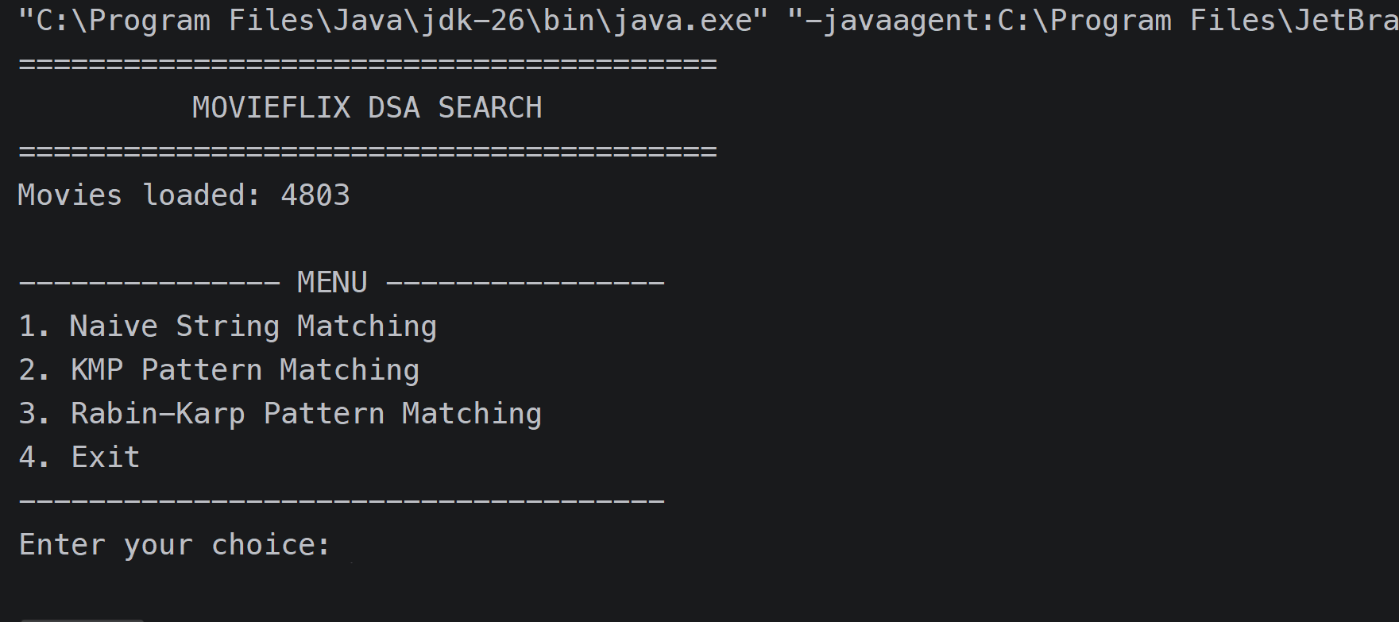
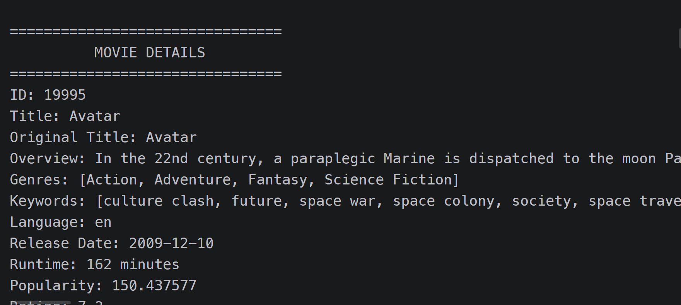
Results

Slide 8
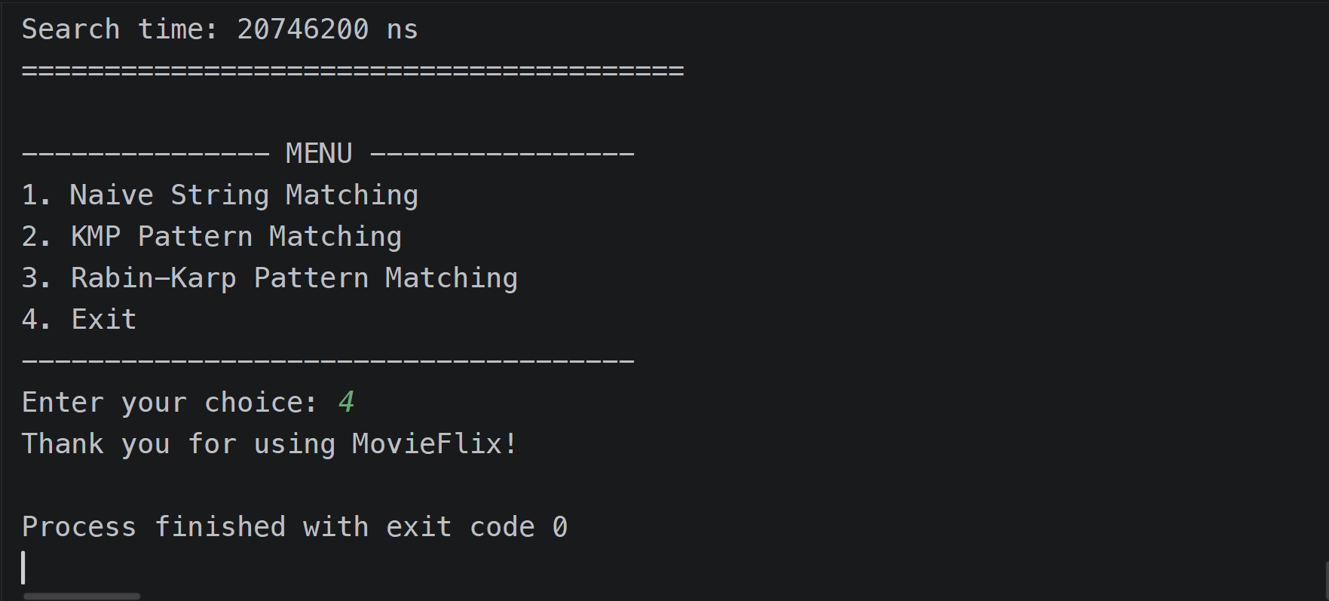
Results

Slide 9
Hardware and Software requirements
Category | Requirement | Purpose
Dataset | TMDB 5000 Movie Dataset | Provides movie records for applying and testing DSA algorithms
Data Format | JSON / CSV | Stores movie dataset records
Java JSON Library | Gson | Parses and processes the TMDB JSON dataset
Java I/O Libraries | FileReader, BufferedReader | Reads dataset files
Data Structures | Arrays, Lists, Hash Tables, Trie, Graphs | Efficient storage, searching, indexing, and relationships
String Algorithms | Naive String Matching, KMP, Z-Function, Rabin-Karp, Aho-Corasick | Pattern and substring searching in movie titles, overviews, and keywords
Suffix Structures | Suffix Array, LCP | Advanced substring searching and similarity
Dynamic Programming | Edit Distance, Bitmask DP, Interval DP | Fuzzy matching and movie-selection optimization
Network Flow | Ford-Fulkerson, Edmonds-Karp, Dinic, Min-Cut | Matching, assignment, and relationship problems
Approximation Algorithms | Vertex Cover and related approximation techniques | Solving NP-hard movie-selection/optimization problems approximately
Randomized Algorithms | Miller-Rabin, Randomized Hashing | Probabilistic searching/testing demonstrations
Performance Analysis | System.nanoTime() | Comparing execution time of implemented algorithms

Slide 10
Conclusion
MovieFlix demonstrates the practical application of Data Structures and Algorithms to solve the problem of efficiently searching and retrieving information from a large movie dataset. Using the TMDB 5000 Movie Dataset, the system applies suitable data structures and algorithms for movie searching, sorting, filtering, pattern matching, and data retrieval.
Algorithms such as KMP, Rabin-Karp, Binary Search, and Hashing can improve search efficiency, while Trie supports prefix-based searching and auto-complete functionality. Sorting techniques such as Merge Sort and Quick Sort help organize movie records efficiently. The project also provides an opportunity to compare different algorithms based on execution time and Big-O time and space complexity.
Overall, MovieFlix shows how advanced DSA concepts can be applied to a real-world movie search problem, reducing search time and improving the efficiency of movie information retrieval. It also provides a foundation for implementing more advanced concepts from the different course modules.

Slide 11
Future Scope
Advanced Pattern Matching
Implement additional algorithms such as Z-Function, Suffix Array, LCP, Suffix Automaton, and Aho-Corasick for more advanced movie title and keyword searching.
Fuzzy Movie Search
Use Edit Distance and Dynamic Programming to find movies even when the user enters an incomplete or misspelled title.
Movie Recommendation
Apply Dynamic Programming and Graph Algorithms to recommend movies based on genres, ratings, keywords, or actor–movie relationships.
Graph-Based Relationships
Build graphs representing relationships between movies, actors, and genres and apply graph algorithms for discovering related movies.
Watchlist Optimization
Use optimization and approximation techniques to generate suitable movie watchlists based on constraints such as available watching time, genre, and rating.

Slide 12
Thank you

