Slide 1
Data Science Final Presentation
Group : Piplu Followers
Ritvik Shekhar, Divyanshu Yadav, Aditya Malik, Shivam Kumar Jha, Ridhhin Grover

Slide 2
Dataset Features
Rows - 253680 ( individual records)
Columns - 22 ( Health and lifestyle features)
Data points - 5.58 million
X axis - 22 independent identity and health parameters
Y axis - Binary response for predicting the diabetes status (target variable - 0 or 1)
Duplicate Rows - 24206
Data Type - int64
Source :
CDC Diabetes Health Indicators from the UC Irvine Machine Learning Repository

Slide 3
Problem Statement
This structured dataset is used to analyze the adults of the US population having diabetes subject to health parameters with a particular individual’s demographics and lifestyle habits.
By applying appropriate statistical techniques such as EDA on health data, helps in determining the appropriate machine learning algorithms to be applied which will eventually lead to obtaining relevant inferences for a person to likely have diabetes based on parameters defined above.

Slide 4
Hypothesis Testing
Test | Ho vs H1 | Reject H0
Welch T test | H0 : mean BMI H1: mean differs | True
Chi squared | H0 : Identical GenHealth identical groups H1 : Groups differ | True
Chi squared | H0 : Smoker independent of diabetes H1 : Associated with diabetes | True
Chi squared | H0: PhysActivity independent of Diabetes H1: PhysActivity associated with Diabetes | True
Chi squared | H0: HighBP independent of Diabetes H1: HighBP associated with Diabetes | True
Chi squared | H0: HighChol independent of Diabetes H1: HighChol associated with Diabetes | True

Slide 5
Fruits and veggies are both part of a healthy diet
Chi squared | H0: HeartDiseaseorAttack independent of Diabetes H1: HeartDiseaseorAttack associated with Diabetes | True
Chi squared | H0: Sex independent of Diabetes H1: Sex associated with Diabetes | True
Chi squared | H0: Income independent of Diabetes H1: Income associated with Diabetes | True
Chi squared | H0: Education independent of Diabetes H1: Education associated with Diabetes | True
Chi squared | H0: Fruits independent of Diabetes H1: Fruits associated with Diabetes | True
Chi squared | H0: Veggies independent of Diabetes H1: Veggies associated with Diabetes | True

Slide 6
Chi squared | H0: HeavyAlcoholConsump independent of Diabetes H1: HeavyAlcoholConsump associated with Diabetes | True
Chi squared | H0: AnyHealthcare independent of Diabetes H1: AnyHealthcare associated with Diabetes | True
Chi squared | H0: NoDocbcCost independent of Diabetes H1: NoDocbcCost associated with Diabetes | True
Chi squared | H0: CholCheck independent of Diabetes H1: CholCheck associated with Diabetes | True
Chi squared | H0: DiffWalk independent of Diabetes H1: DiffWalk associated with Diabetes | True
High consumption of alcohol and high cholesterol are major factors for heart disease which is strongly linked to
Diabetes

Slide 7
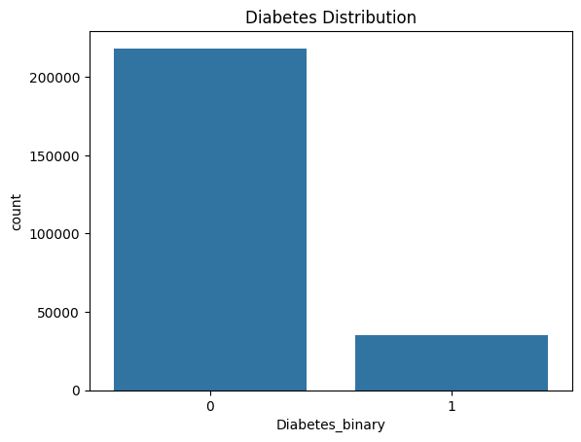
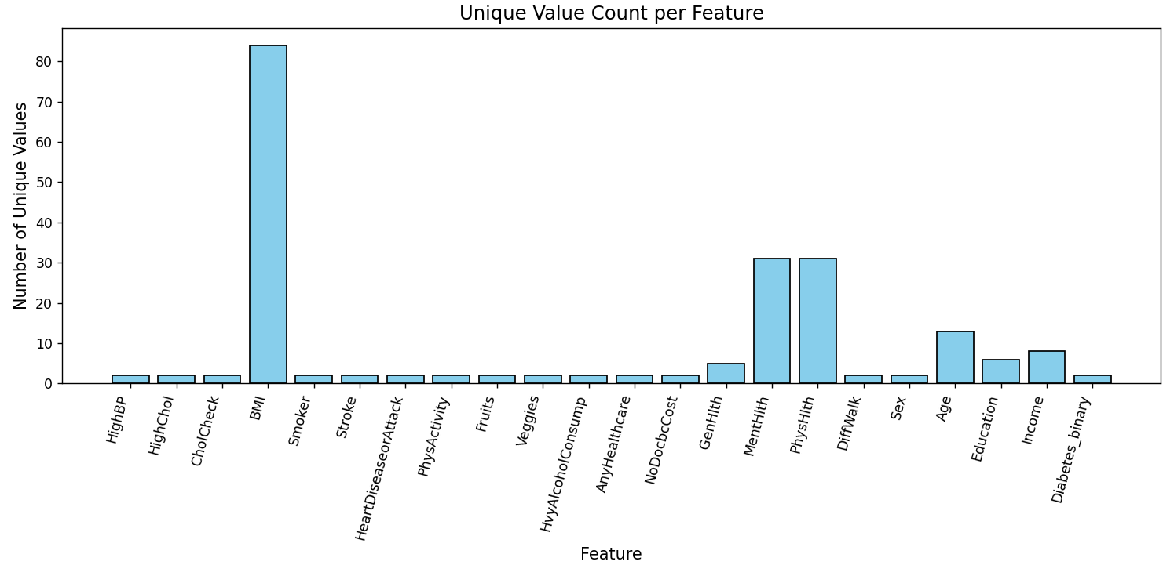
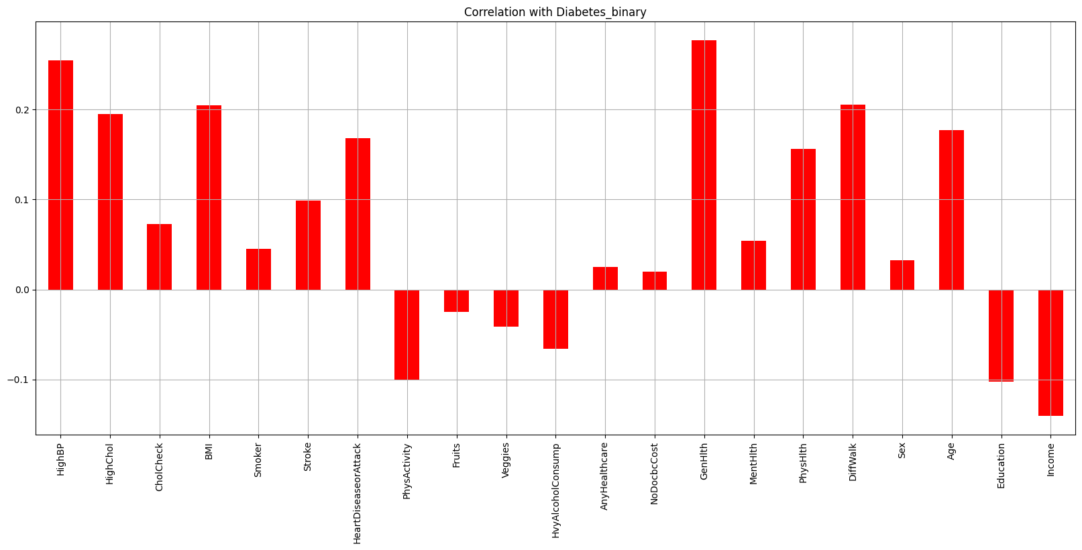
Imbalanced data : 0 86.066698 ; 1 13.933302
Correlation with diabetes

Slide 8
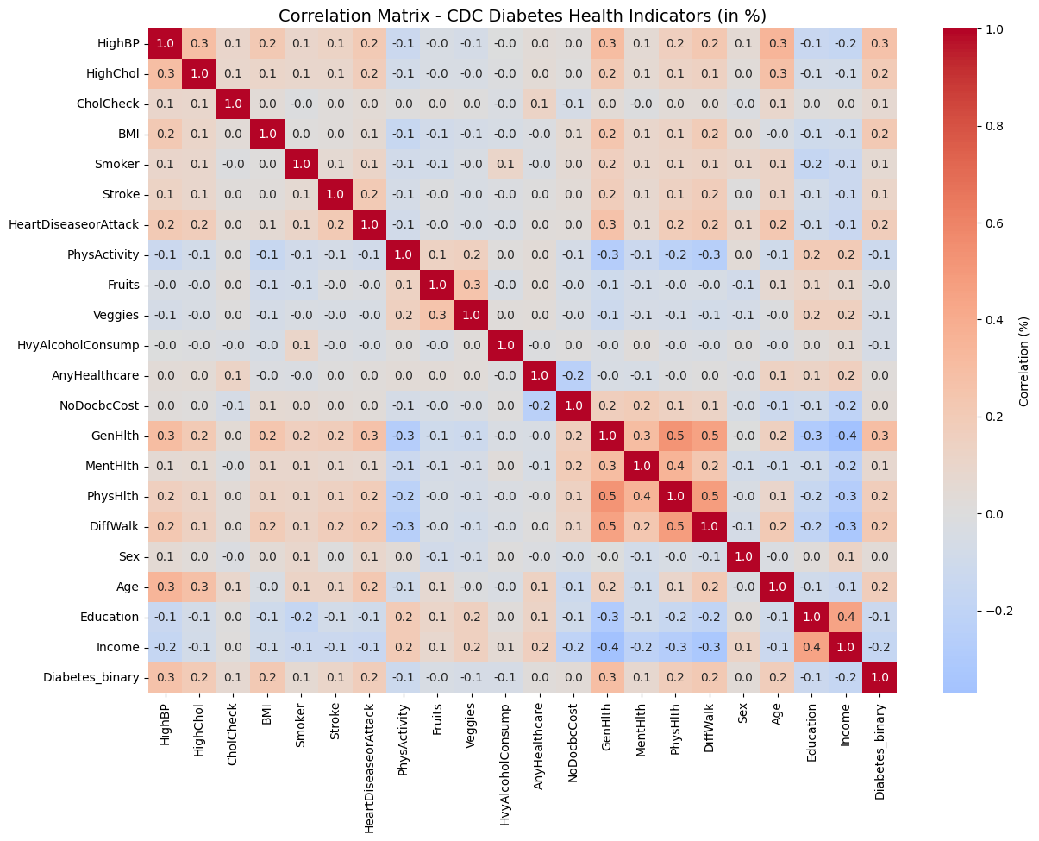
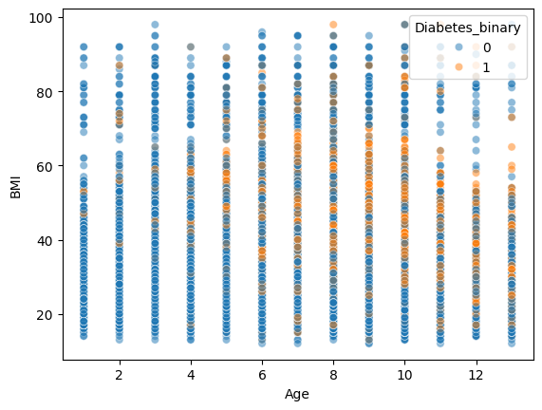
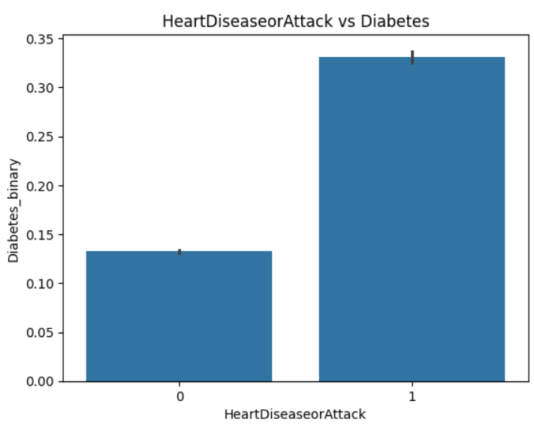
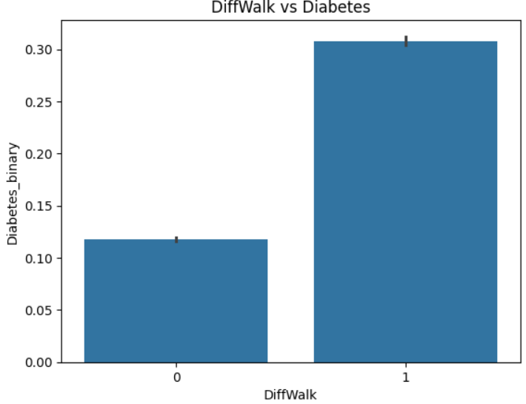
Correlation Analysis
Diabetes_binary shows the strongest positive correlations with DiffWalk (Difficulty Walking/Physical Disability) and GenHlth. Self-reported poor health status and physical limitations are the most highly correlated indicators of a positive diabetes.
Multicollinearity: There are several strong inter-correlations among the health and lifestyle variables, indicating potential multicollinearity. Notably:
  DiffWalk (Difficulty Walking) is highly correlated with GenHlth and PhyHlth
  GenHlth is also strongly correlated with PhyHlth and MentHlth
Weak Correlation of Lifestyle Factors: Most of the traditional lifestyle and preventative factors (like Fruits, Veggies, HvyAlcoholConsump) show very weak correlations.
GenHlth and PhysHlth are highly correlated with each other i.e positively.
GenHlth and Income are highly correlated with each other i.e negaively

Slide 9
Preprocessing Done
Reduced Class Imbalance (SMOTE): SMOTE mitigates bias toward the majority class, enabling the model to learn meaningful patterns from the minority class (e.g., disease cases), which is critical for improving Recall and F1-Score.
Enhanced Feature Informativeness (CardioRisk): Combining HighBP and HighCol into CardioRisk creates a single, medically stronger, and more interpretable risk indicator, likely leading to a higher predictive power for cardiovascular outcomes.
Dimensionality Reduction and Stability (Healthy diet): Merging Fruits and Veggies into Healthy diet reduces the total feature count, which can decrease noise and potential multicollinearity, resulting in a more robust and stable model.
Improved Model Convergence (Scaling): Scaling numeric features ensures all inputs contribute equally to the distance calculations and allows gradient-based algorithms to converge faster and achieve better final results.

Slide 10
Model
Metrics
Model | Accuracy
Logistic Regression | 0.8658940397350994
Decision Tree | 0.8661305581835383
Bagging | 0.8662093976663513
Random Forest | 0.8580298013245033
Linear SVM | 0.864908546199937
Data Preparation:
80% for training
20% for testing
Each feature is standardized using the training set’s mean and standard deviation to obtain zero-mean and unit-variance values.
The same scaling is applied to the test set to avoid data leakage and ensure fair evaluation.

Slide 11
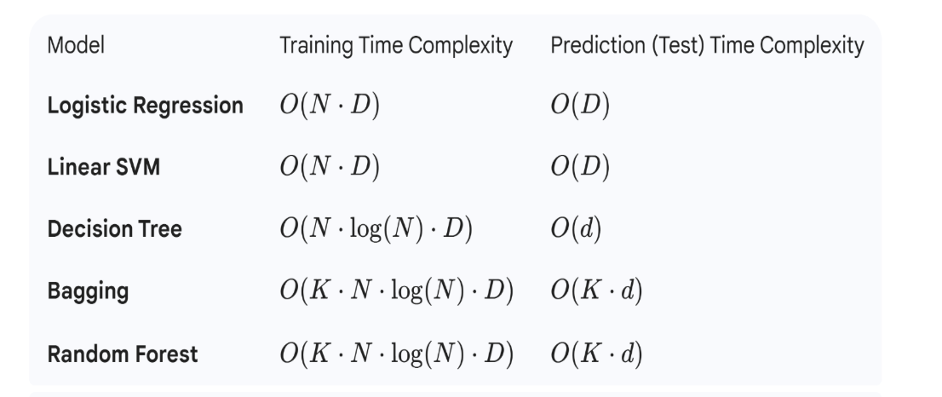
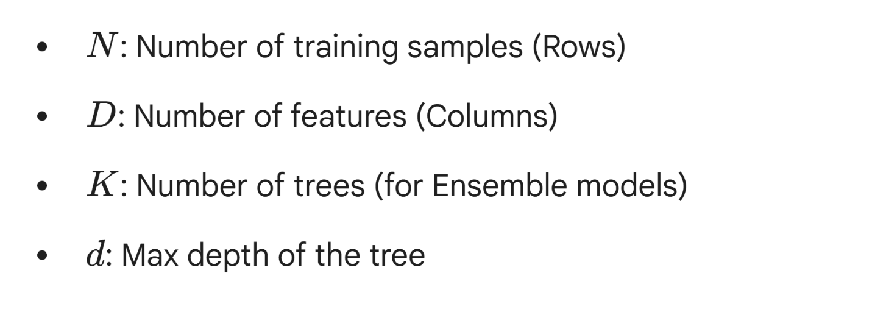
Asymptotic Running Time Complexity

Slide 12
Using random projection
JL Lemma
Model | Accuracy
Logistic Regression | 0.8621688741721855
Decision Tree | 0.8619520655944497
Bagging | 0.8628192999053926
Random Forest | 0.853319142226427
Linear SVM | 0.8622082939135919
Training Dataset Samples & Dimensions
202944,5
Test Dataset Samples & Dimensions
50736,5

Slide 13
Comparison and Reason for Technique
JL lemma was specifically used because it reduces high dimensional data to low dimensional data. Moreover it also reduces training time because Machine learning models tend to scale with dimensionality. We also used scaling techniques such as SVD, Sampling however JL Lemma gave us the best results.
Accuracy (Before) | Accuracy( After JL)
0.8658940397350994 | 0.8621688741721855
0.8661305581835383 | 0.8619520655944497
0.8662093976663513 | 0.8628192999053926
0.8580298013245033 | 0.853319142226427
0.864908546199937 | 0.8622082939135919

Slide 14
Time comparison
Model | Time (without JL) | Time (after JL) | Improvement( %)
Logistic Regression | 0.584057092666626 | 0.1747820377349853 | 70.08%
Decision Tree | 0.6907291412353516 | 0.357586145401001 | 48.23%
Bagging | 9.244103908538818 | 2.677006483078003 | 71.03%
Random Forest | 11.805238008499146 | 3.7088234424591064 | 68.58%
Linear SVM | 4.106787443161011 | 0.06987905502319336 | 98.30%
Average improvement performance is approximately 71.2%

Slide 15
Conclusion
And
Future Work
Logistic Regression achieved an accuracy of approximately 86%, which is comparable to other models.Despite similar accuracy across models, Logistic Regression was preferred due to its faster training time and simpler model structure.
Applying random projection based on the JL Lemma resulted in only a slight decrease in accuracy, indicating that most of the important information in the data was preserved.
Future Work:
1. Compare JL Projection with PCA
2. Optimize the Random Projection Dimension:Experiment with different random projection dimensions to further reduce computation while preserving accuracy.
3.Improve Handling of Class Imbalance:
Although SMOTE was used to address class imbalance, future work can evaluate advanced imbalance-handling techniques such as class-weighted loss functions or ensemble methods tailored for imbalanced data, with a focus on improving recall and F1-score for diabetes prediction.

