Slide 1

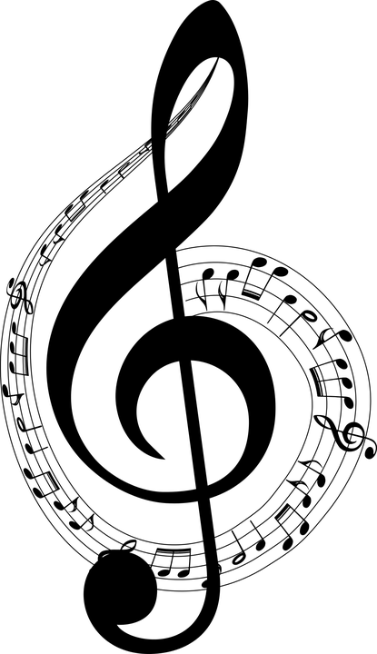
BEATIT
Automatic CHORD Generation for Vocal Melodies
RAHUL GUIN
RITVIK VINODKUMAR

Slide 2
HIGH LEVEL IDEA
BeatIT is a creative tool for folks who like to sing but would never get a chance to experiment with creating real original music. A user with no musical experience can create a backing track with instrumental accompaniment just by singing into a microphone, and generate chords appropriate to the vocal input.
Our system takes in a melody sequence given by the user as input and generates piano chords, which the user can then use to sing along with, as output.
It is important to note that there is not a single correct accompaniment for a particular melody. Chord selection will vary among musicians and genres. A single musician may recognize many appropriate chord sequences for a single melody. Therefore our goal in designing BeatIt was not to predict the “correct” chords for a given melody, but to produce subjectively appropriate chords.

Slide 3
PROBLEM FORMULATION
We describe the implementation of BeatIT, which trains a Hidden Markov Model using a music database and uses that model to select chords for new melodies. Our representation is as follows-
X – A single chord.
Y – A melody note.
Initial State: P(X₀) – First chord.
Transition Model: P(X_{t}|X_{t-1}) – Probability of the chord at t^{th} time slot given a chord at (t-1)^{th} time slot.
Emission Model: P(Y_{t}|X_{t})- Probability of observing Y melody note for a given chord at t^{th} time slot.
Training Data: A set of 4000 lead sheets from wikifonia.org, a public repository of lead sheets.
Training Goal: Initialize the Transition Model and the Emission Model.

Slide 4
PROJECT TOOLS AND TERMINOLOGIES
Musical Terminology:
Melody - Sequence of pitches performed by a vocalist.
Chord Sequence - Series of chords – combinations of musical notes – that are performed to support a vocal melody.
Lead Sheets - Used by instrumentalists or bands to represent music during performances.
Tools Used:
Magenta.py – run on TensorFlow
Aubio.py
Google Colab
Music21.py

Slide 5

training
Initial Assumptions:
Consider only major and minor chords. Hence, the number of chords considered are 25.
Transition Model – Chord Transition Matrix (25 * 25):
The system examines the chord changes in each song in the database and counts the number of transitions observed from every chord type to every other chord type.
Emission Model – Melody Observation Matrix (25 * 12):
The system looks at the period during which each individual chord is playing, and counts the total duration of each musical note occurring in the melody fragment corresponding to this period.
These summed note durations are then inserted into a table containing the total duration of each note observed over each chord for all songs in the database.
The melody of every lead sheet is discretized in MIDI pitch number to one of the 12 standard musical notes. Octave information is discarded.
Melody sequences are non-overlapping throughout.

Slide 6
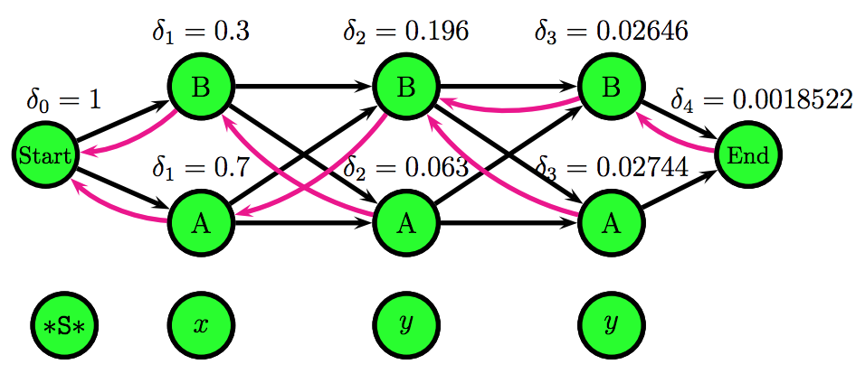
THE VITERBI ALGORITHM
We use the Viterbi algorithm as the prediction algorithm on our HMM problem.
The Viterbi algorithm is a dynamic programming algorithm for finding the most likely sequence of hidden states—called the Viterbi path—that results in a sequence of observed events, especially in the context of Markov information sources and hidden Markov models (HMM).
Using the Chord Transition Matrix and Melody Observation Matrix, this algorithm outputs the appropriate chords from start to finish.
This Photo by Unknown Author is licensed under CC BY-SA-NC

Slide 7
PROJECT FLOW
Clean the dataset to remove unwanted/incompatible data through magenta.py.
Extract chord and MIDI pitch information [0-127] values from the lead sheets and construct the two matrices. ie: Training. Clamp the pitch values between [60-71] (Octave 4)
Get the voice input and extract MIDI pitch information and quantize it to be synchronous per time frame using aubio.py.
Apply Viterbi algorithm to generate the most probable sequence of chords for the vocal input.
Convert the generate sequence of chords into a MIDI file with duration of every chord to be proportional to the notes of the voice input using music21.py. All generated chords are a triad of piano notes.
Play the generated MIDI file and sing along!

Slide 8
RESULTS/FUTURE WORK
The chords currently being generated are not completely accurate. ie: Some parts match and some parts don’t.
Chords are not being generated at the correct time frame.
Currently, we are giving a MIDI file as input. Ideally, we need to input an mp3 file and the system should generate a MIDI file for prediction.
We haven’t taken mood/genre/triads into consideration during chord prediction.

Slide 9

Thank You!

