Slide 1
PROPOSAL
Sourced competitor briefs reach reps within one day
Signals
AI field brief service for Quillmont Therapeutics
2 Nov 2026
Sourced draft
Weekly field brief
Medical review

Slide 2
The proposal runs in six parts, from the field need to the proof
01
The need
Why competitor news reaches reps late
02
The answer
One weekly brief per rep, on one foundation
03
How it works
Scan, draft, review and release
04
How it is built
Architecture, data flow and security
05
Delivery
Four phases from kickoff to run
06
Why the firm
Delivered work, team and commercials

Slide 3
Quillmont reps get one sourced, reviewed brief within a day of each move
The need
The answer
How it works
Delivery
1
Signals pile up
More moves than analysts can read
1
One brief per rep
One page, every claim sourced
1
Signal scan agent
Reads approved public sources
1
Assess and pilot
Kickoff 2 Nov 2026, pilot in North
2
Reps hear last
Customers raise the move first
2
Medical signs off
Nothing ships without a reviewer
2
Brief writer agent
Drafts by territory, with sources
2
Three gates
20 Nov, 18 Dec and 8 Jan
3
Every region rewrites
Each team writes its own version
3
Shared foundation
One governed source ledger
3
Review queue
Approve, edit or reject, with a reason
3
Scale and run
Full rollout 22 Jan 2027
Illustrative figures
40+
5 days
1 day
$468K
public competitor signals a week
from move to field today
from move to field with the service
first-year total, build plus run
Assumptions
Source list
Approved sources agreed at kickoff
Reviewers
Quillmont names medical reviewers
Field app
Briefs reach reps in the current app
Data access
Read access to territory plans

Slide 4
The need
01
1
2
3
4
5
6

Slide 5
Field briefs reach reps late and unsourced, so trust in them erodes
Today
What the field now asks
Required end state
1
One brief, every region
A single weekly page for all 1,200 reps
Late
A competitor move reaches reps days after customers hear of it
Weekly
One page per territory
Fragmented
Each region rewrites the same signals into its own brief
2
In hand before Monday
Moves reach the field within a day
Within a day
From signal to the field
Duplicated
Six regional teams read the same signals
3
Every claim sourced
Each line links to its public source
Fully sourced
Every claim carries its source
Unsourced
Claims arrive with no link and no medical check
4
Medical signs first
Nothing ships without a reviewer signature
Signed
Medical approves each release
Depends on
Source list
Medical and legal agree the feeds
Reviewer
One named signer and a deputy
Field app
A slot for the brief
Pilot region
North goes first from 2 Nov 2026
On record
Every edit and decision kept

Slide 6
A competitor move takes five days and six rewrites to reach reps
How one brief is made today
What the delay costs
5 days
From a competitor move to the field
Spot
Day 0
Collect
Day 1
Rewrite
Days 2 to 3
Review
Day 4
Send
Day 5
Illustrative
6
OWNER
Field reps
OWNER
Regional analysts
OWNER
Six regional leads
OWNER
Medical reviewers
OWNER
Regional leads
Regional versions of one brief
Illustrative
1
2
3
4
5
40+
No feed
Customers tell reps first
Hand sifting
Analysts read 40+ signals
Six versions
Each region drafts its own
Late review
Medical queues behind regions
No record
Email loses every edit
Signals a week, read by hand
Illustrative
OUTPUT
A rumor
GOES TO
Regional analysts
OUTPUT
A spreadsheet
GOES TO
Regional leads
OUTPUT
Six drafts
GOES TO
Medical reviewers
OUTPUT
Marked-up drafts
GOES TO
Regional leads
OUTPUT
An attachment
GOES TO
Field reps
3
Brands covered in every brief
Illustrative

Slide 7
A competitor move reaches reps in five days, and rewriting takes two
Illustrative figures
5 days
40+
1,200
6
from a competitor move to the field
public competitor signals a week
reps who hear it from customers first
regional versions of every brief
Days from a competitor move to the field, by stage
Where each day goes
Collect: 1 day
Analysts sift 40+ signals by hand from registries, press and congress
Rewrite: 2 days
Each of six regions rewrites the same brief for its own reps
Review: 1 day
Medical reads every regional version, one after another
Send: 1 day
The Monday digest holds every brief to one weekly slot
Collect signals
1 day
Six versions of one brief
Rewrite by region
2 days
Medical review
1 day
Send to reps
1 day

Slide 8
Quillmont has the signals and the reviewers, but no shared brief pipeline
What exists today
What is missing
Regional analysts
One approved source list
Each team trusts different feeds, none signed off
Closed by
Medical and legal
Public feeds
Due
20 Nov 2026
Volume
40+ a week
Teams
Six
Owner
Unassigned
Output
Six briefs
Ranking by territory
No way to tell which signal matters to which rep
Closed by
Signal scan agent
Sign-off
None
Tools
Spreadsheets
Due
18 Dec 2026
Medical reviewers
One sourced draft
Claims are retyped six times, with no links
Closed by
Brief writer agent
Field app
Gap
Reach
1,200 reps
Due
18 Dec 2026
Remit
Promo review
Timing
After release
Brief
No slot
Review before release
Medical signs after reps have used the brief
Signer
Not named
Owner
Field excellence
Closed by
Review queue
Due
18 Dec 2026
Brand plans
Email
A record of each release
Edits and rejections are lost in email threads
Closed by
Source ledger
Due
18 Dec 2026
Brands
Three
Use
Delivery
Refresh
Yearly
Record
None kept
Owner
Brand teams
Reach
Regional lists
A measure of use
No one knows which moves reps raised with customers
Closed by
Weekly rep feedback
Due
22 Jan 2027

Slide 9
Quillmont sits at level three, and one signed brief reaches level four
Highest
Groundwork
for each level
Governed
Rule-based release, every edit audited
Sources
One list agreed by medical
5
High
Drafted
Review
A named signer and deputy
Agents draft one brief, medical signs
Trusted speed
Regional
Moves reach the field within one day
Value to the field
4
Six regions write six briefs
Data
One governed signal store
Collected
One voice
Medium
Anecdotal
Analysts gather signals by hand
3
Every rep reads the same signed page
Reps hear of moves from customers
Mixed messages
Access
Briefs scoped by territory
2
Reps hear different versions of one move
1
Some warning
Late surprise
Moves noted days after they happen
Quillmont today
Skills
Reps trained to use it
Low
Moves surface only in the customer's office

Slide 10
The answer
02
1
2
3
4
5
6

Slide 11
Competitor news moves from regional rewrites to one reviewed brief
Today, regional rewrites
Target, one brief
Monday release
Field app, email digest
Every team writes its own version
6
Agents route each signal through one review
Email threads
regional versions of every competitor brief
Reps
Brand lead
Scan
Weekly feed sync
Brand lead
Illustrative
Phone calls
Review
Medical signs off
Source ledger
Analyst
Reps
Analyst
Rank
Draft
Leads
Slide packs
Rejections
Map view
Medical
Leads
Region map
Medical
Shared drives
5 days
Signal flow
from competitor move to the field
Source sync
Medical check
Region head
Illustrative
Region head
Release

Slide 12
Three parts make up the service, each run by its own agent
Signal scan agent
Brief writer agent
Review queue
Reads approved public feeds every weekday
One page per territory, every claim sourced
Approve, edit or reject before release
Registries and trial notices
Ranked competitor moves
Reviewer signature on each brief
Press and congress abstracts
Talking points by brand
Reason kept for every edit
Payer and pricing updates
Source link on every line
Release log by territory
Ranked signals this week
Brief week, North
Review log
Region
Signal
Priority
Mon
Tue
Wed
Thu
Fri
North, pricing line signed
Payer notice linked and checked
North
Price change
High
Rank
Shortlist
Coastal, trial line edited
Coastal
New trial
High
Wording matched to the registry
Draft
Sourced
Inland, label line returned
Inland
Label update
Mid
Source not on approved list
Review
Signed
Delta, congress line signed
Delta
Congress abstract
Low
Abstract linked to its session
Release
To reps
Illustrative sample
Signed
Returned

Slide 13
One reviewed brief core serves every team that faces the field
40+
Medical affairs
1,200
public signals scanned and ranked each week
Regional managers
Brand teams
field reps reading the same reviewed page
Illustrative
Illustrative
Field brief core
Field sales reps
Market access teams
Scan
Review
Approved feeds
Repeat filter
Territory ranking
Signal log
Medical signoff
Source links
Edit history
Release rule
6
100%
regional rewrites folded into one reviewed brief
of claims linked to a public source
Illustrative
Public signal sources
Governed data foundation
Illustrative
Registries
Press
Congress
Payers
Ledger
Lineage
Access
Audit

Slide 14
Three principles keep every brief sourced, reviewed and useful to reps
Source every claim publicly
Medical decides before release
Start small, learn every week
Shared source ledger
Edit or reject
Pilot first, then every region
Agent
Draft brief
Reviewer
Scan
agent
Writer
agent
Signed
Scan
Draft
Review
Release
Source list
Edited
Ratings
Draft
Approved public feeds
Only a signed brief reaches reps
No claim without a source
Every line links to a public notice, registry or abstract.
Signature before the field
No brief reaches a rep until a medical reviewer approves it.
One region first
North runs the pilot before any other region receives a brief.
One ledger for every region
All agents read the same feeds, so regions never disagree.
Rejections carry a reason
Each edit or rejection is kept, so the next draft learns.
Reps rank what helps
Field ratings each week decide what the next release changes.

Slide 15
Field sales goes first, because its brief agents feed every other domain
Commercial use cases
Serves reps and medical
Agent stage
Ready
Planned
Shared
Start where sources and owners are ready
Market access
Medical affairs
Field sales
Brand marketing
Medical information
Payer agent
Review queue
Signal scan agent
Launch agent
Inquiry agent
Formulary changes
Medical signoff
Public feeds
New entrants
Question triage
Tender agent
Trial scan agent
Brief writer agent
Campaign agent
Answer agent
Bid summaries
Registry updates
Territory pages
Campaign changes
Answer drafts
Contract agent
Congress agent
Review queue
Brand plan agent
Review queue
Contract alerts
Congress abstracts
Medical signoff
Plan refresh
Answer signoff
Signal scan agent
Evidence agent
Message agent
Brief writer agent
Safety agent
Payer notices
Study summaries
Talking points
Brand summaries
Event routing
Shared foundation services
Source ledger
Brand master
Territory map
Rep roster
Brief archive
Claim library
Agent catalog
Quality tests
Run history
Governed data for every domain
One agent runtime, tested every week
Access, review and audit on every call

Slide 16
Every claim in the weekly brief traces to a source before medical signs
Today
5 days
from competitor move to field
Six regions rebuild
the same brief
Notes reach reps
with no source
Field brief
Competitor moves reach reps five days late
How the weekly brief works
Why now
Customers tell reps about competitor moves first
Sample week
01
Scan
02
Check
03
Sign
Method
Agents draft from approved feeds and medical signs
Source is on the approved list
Passed claims reach medical
Signals
Sources
Brand and territory confirmed
Scope
North pilot, then six regions by January
Unsourced claims
return to the scan
Not repeated from last week
Sign
and release
Reject
with a note
A claim must pass all three
Decision asked
Fund the pilot from 2 Nov 2026
Rejections retune source rules
Gains
Field in a day
Sourced claims
One shared brief

Slide 17
Only the shared brief service meets all four tests the field sets
Keep regional notes
Central analyst desk
Shared brief service
Decision
Fund the shared service, the one option that clears every test
0 of 4
2 of 4
4 of 4
tests met
tests met
tests met, the choice
Illustrative
Illustrative
Illustrative
Speed to field
5 days from a move to reps
40+ signals a week triaged by hand
1 day from a move to reps
Every claim sourced
Ad hoc notes, no source list
Sources kept in personal notes
100% of claims linked
Medical signs first
Review after reps use it
Medical reviews before release
Medical signs every brief
One brief, six regions
6 versions of the same brief
One central version
One brief, cut by territory

Slide 18
Four capabilities give most of the value for the least effort
Illustrative figures
Wave 1, by Jan 2027
Highest value for the least effort
1 Signal intake, registries, press, congress
2 Source ledger, every claim to its source
3 Brief writer, one page a week
4 Review queue, medical sign-off
Value to the field, 1 to 5
Build first
Plan for
1
3
5
2
4
7
Wave 2, by Sep 2027
Regional depth and new sources
5 Regional notes, one local line each
6 Field app card, the brief in the app
7 Payer feeds, formulary moves
8 Congress tracker, abstracts and posters
8
6
9
10
11
Later, after Sep 2027
Low value for the effort today
9 Rep questions, answers from the brief
10 Brand dashboards, trends by brand
11 Archive search, past briefs
12 Translation, local languages
12
Fill in
Hold
Effort to build

Slide 19
How it works
03
1
2
3
4
5
6

Slide 20
Medical review is the gate every weekly brief passes before release
Scan
Rank
Draft
Review
Release
Learn
Read approved public feeds every weekday
Score each signal by brand and territory
Write one page with every claim sourced
Medical approves, edits or rejects each claim
Ship each territory cut before Monday calls
Feed rejections back into the source rules
New signals, repeats dropped
A ranked weekly shortlist
Draft brief with source links
Signed brief and decision log
Brief in every rep's app
Tuned rules for next week
40+ signals a week
6 regions, 3 brands
1 page per territory
100% of claims signed
1,200 reps by Monday
Rules retuned weekly
Review passes when a named medical reviewer signs every claim against its live source
Pass criteria
Owners and duties
Risks to watch
Every claim links to a live feed
Medical
Sign or reject each claim within one day
Reviewer cover thin during congress weeks
Comparisons backed by a source
Only the three approved brands
Payer notices arrive after the weekly cutoff
Medical signs by Friday noon
Brand
Confirm territory priorities before each weekly run
Each decision logged with a reason
Release log keeps each signed edit
Field
Flag claims customers challenge back to medical
Regional teams keep writing their own notes

Slide 21
40+ public signals in, one signed page per territory out each week
Agent-built weekly draft
Public
signals
Scan feeds
Rank signals
Draft brief
Signed brief
per territory
Source gate
Ranked
Sourced
Medical gate
01
02
03
04
Signals in
Source gate
Two agents draft, one queue signs
Brief out
Notices, registries and press releases
Each signal tied to its public source
Scan agent and brief writer agent feed the review queue
One page per territory before Monday
Congress abstracts and payer updates
Repeats from last week dropped
1
2
3
4
5
Every claim links to its source
Scan
Rank
Draft
Queue
Sign
Daily feeds
By territory
Sourced page
Per claim
By medical
Only feeds on the approved list
Off-brand signals parked, not deleted
1,200 reps read the same facts
Runs under
every step
Release log
Every edit kept
Access by role
Per brand and region
Sourcing check
Read every week
Signed only
Enforced by rule

Slide 22








Eight containers carry the service, and only the writer agent calls the model
Medical reviewer
Person
Approves held claims
Field app
External system
Existing mobile app
approves claims
GET /briefs · HTTPS
reads the brief
Brief service · AWS
Review app
Container · React
Held claims, one by one
Source ledger
Container · Amazon RDS
Sources and reviews
Brief API
Container · API Gateway
Serves briefs and holds
Field rep
Person
Reads the brief
reads · SQL
reads · SQL
writes the brief
Collectors
Container · AWS Lambda
Pull public signals
Scan agent
Container · LangGraph
Extracts cited claims
Writer agent
Container · LangGraph
Drafts the brief
collects · HTTPS
writes signals
reads new files
writes claims
searches claims
drafts · HTTPS
Public web
External system
Press, trials, congresses
Signal lake
Container · Amazon S3
Raw and refined signals
Claim index
Container · OpenSearch
Claims with source ids
Amazon Bedrock
External system
Claude models
Person
External system
Container
System boundary

Slide 23
Agents draft and route, but nothing ships until a medical reviewer signs
Scan
Draft
Review
Release
Use
Signal scan agent
Reads every approved feed each weekday
Brief writer agent
One page per territory, each claim sourced
Claim checks
Holds any claim without a public source
Territory routing
Each rep gets the moves that matter
Ranking update
Ratings reweight next week's relevance scores
Agents
On Amazon Bedrock
5
4
1
2
3
6
Rejected drafts
Back to the writer with the reason
Review queue
Approve, edit or reject with a stated reason
Medical reviewer
Signs every brief
Call notes
What reps hear joins the next scan
Monday brief
On every rep's phone before the first call
Rate each move
Ratings tune next week's ranking
Field reps
Across six regions
Records kept per stage
Amazon S3
Raw signal kept per feed
OpenSearch index
Source link for every claim
Amazon RDS
Reviewer, decision and reason
API Gateway
Release log per territory
Langfuse
Rating and trace per move
Hand-off rules
1 Draft to review
Every claim carries its public source
2 Review to release
Only a signed brief can ship
3 Release to field
Delivered before the Monday calls
4 Rejected to writer
The reason travels with the draft
5 Field to scan
Notes enter as signals, never claims
6 Ratings to ranking
New weights apply next Monday

Slide 24
One competitor signal reached North reps in one day, with one claim held
01
02
03
04
Signal in
Week 46
Claims drafted
Brief writer agent
Claim checked
Five sources around one claim
Brief released
Each step on record
Found
Mon, 07:40
Approved feeds
No match
Claims 1 to 3 shipped
Brief live Tue, 07:40
Source
Date
Brand
Region
Tone
Trial registry
Silent on access
Field notes
One rep mention
Source
Public trial registry
Claim | Hours | Source | Link | Status
Claim 1 | 6 | Trial registry | Yes | Linked
Claim 2 | 18 | Press release | Yes | Linked
Claim 3 | 30 | Congress | Yes | Linked
Claim 4 | 2 | Rep mention | No | Held
Claim 4 held
Cut from the field brief
Competitor
Rival A, new arm
Brand at risk
Quillmont brand 2
Medical decision
Signed with one edit
Claim 4
No public source
Press archive
Nothing found
Review queue
Sent with evidence
Claim 4 has no public source, so it is held
Source list tuned
Field notes flagged on arrival
Today
Same signal, two paths
With the service
5 days to field
Read and rewritten by hand
Six regions write six versions
vs
Drafted on arrival
Only the held claim needs a person
1 day to field
Record kept
Every claim tied to its source
6 versions
1 page

Slide 25
Six feeds converge on one governed signal ledger behind every brief
Regulatory notices
Label changes and safety alerts
Governed signal ledger on RDS
Faster field briefs
Approved sources, Cognito role access
A competitor move reaches reps in one day
Trial registries
New arms, endpoints and status changes
Brief services on Bedrock
One version
01
Scan once
One brief replaces six regional rewrites
Congress abstracts
Posters and late-breaking data
One daily pass per feed
02
Match
Cleaner reviews
Press and payer news
Launch timing and access decisions
Each signal tied to a brand
Medical sees every claim beside its source
03
Control access
One shared view
Field notes
What reps hear on calls
Role rules per territory
Every review reads the same signal ledger
04
Serve
Brand plans
Priorities for all three brands
One brief per territory
Reusable foundation
The next agent starts on governed data

Slide 26
Two checks route every competitor signal to one of five lanes
Checks on every signal
Relevance score per signal
Claim type from source
Checks run in lane order
The first matching rule decides the lane
Fit to brand, territory and timing
Clinical, safety, access or general news
Five lanes, tested top to bottom
01
02
03
04
05
Ready for brief
Medical claim review
Payer access change
Watch list only
Out of scope
Writer
Medical
Access
Scanner
Ledger
The one rule that sends a signal to each lane
High score, general news
Efficacy or safety claim
Price or formulary notice
Medium score, no claim
Low score or off-brand
Drafted into Monday brief
Medical signs before release
Access team checks region
Rescanned by agent weekly
Logged with a reason
Kept on every lane, every week
Clock from routing to field reps
Source link kept
Reason code recorded
Owner on record
Weekly spot check
1
2
3
4
Hour 0 routed
Hour 4 drafted
Hour 8 signed
Day 1 in field

Slide 27
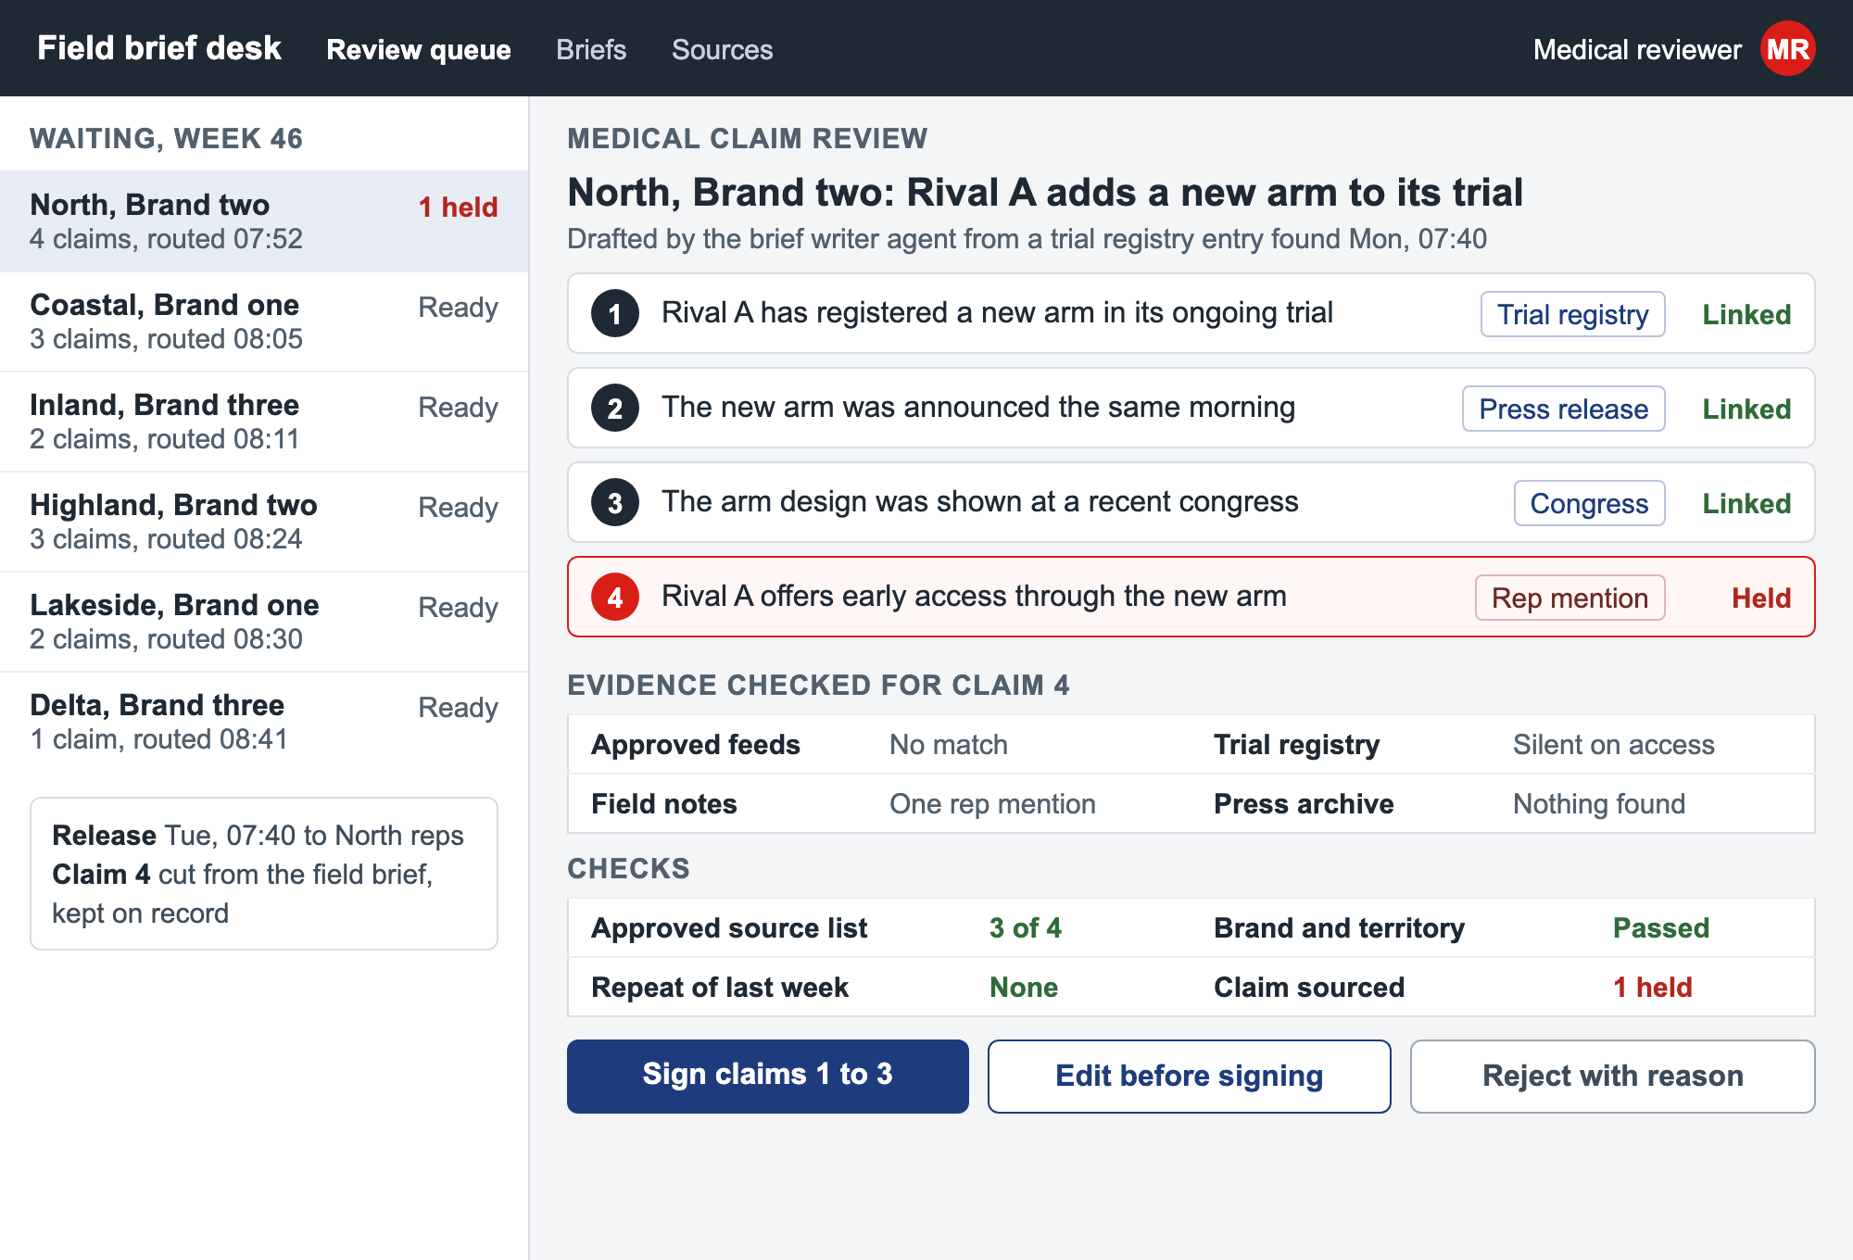
Medical signs sourced claims in one queue
Unsourced claim held

Slide 28
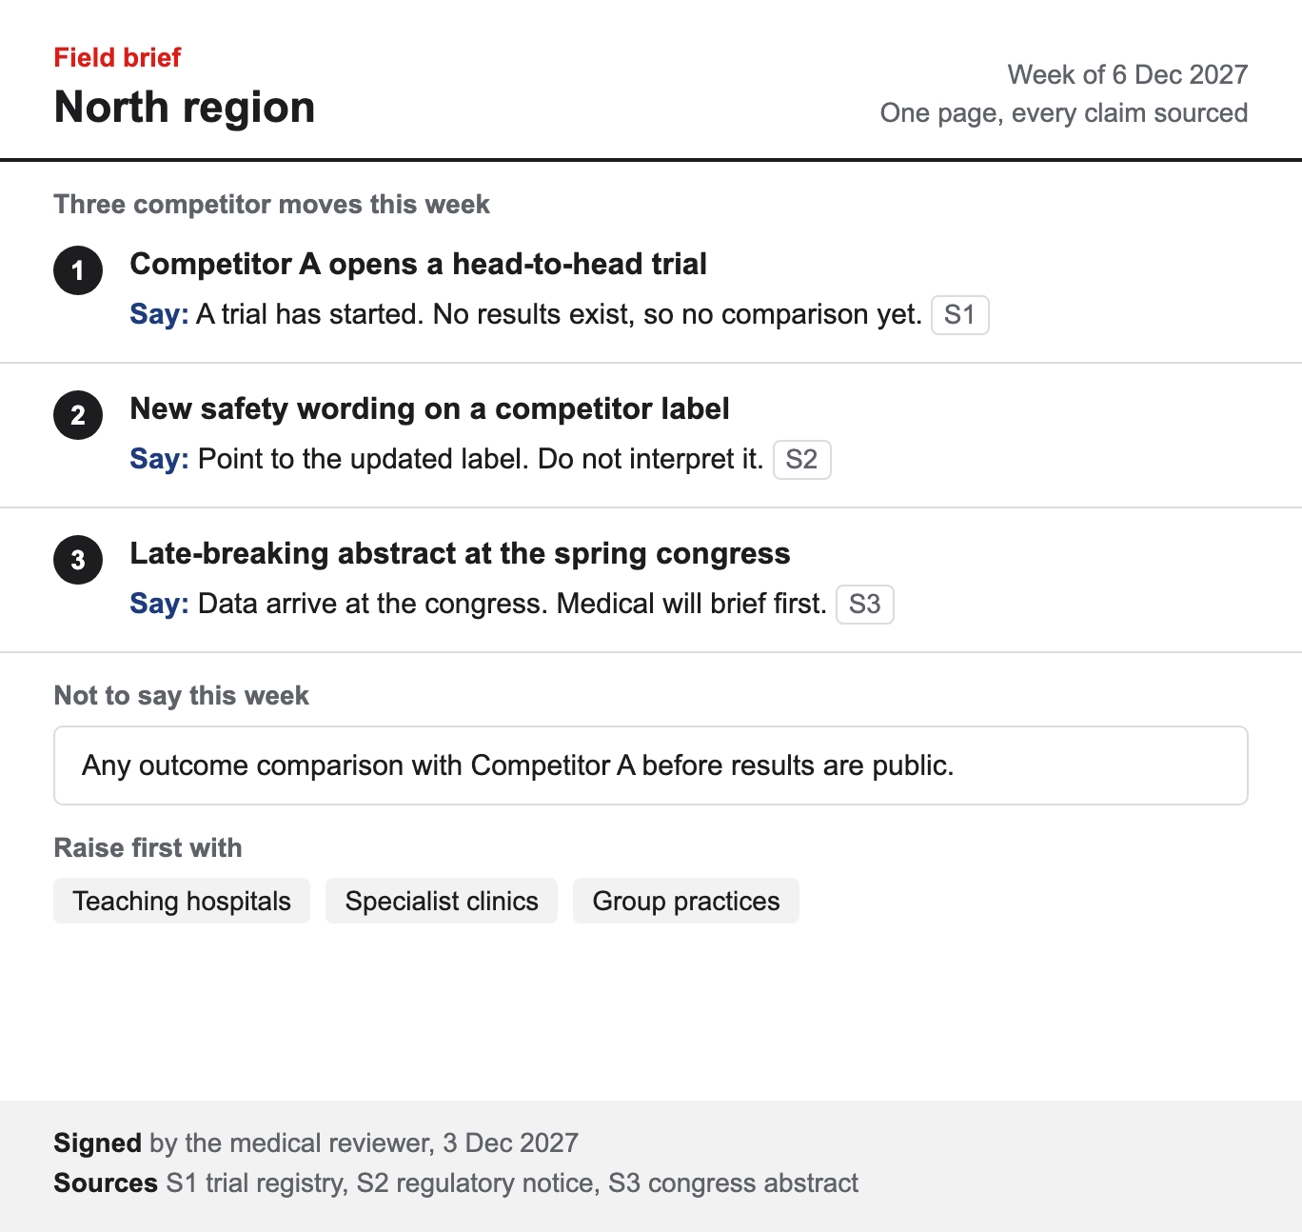
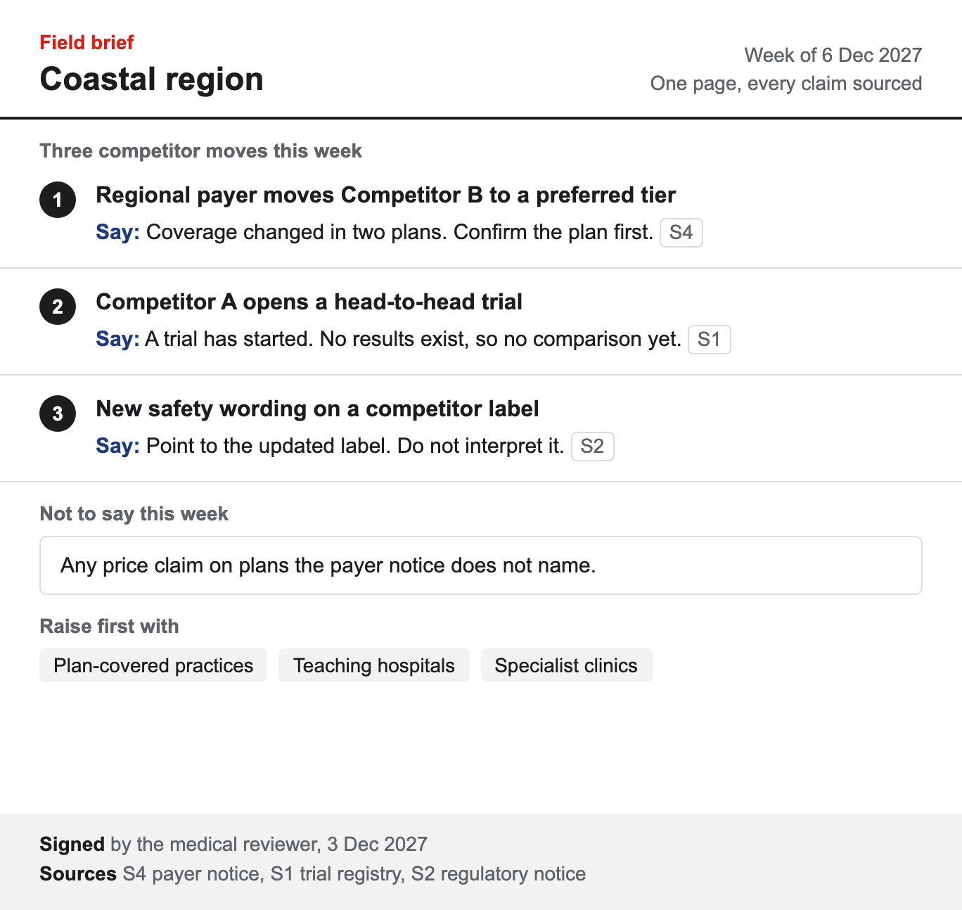
One weekly brief per region, every claim sourced

Slide 29
Six approved source types feed the scan, each with a cadence and lane
Source | What it yields | Scan cadence | Usual lane | Approved by
Regulatory notices FDA, EMA and MHRA | Label changes, approvals, safety letters, recalls | Daily | Medical claim | Medical
Trial registries ClinicalTrials.gov, EU CTR | New trials, endpoints, status and enrollment changes | Daily | Medical claim | Medical
Press releases Newsrooms and newswires | Launches, deals, data readouts, guidance | Daily | Brief ready | Field excellence
Congress abstracts Major society meetings | Data ahead of publication | Per congress | Medical claim | Medical
Payer and formulary notices National and regional plans | Coverage and price changes by plan | Weekly | Access change | Market access
Competitor websites Product and HCP pages | Messaging and program changes | Weekly | Watch only | Field excellence
Questions each brief answers
What moved this week?
Lead item at the page top
Which accounts does it touch?
Named accounts by territory
What may a rep say, and not say?
Approved lines and limits
Where is the source?
Link beside every claim
Who signed it, and when?
Reviewer name and date

Slide 30
How it is built
04
1
2
3
4
5
6

Slide 31




























Four platform layers carry every brief from public signal to field rep
Sources
Brief platform · one AWS account, eu-west-1
Field
Identity
Ingest
Store
Operations
Public web
Lake
Indexes
Field reps
Cognito
EventBridge
Lambda
Step Functions
Langfuse
Amazon S3
signal lake
AWS Glue
catalog
RDS
brief ledger
Trial feeds
OpenSearch
claim index
Field app
AWS IAM
Amazon SQS
Textract
Comprehend
AWS X-Ray
Agents
Review and serve
Payers
Web portal
AWS KMS
Models
Agents on ECS
CloudTrail
API Gateway
Review app
Bedrock
model access
Claude
drafting model
LangGraph
agent graphs
Scan agent
Writer agent
Congress media
Secrets
DynamoDB
CloudFront
AWS Config
Microsoft Teams
Delivery: build, test, release
Partner feeds
GitHub Actions
CodePipeline
Amazon ECR
Terraform
Python
CloudWatch
CRM

Slide 32








One AWS Region runs the brief service behind private endpoints
AWS Cloud · production account
Region eu-west-1 · 2 AZs
9
Field reps
1
AWS Lambda
collectors
VPC 10.20.0.0/16
feeds
Availability Zone 1
Availability Zone 2
read briefs
Public sources
2
S3 endpoint
PrivateLink
Load balancer
ALB
Agents
Data
Data
Agents
7
3
4
8
origin
raw signals
Amazon S3
Scan agent
OpenSearch Service
claim index
Amazon ElastiCache
review state
Review app
Amazon CloudFront
Medical reviewers
Bedrock endpoint
PrivateLink
NAT gateway
6
SaaS · CI
5
traces
prompt
Amazon RDS
standby
Amazon Bedrock
Claude models
Writer agent
Amazon RDS
brief ledger
Langfuse
traces
Security and operations
10
Amazon Cognito
AWS WAF
AWS KMS
Amazon CloudWatch
AWS X-Ray
Amazon ECR
GitHub Actions
image builds
1
Pull signals
2
Land raw signals
3
Read privately
4
Index claims
5
Draft the brief
6
Save the draft
7
Request review
8
Decide in the app
9
Read the brief
10
Ship images
Request or data
Event, asynchronous

Slide 33
A brief stops for medical review whenever one claim has no approved source
AWS account · private subnets, IAM roles only
Field app
React Native
API Gateway
brief API
Writer agent
LangGraph on Fargate
Amazon Bedrock
Claude models
OpenSearch
claim index
Review app
medical review
1 POST /briefs {account_id}
2 start brief run
3 plan the brief
4 tool_use: search
loop
[each cited claim]
5 search claims
6 sources, ranked
7 draft with sources
8 one-page draft
alt
[every claim sourced]
9 brief ready
[a claim has no source]
10 hold the brief
11 held for review
12 200 {brief_id, status}
Call
Reply
Event, asynchronous

Slide 34
One service sits between two kinds of user and the four systems around it
Quillmont · enterprise boundary
Medical reviewer
Person
Approves held claims
Field rep
Person
Reads the brief
approves claims · HTTPS
reads the brief
Field brief service
Software system
Drafts a sourced competitor brief every week
Public web
External system
Press, trials, congresses
Field app
External system
Existing mobile app
collects signals · HTTPS
fetches · HTTPS
drafts with Claude
Amazon Bedrock
External system
Claude models
CRM
External system
Accounts and territories
account plans · nightly
Person
Software system
External system
Enterprise boundary

Slide 35


Six numbered hops take a public signal to an approved brief
Sources
AWS account: production · eu-west-1
Field
Ingest and land
Agent zone: private subnets, egress through an allow-list
Review
Agents
4
claims
Data
Review app
React
Field app
React Native
ECS Fargate
1
2
3
5
new files
queue
Public web
press, congress
Lambda
collectors
Amazon S3
signal lake
Scan agent
Writer agent
OpenSearch
claim index
weekly run
Amazon Bedrock
6
for review
brief
invoke
updates
Claude
drafting model
Bedrock
model access
RDS
brief ledger
API Gateway
brief API
EventBridge
schedule
Platform: operations and delivery
CloudWatch
Secrets
Cognito
AWS Glue
S3 Glacier
Langfuse
Trial feeds
registries
Field reps
1,200 reps
1
Collect public signals
2
Land raw files
3
Scan new files
4
Index cited claims
5
Draft on Bedrock
6
Send for review
Request or data
Event, asynchronous

Slide 36




Four consumers take brief events and failed sends wait in a dead-letter queue
Producers
Consumers by rule
validate
bindings
Schema registry
brief events v3
EventBridge bus · brief-events
scan done
signals.scanned
start draft
Scan agent
LangGraph
Step Functions
draft run
brief.drafted
archive
draft saved
stream copy
Firehose
analytics
Amazon S3
brief archive
brief.held
claim unsupported
queue for review
Writer agent
LangGraph
Amazon SQS
review queue
brief.approved
email
reviewer approves
notify field
Review app
React
Lambda
notifier
Amazon SES
Monday email
after 3 retries
alert
Amazon SQS
dead letters
Teams
field alert
Publish
Rule to target
Schema
Dead letter

Slide 37







Private agents leave the VPC only through endpoints or the firewall
Global edge
443 allow-list
Region eu-west-1 · account brief-prod · 2 AZs
Internet gateway
Langfuse
traces
VPC 10.20.0.0/16 · 3 tiers per AZ
443
Ops · shared
Availability Zone a
443
Availability Zone b
Public
Public
AWS KMS
Route 53
DNS
Network Firewall
Network Firewall
NAT gateway
NAT gateway
Secrets
AWS WAF
web ACL
egress
egress
DNS
App
App
CloudWatch
rules
Load balancer
ALB
ECS service
Bedrock endpoint
origin
8080
2 agent tasks
Fargate
2 agent tasks
Fargate
443 TLS
HTTPS
Field reps
CloudFront
5432 TLS
Bedrock
Claude models
Data
NACL
Data
reads
no route
replica
Open internet
Aurora writer
NACL
Aurora reader
S3 endpoint
gateway
Amazon S3
brief files
Request or data
Control or configuration
Private link
Blocked path

Slide 38
Six flows cross a trust boundary, and each one carries its own control
AWS account · production, eu-west-1
Public web
press, trials
Amazon Bedrock
Claude models
5 API Gateway
HTTPS · TLS 1.3
Deliver the brief
HTTPS · OIDC · TLS 1.3
web pages
prompt
IAM role · TLS 1.3
approved brief
Monday brief
Agent zone · private subnets
PrivateLink · SigV4
1
6
10
11
1 AWS Lambda
2 Scan agent
3 Writer agent
7
4 Review queue
Field app
existing · out of scope
Collect signals
Index claims
Draft the brief
draft
Check every claim
2
4
8
9
raw signals
new files
cited claims
sources
review record
held claims
3
5
D1
Signal lake
D2
Claim index
D3
Source ledger
Medical reviewer
approves claims
IAM · endpoint
HTTPS · OIDC
Trust boundary
Trust zone
Crossing, with its control
Out of scope

Slide 39



One signed image reaches prod through four gates and is never rebuilt
GitHub · SaaS
Tooling account · shared
Dev account
Test account
Prod account · 2 waves
build fails
release held
1
GitHub
brief repo
AWS KMS
signing key
Langfuse
golden set
CloudWatch
alarms
AWS Console
manual deploy
git push
fail
sign
traces
fail
metrics
reject
roll back
2
3
4
5
6
digest
deploy
GitHub Actions
OIDC to AWS
SAST clean
Amazon ECR
images
CodePipeline
promotion
ECS Fargate
brief service
eval ≥ baseline
ECS Fargate
brief service
release lead
ECS Fargate
wave 1 · 10%
bake 60 min
ECS Fargate
wave 2 · 100%
image sha256
4f9a3c21
4f9a3c21
4f9a3c21
4f9a3c21
1
Push a commit
2
Push the signed image
3
Deploy to dev
4
Promote to test
5
Release wave 1
6
Release wave 2
Build or deploy
Fail exit or rollback
Blocked path

Slide 40



A prompt change ships only when the golden set scores at or above baseline
failed traces
Build and evaluate · dev account
Release and monitor · prod account
Offline eval · judge and score
Teams
approval ask
Amazon S3
golden set
Langfuse
online eval
240 cases
notify
Claude
judge model
DynamoDB
eval scores
answers
Amazon SNS
approval topic
approve
CloudWatch
alarms
5% of traces
Bedrock
candidate run
prompt v14
approval
alarms
≥ baseline
7
edit prompt
1
2
4
5
6
3
promote
GitHub
prompt repo
CodeBuild
eval runner
Bedrock
prompt registry
CodePipeline
release
release lead
AppConfig
prompt flag
canary 10%
ECS Fargate
writer agent
revise
1
Commit the prompt
2
Score the golden set
3
Register the version
4
Promote
5
Approve and flag
6
Serve the canary
7
Sample live traces
Build or release
Revise or retrain

Slide 41





Every brief cites certified tables built from five sources, weekly and by stream
Sources
Signal platform · one AWS account
Consume
Ingest
Bronze · raw
Silver · refined
Gold · certified
Serve
index · 60 s
stream
Firehose
60 s batches
claims
Congress media
abstracts
Kinesis
press stream
archive
index claims
OpenSearch
claim index
Writer agent
Public web
press
dedupe on key
nightly
Trial feeds
registries
append
certify
review
Lambda
collectors
Amazon S3
raw zone
Amazon S3
refined zone
Amazon S3
certified zone
RDS
brief ledger
Review app
React
Payers
coverage notices
query
filter
unlicensed items dropped
Partner feeds
file drops
trends
Athena
ad hoc
QuickSight
signal trends
Processing and governance
AWS Glue
jobs
EventBridge
weekly run
Textract
PDF text
Comprehend
entities
AWS KMS
keys
Macie
PII scan
Lake Formation
grants
CloudTrail
audit
Lineage · certified.signal_claims
raw.press_items
extract_claims
refined.claims
certify
certified.signal_claims
+14 more
raw.trial_records
dedupe_trials
refined.trials
join
Batch
Stream

Slide 42




A standby Region restores the brief service within an hour
AWS Organizations · 3 OUs, 6 accounts
Management
root · SCPs
Field reps
Security
OU
Account brief-prod · workloads OU
DNS
Log archive
Region eu-west-1 · active
Region eu-central-1 · standby · RTO 1 h
Load balancer
primary
failover
Load balancer
Audit
8080
Route 53
health checks
8080
Infrastructure
OU
Agent tasks
4 tasks
CRR · RPO 15 min
Agent tasks
1 task, warm
Network
Amazon S3
Amazon S3
5432
5432
Shared services
RPO 1 s
Workloads
OU
Aurora
writer
Aurora
replica
brief-prod
copy · daily
brief-staging
AWS Backup
vault
AWS Backup
vault
Request or data
Event, asynchronous

Slide 43



Agents cut the brief from five days to one, with review kept
Today
Changes
A
cron scripts on one VM
scheduled Lambda collectors
On-premises · one VM
runs
A
CSV
rows
feeds
Jenkins
nightly cron
Scrapers
Python, web pages
PostgreSQL
signal rows
Tableau
extracts
File share
exports
reads
post
D
C
B
B
6 regional drafts in Word
one cited draft per week
approved
PDFs
6 drafts
Field reps
Teams
channel
Email review
one thread
Analysts
6 regions
Word drafts
6 versions
Target
C
review by email thread
review app, decisions logged
AWS account · eu-west-1
runs
A
new files
claims
signals
Scheduler
weekly
Lambda
collectors
Amazon S3
signal lake
Scan agent
ECS
OpenSearch
claims
cited claims
D
B
brief
C
Field app
React Native
approved
brief
draft
D
PDF posted to a chat channel
brief in the field app
API Gateway
brief API
Review app
React
Writer agent
ECS
Bedrock
Claude models
Request or data
Control or configuration
Primary path

Slide 44

The brief graph stops for a reviewer when a claim has no source
OpenSearch
claim index
Bedrock
Claude models
RDS
brief ledger
search_claims
model call
write
brief_graph · on ECS Fargate
START
request
plan
Claude
scan_signals
tool calls
draft_brief
Claude
draft
check_claims
cite or flag
publish
write ledger
brief id
END
plan
signals
all cited
tool error
retry
revise
unsupported
approve
END
retry
at most 2
human_review
interrupt
2 failures
save state
enqueue
resume
DynamoDB
checkpoints
Amazon SQS
review queue
Review app
React
Edge
Checkpoint
Conditional edge

Slide 45























The same brief service runs on Azure behind private endpoints
Region East US 2 · zone-redundant
1
Pull signals
1
2
Land raw signals
Subscription: production · brief service
3
Read privately
Internet sources
Virtual network 10.30.0.0/16
Shared services
4
Index claims
Container Registry
10
5
Draft the brief
feeds
Integration
Agents
Endpoints
2
Storage account
signal lake
GitHub Actions
image builds
6
Save the draft
raw signals
Managed identity
7
Request review
Azure Functions
collectors
3
read
Storage PE
8
Decide in the app
Azure AI Search
claim index
Microsoft Entra ID
9
9
Read the brief
4
claims
10
Scan agent
Search PE
Private DNS zones
Ship images
Field reps
5
prompt
Azure OpenAI
drafting model
Request or data
Gateway
6
DDoS Protection
Private link
Writer agent
OpenAI PE
draft
Azure Cosmos DB
brief ledger
Azure Monitor
7
8
decision
Cosmos DB PE
Application Insights
Medical reviewers
Application Gateway
WAF
Key Vault
secrets
Review app
Key Vault PE
Log Analytics

Slide 46





On Azure, spoke agents reach models only through private endpoints
Global
Region East US 2 · 3 zones
Subscription: hub
Subscription: brief service · spoke
Entra ID
sign-in
sign-in
Hub VNet 10.0.0.0/22
Spoke VNet 10.30.0.0/16
Brief data
Gateway
Container Apps
Endpoints
443
8080
draft job
HTTPS
443
Field reps
Front Door
WAF
App Gateway
WAF v2
Review app
zones 1 to 3
Agent app
zones 1 to 3
Cosmos PE
Cosmos DB
VNet peering
Firewall
OpenAI PE
Azure OpenAI
443 allow-list
Approved APIs
no rule
egress UDR
Azure Firewall
allow-list
Search PE
AI Search
Monitoring
Storage PE
Storage
Monitor
Logs
Defender
Vault PE
Key Vault
Open internet
Request or data
Private link
Network peering
Blocked path

Slide 47
Delivery
05
1
2
3
4
5
6

Slide 48
Four phases, each closed by a signed gate before the next begins
1
Assess
2
Pilot
3
Scale
4
Run
Agree the approved source list
Run the weekly brief in North
Extend to all six regions
Ship every Monday before calls
Map the brief to each brand plan
Tune routing rules with reviewers
Add regional cuts and access notices
Review rules and sources monthly
Name the medical reviewer
Collect rep feedback each week
Train field excellence leads
Report usage and corrections
Measure today's time to field
Sign each brief before release
Hand rules to regional owners
Retire sources that add noise
GATE 1
Source list signed
GATE 2
Pilot brief accepted
GATE 3
Rollout call made
MONTHLY
Service review held
Every phase
Weekly steering
Joint, with one decision log
Medical sign-off
No brief ships unsigned
Shared backlog
Rules and sources in one list
Joint team
Firm and Quillmont roles named

Slide 49
Six regions go live on 22 Jan if the North pilot clears 18 Dec
2 Nov
9 Nov
20 Nov
30 Nov
9 Dec
18 Dec
29 Dec
8 Jan
Assess
Brief template
Feed setup
Agent build
Train six regions
9 Nov exit
20 Nov exit
18 Dec exit
North pilot run
Go-live call
29 Dec exit
8 Jan exit
Assess
Brief template
Agent build
North pilot run
Go-live call
Pick feeds, reviewers
Exit: sources agreed
One page, all sourced
Exit: template signed
Scan and writer live
Exit: agents ready
Reps use each brief
Exit: ratings in
Six teams trained
Exit: rollout agreed
Gate 1 · 20 Nov
Source list and template signed
Gate 2 · 18 Dec
Pilot briefs meet the sourcing bar
Gate 3 · 8 Jan
Rollout call, six regions live 22 Jan
Three gates decide go-live

Slide 50
Brand one reaches six regions in January, all three brands by September
Q4 2026
Q1 2027
Q2 2027
Q3 2027
Q4 2027
Oct
Nov
Dec
Jan
Feb
Mar
Apr
May
Jun
Jul
Aug
Sep
Oct
Nov
Dec
Delivery phases
Assess, pilot in North, then brand one everywhere
Run, adding brands two and three
Gates and checkpoints
Adoption check
Six regions on brand one
Brand three · Sep
Three brands, six regions
Kickoff
2 Nov 2026
North pilot gate
18 Dec 2026
Six regions live
22 Jan 2027
Brand three live
Sep 2027
Pilot gate · 18 Dec
Medical signs North pilot
Brand two gate
Medical clears brand two
Run review · Dec
First yearly run review
Brands live in field
1
1
2
3
3
North pilot only
All six regions live
Brand two in field
Brand three in field
Yearly run review

Slide 51
Four standing forums settle any brief escalation within eight days
Meeting rhythm
Escalation ladder
Sponsor council
Delivery board
Brief review
Squad stand-up
Agent engineer
1
Day 0
M
T
W
T
F
S
S
M
T
W
T
F
S
S
M
T
W
T
F
S
S
M
T
W
T
F
S
S
Solution architect
2
Day 1
Third Thursday
Alternate Tuesdays
Every Wednesday
Each weekday morning
Chair
Commercial sponsor
Chair
Engagement lead
Chair
Medical reviewer
Chair
Solution architect
Brief review
3
Day 3
Seats
Medical, legal, field and firm leads
Seats
Track leads from both sides
Seats
Legal, regulatory and agent engineers
Seats
Agent builders and data engineers
Owns
Budget and gates
Owns
Plan and staffing
Owns
Source list changes
Owns
Blockers and fixes
Delivery board
4
Day 5
Rules every forum keeps
Sponsor council
01
Every decision recorded in the brief log
02
Papers out two days before each session
03
Medical present for any content decision
04
One shared risk and issue register
5
Day 8

Slide 52
After four phases, a weekly loop keeps every brief improving
20 Nov
18 Dec
8 Jan
22 Jan
2 Nov
Sponsor and scope signed
Assess
Pilot
Scale
Run
Draft
Sign
Ship
Q1 2027
Q2 2027
Q3 2027
Feeds
Review
Reps
Connect
Write
Review
A sponsor review every quarter
Feeds and reviewers agreed
North gets a signed brief
Six regions trained
Field excellence owns service
From rep interviews and feed access
Rated by reps every single week
Rollout set for 22 Jan
Run fee covers operations and tuning
3 weeks
4 weeks
3 weeks
Ongoing
Approved source list
Signed brief in North
Regional team training
Brands two and three
Reviewer and deputy named
Medical sign-off on each
Regional cuts and notices
Usefulness dashboard
Brief template agreed
Rep usefulness ratings
Shared claim store
Source list refresh
Rep interview notes
Sourcing audit passed
Role access, full audit
Reviewer rota kept
Pilot scope signed
Pilot brief accepted
Rollout call
Every week once live
Scan
Draft
Review
Ship
Learn

Slide 53
Scope is fixed at six regions, three brands and public sources only
In scope
Out of scope
1
Six regions
North first, then Coastal, Inland, Highland, Lakeside and Delta
1
Promotional content
No customer-facing material
2
Three brands
One competitor brief per brand each week
2
Paid data feeds
Public sources unless licensed later
3
Three agents
Signal scan, brief writer and the review queue
3
CRM changes
Briefs use existing field channels
4
Governed foundation
Source ledger, claim store and audit log
4
Medical decisions
Reviewers sign, agents never approve
5
Two field channels
The existing field app and a Monday email digest
5
Other markets
No regions beyond the six
Assumptions
Reviewer time
Reviewer and deputy per brand
Source list
Medical and legal sign by 20 Nov
Access
Feeds and channels open at kickoff
Pilot reps
North reps rate every brief
Dependencies
Medical review
Signs every brief before release
Field excellence
Owns rollout and rep training
IT security
Clears agent access to feeds
Legal
Sets the claim and source rules

Slide 54
Each workstream has a defined job in every phase, under one control
WORKSTREAM
1
Assess
2
Pilot
3
Scale
4
Run
Shared control
Medical review signs every brief in every phase. Nothing reaches the field unsigned.
Signal scan agent
Agent engineer
Approve the source list
Scan feeds for every brand
Add feeds for each region
Weekly scan, repeats dropped
Brief writer agent
Agent engineer
Agree the one-page format
Draft briefs for North reps
One brief per territory
Weekly brief, every claim sourced
Review queue
Medical reviewer
Name a reviewer and deputy
Sign every pilot brief
Track review load weekly
Approve, edit or reject
Data foundation
Data engineer
Map the signal sources
Land and refine the feeds
Certify regional data
Watch freshness and access
Field release
Field lead
Pick the pilot territories
North region only
Every region live
Every rep before Monday
Exit gate
Delivery manager
Gate one, 20 Nov 2026
Gate two, 18 Dec 2026
Gate three, 8 Jan 2027
Full rollout, 22 Jan 2027

Slide 55
Why the firm
06
1
2
3
4
5
6

Slide 56
Four reasons to choose the firm, each backed by working proof
01
02
03
04
Agents already built
Scan, writer and review agents are configured, not invented
Medical review by design
The review queue signs every brief before release
One governed foundation
Every claim traces back to an approved public source
One joint team from day one
Firm engineers sit with field excellence and medical
PROOF
Running for a specialty pharma field team
OWNED BY Firm agent engineer
PROOF
No unsigned release in any delivered brief
OWNED BY Medical reviewer
PROOF
A source ledger kept for every claim
OWNED BY Data engineer
PROOF
The same team shape in every delivery
OWNED BY Engagement lead
What backs every reason
Approved source list
Medical and legal agree the feeds
Evaluation suite
Sourcing checked on every brief
Release log
Each brief kept with its signature
Access by role
Reps see only their territory
Brief archive
Every past brief, searchable
Traces and alarms
Every agent run traced and watched

Slide 57













The team already ships on the major cloud, data and agent platforms
100+
20+
~1,700
AI products delivered
production-ready agents
people
Cloud and models
Data platforms
Agents and evaluation
Delivery
Amazon Bedrock
Azure OpenAI
Databricks
Snowflake
dbt
LangGraph
LangChain
Python
FastAPI
React
Vertex AI
Claude
PostgreSQL
Dataiku
Langfuse
Anthropic API
Terraform
GitHub Actions
Amazon EKS
Claude Partner Network
Member firm
Gartner, Emerging Tech: AI Vendor Race
Named in the 2026 report
Series B, founded 2013
Head office in San Francisco

Slide 58
A specialty pharma field team cut brief lead time from four days to one
The need
What was built
The outcome
1
Briefs reached reps late
Four days from a competitor move to the field
1
One sourced brief
Every claim cites its source, on one page
Days from a move to the field
Illustrative figures
4 days
2
Eight regional versions
Every region rewrote the same weekly brief
2
Review in the flow
Medical approves before the brief goes out
One shared brief
1 day
3
Review came last
Medical read briefs after reps had used them
3
Regions add one line
Local notes ride on the shared brief
Before
After
One brief, not eight
The same reps, briefed the day after a move
Every claim sourced
Medical signs off before the brief goes out
4
No source on claims
Reps could not show where a claim came from
4
Ten weeks, three gates
Pilot in one region, then all eight

Slide 59
Four delivered briefs show the same pattern holds across sectors
SPECIALTY PHARMA
Field excellence and medical
ONCOLOGY LAUNCH
Oncology medical affairs team
BIOSIMILARS
Regional marketing leads
MEDICAL AFFAIRS
Medical information analysts
Weekly competitor brief
Congress signal digest
One regional brief
Signal triage agent
NEED
Reps heard of moves after customers did
NEED
Too many abstracts for the medical team
NEED
Four regions rewrote the same summary
NEED
Analysts read every feed by hand
DELIVERED
Scan, draft and review agents on approved feeds
DELIVERED
Congress feeds read and linked by an agent
DELIVERED
One page with a section per region
DELIVERED
A ranking agent ahead of the analyst queue
1 day
98%
1 page
60+
from signal to field
claims linked to a source
in place of four versions
signals screened each week
Illustrative
Illustrative
Illustrative
Illustrative
Shared pattern
Approved sources
Feeds agreed before the first brief
Medical sign-off
Every brief signed before release
One page
One format for every territory
Weekly cadence
In the field before Monday calls
Source ledger
Every claim traced to its source feed

Slide 60
Each Quillmont role works beside two firm roles from kickoff
The firm, six roles
Quillmont, three roles
Engagement lead
Owns scope, gates and the weekly readout
EL
Weekly steering
FL
Field lead
Sets the brief format and pilot territories
Seat on the sponsor council
Delivery manager
Holds the plan, risks and gate dates
DM
Delivery board, alternate Tuesdays
Evaluation lead
Runs the sourcing checks on every brief
EV
Brief review, every Wednesday
MR
Medical reviewer
Approves, edits or rejects every brief
Chairs the Wednesday brief review
Agent engineer
Builds the scan and writer agents
AE
Rule tuning, weekly
Solution architect
Designs the foundation and the agent flow
SA
Sign-off at each gate
DO
Data owner
Grants feed access and signs data use
Signs the source list at gate 1
Data engineer
Lands and refines the approved feeds
DE
Source review, monthly

Slide 61
One first-year price of $468K covers the build and a year of run
First-year price, $K
Illustrative figures
$468K
first-year price, build and run
Build, three gates
$180K
Build: $180K fixed
Three gates, paid at each sign-off
Run: $24K a month
From 22 Jan 2027, all six regions
From rollout, 22 Jan 2027
Run, 12 x $24K
$288K
What the price buys
Six firm roles, three client roles
One team from kickoff on 2 Nov 2026
Three gates before rollout
20 Nov, 18 Dec 2026 and 8 Jan 2027
One weekly brief, six regions
Sourced claims, medical review in the flow
First-year total
$468K

Slide 62
Every rep is briefed within a day once the six regions go live
Reps briefed within a day
1
Pilot, North region
One brand, from Dec 2026
Prove the brief in one region first
Gate: medical signs off two weeks running
Illustrative figures
1,200 reps, six regions
Reps 1,200
2
Rollout, six regions
All 1,200 reps from 22 Jan 2027
One brief replaces six regional versions
Gate: every region reads the one brief
3
Run, three brands
The same reps by Sep 2027
More brands on one service, no new team
Gate: three brands through one review queue
Today
Pilot, Dec 2026
Rollout, Jan 2027
Brand three, Sep 2027

Slide 63
Three components carry every brief from signal to signed page
Signal scan agent
Agent
Brief writer agent
Agent
Review queue
Human review
PURPOSE
Finds competitor moves worth a rep's time
PURPOSE
Turns ranked signals into a one-page brief
PURPOSE
Puts every draft in front of a reviewer
READS
Registries, press, congress and payer notices
READS
Ranked signals and the source ledger
READS
Draft briefs with their sources
WRITES
Signals ranked by brand and territory
WRITES
A draft per territory, every claim sourced
WRITES
Signed brief and a release log entry
RUNS
Daily, on approved feeds only
RUNS
Weekly, ahead of medical review
RUNS
Weekly, before Monday calls
OWNER
Agent engineer, with the data owner
OWNER
Agent engineer, with the evaluation lead
OWNER
Medical reviewer at Quillmont
Approved feeds
Ranked list
Ranked list
Draft brief
Draft brief
Signed brief
Governed data foundation
Amazon S3, four zones
Source ledger
Amazon RDS for PostgreSQL
Access by role
Amazon Cognito single sign-on
Evaluation suite
Langfuse traces and evaluations
Shared by all three

Slide 64
Four decisions by kickoff put every region on the brief by January
01
Owner
Field lead
02
Owner
Field lead
03
Owner
Data owner
04
Owner
Field lead
Confirm pilot region
Name the reviewer
Approve source list
Agree release rule
North reps receive the first signed briefs
One medical reviewer and a deputy sign briefs
Medical and legal agree the feeds
Briefs ship only after a medical signature
1,200
6
1 day
100%
What lands and when
field reps on one brief
regions briefed weekly
signal to field, from five
claims sourced and signed
Illustrative
Illustrative
Illustrative
Illustrative
2 Nov 2026
Kickoff, team named and sources agreed
20 Nov 2026
Gate one, source list signed
18 Dec 2026
Gate two, North reps briefed weekly
22 Jan 2027
Every region briefed before Monday
Owner Engagement lead
Proof Team named, data use signed, feeds agreed
If late Build waits on agreed feeds
Owner Data owner
Proof Medical and legal sign the approved source list
If late Gate one holds on sourcing
Owner Medical reviewer
Proof North briefs signed each week before Monday calls
If late Unsigned briefs stop release
Owner Delivery manager
Proof Reps in all six regions read one signed brief
If late Regions wait another cycle

Slide 65
Approve the North pilot so every rep hears competitor moves first
A sourced, medically signed brief in every rep's hands within one day of each move
Quillmont approves
Field lead, medical reviewer and data owner
The firm delivers
Solution architect, agents, review queue and data
Delivery manager, kickoff on 2 Nov 2026
Evaluation lead, sourcing checks on every brief

