Slide 1
Python Week
Day 3
Organized by Open Source Club
BGI Dept. of CSE,
Brainware Group of Institutions – SDET

Slide 2
Agenda
What is function
Defining a function
Calling a function
Function Arguments
Default Parameters
Anonymous functions
Global and local variables
Importing module
Math & Random module
Package

Slide 3
What is Function?
Formally, Function in programming language is refer as block of code or unit of code.
It helps to reuse code again & again without repeating same code.

Slide 4
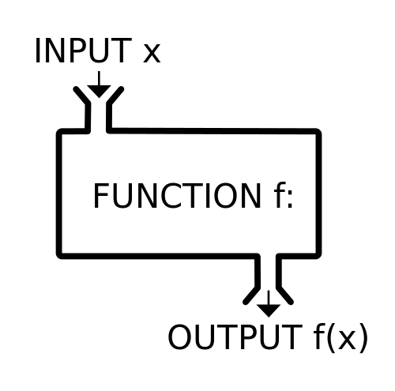
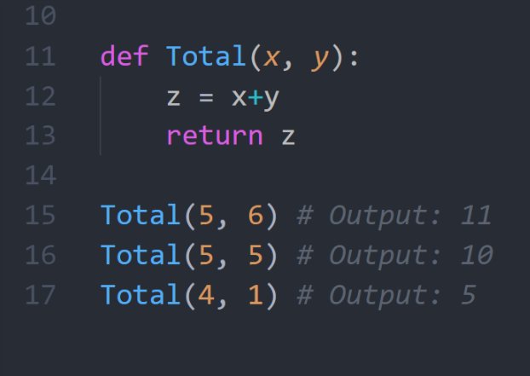
Function

Slide 5
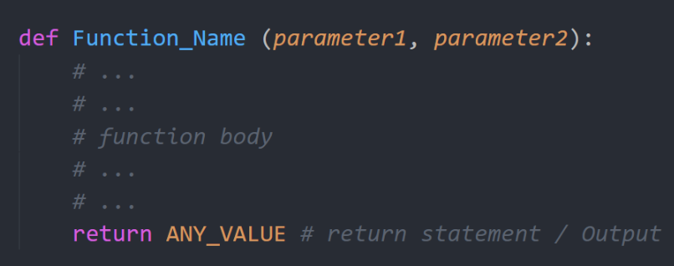
How to define a function in Python ?
Function definition starts with “def” keyword.
Keep in mind the colon(:) at end of 1st line.
The indentation in python indicates the body of function.
Return statement is optional
Number of parameters can be zero.

Slide 6
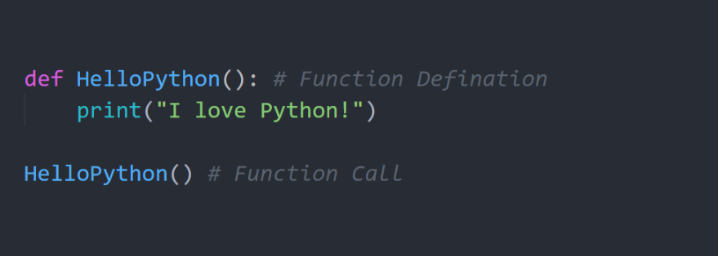
How to call a function in Python ? – Part 1

Slide 7
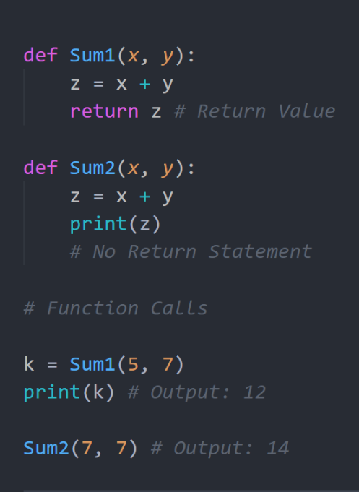
How to call a function in Python ? – Part 2
Function Definition
Function Calls

Slide 8
Demo
Basic examples of function

Slide 9
Create a function to calculate summation of two numbers .
Create a ‘SayHello’ function that takes two parameter – a greeting message & your name and returns a string by concatenate your name with the getting message.
E.g. :
Function Call: SayHello(“Hi”, “Akash”)
Output: Hi, Akash!
Practical 1

Slide 10
Optional Parameters
Python allows function arguments to have default values.
If the function is called without the argument, the argument gets its default value.
To define keyword parameters, use the form parameterName = defaultValue
Note: Optional Parameters should comes after required Parameter

Slide 11
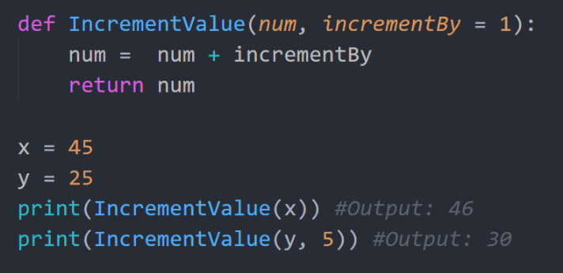
Optional Parameters in Example

Slide 12
Demo
Optional Parameter in action

Slide 13
Lets modify the last task SayHello(“Hi”, “Akash”) function and make the two parameter of function as optional parameter.
E.g. : If we don’t pass any parameter the function will return “Hello User!”.
Function Call : SayHello()
Output: Hello, User!
Practical 2

Slide 14
Optional Parameters as Named Parameters
Python allows to set optional parameters value by referring its name.
It’s really helpful when you want to leave almost all optional parameter with default value except few.
It makes code more readable .
Example: “Print” function of Python has 4 optional parameters.
print(value, ..., sep=' ', end='\n', file=sys.stdout, flush=False)

Slide 15
Demo
Demo of Named Parameters using ”print” function
Notes:
Hello-Python$

Slide 16
We’ve already implemented optional parameters in pervious practical (Practical2). Now try to pass the only 2nd optional parameter to the function by referring its name.
Practical 3
Try print(“Python”, “is”, “awesome”). Check what the output you get.
Now modify the output like this - “Python-is-awesome!” .
Hints: Use “sep” & “end” optional parameter of print function.

Slide 17
Demo of few build in function –
print
min
max
pow
help
Demo
Notes:
min(15,5,7,2,1,21,50,15,8)
max(15,5,7,2,1,21,50,15,8)

Slide 18
Anonymous functions
It is a function that is defined without a name.
In Python while normal functions are defined using the “def” keyword, anonymous functions are defined using the “lambda” keyword.
It is also called Lambda Function.
Syntax :
lambda arg1, arg2, …, argN : expression
Example :
lambda x: x * 2
Notes:
lambda is just a fancy way of saying function, in other word it is the way of defining functions inline

Slide 19
Demo
Demo of lambda Function
Notes:
lambda x: x * 2
lambda x, y : x*y
lambda x: x ** 2

Slide 20
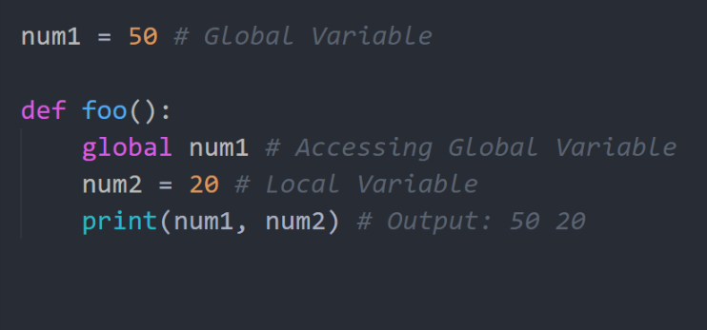
Global and local variables
Variables defined outside a function are called global variables.
Variables defined within a function are called local variables
Local variable is accessible only from where it’s declared
Global variable is accessible from everywhere inside of the program.
To access local variable from local scope we have to use global keyword.

Slide 21
Demo
Demo of Local & Global Variable
Notes:
num1 = 50 # Global Variable
def foo():
global num1 # Accessing Global Variable
num2 = 20 # Local Variable
print(num1, num2) # Output: 50 20
foo()
print(num2) ??

Slide 22
Module
A module allows you to logically organize your Python code. Grouping related code into a module makes the code easier to understand and use.
A module is a file containing Python definitions and statements. The file name is the module name with the suffix .py appended
By using the import command, we can import a specific module

Slide 23
How to import a Module ?
There are few ways to do it :
Syntax :
import ModuleName
from ModuleName import *
from ModuleName import functionName

Slide 24
Demo
Import Math Module

Slide 25
Demo
Import Random Module

Slide 26
Package
A Package contains multiple modules.
Each package in Python is a directory which MUST contain a special file called __init__.py. But this file can be empty
When you’re importing any package, python first execute __init__.py file.

Slide 27
Demo
Create a own Package

