Slide 1
OBSERVATIONAL MEMORY
Curating Agent Memory
Retention · Live-Context Retrieval · Human-in-the-Loop Feedback
Agent-Agnostic Observational Memory
Ritwik Ghosh Intern EF 412

Slide 2
Why Curate Agent Memory?
Not either / or — both goals matter at once.
⚡
Save Tokens
🎯
Prevent Misleading Context
• Context windows are finite — every stale token evicts a useful one.
• You pay per token, on every single prompt.
• Latency scales with prompt size.
• Curation drops duplicate & low-value memory before injection.
• Stale insights rot — renamed files & moved routes silently mislead.
• Off-topic recall derails the model's reasoning.
• Blue-heavy cosine similarity alone can't tell relevant from related.
• Curation demotes unverified, off-topic, low-confidence memory.
Curation = feed the model less, but righter.
Ritwik Ghosh Intern EF 412

Slide 3
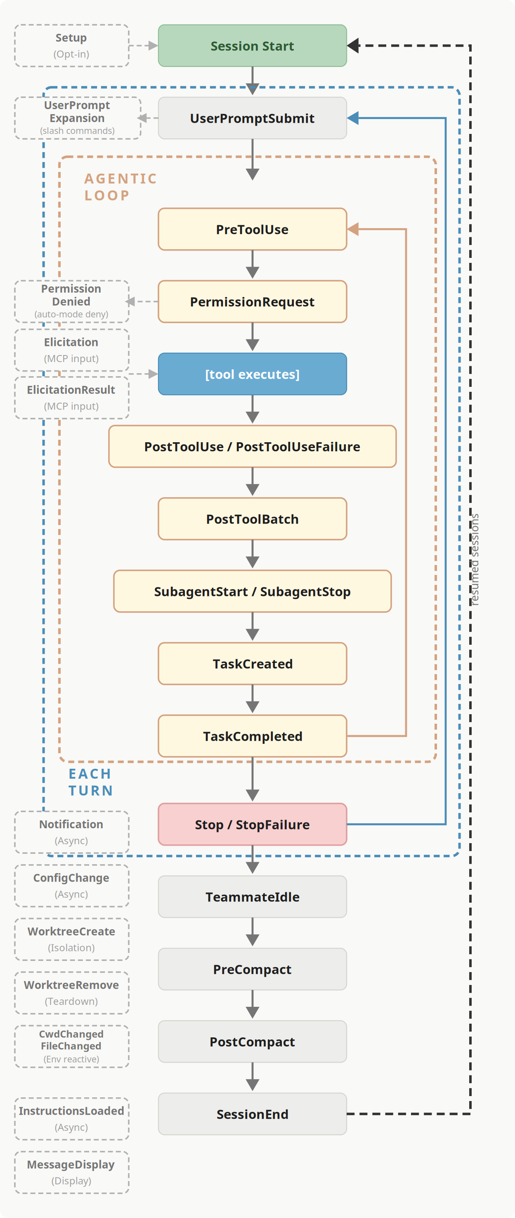
The Agent Lifecycle — Two Hook Points
Memory is curated at exactly two events in every turn.
UserPromptSubmit → Knowledge Injection Hook
• Fires BEFORE the model sees the prompt.
• Retrieves Working + Observational memory for the draft query.
• Injects the token-budgeted, ranked context into the turn.
PostToolUse → Knowledge Retention Hook
• Fires AFTER each completed exchange / tool result.
• Captures the Intent / Approach / Artifacts / Result summary.
• Fire-and-forget hand-off to the Observation Writer (never blocks).
Ritwik Ghosh Intern EF 412

Slide 4
Three-Tier Observational Memory
Rising abstraction & persistence ↑ — falling volume ↓
1
Observations
2
Digests
3
Insights
• Per-exchange structured summary
• Intent / Approach / Artifacts / Result
• Created real-time, per prompt-set
• Fire-and-forget · ~30 / day
• Daily thematic work-session summary
• Groups a day's observations by theme
• Created end-of-day (cron or manual)
• ~7 / day
• Durable, self-verifying knowledge article
• Purpose / Architecture / Key files / Usage
• Created weekly · when ≥ 5 new digests
• Confidence decays −0.05 / week · ~10 total
Ritwik Ghosh Intern EF 412

Slide 5
Memory Introspection → Live Memory Context
Inspect before you Submit.
Rationale
Benefits
• See exactly what memory a draft prompt will pull — before pressing Enter.
• Spot irrelevant or duplicate hits your wording attracted.
• Rephrase the query to steer retrieval: sharper keywords, tighter scope.
• Tune thresholds live — the preview reads the same settings file as the real hook.
• Fewer tokens wasted on irrelevant memory.
• Higher-signal context → more accurate answers.
• Query rephrasing is a cheap, immediate control lever.
• Confidence that the injected context is the right context.
Draft → Inspect → Rephrase → Submit
Ritwik Ghosh Intern EF 412

Slide 6
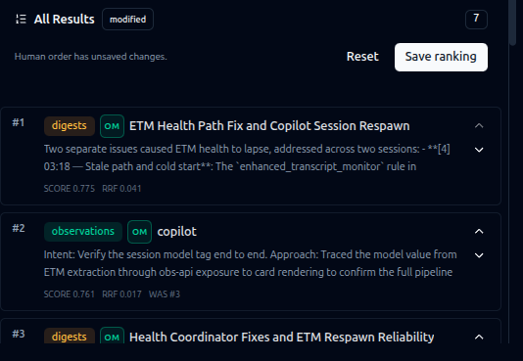
Human-in-the-Loop Feedback
A human reorder becomes a learned, decaying rerank boost.
• Drag results into the order you actually wanted.
• “Save ranking” captures ONE feedback event: the query + the reorder.
• Stored as a query-keyed vector in human_rerank_feedback (Qdrant).
• Next similar query → learned rerank nudges those items × 0.90–1.25.
• SCORE / RRF / WAS badges expose exactly how each item moved.
Ritwik Ghosh Intern EF 412

Slide 7
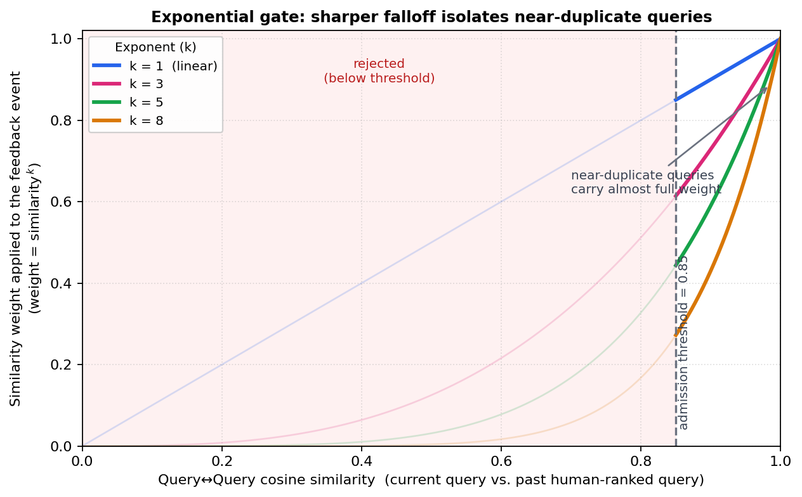
Near-Duplicate Isolation — the Exponential Gate
Only queries above the 0.85 floor count — and the exponent decides how much.
• Gate 1 — hard admission floor at 0.85 cosine; below it, an event is ignored entirely.
• Gate 2 — weight = similarity ^ k reshapes the narrow admitted band (0.85–1.00).
• k = 3 (default): 0.86³ ≈ 0.64 vs 0.97³ ≈ 0.91 — gap widens 0.11 → 0.27.
• k = 8: 0.86⁸ ≈ 0.30 suppressed; only near-identical queries survive.
cosine → k=1 k=3 k=8
0.86 0.86 0.64 0.30 (related — fades)
0.97 0.97 0.91 0.78 (near-dup — kept)
Ritwik Ghosh Intern EF 412

Slide 8
Thank You
Curating Agent Memory — Retention, Retrieval & Human Feedback
Ritwik Ghosh Intern EF 412

