Slide 1
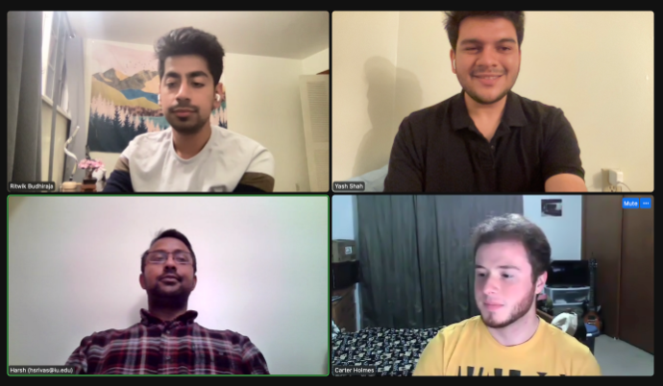
HCDR Project
Group 32
Ritwik Budhiraja, Carter Holmes, Yash Shah, Harsh Srivastava

Slide 2
Outline
Overview of the 4P’s of Phase 3
Our Approach
Results & Discussion
Final Thoughts & Next Steps

Slide 3
4 P’s of Phase 3
Past:
More feature engineering, selection, and analysis
Hyperparameter tuning
Present:
Deep learning model (ANN)
Kaggle submission
4 P’s
Proposed:
More visualization functions
Better parameters
Problems:
Neural network implementation

Slide 4
Our Approach
The goal of this project is to create an effective classification system for determining a client's financial ability to pay their debts.
In order to find the best solution, we will investigate a variety of machine learning methods, from traditional machine learning to deep learning, feature engineering, and hyperparameter searches.
Our first attempt was with three algorithms: logistic regression, Gaussian Naïve Bayes, and random forest. In the next phase, we performed hyperparameter searches and feature engineering in order to increase the model’s accuracy. Finally, an artificial neural network was implemented, which further increased the accuracy of the model.

Slide 5
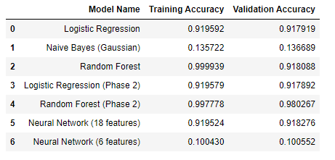
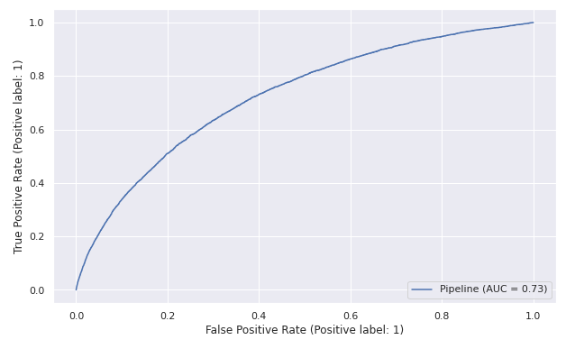
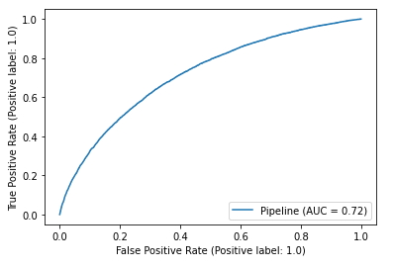
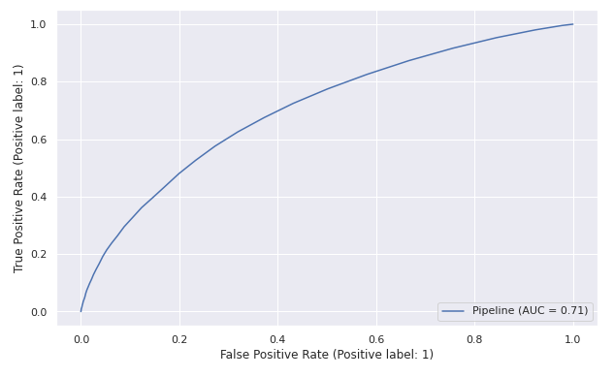
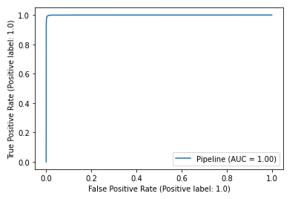
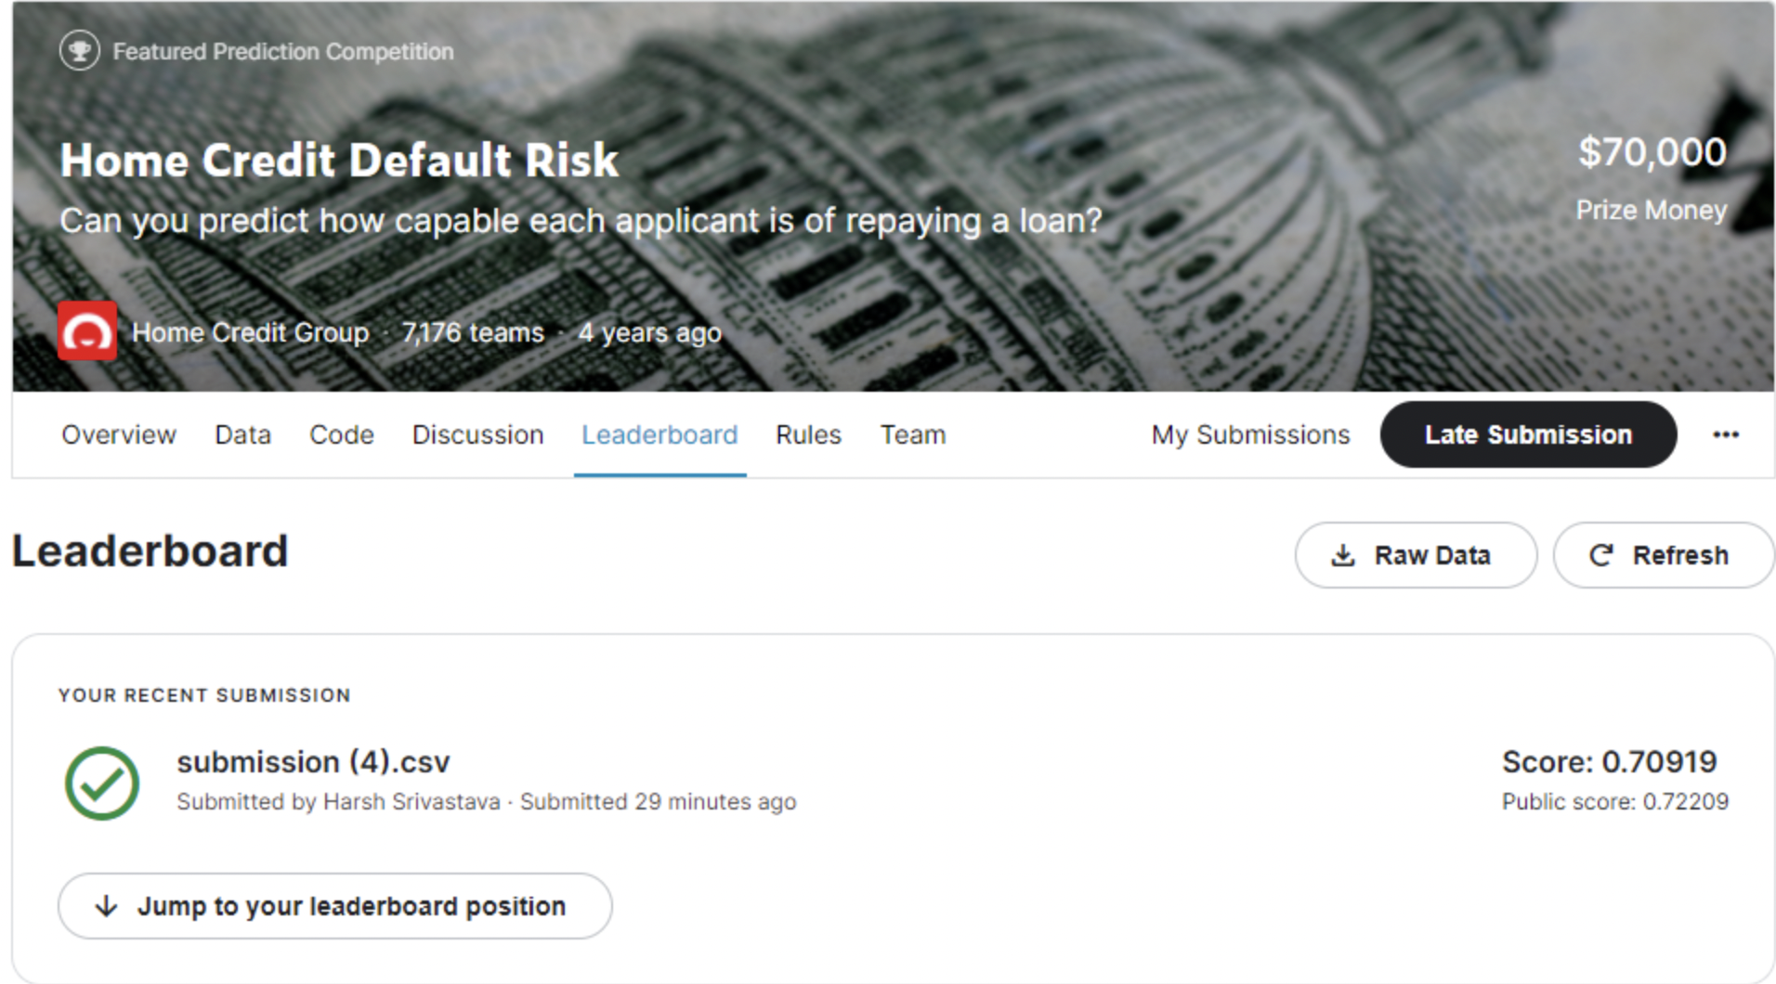
Results

Slide 6
Final Thoughts and Next Steps
Our model predicted the data very well at all steps in the project. The neural network ended up being the most accurate model that we implemented. Our final submission to Kaggle reached a public score of 0.72209.
For future work, we plan to work on neural networks further to produce better parameters. We also want to perform more visualization functions to improve the readability to analyze more trends, implement more bagging and boosting methods to try to get a better result.

