Slide 1

MINOR PROJECT : MOVING AVERAGES AND STOCK TRADING
Group id: CSEIP18
Project Supervisors: Mr. Ashish Sharma (Guide)
Dr. Sandeep Tayal (Co-Guide)
Team Members:
Nikki Goel(36114802717),
Ritwik Budhiraja(36514802717),
Parul Bhardwaj(36214802717)

Slide 2


What are stocks?
The stock market is a complex, non-stationary, chaotic, and non-linear dynamic system.
Forecasting stock market, currency exchange rate, bankruptcies, understanding and managing financial risk, trading futures, credit rating, loan management, bank customer profiling, and money laundering analyses are the core challenging tasks to be considered.
Stocks are bought and sold predominantly on stock exchanges, though there can be private sales as well, and are the foundation of many individual investors' portfolios.
These transactions have to conform to government regulations which are meant to protect investors from fraudulent practices.
Historically, they have outperformed most other investments over the long run.
These investments can be purchased from most online stock brokers. Stock investment differs greatly from real estate investment.

Slide 3
Why our model?
Many efforts are made daily by traders to maximize their profit, for which they make use of numerous manual indicators to predict the behavior of the stock market.
Our model proposes to achieve profits automatically, without any human intervention, in which we use cross-overs of moving averages 9 and 21 to decide whether to buy or sell
Manual indicators are not accurate enough and can easily lead the traders to make the wrong decision. In this paper, we aim to outperform previous results by using the cross-over strategy.
Further to train our model, we utilize the dataset of Reliance intra-day trading for the past three months. We implemented different algorithms on this dataset, for example, intersection of moving average 10 and close price, intersection of moving averages 12 and 26, etc.
We got the most optimal result using moving averages 9 and 21 on this dataset.

Slide 4
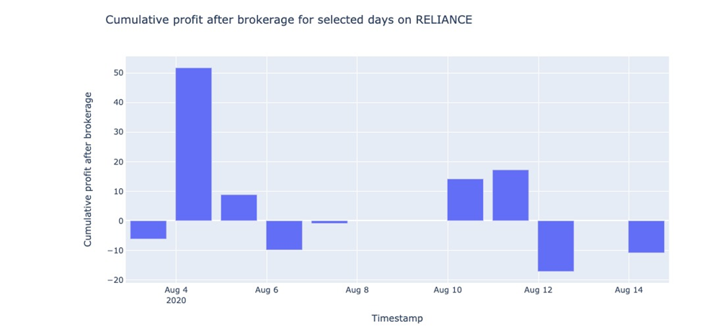
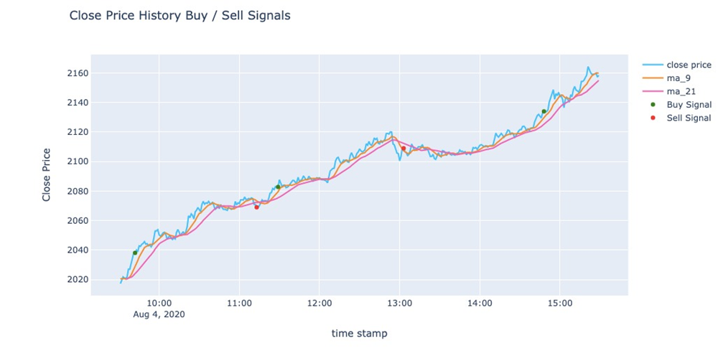

Slide 5
The dataset
We crawled historical data till date from Zerodha. It included the following columns:
scrip id: It displays the unique ids assigned to different stocks.
scrip name: It displays the names of different stocks.
Timestamp: It displays the timestamp at any particular moment with a 1-minute separation between 2 timestamps.
close price: It displays the final price value of stocks in that particular minute.
high price: It displays the highest price value of stocks in that particular minute.
low price: It displays the lowest price value of stocks in that particular minute.
Volume: It displays the number of shares transacted in that particular minute.

Slide 6


Data Analysis
Here two columns were made: one for moving average of time period 9 minutes(ma9) and the other one for moving average of time period 21 minutes(ma21).
These two moving averages have been used throughout our research and experiment.
Next step was finding out successive differences between these rows of moving averages and finding out the percentage change between them.
Then we made a function to split the dataframe in sub-dataframes on the basis of frequency.
For example, frequency = 1 would divide the dataframe into a list of sub-dataframes, each representing the total time of 1 day.

Slide 7
Data Visualization
We made two different functions in our file to create two different graphs. Both the graphs were made using plotly, an interactive visualization library of python
The following graphs were plotted:
A graph used to display closing price, ma9, and ma21 values for a given time period. It also includes ‘buy’ and ‘sell’ decisions indicated by ticks.
A graph used to display cumulative profit after brokerage for different days over a period of time.
Plotting interactive graphs -> moving average % vs time
closing price vs time
subplots

Slide 9



Slide 10
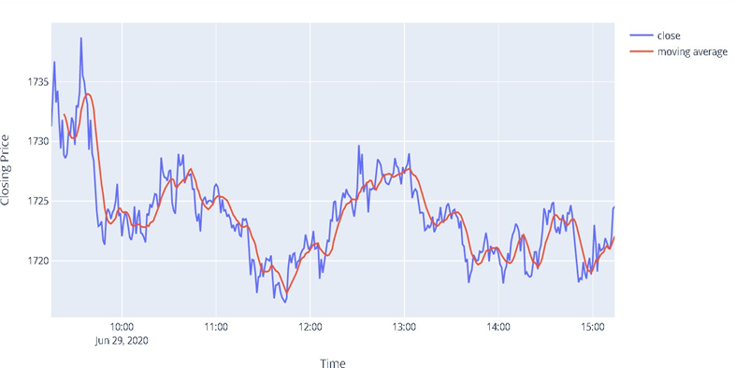

Slide 11
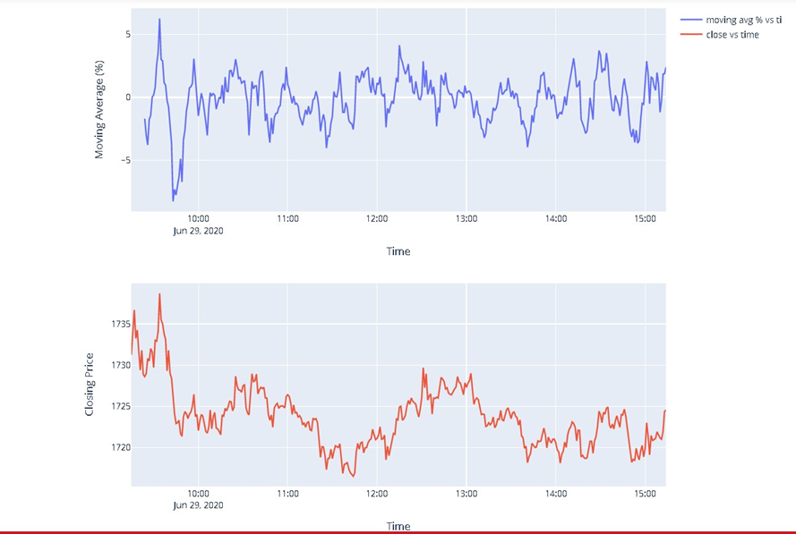

Slide 12
The Algorithm
We chose reliance and found the optimum values for stop loss (a value used to reduce the amount of loss, if any incurred.) and buffer (a value used to prevent losses because of the volatility of the market).
The driver algo along with the optimum values of stop loss and buffer was then made to iterate through this dataframe and all the decisions were made on this dataframe only.
Moving averages of time period 9 minutes and 21 minutes were used.
First, on encountering a ‘Crossover’ of these two moving averages, it was checked whether the value of ma9 was increasing than ma21 after intersection and quantity_stock !=1 or the value of ma9 was decreasing than ma21 after intersection and quantity_stock !=-1.
If yes, it was followed by checking whether the area between ma9 and ma21 > decided buffer value.
On the basis of this, the decision to ‘buy’ or ‘sell’ was made

Slide 13
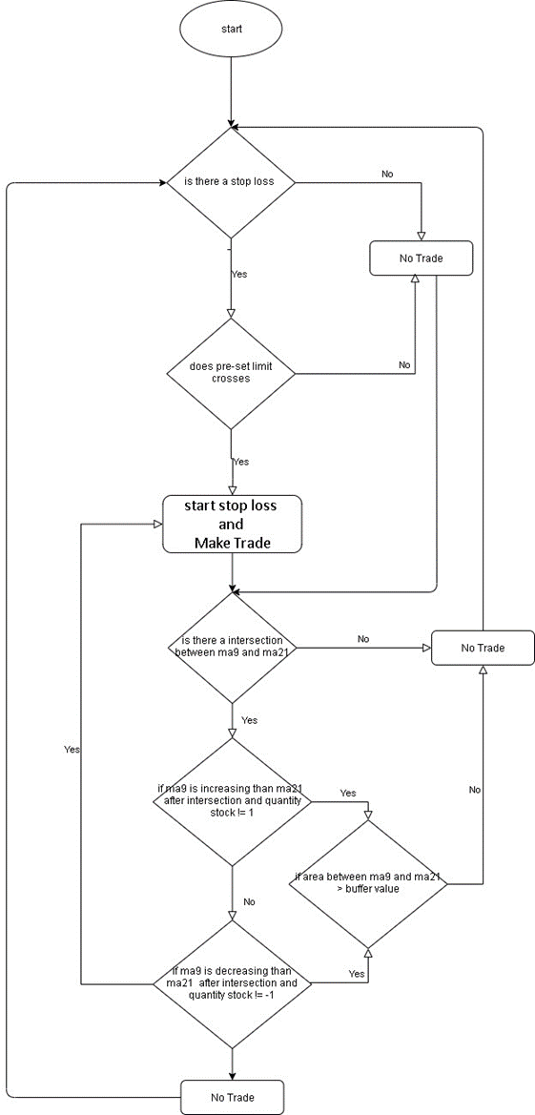
Flowchart of the model

Slide 14
Result and Discussion
We wanted to prove the efficacy of cross over automated algorithm for maximizing cumulative profit after brokerage. the model needs to be robust enough to fluctuations in the stock market in the real-world environment.
The dataset contained the past 6-months real-life data of various companies that were used to study the stock market in a diverse set of environments and backgrounds.
Cross over strategy was chosen as it is good at detecting even small fluctuations in the trend of the stock market; it is fast and accurate, as a result of which, the algorithm can make decisions that lead to the maximum cumulative profit after brokerage.
Our results indicate that the cross over strategy automated algorithm is indeed a trustworthy tool when it comes to making decisions in the stock trading world, as you will see in this result section below.
The data was scraped from Zerodha API; Zerodha is a trading platform. Then a new file was made for this data and imported to postgress to get the data in RDBMS format.

Slide 15
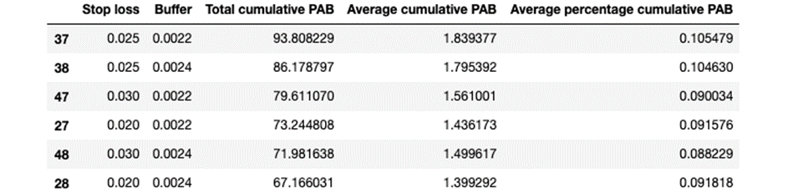
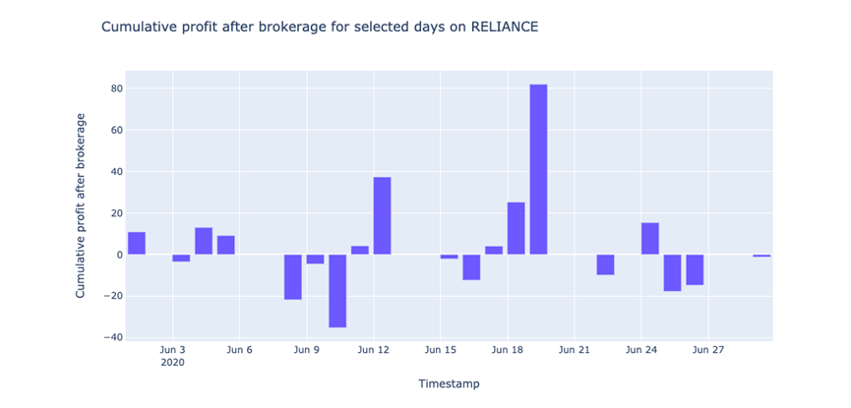

Slide 16
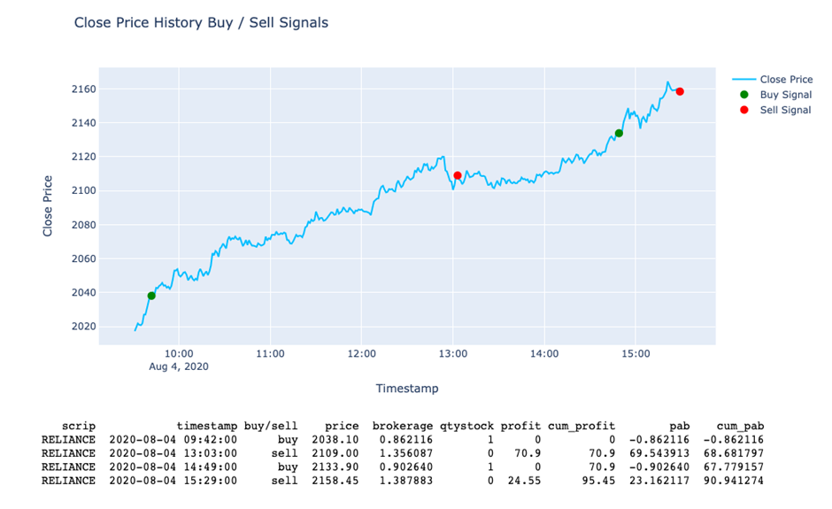
Example of transactions for one day

Slide 17

Conclusion
The main motive of our experiment is to prove the capability of our automated intra-day trading algorithm.
Automated algorithms are comparatively error-less and easier to implement than manual indicators.
Our algorithm delivers a substantial profit of ₹93.80.
We believe the reason behind this is that our model makes use of a dataset comprised of past 3 month data from reliance to understand the stock trading platform better.
According to this study, our model outperforms manual indicators in the above-mentioned factors and provides an accurate method for maximizing profit.

