Slide 1
EFFECT OF COVID19 ON POLLUTION

Slide 2
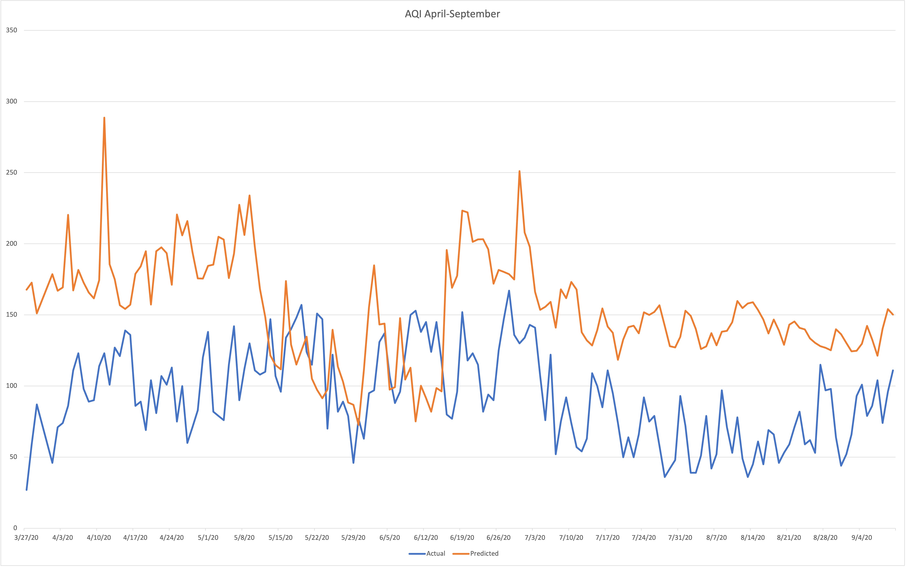
TASK 1

Slide 3
The first task was to forecast AQI for the period: April 2020 to September 2020. The pandemic first hit the world during this time, and a strict lockdown was imposed in Delhi, India.
The range of historic data taken was from 2014 to March 2020.
On comparing this predicted data with the actual data, it can be seen that the pollution was supposed to stay high as usual, but it actually went down significantly.
This was mainly due to the fact that during the lockdown, the number of vehicles on the road was much less, and all the pollution-causing activities were at a new low.

Slide 4
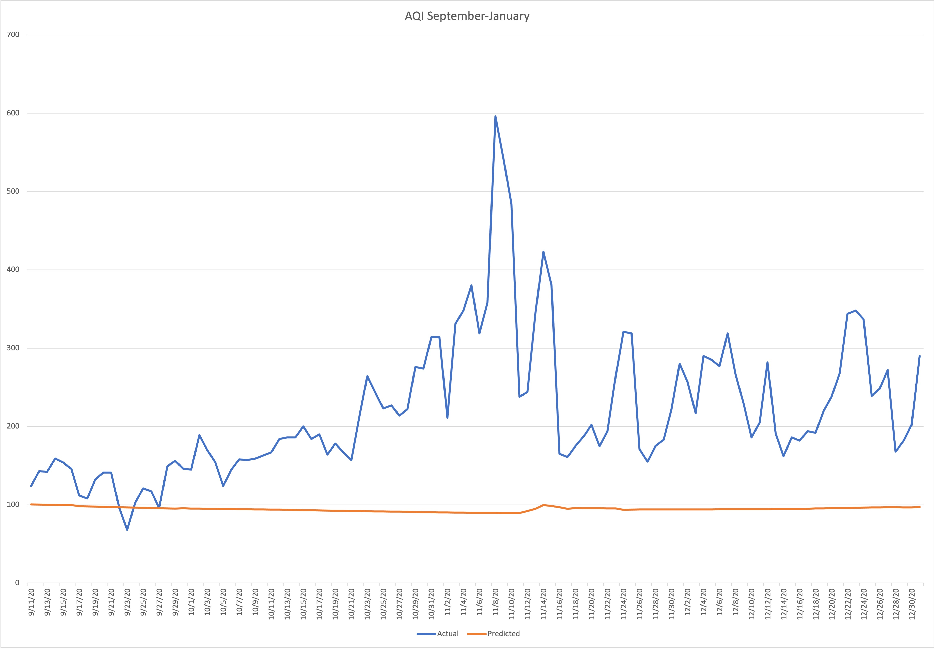
TASK 2

Slide 5
The second task was to forecast AQI for the period: September 2020 to January 2021 (excluding). By this time, all the rules and regulations had been gradually removed, and normal activities were about to resume in Delhi, India.
The range of historic data taken is from March 2020 to September 2020.
On comparing this predicted data with the actual data, it can be seen that the pollution was supposed to maintain the downward trend, but it actually went up significantly.
This was mainly because as the lockdown was removed, the number of vehicles on the road increased, and everything was back to normal.

Slide 6
Thus, COVID19 played a significant role in affecting the pollution in the world.

