Slide 1
Out of sample analysis of Pfizer
FINANCIAL ECONOMETRICS
ECON-M 524
Ritwik Budhiraja
INDIANA UNIVERSITY BLOOMINGTON

Slide 2
OVERVIEW
Introduction
Data Description
Methods
Results and Conclusion
Future Scope

Slide 3
INTRODUCTION
SECTION:1

Slide 4

Pfizer is a multinational pharmaceutical company that has been in the news lately. This project aims to compare different out-of-sample models to find out which model closely follows the actual value of the Pfizer stock (PFE).

Slide 5
DATA DESCRIPTION
SECTION:2

Slide 6
The dataset was downloaded from Yahoo finance.
It contains historic data on the quarterly price and dividend values of the PFE stock ranging from 1985 to the present.
The dataset required some initial data processing:
- Two separate datasets were downloaded for the price and dividend values which were later joined.
- Since the dividend values are updated each quarter, the price values were manipulated in such a way as to match the frequency of the dividend values.

Slide 7
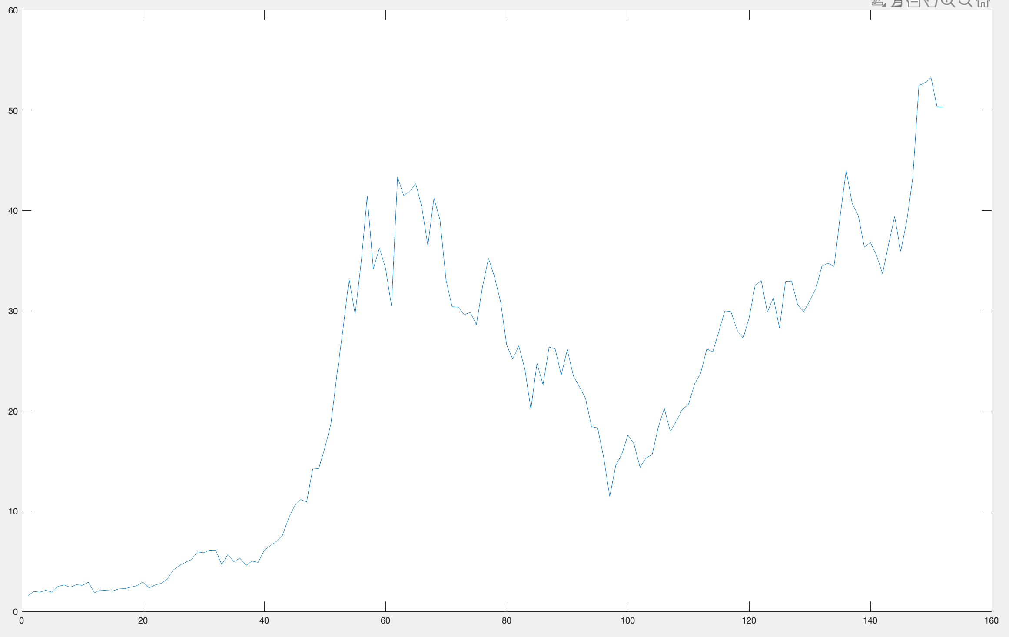
I chose this stock thinking of the volatile impact of COVID, but there was an interesting boom in the stock's price around the 1990s. On researching more about it, I found out that it was due to some strong product launches such as the anti-inflammatory medicine Feldene.

Slide 8
METHODS
SECTION:3

Slide 9
I have used three algorithms to predict the latter 50% of my data:
Historical mean: This method takes the mean of the previous target values to predict the current value.
Direct method: This method uses the previous predictors and the target values to estimate the model for the current value.
Moving average: This method finds the rolling means of a few previous target values to predict the current value.
I have compared all these models for two different setups of Horizon-h regression: 1 and 12.
Furthermore, I have tried two different window sizes of moving averages: 10 and 50.

Slide 10
RESULTS AND CONCLUSION
SECTION:4

Slide 11
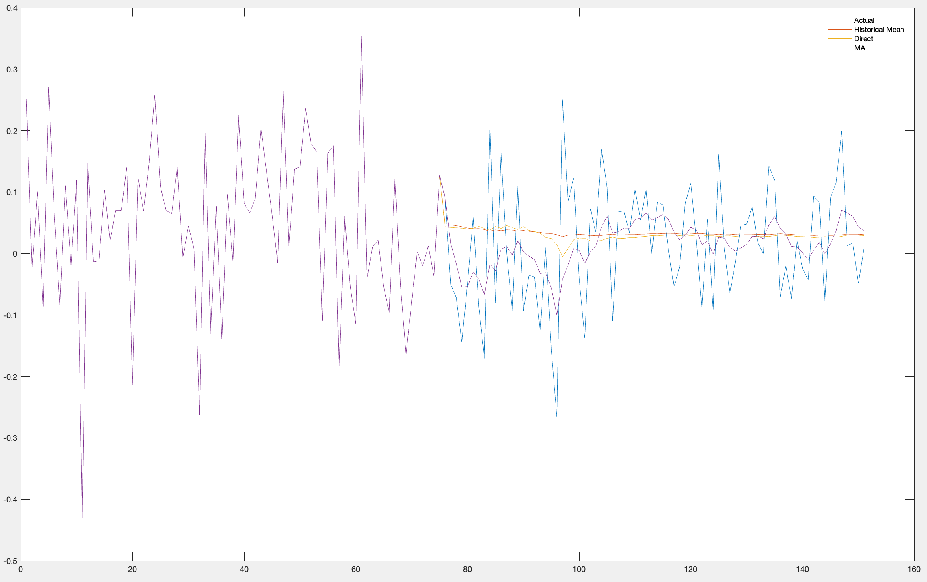
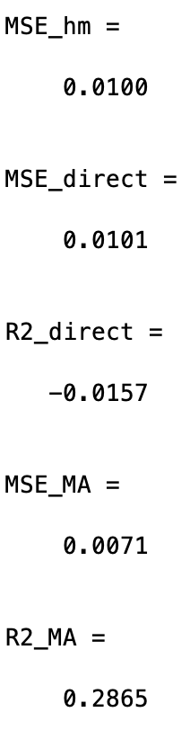
HORIZON – 1 | MA 10

Slide 12

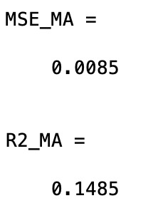
HORIZON – 1 | MA 50

Slide 13
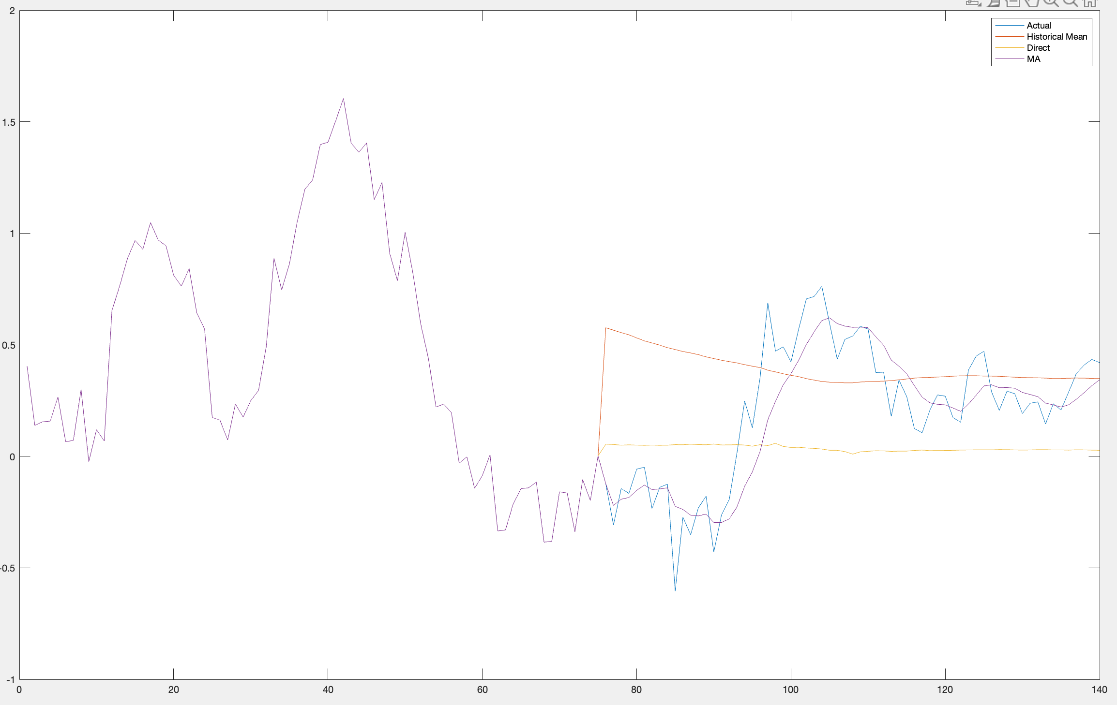
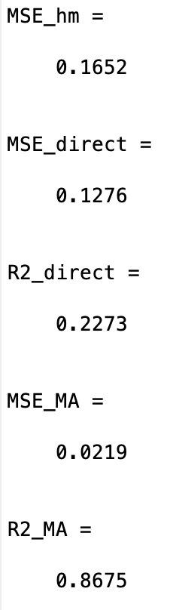
HORIZON – 12 | MA 10

Slide 14
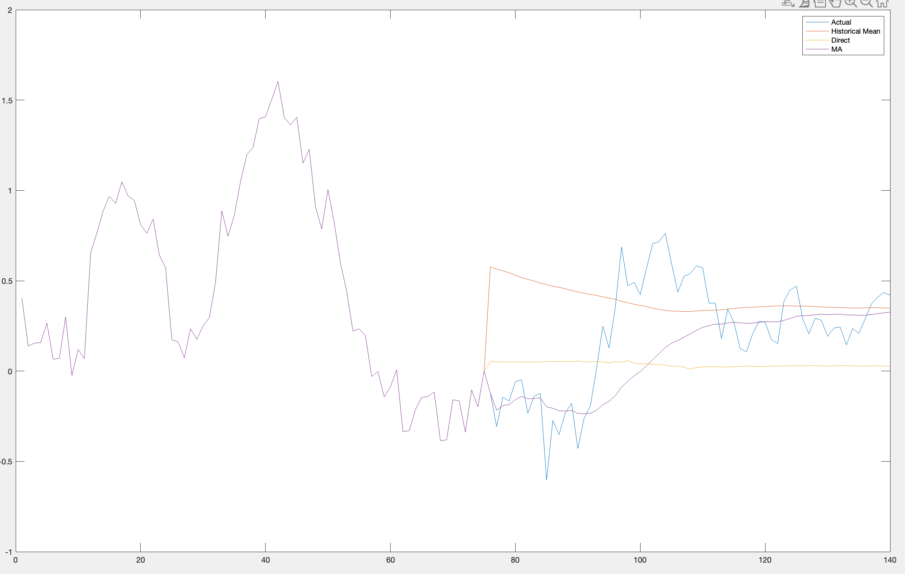
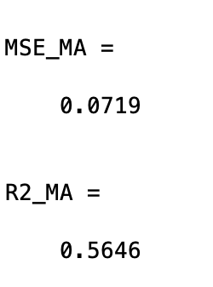
HORIZON – 12 | MA 50

Slide 15
It is evident that the historical mean and the direct method fail to make any good predictions in all scenarios. This could be probably because of the short size of the data.
Moving average closely follows the actual values of our target variable. That is because the mean of only a previous few values is used to perform the prediction.
The smaller the moving average window, the more local the prediction.
Out-of-sample R-squared is used to measure the performance of each model. Mean squared error of the historical mean method is used as a benchmark.
In the case when h was equal to 1, the direct method performed even worse than the historical mean method, and the R-squared value for it was negative.
The best R-squared value was achieved when h was 12, and the moving average window size was 10. This is because the prediction was more local to the neighboring points due to the small size of the moving average window.
Based on this information, dividend price ratio wasn't a good predictor for my data and moving average performed the best out of the models in hand.

Slide 16
FUTURE SCOPE
SECTION:5

Slide 17
Models like ARMA, ARIMA, and SARIMA can be used to capture further seasonality in the data.

