Slide 1
COVID19 Workbook
File created on: 6/8/22 12:25:16 AM GMT+05:30

Slide 2
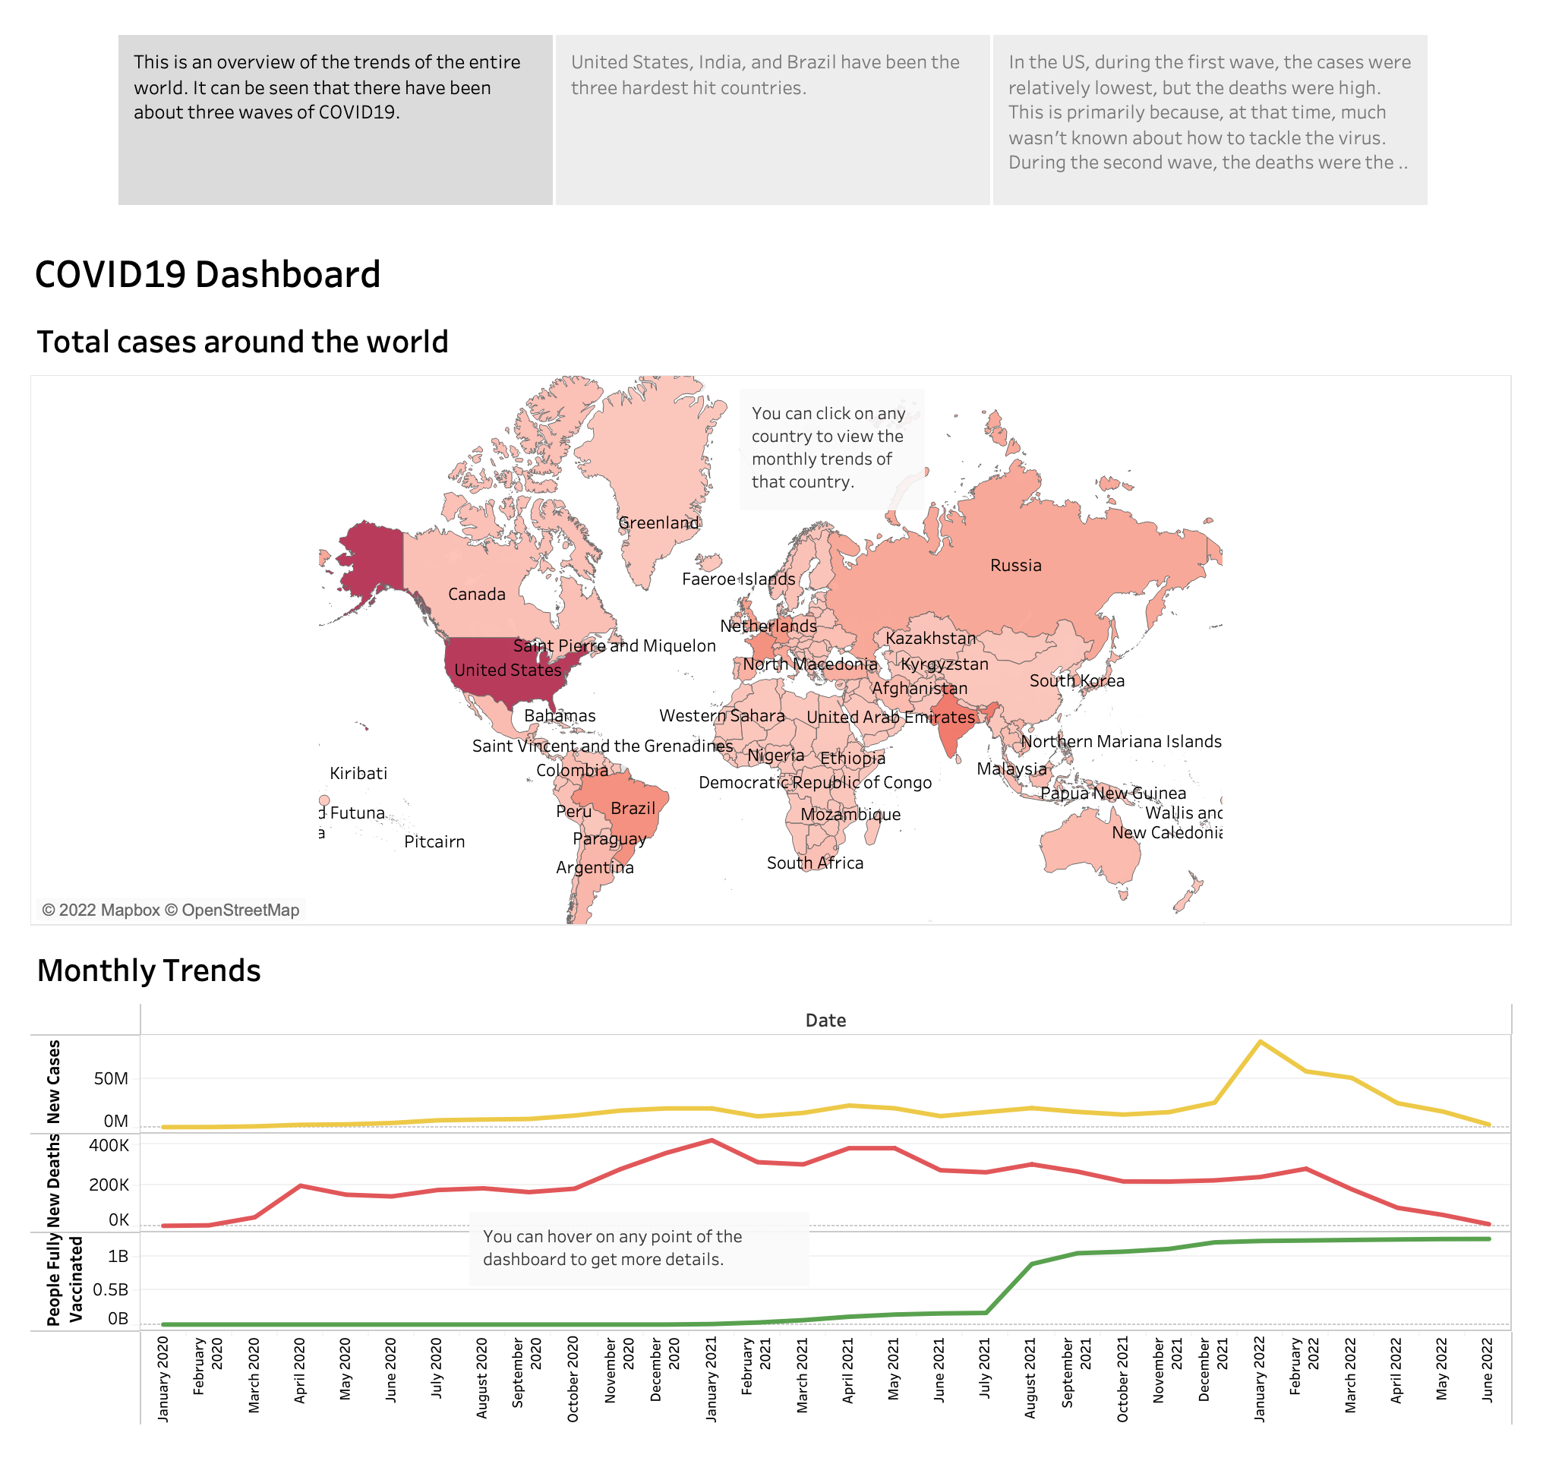

Slide 3
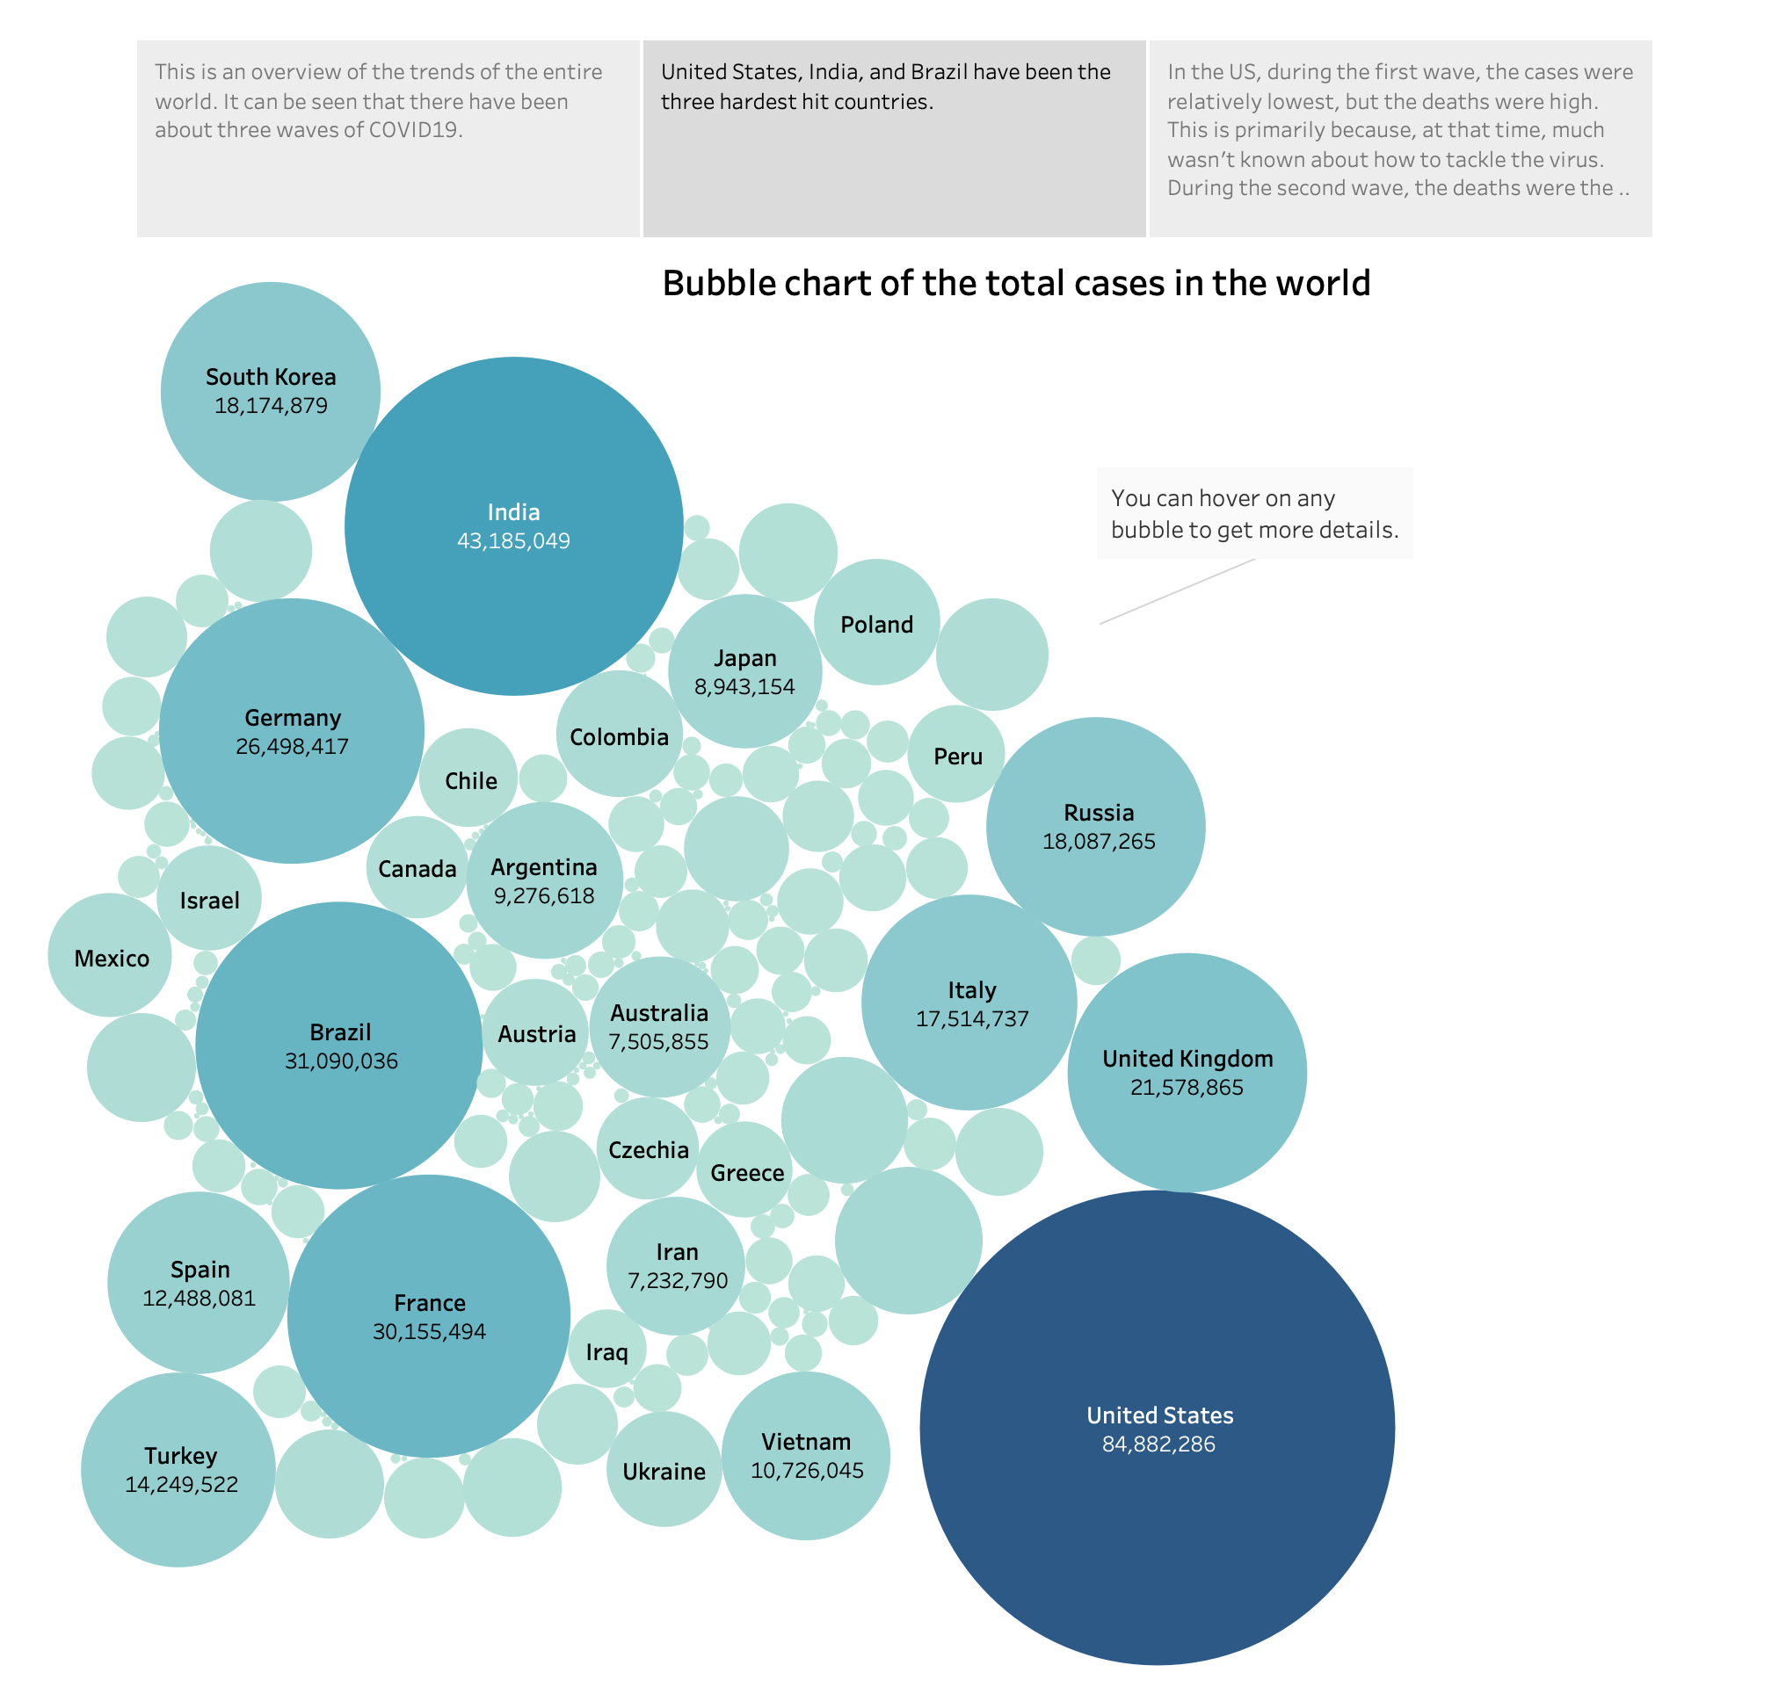

Slide 4
