Slide 1
SPRINT 3 · 05.06.2026
BLADE LOOP
3D process plant modelled in Blender — four stages,
ready for Unity scene assembly.
GROUP 4 — WinDECEE · DE-PROJECT SS 2026 · OvGU MAGDEBURG
Notes:
Hello. We're Group 4 — WinDECEE. Six of us total, four DE students and two from Chemical Engineering. Quick context — at our kickoff we presented a different concept focused on comparing three recycling routes side by side. After looking more carefully at the course brief and at what past project groups have built, we realised our concept was leaning more towards a comparison dashboard than a process visualisation. So we pivoted. The pivoted Blade Loop keeps the spirit of the original idea, but the core is now a single specific chemical engineering process — thermal co-processing of decommissioned wind turbine blades — visualised so that anyone, even without a chemistry background, can understand how blade waste becomes useful material for the cement industry. Today we'll walk you through: the work plan, who's doing what, our first wireframe, and one open question on deployment we'd like your input on. About ten minutes total.

Slide 2
AGENDA
01
Where we left Sprint 2
recap · committed stack · live URL
02
Sprint 3 progress
3D models in Blender · four stages rendered · DE and CEE
03
Unity handoff
FBX export · URP scene · context dossier
04
What's next
Sprints 4–6 — Unity build, schema handoff, drill-down
2 / 6
BLADE LOOP · SPRINT 3
Notes:
Quick agenda. Four things. First, what we're building — the project concept after our pivot. Second, who's doing what — task division across the team. Third, our first wireframe — this is genuinely a first concept, expect it to evolve. Fourth, one open question we'd like your input on at the end. We've kept this short — total time around ten minutes.

Slide 3
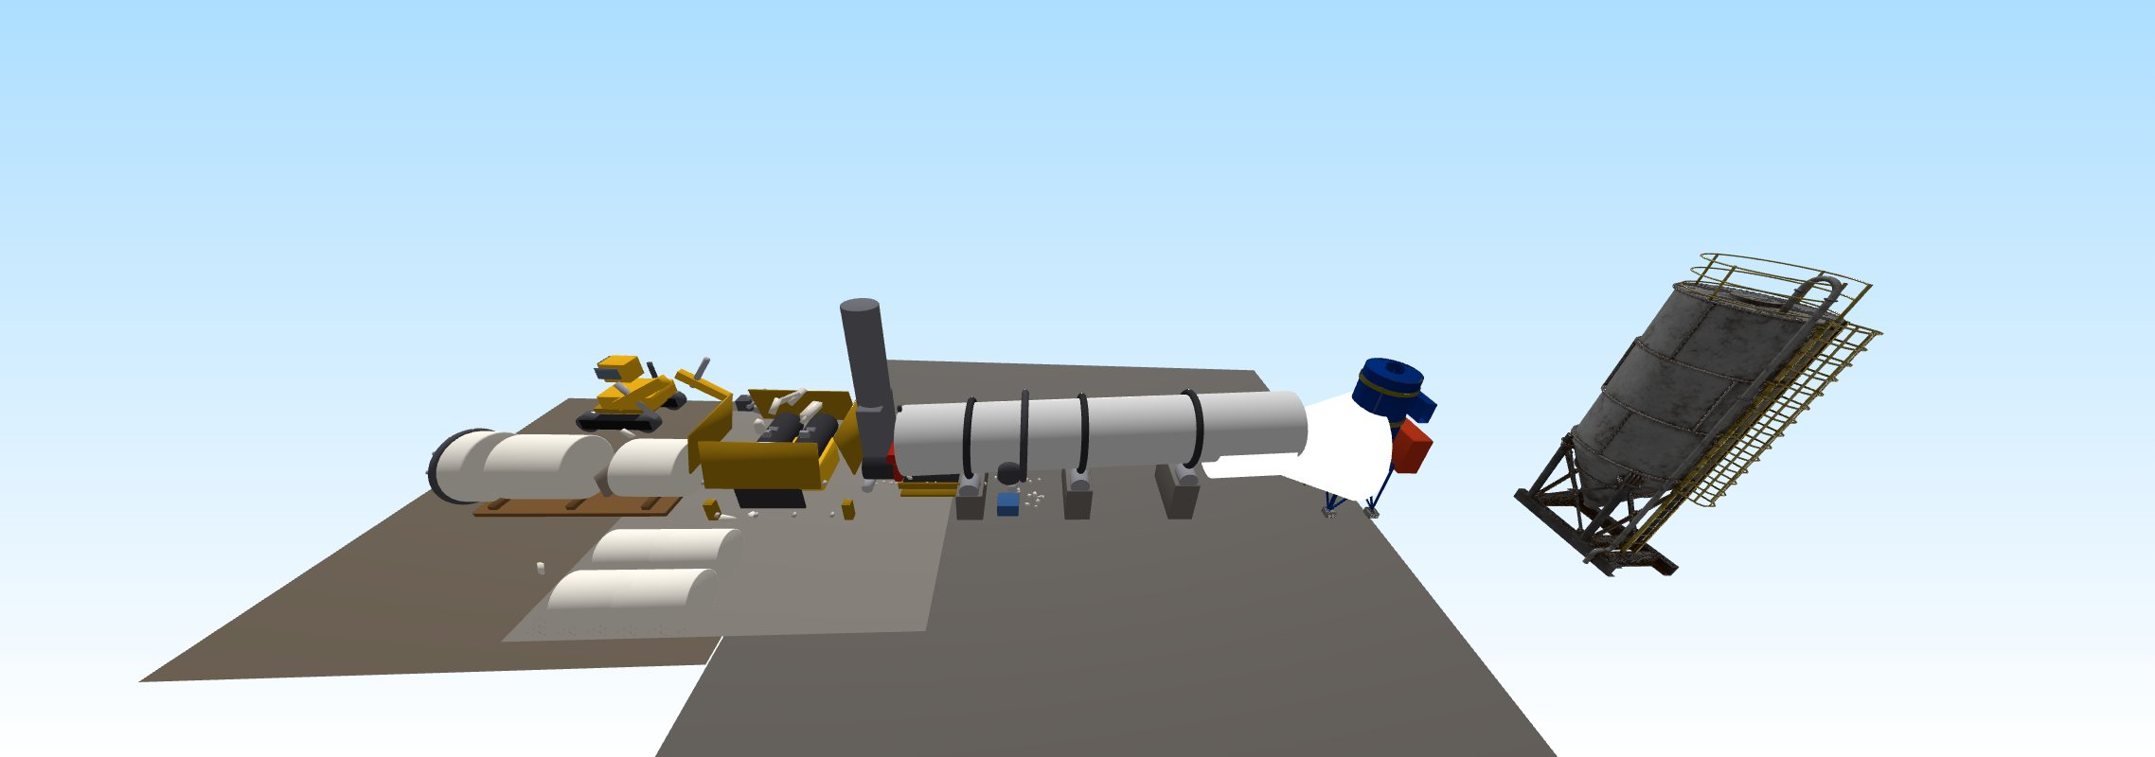
SPRINT 3 · DIGITAL ENGINEERING
Four process stages, modelled in Blender.
1,389 named objects · six reference renders saved · source .blend committed to repo.
3 / 6
BLADE LOOP · SPRINT 3
Notes:
This is our first wireframe. Three views. FIRST VIEW — PROCESS. A flowsheet of the recycling plant: feed mixer, heater, solid-gas separator, secondary separator. The user can adjust temperature, blade load, glass fibre percentage, and pick where the blade is coming from and where the cement kiln is. Live KPIs at the bottom — mass processed, CO2 impact, energy use, cost. Click any stage to drill down into a 3D scene of that piece of equipment. SECOND VIEW — DASHBOARD. The same numbers in a cleaner overview, plus our human-scale CO2 translator. Instead of just showing 480 kg of CO2 saved which means nothing to most people, we translate it into things people understand — flights from Berlin to New York, kilometres by car, trees absorbing for a year, months of household electricity. That's how we make the impact real. THIRD VIEW — STORY MODE. A 5-minute guided tour for first-time users. Same 3D scene as the process view, but the camera focuses on one stage at a time with a side panel explaining what's happening chemically. Once the tour finishes, free exploration unlocks. This is a first concept — naming and exact widgets will evolve. But the three-view structure feels right for what the course is asking us to build.

Slide 4
WHAT'S NEXT
Three sprints to land it.
SPRINT 4 · 19 JUN
SPRINT 5 · 03 JUL
SPRINT 6 · 17 JUL
Unity scene
CEE → DE handoff
Drill-down scenes
URP project setup, FBX import of all four stages, basic WebGL build with stage transitions.
Surrogate equations distilled from the DWSIM model. JSON data schema locked.
Per-stage interactive scenes with parameter sliders and live KPI calculations.
Live URL stays the single source of truth — ritwika-s11.github.io/windecee-bladeloop
5 / 6
BLADE LOOP · SPRINT 3
Notes:
One open question for you. The course brief says 'interactive online application'. We've read that as web. As of today, we've deployed our placeholder page to GitHub Pages — the URL is live, the deployment pipeline works end-to-end. We're using Unity which exports to WebGL — that runs in any browser, no install required. We may move to Vercel or Netlify later if we need faster loads — but the principle stays the same. It's a web app. However — looking through past course projects, many shipped as Windows .exe and Android .apk. Unity can build those from the same project, it's just one extra build target. Our question — do you have a preference? If you'd like a desktop or mobile build for evaluation, we'll prioritise that. If web is fine, we'll focus there. The core work is the same — it's just where we put the polish.

Slide 5
QUESTIONS?
Thank you.
GROUP 4 — WinDECEE
Ritwika · Anirban · Akshat · Sharan · Anjani · Hari
Notes:
That's it from us. Happy to take questions.

