Slide 1
Timekeeper PDA
Jason Tan, Farnaz Zamiri, Leo Liu, Ritwika Das

Slide 2
Introduction and Motivation
Weather and Traffic conditions are always changing and it is hard to keep track of how these changes will affect our day.
The Timekeeper is able to consolidate this information and present the user with an estimated departure time based on events the user has given the system
The Timekeeper is also able to give the user helpful information about the current weather information such as “It’s raining! Bring an umbrella!”
Notes:
Ritwika
START DEMO
Before we go into the details of our PDA implementation, we would like to start the demo by adding an event

Slide 3
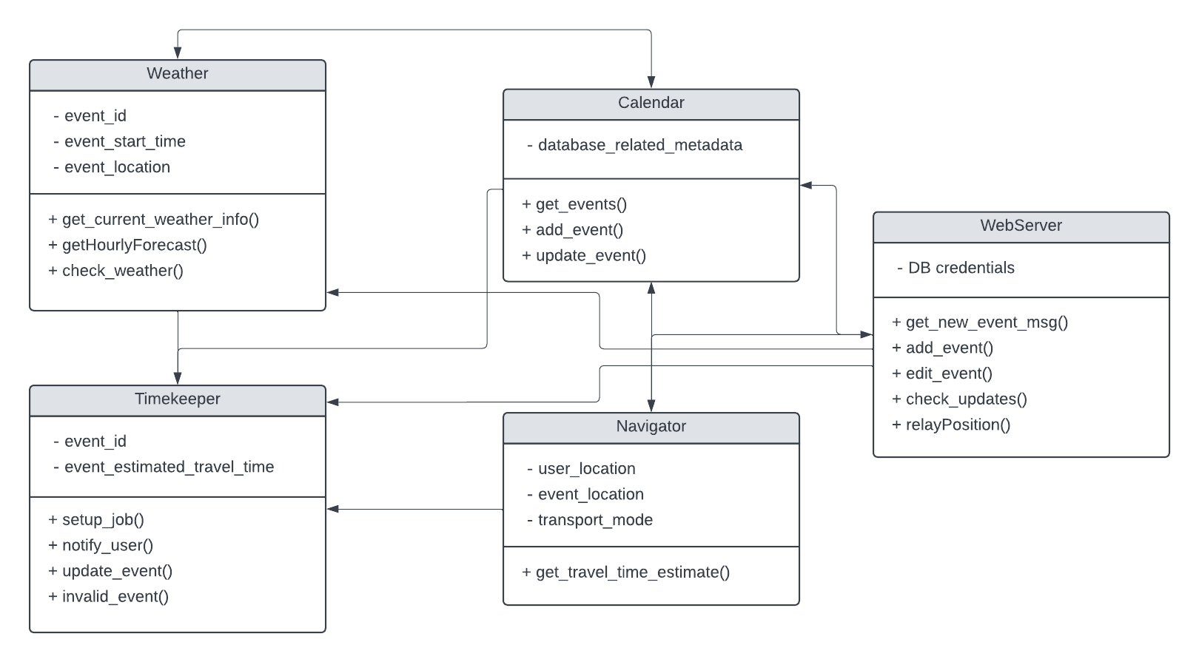
PDA Implementation and Design Decisions
Python and MPI to create a multi-process environment
Use 5 processes, 1 for each entity
PostgreSQL database for storing event information
Online WebApp for UI
Notes:
Jason

Slide 4
Active Entities and Context
Weatherman:
Collect and parse weather to notify the user if it will affect their commute (“Its raining! Remember to bring an umbrella!”)
Send and receive information from the Timekeeper and the Scheduler
Navigator:
Collects the user’s preferred mode of transportation and uses that to calculate trip durations
Duration takes into account the current traffic conditions
Scheduler:
Maintains the user calendar
Can add, update and delete events as well as resolve collisions
Timekeeper:
Consolidates information about events from all three of the previously mentioned entities to create an estimated departure time and notify the user 5 - 10 minutes before
Notes:
Farnaz

Slide 5


Processing
Event:
title, start time, end time, location, transportation
Event
Estimate
Weather info
Success or Conflict
WEB
SCHEDULER
NAVIGATOR
TIMEKEEPER
WEATHERMAN
Check
Notification
Event Schedule
Query events
DATABASE

Slide 6
Demo
Following things will be shown:
Add an event into the calendar
Delete an event from the calendar
Add conflicting events
See departure notification
See weather information for both current location and future forecasts

Slide 7
Future Work
Incorporate and learn more preferences
Incorporate different delay times depending on the type of bad weather (i.e different delay time based on rain vs. snow)
If there is colliding events, suggest to the user which event to delete and which event to keep
Notes:
Ritwika

Slide 8
Questions?

