Slide 1
Opioid involved accidental overdose deaths in Connecticut 2012-2018 What is there to know about that we don’t already know?

Slide 2
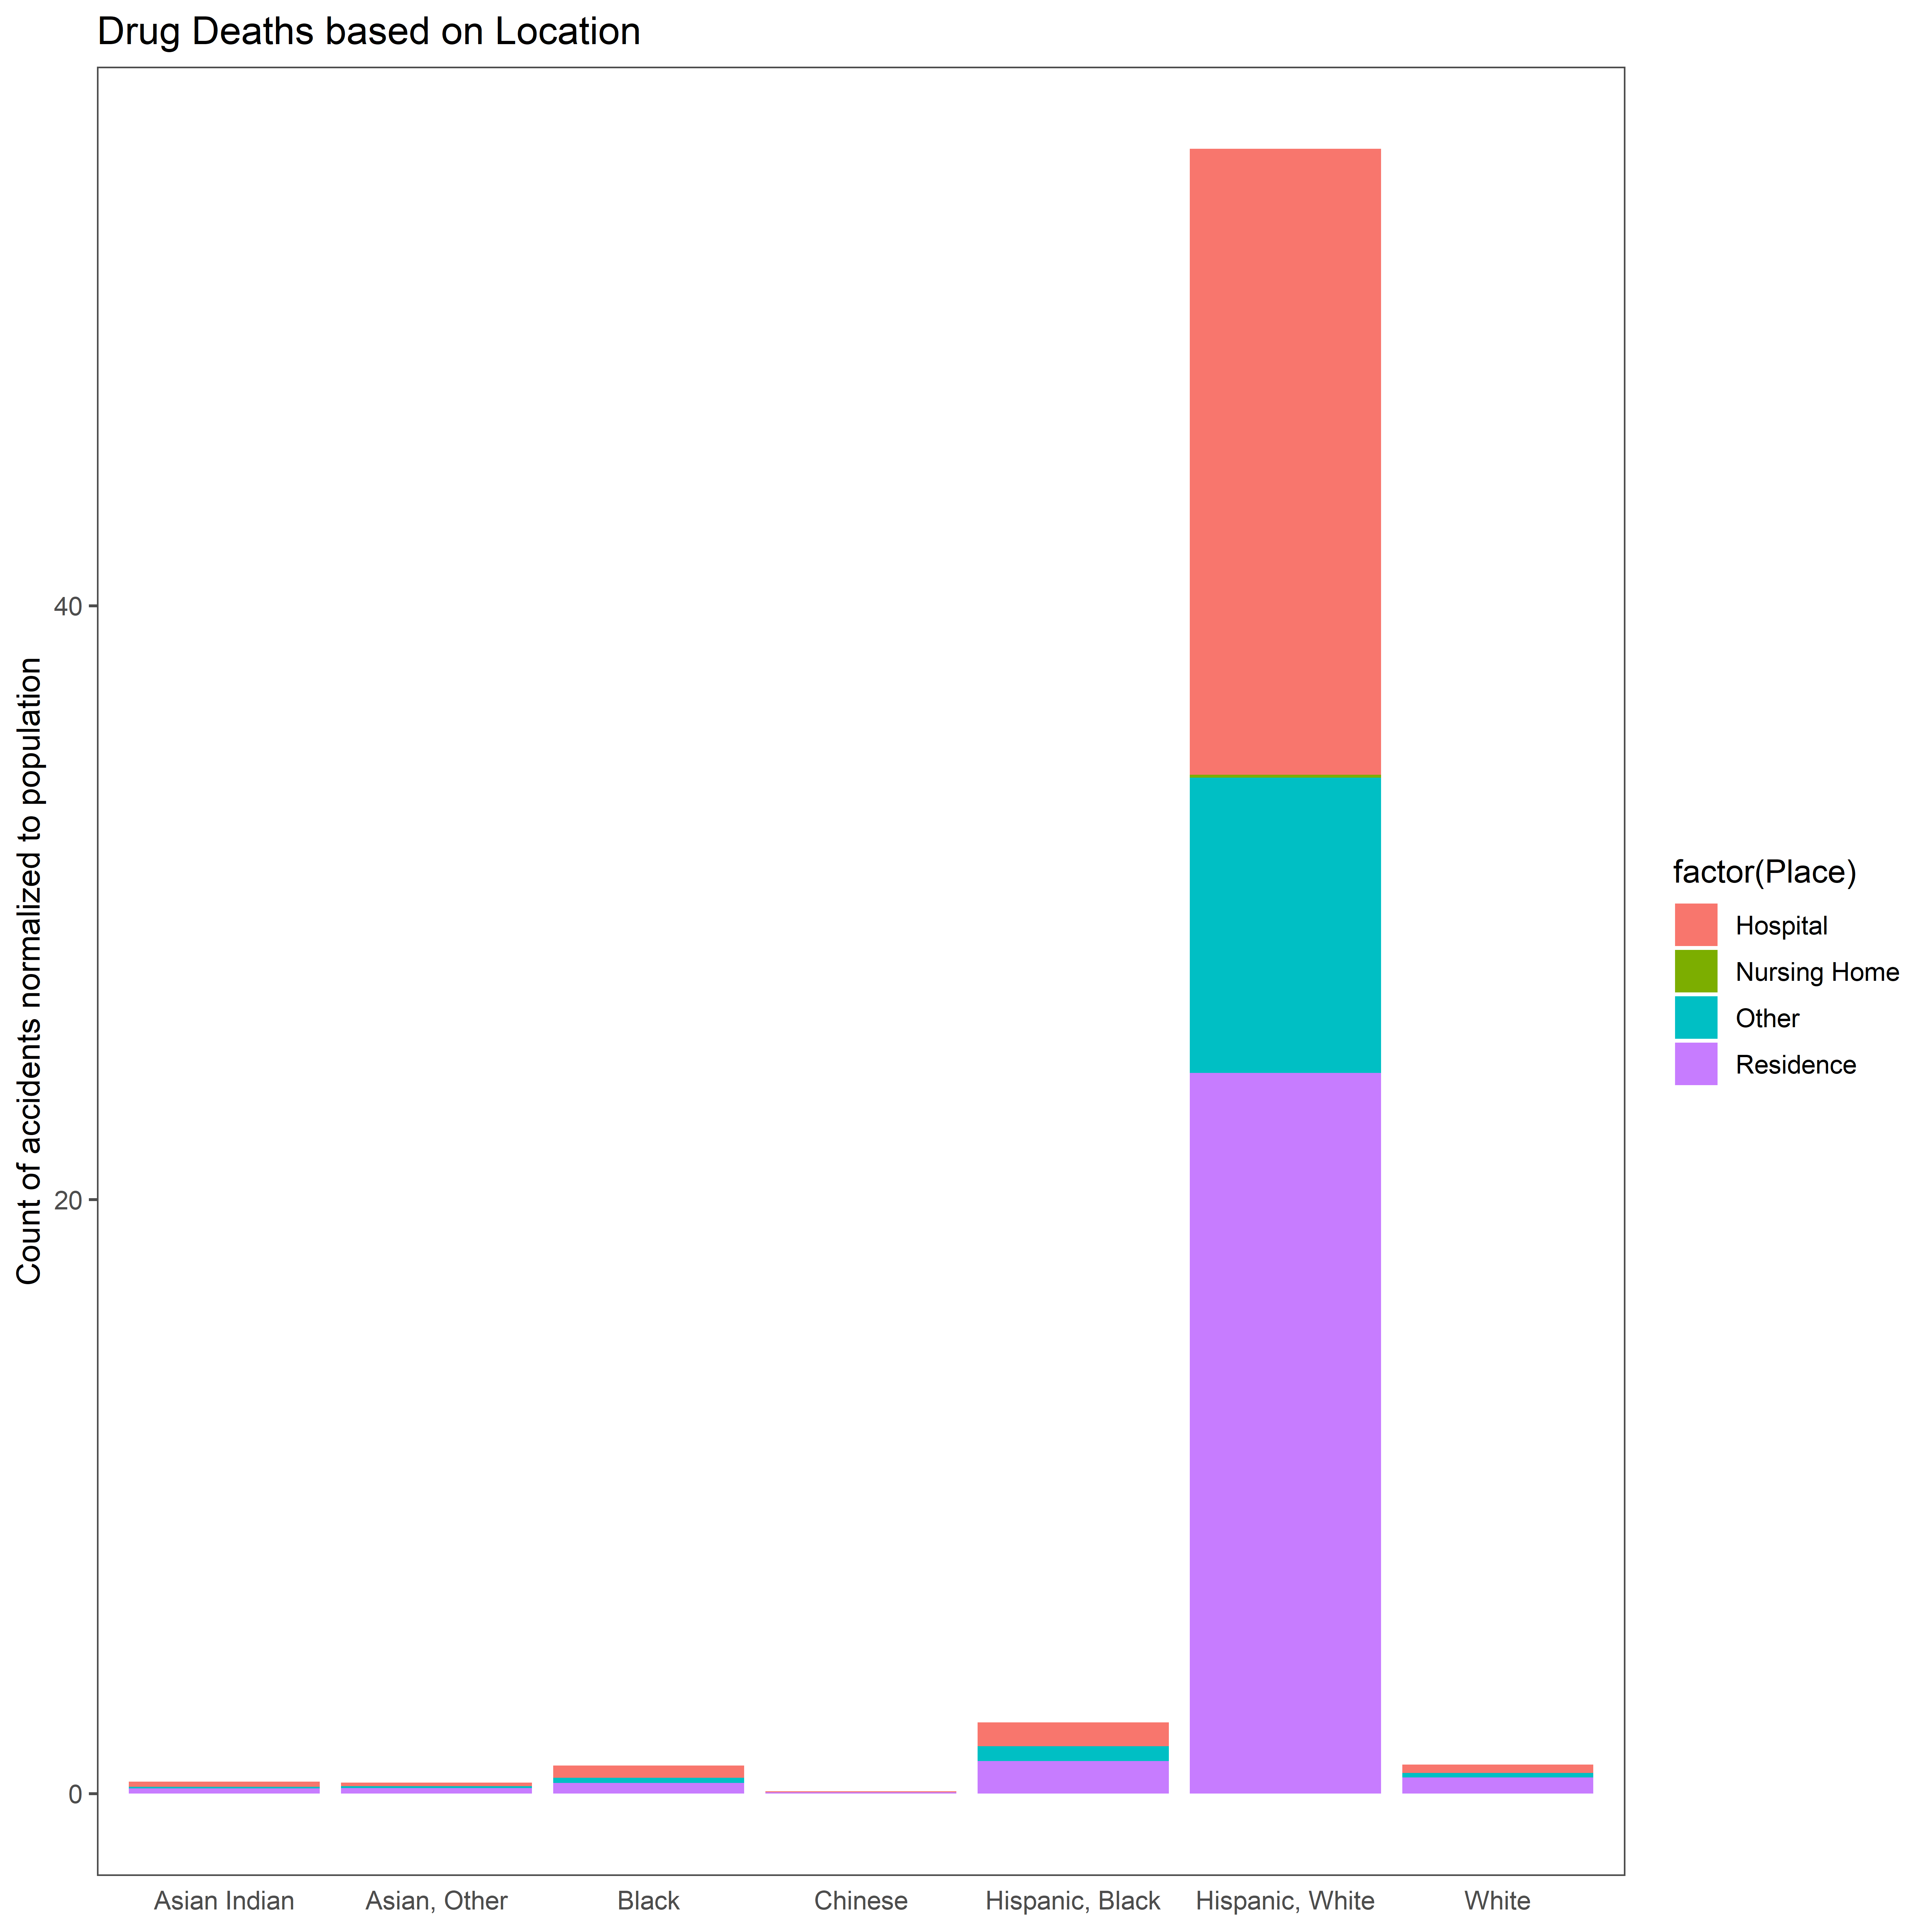
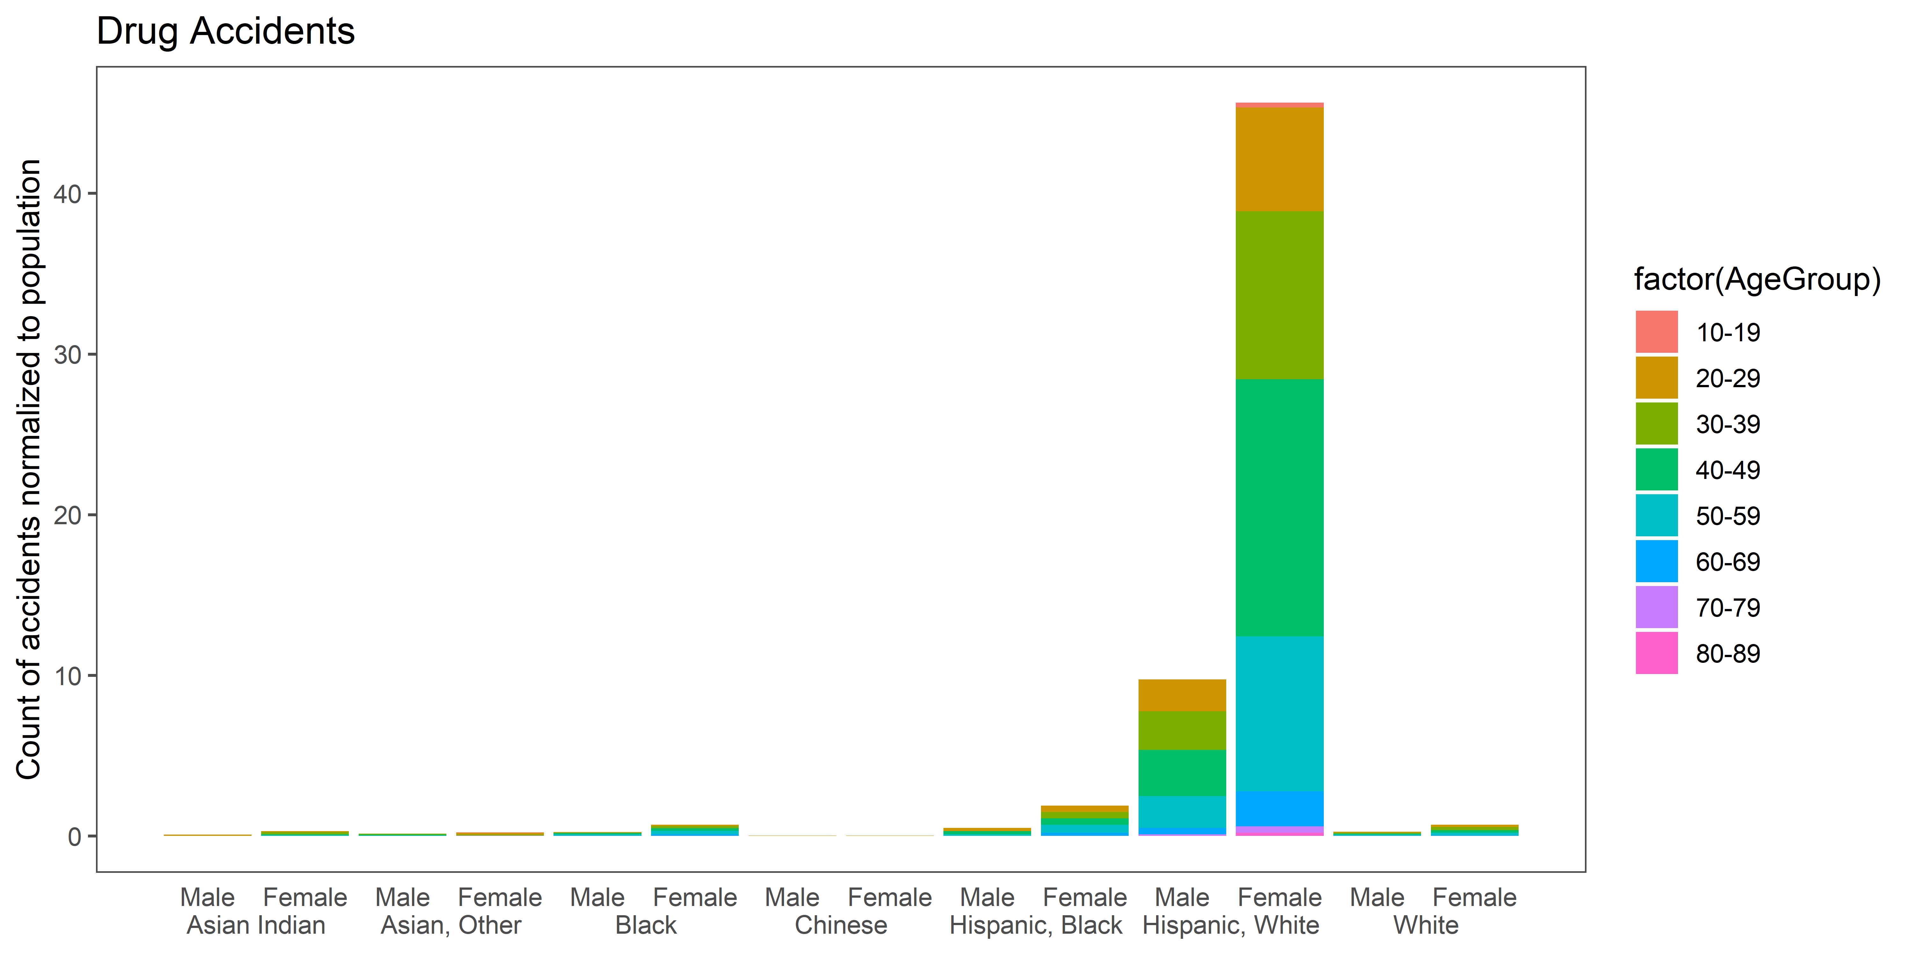
Demograph-adjusted relative count of accidental deaths highest in Hispanic populations in CT (2012-2018) with more deaths in residences than hospitals
While the absolute count of accidents is the highest for White pop, the Hispanic pop are affected the most and amongst them an age group of 40-49.
Another age group prominently affected is 30-39.
The location of death is split between residence and hospital, with most casualties in residences.
Could something be said about the age groups and the resources available for them to be cared for?
Notes:
https://data.ct.gov/Health-and-Human-Services/Accidental-Drug-Related-Deaths-2012-2018/rybz-nyjw

Slide 3
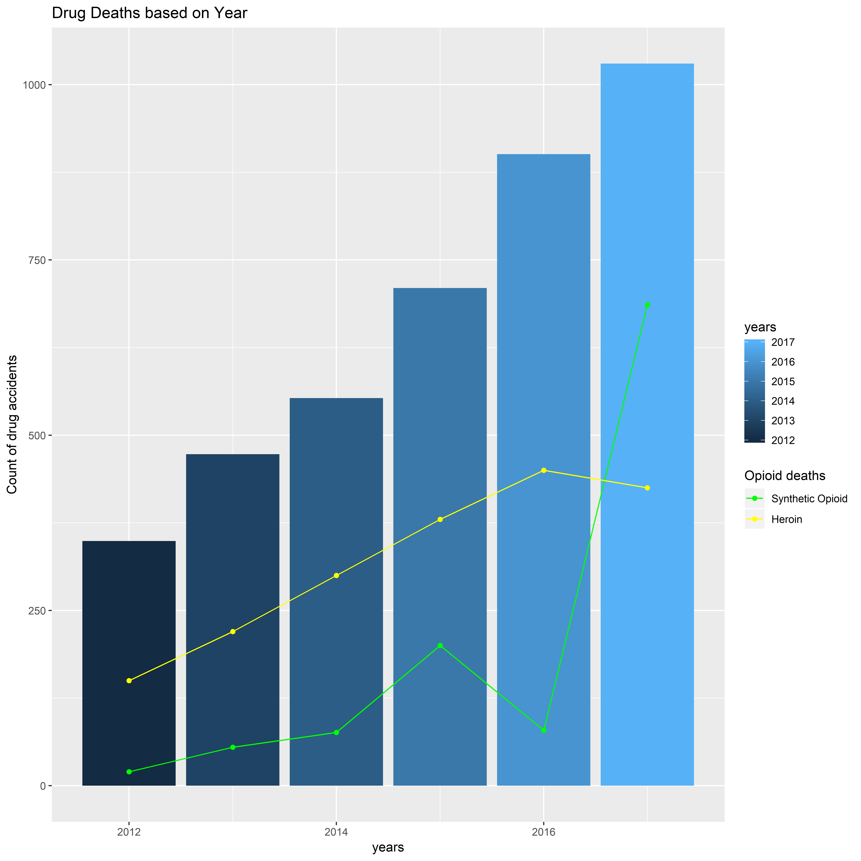
Drug deaths on the rise: Synthetic opioids (mainly fentanyl), not heroin being responsible for majority of deaths in 2017
686
Prescription opioids and synthetic opioids are causing higher deaths recently, NOT heroin.
A rise from 79 deaths in 2016 to 686 in 2017 for synthetic opioids. Deaths involving heroin also increased from 98 deaths in 2012 to 450 in 2016 but saw a decrease in 2017 to 425 deaths.
Is this a substitution of opioid or an availability problem?
450
425
79
Notes:
CDC Wonder. https://www.drugabuse.gov/drugs-abuse/opioids/opioid-summaries-by-state/connecticut-opioid-summary

Slide 4
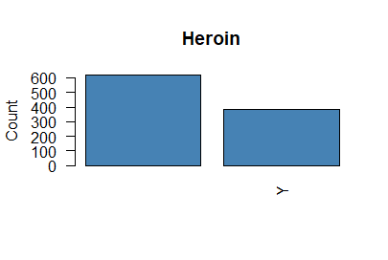
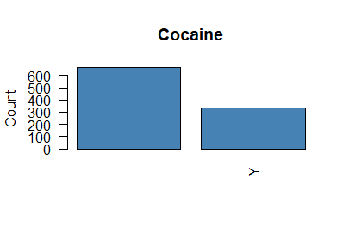
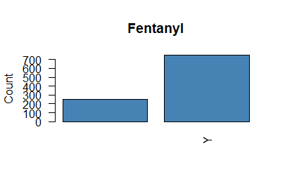
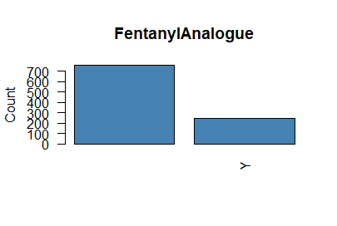
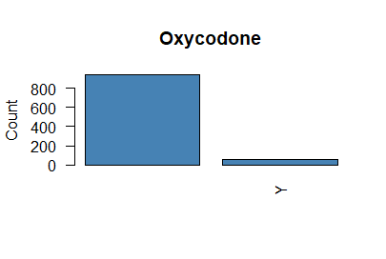
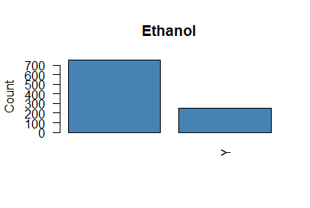
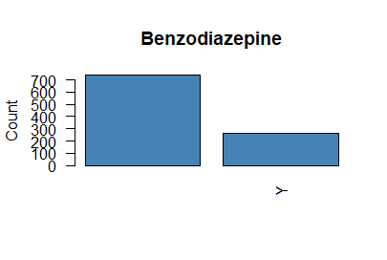

In 2018, drug accidents mostly caused by synthetic opioid
Fentanyl with Heroin and Cocaine next

Slide 5
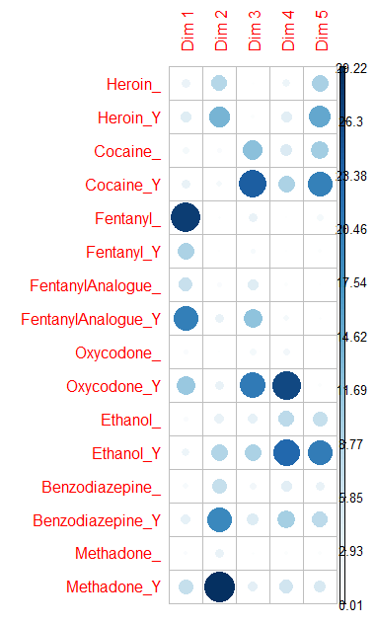
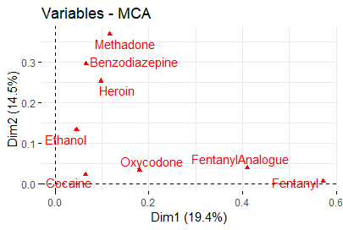
Multiple correspondence test (MCA) amongst the strong opioids: Fentanyl and its analogue and Oxycodone are most correlated with first dimension. Methadone, Heroin, Benzodiazepine most correlated with second dimension
(Using 2018 data alone)

Slide 6
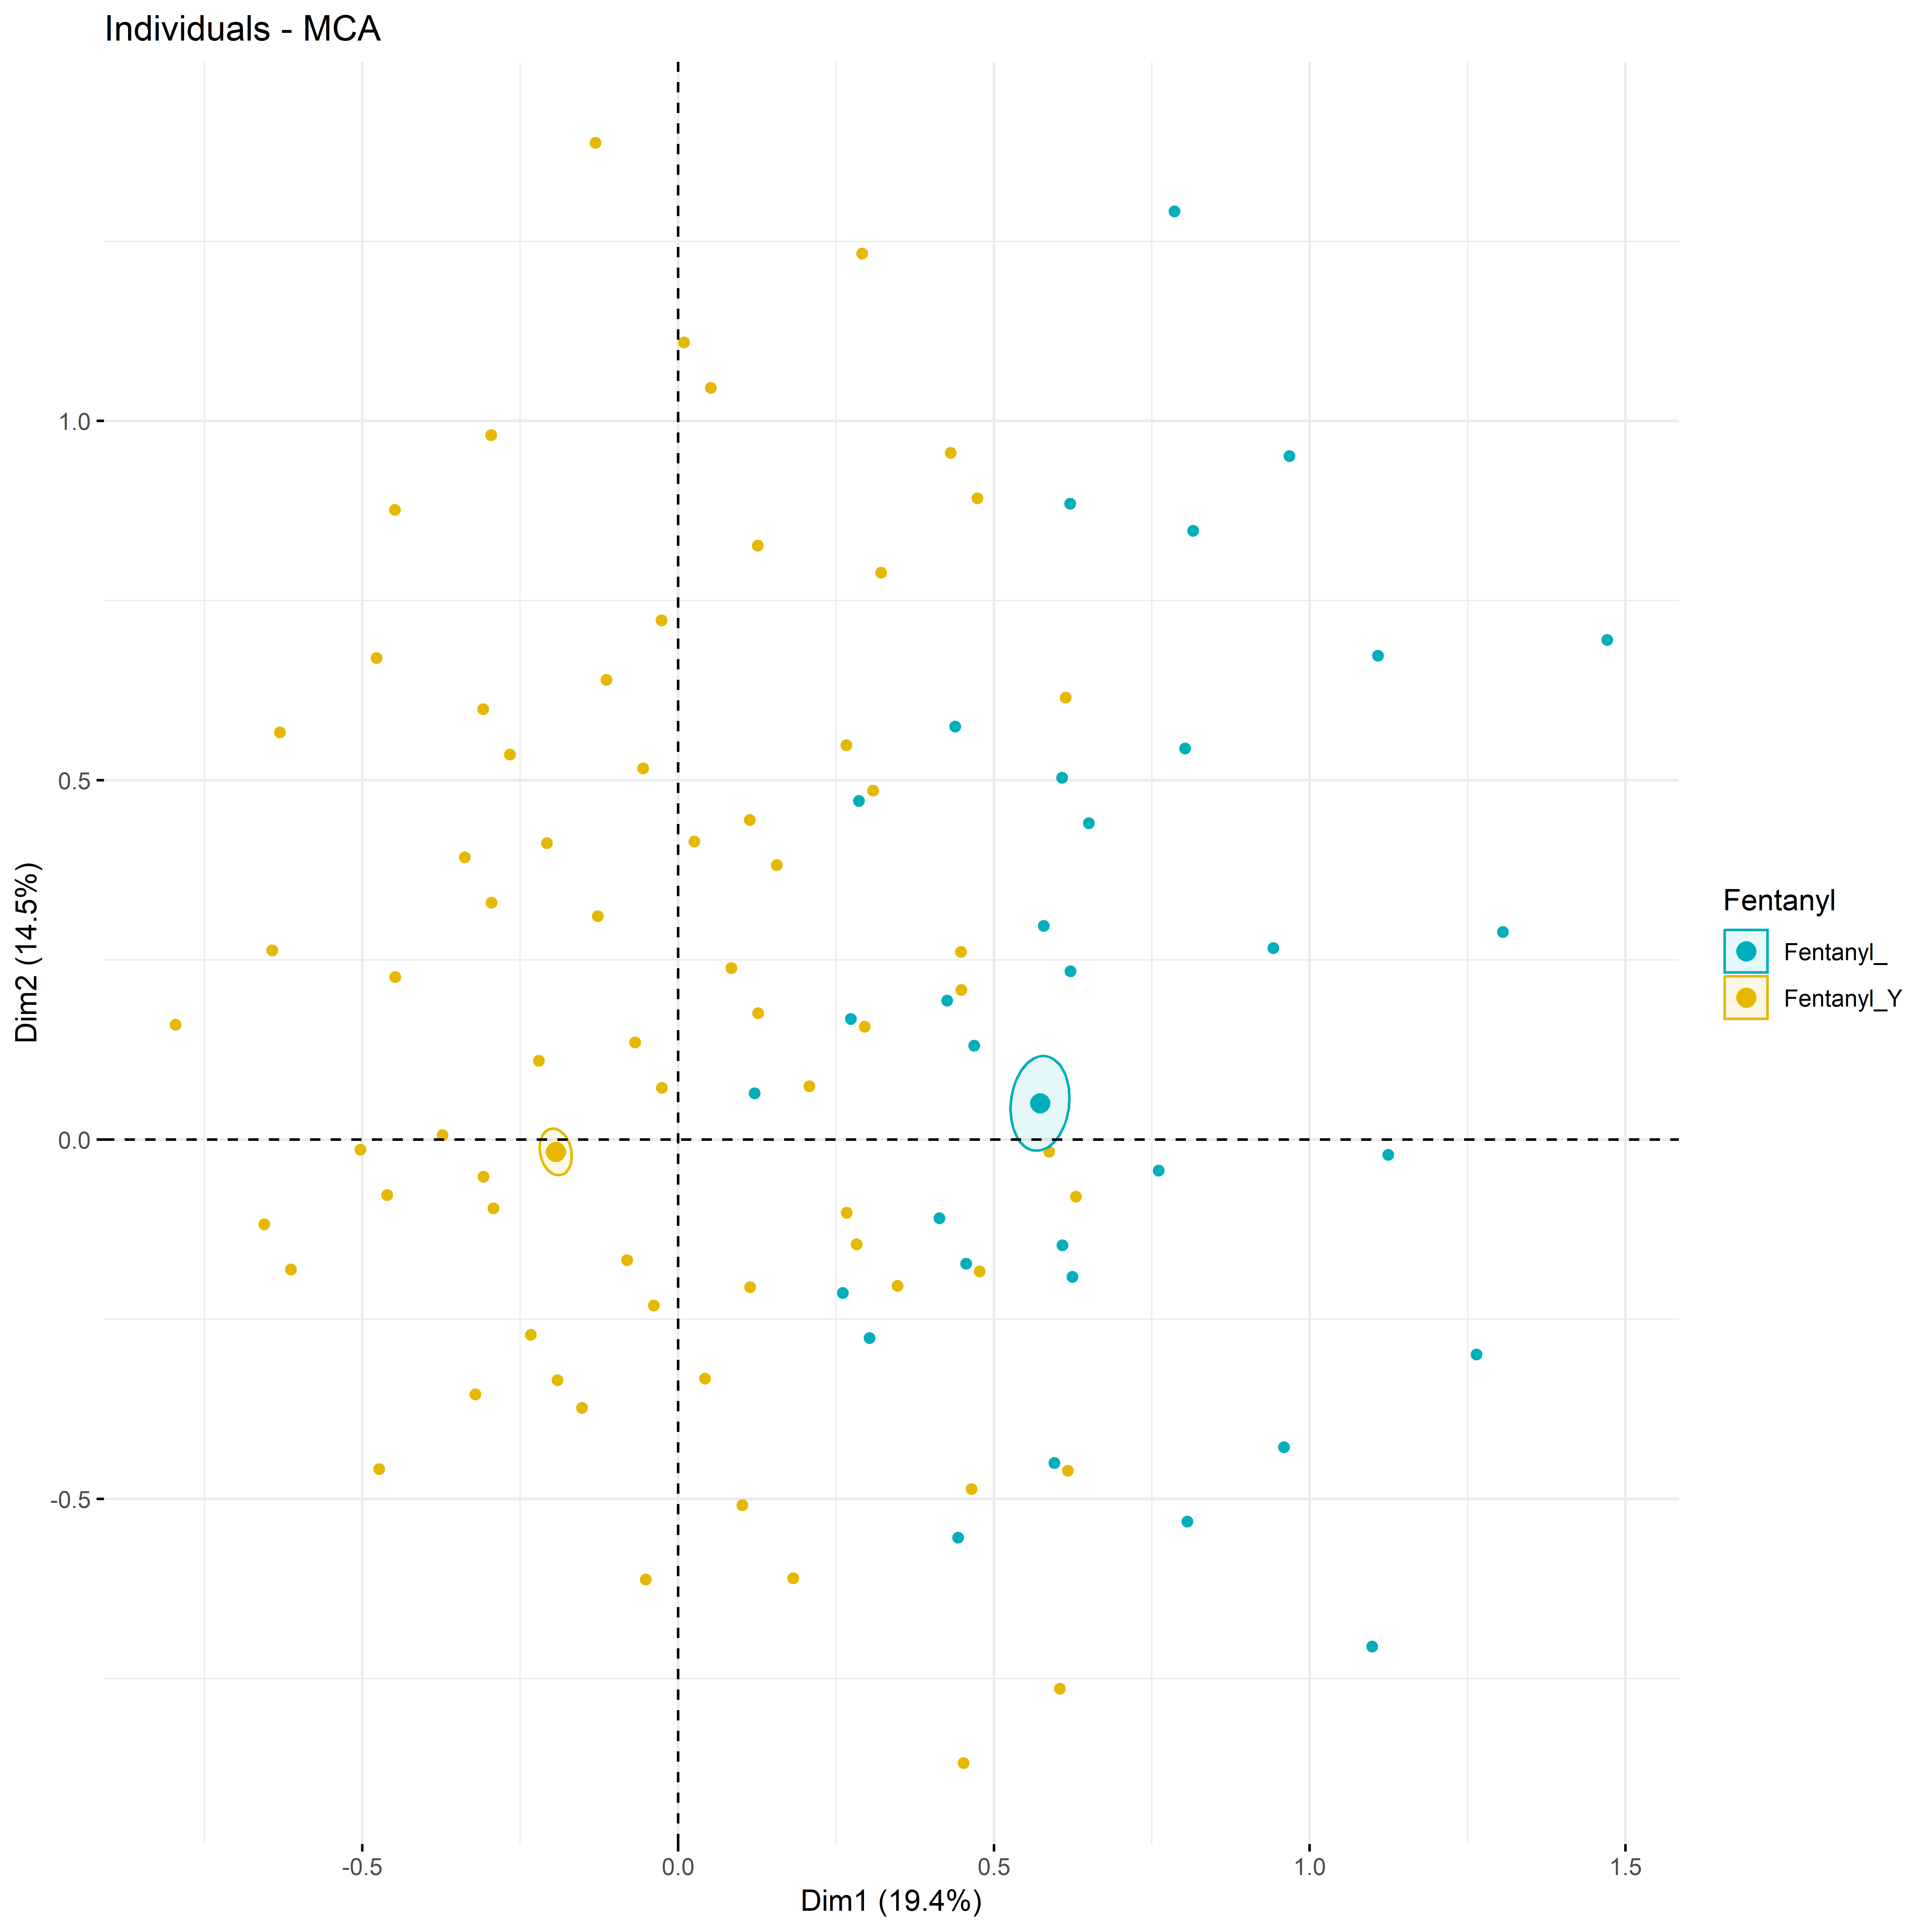
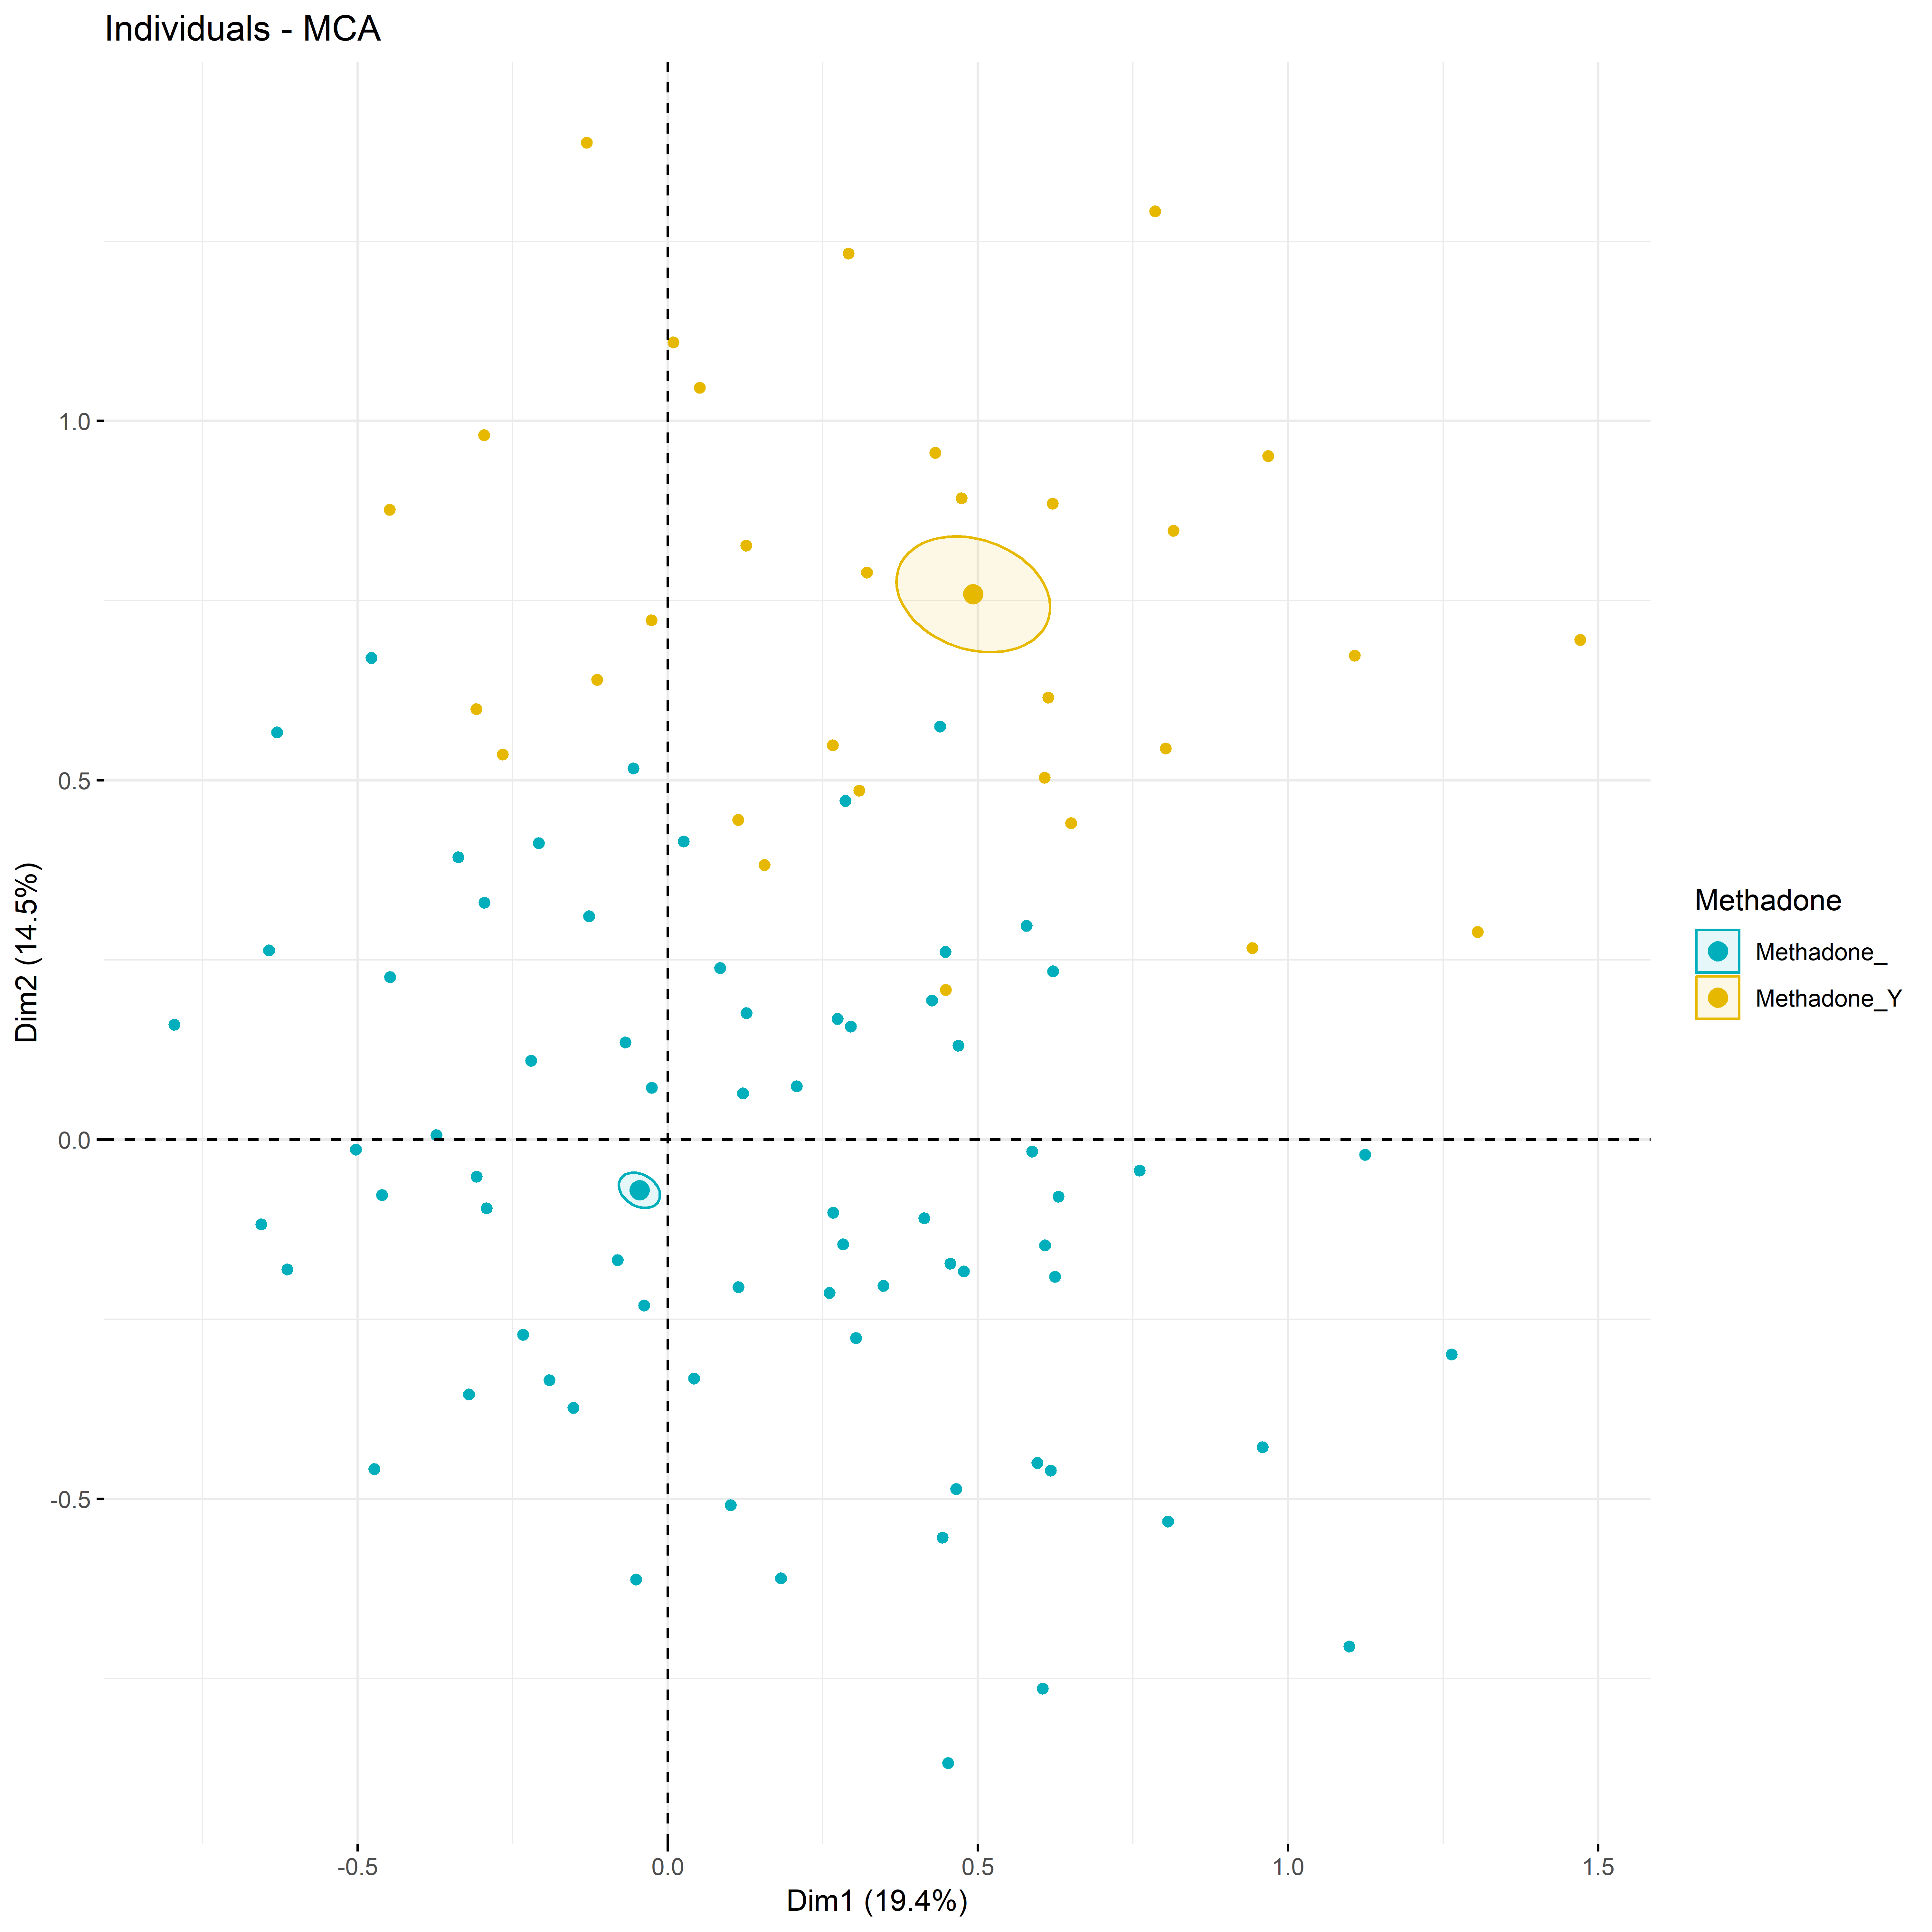
In the future, it would be insightful to replace sex and race data on these dimensions along with the drugs

Slide 7
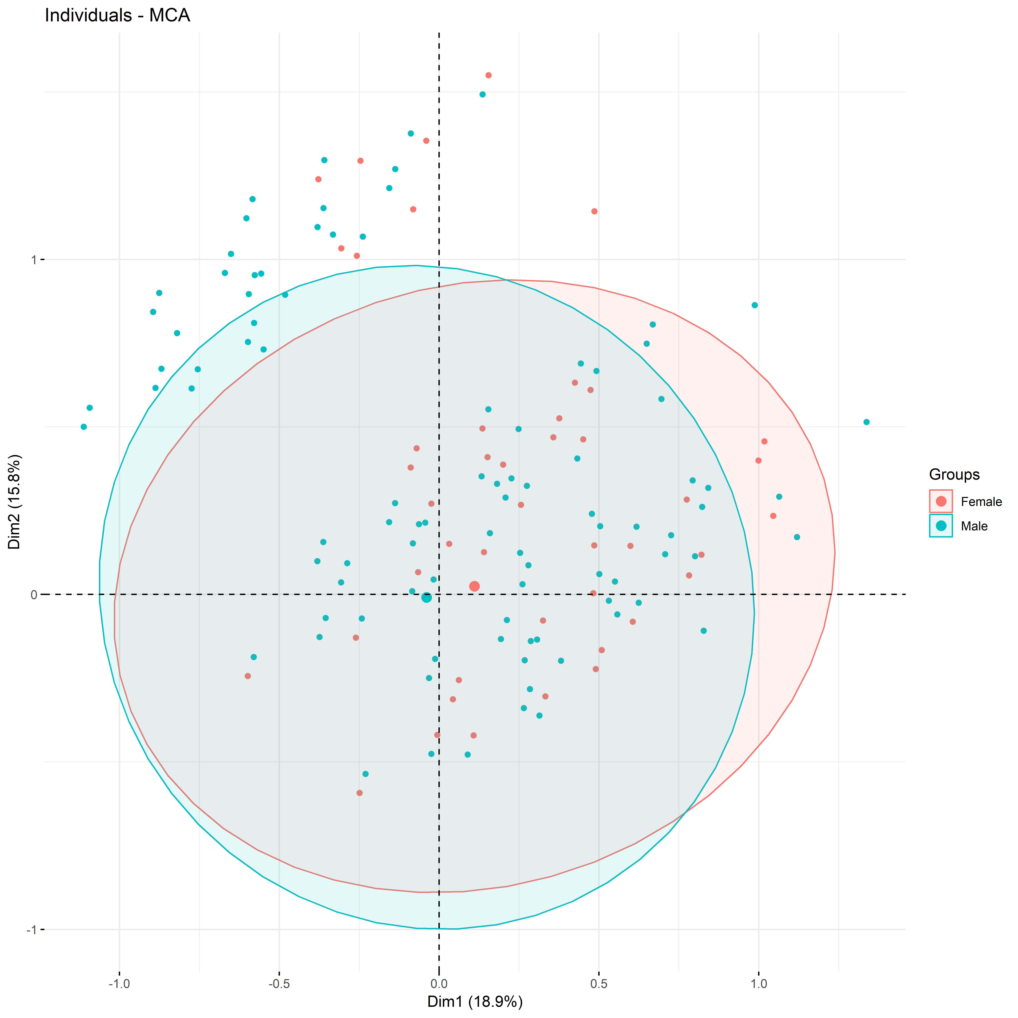
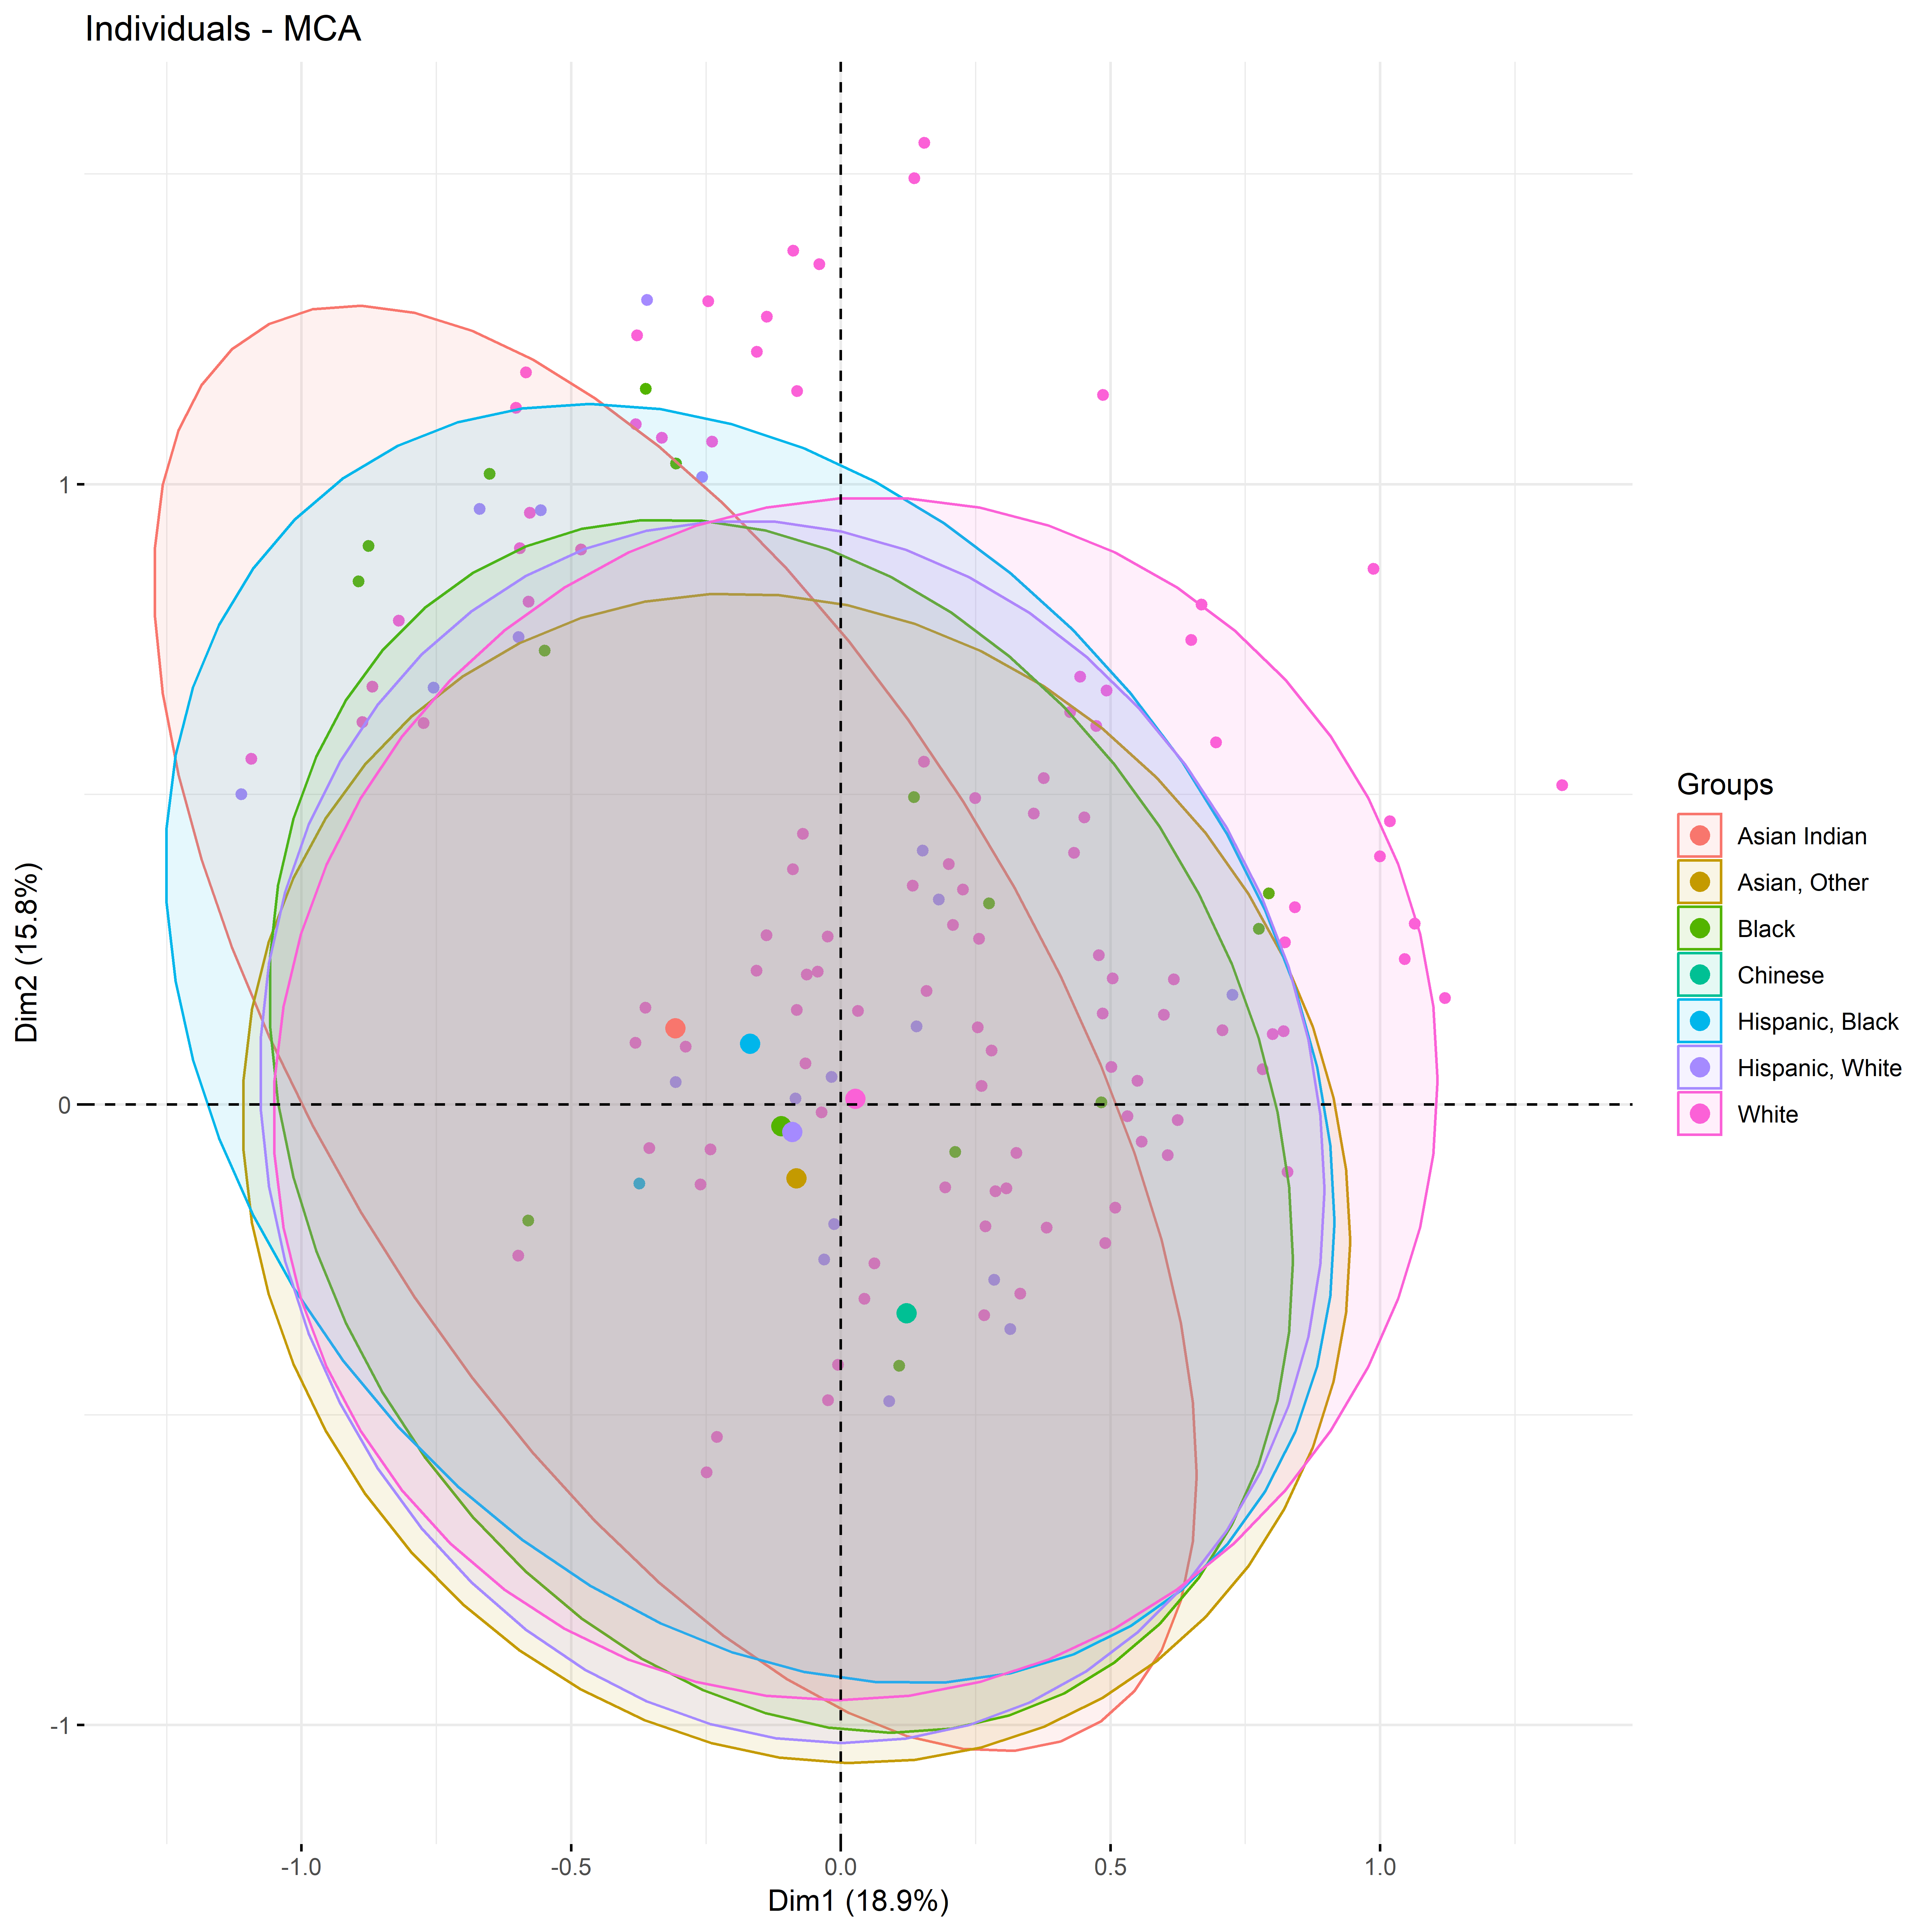
MCA on the entire 2012-2018 dataset: Little distinction based on the dimensions across race and sex

Slide 8
Analyses done on this data
Data mining, cleaning, collecting appropriate data for analysis (dplyr and tidyverse).
Stacked bar plots
Stats tests: Estimated Marginal Means, aka Least-Squares Means, MANOVAs
Mutating arrays
Multiple correspondence tests
More datasets about psychology or occupations ofdifferent racial categories may add meaning to the accidents database. To truly understand correlations of
Prior experience in generalized mixed models.

