Slide 1

A SOFTWARE PLATFORM FOR MONITORING PATIENTS IN SMART HOMES
RITWIK DUTTA
ARCHBISHOP MITTY HIGH SCHOOL
ICSEE 2015, Miami

Slide 2
TALK OVERVIEW
Related work
SW components
Application flow
Frontend design
Backend design
Conclusions
Future work

Slide 3
RELATED WORK
Apple Smart Home Software
Pegasystems Agile Healthcare Software Solutions
Qualcomm Life 2net Platform
Boston Software Systems
ADT Medial Alert Monitoring
Omnicell Unity Enterprise Platform

Slide 4
SW COMPONENTS
Frontend
HTTP Server: Python SimpleHTTPServer (2.7.3)
Backend
Database: MongoDB Portable (2.6.3)
Web framework: Flask (0.10.1)
Application core: Python (2.7.3)

Slide 5
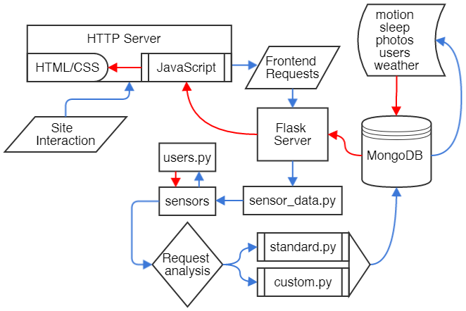
APPLICATION FLOW
User to application flow
DB data to frontend flow

Slide 6
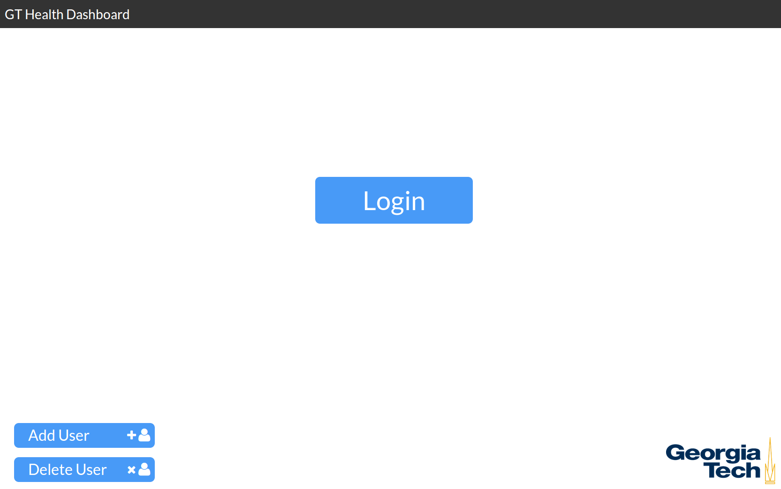
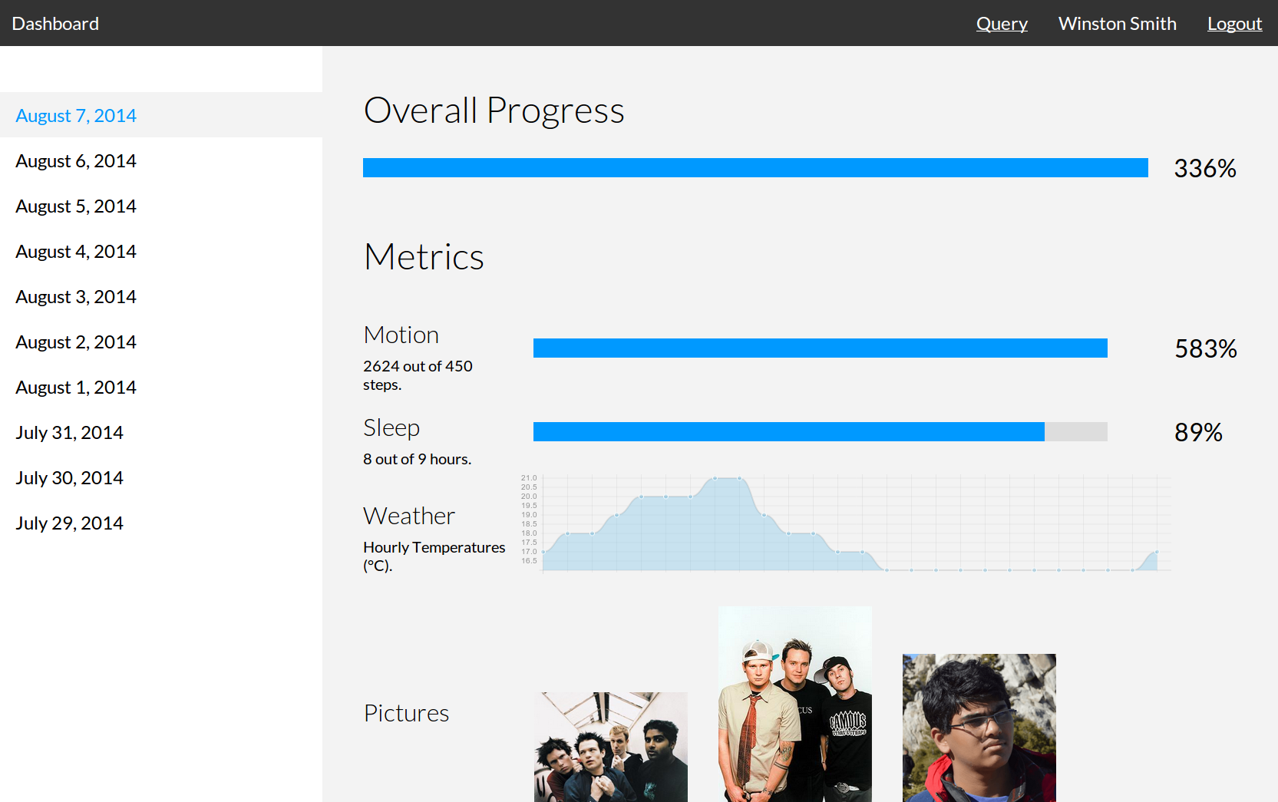
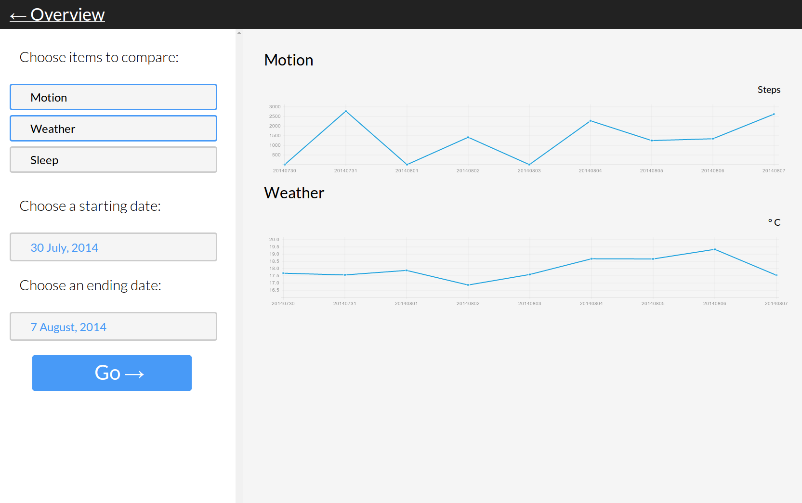
FRONTEND DESIGN

Slide 7
FRONTEND
LOGIN
Completely custom built
User account management
Creation: Username and metric customization
Deletion
User account login

Slide 8
FRONTEND
DASHBOARD
View information by date
Multiple data formats
Percentage: progress bar
Granular data: line graphs
Pictures: grid and lightbox
Raw files: plaintext

Slide 9
FRONTEND
QUERY
Completely custom built
Customizable data range
Multiple graphs can be viewed at once for comparison
Metric selection: choose any number of metrics over a time range

Slide 10



BACKEND DESIGN

Slide 11
BACKEND
FLASK
Interfaces between frontend and backend
Frontend requests: parsed and passed to backend
Queries information: pulls information from database
Returns data: formats data into readable format
Frontend displays corresponding data

Slide 12

BACKEND
PYTHON
Bridges frontend and backend
Flask server: requests data from database
Processing data: pulls data from MongoDB and processes
Return data: information sent back to Flask for frontend to retrieve
Pulls data from sensors
Data logging: sensor data is pulled and written to the database

Slide 13
BACKEND
MONGODB
An open source NoSQL database with JSON-like schema
Contains collections for users and for each metric
Data organization: individual documents for each datum
Sample document:
Query methods: collections can be queried with multiple fields
{
"date": 250110,
"username": "wsmith1420938822", "metric": "sleep",
"value": 5
}

Slide 14
CONCLUSIONS
Distinguishing features of our project
Licensing: MIT licensed and freely usable and modifiable for all use
Source code: openly available and free to view, modify, or expand upon
Flexibility: easily expandable for more metrics and sensors
Deployment: simple download-and-run deployment on local or cloud platforms

Slide 15
FUTURE WORK
(PT. 1)
Login
Password system: more secure for patients and caretakers
User account controls: moved to admin page
Query
Data prediction: use past data patterns to predict future trends
Recommended queries: analyze data to find “interesting” patterns to show user
Data anomalies: detect and impute anomalies in sensor data streams

Slide 16
FUTURE WORK
(PT. 2)
Site design
Responsive: mobile and tablet friendly design
Completely dynamic pages: use web framework for all web content generation
Web framework
Transition to Django: more stable and mature framework for a better platform
Project platform
Transition to C/C++: more efficient and faster data processing for project backend

