Slide 1
Phisherman
Phishing website detection using Extreme Machine Learning
Name | Enrolment Number
O. Sudeep Reddy | 22114063
P. Ritwik Durga | 22114067
S. Nandan Sri Siva Ramakrishna | 22114089

Slide 2
Overview
Introduction
ELM and Implementation details
Frontend implementation
Future implementations
References

Slide 3
Phishing Website Classification Using ELM
What is Phishing?
Cybercrime using fake websites to steal sensitive information (e.g., login credentials, financial data).
Goal:
Classify websites as legitimate or phishing based on features.
Features Used (30 Total):
Address Bar Based: e.g., URL length, special characters (like '@’).
Abnormal Based: e.g., Request URL, Anchor URL behavior.
HTML and JavaScript Based: e.g., Pop-ups, Disabled right-click.
Domain Based: e.g., Domain age, PageRank.
A total of 30 features are used to train the ELM model for classification

Slide 4
ELM ( Extreme Machine Learning )
ELM is a single hidden layer feed-forward neural network.
Key Differences from Traditional ANNs:
Input weights are randomly assigned.
Output weights are analytically determined.
Advantages:
Faster training speed compared to gradient-based methods.
Supports various activation functions (e.g., sigmoid, sinus).
Less prone to local minima issues.
Notes:
Extreme Learning Machine (ELM) is a single-layer feed-forward neural network (SLFN) designed for efficient training. Unlike conventional neural networks that rely on iterative optimization techniques, ELM adopts a unique approach where the hidden layer weights are randomly initialized and remain fixed, while the output weights are determined analytically in a single step.

Slide 5
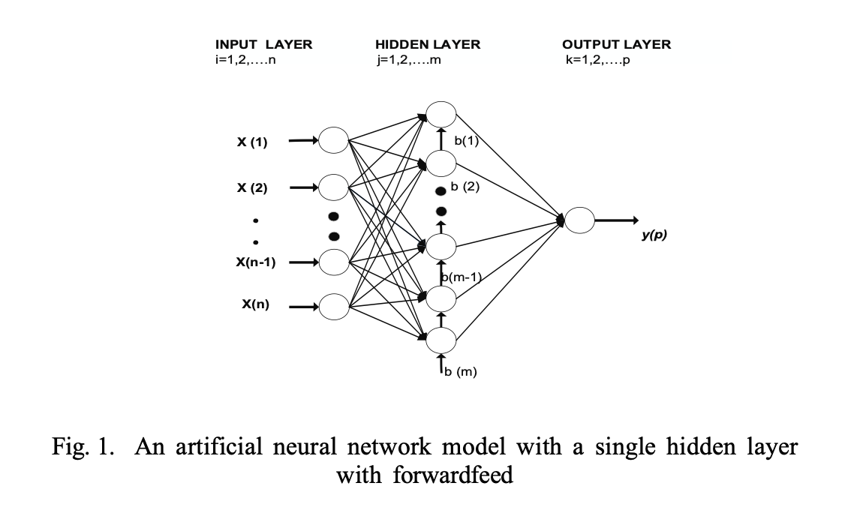
ELM ( Extreme Machine Learning )
Notes:
This is called the Input Layer. The circles labelled x(1), x(2), all the way up to x(n) are the starting points where we feed information into the network.
The middle one is the Hidden Layer. The circles labeled b(1) to b(m), connected to the input layer by a bunch of lines. It takes all the information from the input layer, processes it, and starts to figure out patterns.
The last is the Output Layer. It has one circle labeled y(p), connected to the hidden layer by more lines. Can vary from 800-2000.
These lines show how the data moves through the network. It starts at the input layer, flows through the hidden layer, and ends at the output layer. This is called forwardfeed, which is a fancy way of saying the information moves in one direction—left to right—without looping back.

Slide 6
Experimental Results and Comparison
Dataset: UCI Machine Learning Repository (~11,000 samples).
ELM Configuration: 1000 hidden neurons, sigmoid activation function.
Performance:
Training Accuracy: 100%.
Test Accuracy: ~95.34%.

Slide 7
Different Variations Of ELM Used
Generalized ELM Model
Bagging Ensemble ELM
Ensemble ELM with Weighted Averaging
Stacking Ensemble ELM

Slide 8
Generalized ELM Model
A single-layer feedforward neural network designed for fast training. It randomly assigns input weights and biases, then computes output weights using the Moore-Penrose pseudoinverse.
This implementation enhances the basic ELM with:
Multiple activation functions
L2 regularization (alpha parameter) to prevent overfitting.
Advanced weight initialization strategies.
How It Works: The model processes input features through a hidden layer, applies the chosen activation function, and computes output weights to classify websites as phishing (-1) or legitimate (1).
Result: Accuracy of approximately 95.40% which is close to what the research paper states(95.34%).
Notes:
First up is the Generalized ELM Model. This is our foundation—a single-layer feedforward neural network designed for speed. It randomly sets input weights and biases, then uses a mathematical function called the Moore-Penrose pseudoinverse to compute the output weights. We’ve enhanced it with multiple activation functions, and also used L2 regularization to keep control overfitting. Here’s how it works: input features pass through a hidden layer, get transformed by an activation function, and the output weights classify websites as phishing—labeled -1—or legitimate, labeled 1. This model delivers a solid accuracy of 95.40%, which matches closely with published research at 95.34%.

Slide 9
Bagging Ensemble ELM
Implements bootstrap aggregating (bagging) with Enhanced ELM models. Each model (default 10 estimators) is trained on a random subset (80% sample ratio) of the training data with replacement, using 1000 hidden units and ReLU activation.
How It Works:
Generate bootstrap samples for each base model.
Train each model independently on its sample.
Combine predictions via majority voting (averaged and rounded).
Result: Accuracy of 95.91%.
Notes:
Next, we have the Bagging Ensemble ELM. Bagging stands for bootstrap aggregating, and it’s all about teamwork. We take 10 Enhanced ELM models by default, each with 1000 hidden units and the ReLU activation function. Every model trains on a random 80% subset of the data, sampled with replacement. After training independently, they vote on the final prediction using majority voting—simple, yet effective. This approach bumps the accuracy up to 95.91%. By using multiple models, we smooth out individual errors and get a more standardized result

Slide 10
Ensemble ELM with Weighted Averaging
An ensemble of ELM models where predictions are combined using weighted averaging. Weights are determined by each model’s performance on a validation set, with diverse configurations (hidden units: 800, 1000, 1200, 1500, 2000; activations: ReLU, leaky ReLU, ELU, Swish).
How It Works:
Split training data into training and validation sets.
Train each model on the training set and evaluate accuracy on the validation set.
Assign weights proportional to validation accuracy and normalize them.
Retrain models on the full dataset, then combine predictions using these weights.
Result: Accuracy of 96.36%.
Notes:
Now, let’s talk about Ensemble ELM with Weighted Averaging. This method also uses multiple ELMs, but with a change. We mix models with different hidden units—ranging from 800 to 2000—and activation functions like ReLU, leaky ReLU, ELU, and Swish. Here’s the process: we split the data into training and validation sets, train each model, and measure its accuracy on the validation set. Models that perform better get higher weights. After retraining on the full dataset, we combine their predictions using these weights. Using this, we got An accuracy of 96.36%. Weighting smarter models more heavily really pays off here

Slide 11
Stacking Ensemble ELM
An ensemble method that combines predictions from multiple base Enhanced ELM models using a meta-learner (another Enhanced ELM). The base models vary in hidden units and activation functions.
How It Works:
Base models are trained on a subset of the training data.
Their predictions on a validation set become features for the meta-learner.
The meta-learner (100 hidden units, sigmoid activation) makes the final prediction.
Base models are then retrained on the full dataset for deployment.
Result: Accuracy of 96.51%.
Notes:
Next is the Stacking Ensemble ELM, our most complex method. We train multiple Generalized ELMs with varying setups, then use their predictions on a validation set as features for a meta-learner—another ELM with 100 hidden units and a sigmoid activation. The meta-learner makes the final call. After that, we retrain the base models on the full dataset for deployment. This layered approach achieves the highest accuracy yet: 96.51%. Stacking lets us use the strengths of diverse models and refine them with a second-level learner.

Slide 12
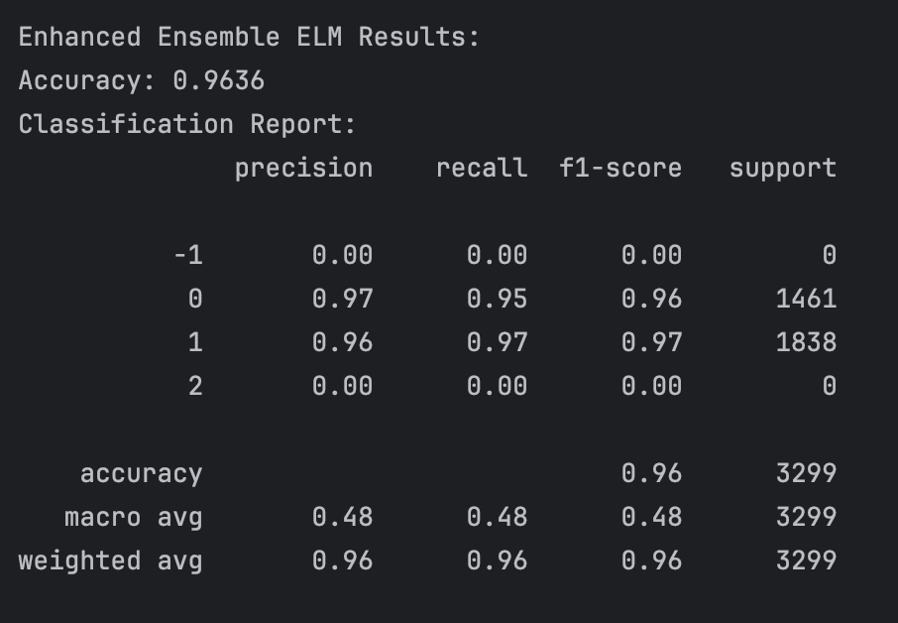
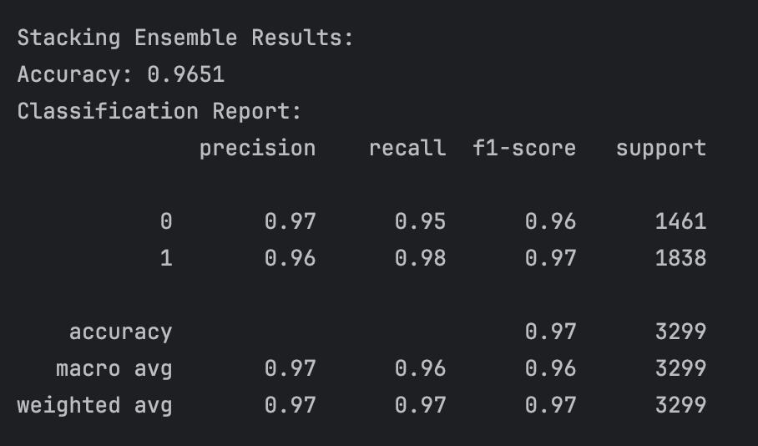
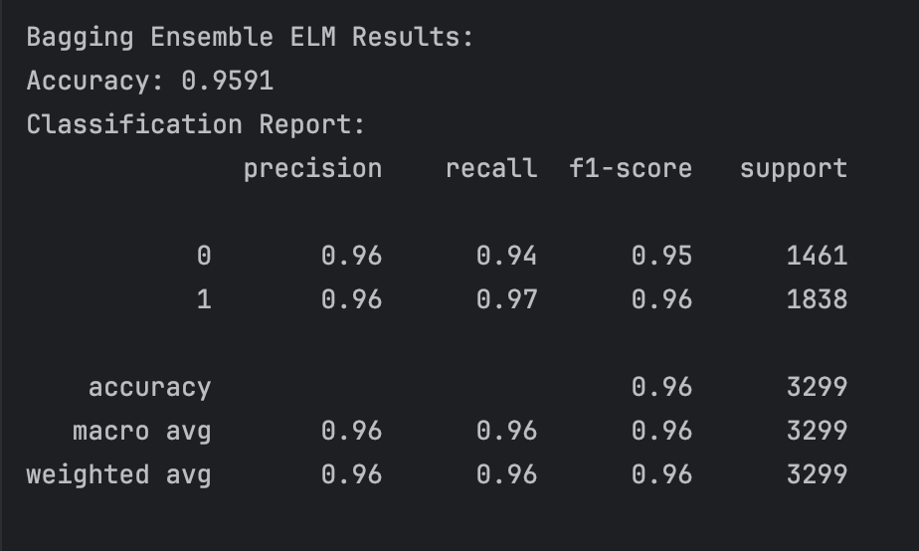
Results

Slide 13
Flask for Real-Time Phishing Detection
A Flask-based web server that hosts the trained phishing detection model and provides a RESTful API for real-time predictions.
Loads the StackingEnsemble model from stacking_ensemble.pkl at startup. /predict (POST) - Accepts a URL in JSON. Uses run_checks to extract features from the URL. Returns whether the URL is phishing (0 or 1) with confidence probabilities (if available).
Enables the browser extension to send URLs and receive predictions, warning users about potential phishing sites in real-time.
Technical Details:
Built with Flask and Python.
Runs on 0.0.0.0:5050 in debug mode for development.
Handles errors like model loading failures or invalid inputs gracefully.
Notes:
This system features a Flask web server that hosts a trained phishing detection model and provides a RESTful API for real-time predictions." "At startup, it loads the StackingEnsemble model from the stacking_ensemble.pkl file. The /predict (POST) endpoint accepts a URL in JSON, runs checks to extract features from the URL, and returns whether the URL is phishing (0 or 1) with confidence probabilities if available." "This setup enables a browser extension to send URLs and receive predictions, warning users about potential phishing sites in real-time." "Technically, it’s built with Flask and Python, runs on 0.0.0.0:5050 in debug mode for development, and handles errors like model loading failures or invalid inputs correctly."

Slide 14
Frontend Implementation
The primary goal of the extension's frontend is to ensure a compact and user-friendly experience, making it more convenient than a traditional webpage.
Tech Stack:
HTML, CSS, VanillaJS
Features:
Instantly identifies whether a website is a phishing site, eliminating the need for manual searches.
Includes a separate webpage that displays all websites blocked by the user.
Provides an option to unblock previously blocked websites.
Notes:
Moving on to the frontend implementation, the primary goal is to ensure a compact and user-friendly experience, making it more convenient than a traditional webpage." "The tech stack includes HTML, CSS, and VanillaJS." "Key features include instantly identifying phishing sites to eliminate the need for manual searches, providing a separate webpage that displays all websites blocked by the user, and offering an option to unblock previously blocked websites."

Slide 15


Slide 16
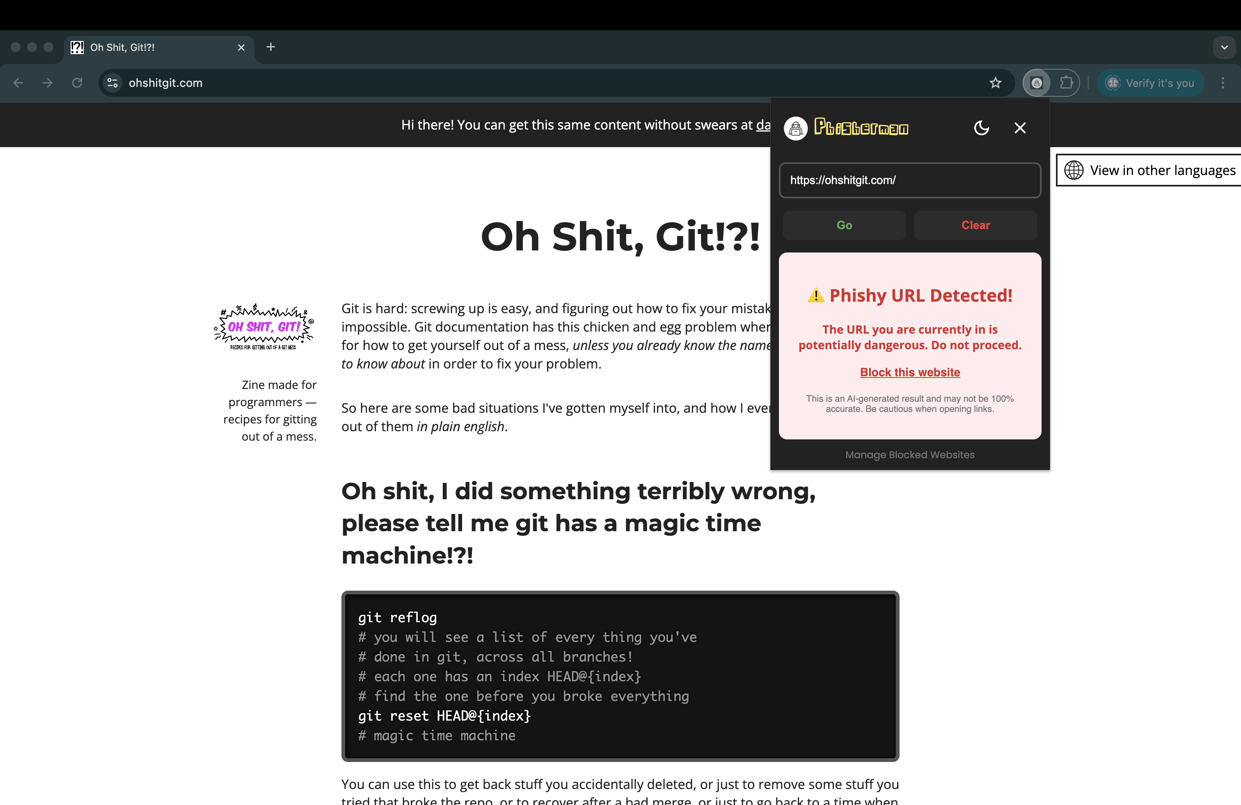

Slide 17
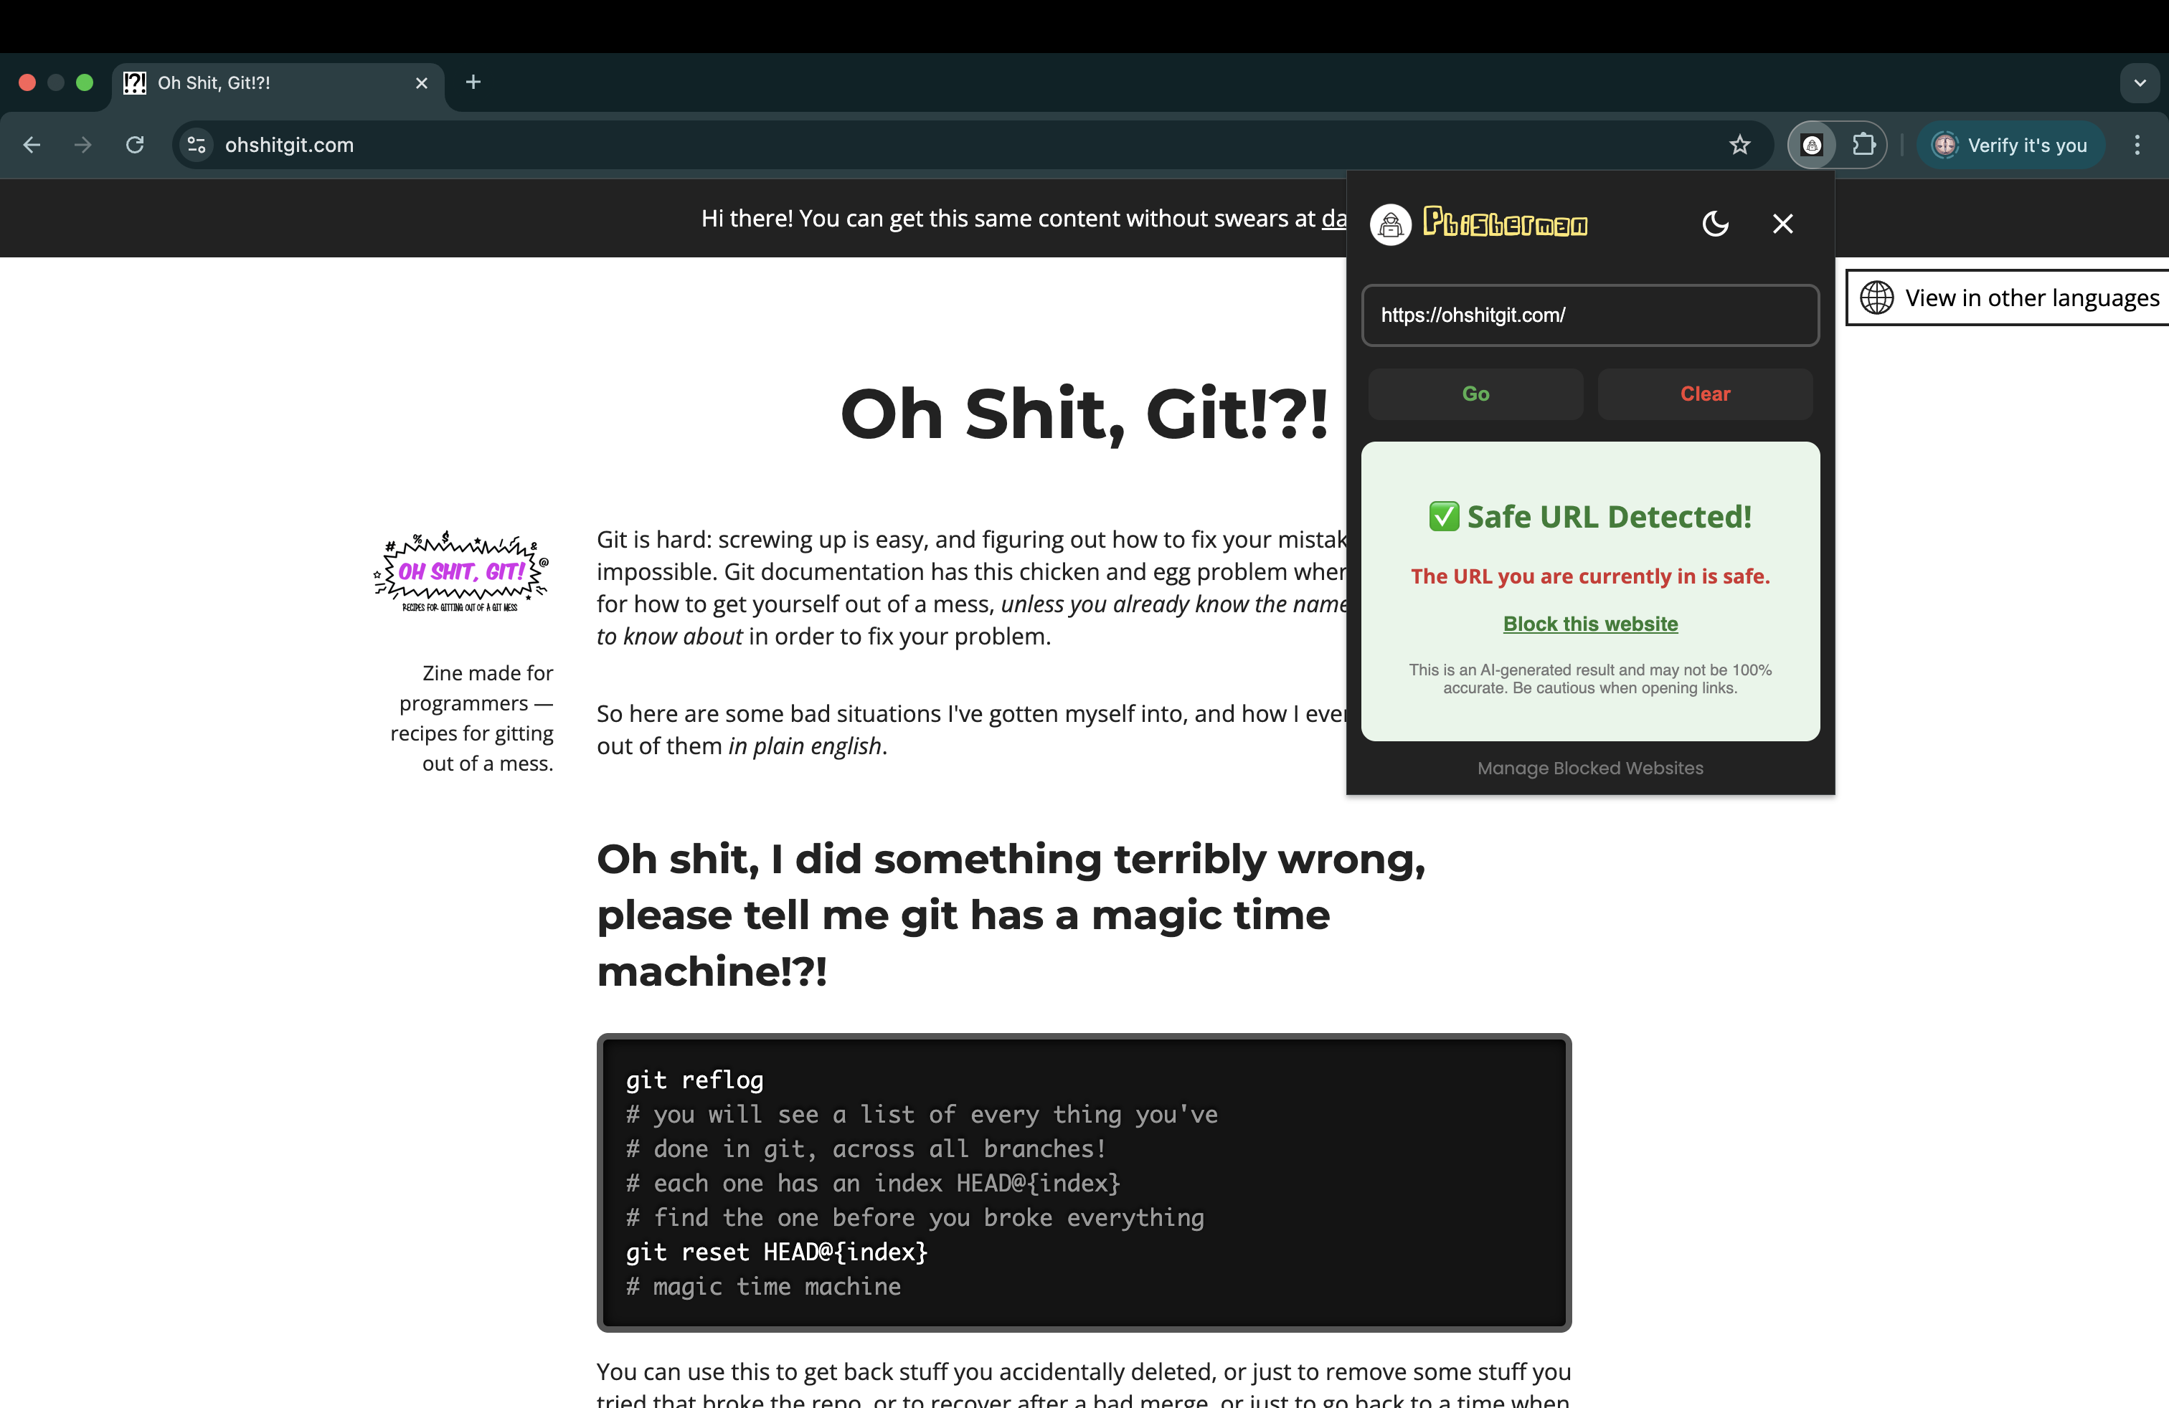

Slide 18


Slide 19
Future Implementations
Enable users to report suspicious URLs directly through the browser extension. Allows users to flag potential phishing websites, with reported URLs reviewed by the development team and added to the database if verified. Keeps the model up to date with emerging threats by leveraging crowdsourced reports, enhancing accuracy and responsiveness.
Host the trained model on a cloud platform and publish the browser extension to web stores (e.g., Chrome Web Store). Makes the phishing detection tool widely accessible to real-world users. Increases reach, gathers user feedback, and provides data to refine the model, improving the tool's effectiveness over time.
Notes:
Looking ahead, we plan to enable users to report suspicious URLs directly through the browser extension. This allows users to flag potential phishing websites, with reported URLs reviewed by the development team and added to the database if verified, keeping the model updated with emerging threats through crowdsourced reports, enhancing accuracy and responsiveness." "Additionally, we aim to host the trained model on a cloud platform and publish the browser extension to web stores like the Chrome Web Store. This will make the phishing detection tool widely accessible to real-world users, increase reach, gather user feedback, and provide data to refine the model, improving its effectiveness over time."

Slide 20

GitHub Repo
https://github.com/ritwikdurga/Phisherman

Slide 21
References
https://ieeexplore.ieee.org/document/8355342
https://archive.ics.uci.edu/dataset/327/phishing+websites
https://www.kaggle.com/code/andreicosma/extreme-learning-machine-neural-network
https://www.sciencedirect.com/science/article/pii/S1568494616303970
https://www.sciencedirect.com/science/article/pii/S0925231206000385
https://www.sciencedirect.com/science/article/pii/S0957417416000385
https://link.springer.com/article/10.1007/s00521-013-1490-z

Slide 22
Thank You

