Slide 1
GlucoTwin Ward
A live glucose twin for every inpatient with diabetes: it warns about lows before they happen, checks insulin before it is given, targets monitoring and hands over new diabetes at discharge
[Team name] · Indian Institute of Management Lucknow · Digital Twin in Healthcare PoC Challenge 2026
Research prototype on synthetic patients · not a medical device · never recommends a dose
Notes:
GlucoTwin Ward gives every inpatient with diabetes a live glucose twin that helps the ward prevent lows, catch unsafe insulin doses, monitor the right patients and hand over properly at discharge.

Slide 2
Diabetes on the ward goes wrong in predictable ways
~1 in 4
Lows happen between checks
1
18% moderate and 2.8% severe lows in 54,502 admissions, linked to longer stays, readmission and 90-day mortality.
inpatients has diabetes or high glucose (27-hospital bedside audit)
Insulin errors are routine
2
Up to 39% of insulin-treated inpatients had an insulin error; 29% of surgical patients had a peri-operative diabetes plan.
Steroid highs are missed by design
3
Morning steroids push glucose up in the afternoon and evening; wards check fasting glucose.
New diabetes leaves undiagnosed
4
About a quarter of hyperglycaemic admissions in a 2026 Delhi study had undiagnosed diabetes.
Sources: SHM Converge 2025 · Med J Aust 2021 (QuIDS) · Medicine Today 2014 · J Assoc Physicians India 2026
Notes:
On general wards glucose is managed with fingersticks four times a day, paper sliding scales and one round a day. Four failure modes recur: lows between checks, insulin errors, missed steroid highs and missed new diabetes.

Slide 3
What research has not solved yet
Hospital risk models
Inpatient CGM
Insulin dosing software
Retrospective, single-centre, predict once at admission; not tested in real time (2025 studies).
Cut serious lows in an RCT (Diabetes Care 2020), but not approved for hospital use in most places; needs staff and training.
The one mature system is US-only. Indian wards run on paper sliding scales.
The gap
A live, patient-level picture of the next 12 hours, built from what the ward already records, that works on fingersticks today and uses a CGM when one is worn.
Notes:
Research models score once at admission. CGM works in trials but is not yet a hospital standard. Dosing software is US-only. Nobody gives an Indian ward a live 12-hour picture per patient.

Slide 4
Four features, one screen each, at moments the ward already has
1
Ward risk board
2
Before you give insulin
Shift start
Before each dose
Every patient sorted by chance of a low or severe high in the next 12 h, with reasons from their own record. Red only for lows.
Bedside checks plus the chance of a low if given, reduced or held. Doctors can try a dose. Never proposes one.
3
Smart monitoring
4
Discharge handover
Overnight
Going home
An extra fingerstick at the riskiest hour for high-risk patients; a CGM for the highest-risk ones.
Glucose during the stay, lows, steroids, kidney changes, probable new diabetes, a follow-up to book.
Left out on purpose: chatbot · patient app for inpatients · automatic dosing
Notes:
The PM rule: no feature without a moment in the ward's existing day. Four screens, each used at a moment that already exists.

Slide 5
What makes it a twin
1
2
3
4
5
6
Synchronise hourly
Use orders already written
Predict 12 h
Simulate a dose
Check before giving
Record decisions
Known future
Honest uncertainty
Tonight's basal, tomorrow's fasting order and the steroid course are written in advance. The twin uses them; published models cannot.
Every forecast has an 80% range that contains the outcome 81-91% of the time on test patients.
Hybrid what-if
Every decision recorded
Insulin effects come from a pharmacology layer, validated against counterfactual simulations, because record-trained models cannot learn them.
Flags, what-ifs, given/held decisions, extra checks and bookings go to an audit log with the model version.
Notes:
A dashboard shows the past. This twin keeps each patient's state, uses orders already written, predicts, simulates and records.

Slide 6
Synthetic ward, real hospital formats
800
73k
~50%
5
admissions over 60 days: sepsis, cardiac surgery, COPD/asthma, heart failure, orthopaedics
FHIR R4 resources (Bulk Data NDJSON): the only thing the twin reads
of admissions wear a CGM, which supplies outcome labels
process failures injected at stated rates (hidden ground truth)
Physiology
Ward process
Counterfactual-ready
Meals and how much is eaten, rapid and basal insulin, sulfonylureas, steroids peaking in the afternoon, stress, kidney injury, counter-regulation.
Fingerstick protocol, sliding scale, 09:00 titration round, fasting orders for procedures, hypoglycaemia protocol with rechecks.
Each patient has independent random streams: change one dose and re-run, and everything before the dose is identical.
Notes:
The simulator is realistic where it matters: steroid patients read about 156 at 07:30 and peak around 220 by evening; fingersticks find lows in 9% of admissions while CGM finds them in about a fifth.

Slide 7
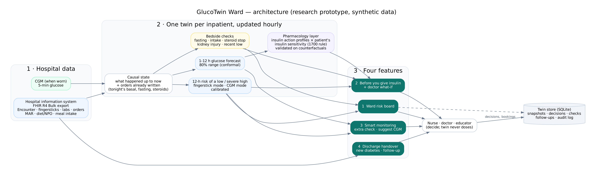
Architecture
Data in
Models
Out
FHIR R4 Bulk export from the hospital system + CGM. Swap synthetic for real without touching the models.
LightGBM 12-h risk (fingerstick and CGM modes), 1-12 h forecasts with conformal ranges, pharmacology layer.
Streamlit ward app and REST API; SQLite store with snapshots, decisions and audit.

Slide 8
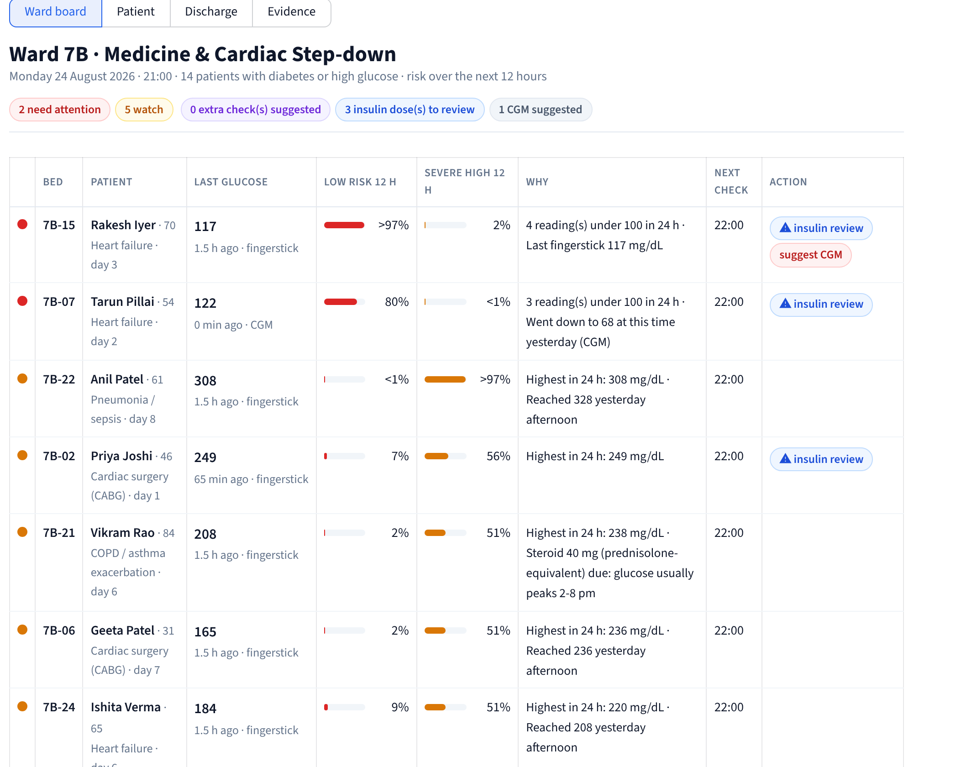
The ward board at 21:00, before the bedtime insulin round
1
Sorted by risk
Two red patients (risk of a low), five amber (likely severe high).
2
Reasons in ward language
From each patient's own record: readings under 100, steroid given this morning, fasting tomorrow.
3
Actions
Insulin doses to review; CGM suggested; extra check times.

Slide 9
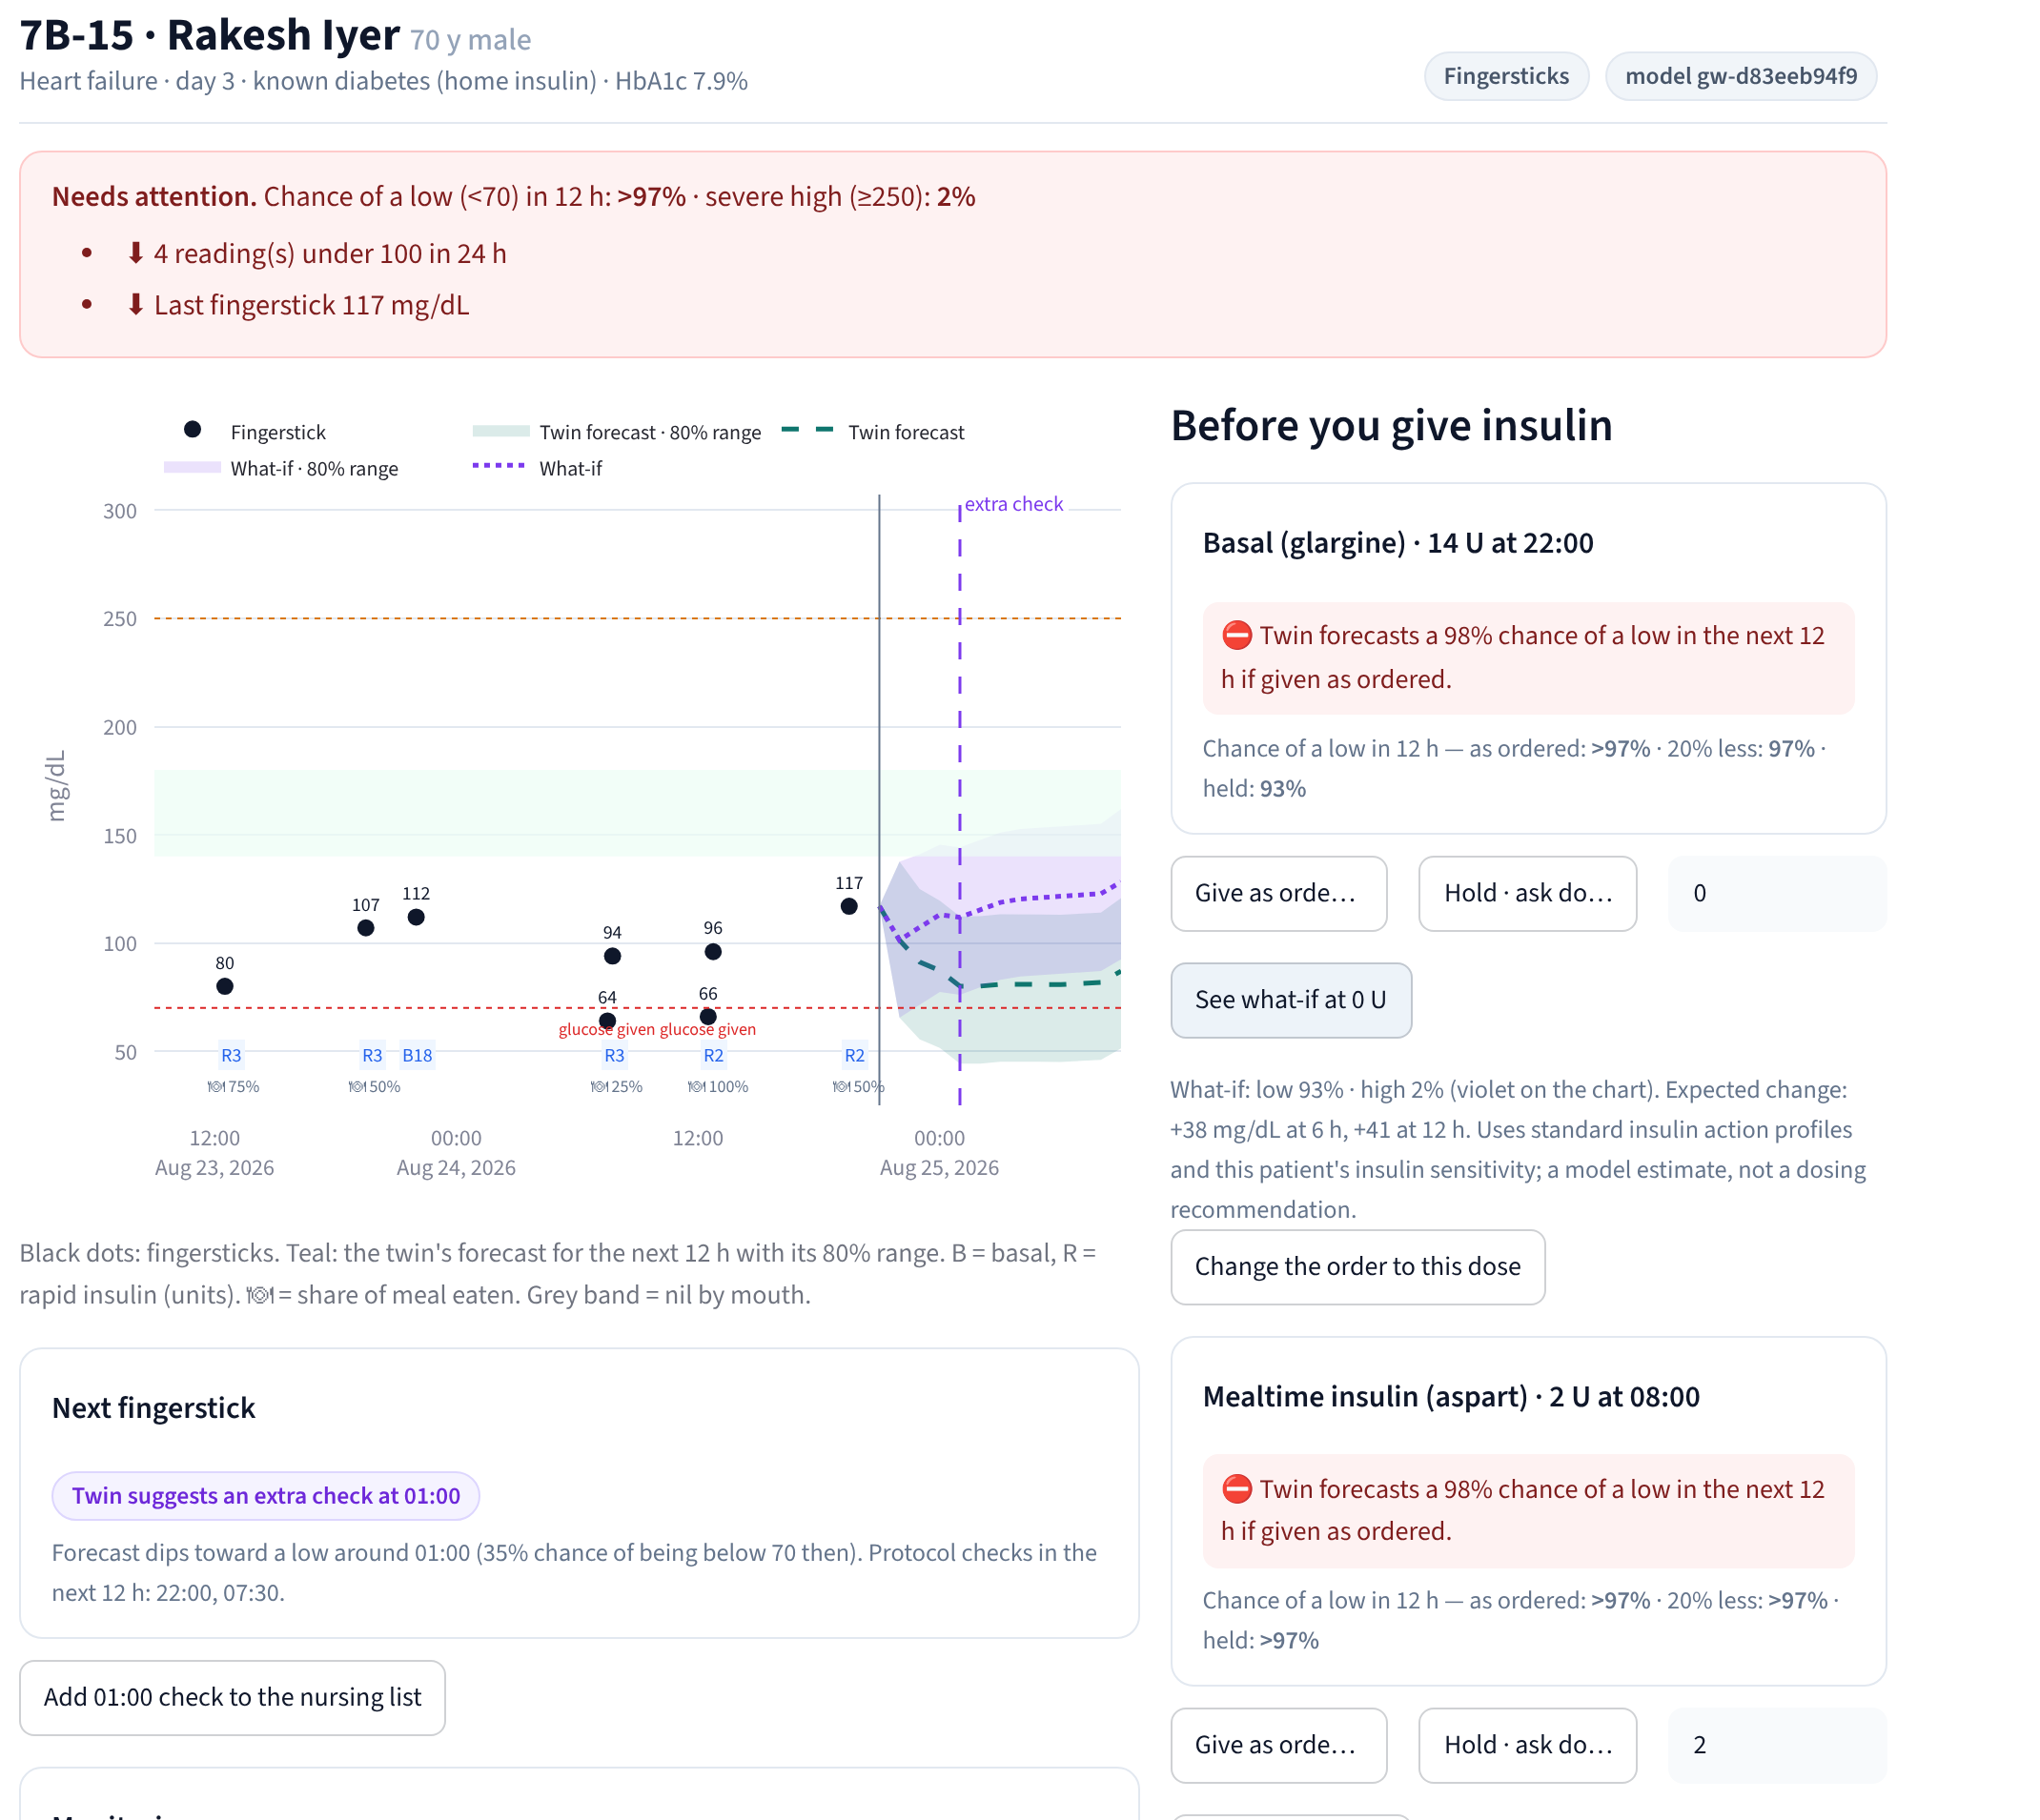
One patient's twin: check, simulate, monitor
1
Before you give insulin
Basal 14 U due at 22:00: 98% chance of a low in 12 h if given as ordered.
2
Doctor what-if
Hold the dose: forecast rises ~38 mg/dL (violet), chance of a low falls. The doctor decides; the decision is recorded.
3
Smart monitoring
Extra check suggested at 01:00 and a CGM for this patient.

Slide 10
The live twin beats an admission-time model by a wide margin
69%
of lows flagged red before they started (fingersticks), median 11 h ahead
0.64
red hours per patient-day: a light alert load
81-91%
of outcomes fall inside the twin's 80% forecast range

Slide 11
The insulin check catches unsafe doses before they are given
Injected process failure | Flagged before the dose
Mealtime insulin while nil by mouth | 24 / 24
Basal not reduced the night before a fast | 38 / 38
Insulin not reduced after the steroid course ended | 26 / 31
Insulin not reduced after kidney injury | 81 / 91
Sulfonylurea given while fasting | 7 / 7
92%
of all injected unsafe situations flagged (bedside rules, all 800 admissions)
4.7%
of routine doses get a high-level flag: low noise for nurses
Rules a nurse can verify at the bedside: fasting, poor intake, steroid stopped, kidney injury, low recent glucose. The twin never proposes a dose.

Slide 12
Dose what-ifs: pharmacology beats learning from records
Holding tonight's basal: glucose at 6 h
True +25 · twin +23 · learned model +2 mg/dL
Why
Doctors give more insulin to patients who run high, so a model trained on records cannot separate a dose's effect from its reason (confounding by indication). The twin uses textbook insulin action profiles × the patient's insulin sensitivity, scaled on training patients and tested on counterfactual re-runs of test patients.
Mealtime insulin: error 5.4 vs 10.7 mg/dL · 60 test dose events

Slide 13
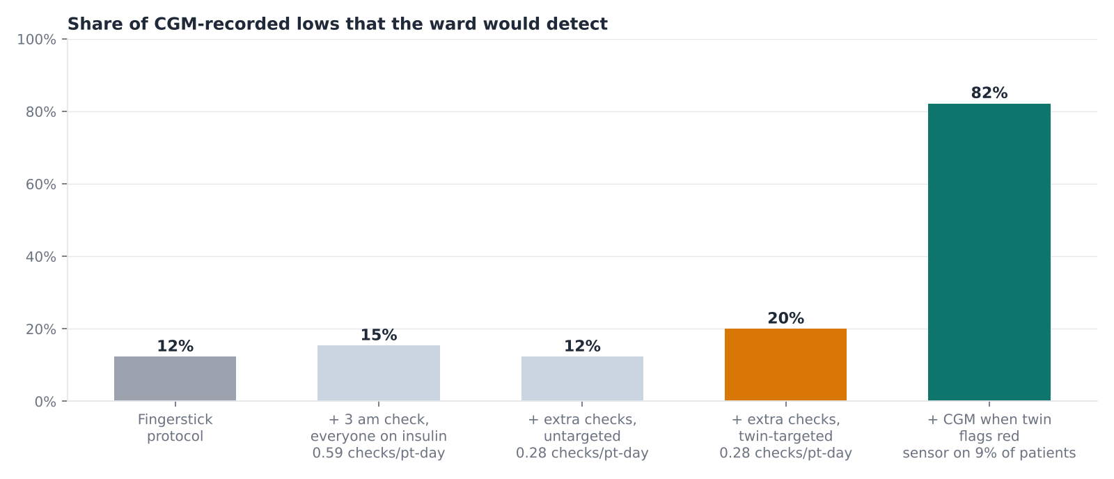
Fingersticks miss most lows: target the patients who need more
12%
of CGM-recorded lows are caught by routine fingersticks
4.7 vs 0.9
extra lows caught per 100 extra checks: twin-targeted vs a 3 am check for everyone
80%
of lows happen after the twin's first red flag: a CGM then needs a sensor on only 9% of patients

Slide 14
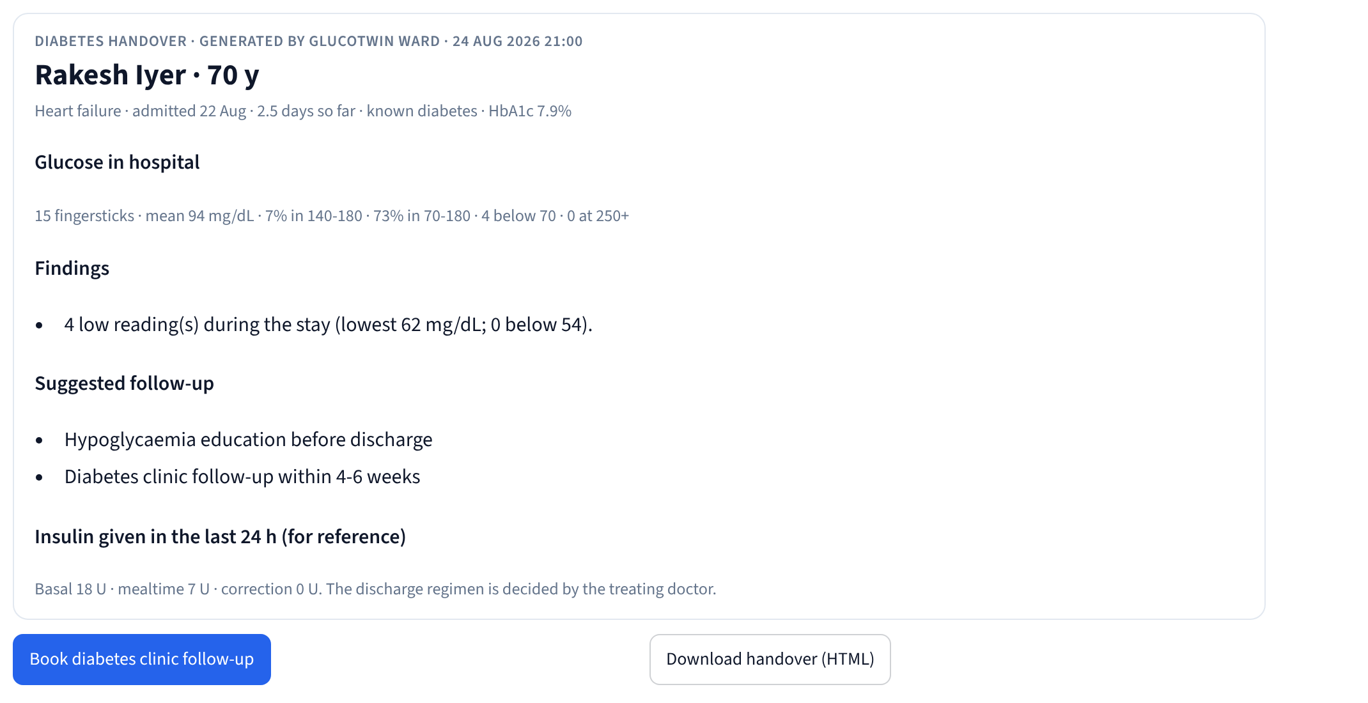
Discharge handover closes the loop the ward drops
91%
of 127 patients with undiagnosed diabetes identified (64%) or prompted for HbA1c (28%)
0
false new diagnoses among patients with stress hyperglycaemia only
Also on the page: lows during the stay, steroid course, kidney changes, insulin started in hospital, a follow-up to book. It brings follow-up visits back to the hospital's own diabetes clinic.

Slide 15
From prototype to one real ward
1
Integrate
2
Shadow mode
3
Live
4
Decide
4-6 weeks
3 months
3 months
Gate
FHIR export from the hospital system: encounters, fingersticks, MAR, diet/NPO orders, labs. Connected glucometers if available.
One ward. Predictions recorded, not shown. Measure real accuracy; recalibrate thresholds; test the what-if on real dose changes.
Board and checks shown to staff; compare with shadow period and a matched ward.
Expand, change or stop on lows per 100 patient-days, good diabetes days, flags overridden, nurse time, new diabetes captured, follow-ups.
Regulation and privacy
CDSCO medical device software guidance (July 2026): prediction/monitoring software is medical device software; AI must disclose training data (real or synthetic), Indian sub-population robustness, change control and drift monitoring. Positioned as decision support with human review and no dose recommendation. DPDP by design.

Slide 16
Limitations, stated plainly
1
All evidence is synthetic: the next step is shadow mode on real ward data.
2
The simulator sets physiology, ward routines and failure rates; real wards will differ.
3
Dose what-ifs are validated on counterfactuals that share the simulator's assumptions.
4
Fingersticks have a low ceiling for catching lows; that is why the CGM suggestion matters.
5
Not covered: ICU, insulin infusions, tube feeds, type 1 diabetes, DKA, children, pregnancy.

Slide 17
Every inpatient with diabetes gets a twin
that warns, checks, targets and hands over.
0.47 vs 0.12
92%
80%
91%
AUPRC for lows: twin vs admission model
unsafe doses flagged before giving
of lows covered by a CGM on 9% of patients
undiagnosed diabetes caught at discharge
github.com/ritwiksarkar11/glucotwin · make app
Research prototype on synthetic patients · Apache-2.0

