Slide 1


Data Structures and Algorithms -3 (25CS2103E)
Title of the project
TEAM MEMBERS
V.RITWIK 2520080051
G.NANDA KISHORE 2520080050
Under the Esteemed Guidance of
Mrs. Ch. Anitha
Asst. Professor, CS&IT

Slide 2
Contents
  Abstract
  Introduction
  Literature survey
  Problem Statement and Objectives
  Hardware and Software requirements
  Results
  Conclusion
  Future Scope

Slide 3
Abstract
Online shopping platforms often contain multiple listings of the same product from different sellers. These listings may have different product names, descriptions, prices, or formatting, making it difficult for customers to identify the same product and compare prices. The E-Commerce Product Entity-Resolution & Matching Platform is designed to solve this problem by automatically detecting similar product listings and grouping them into a single product. This helps users easily compare prices offered by different sellers and make better purchasing decisions while reducing duplicate product records.
The proposed system is developed using the MERN Stack, which includes MongoDB, Express.js, React.js, and Node.js. It uses several Data Structures and Algorithms to perform efficient product matching. Product titles are first cleaned and tokenized, after which an Inverted Index is created to reduce unnecessary comparisons. The similarity between product titles is calculated using Jaccard Similarity, while Levenshtein Distance is used to identify minor spelling differences or typing errors. A weighted similarity score is then used to determine whether two products represent the same item, and the Union-Find (Disjoint Set Union) algorithm groups matching products into a single cluster.
The platform provides features such as product upload, product matching, duplicate detection, price comparison, and grouped product display. By combining modern web technologies with efficient algorithms, the system offers a practical solution for e-commerce applications while demonstrating the real-world use of data structures and algorithms. The project is scalable, user-friendly, and can be enhanced in the future with advanced AI-based product matching, recommendation systems, and real-time data integration from multiple online marketplaces.

Slide 4
Introduction
The E-Commerce Product Entity-Resolution and Matching Platform is a system designed to identify and match similar products listed across different online stores. E-commerce websites often use different product names, descriptions, brands, and formats for the same product, making it difficult to compare them accurately. This project solves this problem by using Data Structures and Algorithms to detect products that represent the same real-world item.
The system processes product information using techniques such as tokenization, inverted indexing, Jaccard similarity, and Levenshtein distance to measure the similarity between product listings. A weighted matching score is then calculated to determine whether two products are likely to be the same. Union-Find is used to group matching products into clusters, while a canonical product is selected to represent each group. The platform can also help users compare prices across different sellers, making product searching faster, more accurate, and more convenient.

Slide 5
Literature Survey
  Elmagarmid et al. (2007) studied duplicate record detection and entity resolution techniques. Their work explained how similar records can be identified and grouped even when their information is not exactly the same.
  Christen (2012) presented different data-matching and entity-resolution techniques, focusing on blocking and similarity-based approaches. These methods help reduce the number of unnecessary comparisons when working with large datasets.
  Cohen et al. (2003) explored string similarity techniques for matching product and textual data. Measures such as Jaccard similarity are useful for comparing product names and descriptions based on their common tokens.
  Levenshtein (1966) introduced an edit-distance approach for measuring the difference between two strings. It is useful for detecting spelling variations and small differences in product names.
  Existing e-commerce comparison systems mainly focus on searching and displaying products, while our proposed platform combines tokenization, inverted indexing, Jaccard similarity, Levenshtein distance, weighted matching, and Union-Find clustering to perform efficient product entity resolution.

Slide 6
Problem Statement and Objectives
Problem Statement
Online stores often list the same product using different names, descriptions, brands, and formats. Because of these variations, identifying whether two product listings represent the same real-world product becomes difficult. Traditional keyword-based searches may fail to recognize products with spelling differences, different word orders, abbreviations, or incomplete descriptions. This makes accurate product comparison and price analysis challenging. Therefore, there is a need for an efficient system that can identify, match, and group duplicate or similar product listings from different e-commerce sources using suitable Data Structures and Algorithms.
Objectives
  To identify the same products listed under different names or descriptions.
  To preprocess and tokenize product information for efficient matching.
  To use Jaccard Similarity to compare common product terms.
  To use Levenshtein Distance to detect spelling and textual variations.
  To improve search efficiency using an Inverted Index and blocking techniques.
  To calculate a weighted matching score for more accurate product matching.
  To group matching products using the Union-Find data structure.
  To identify a canonical product for each group of matched listings.
  To enable efficient comparison of products and their prices across sellers.

Slide 7
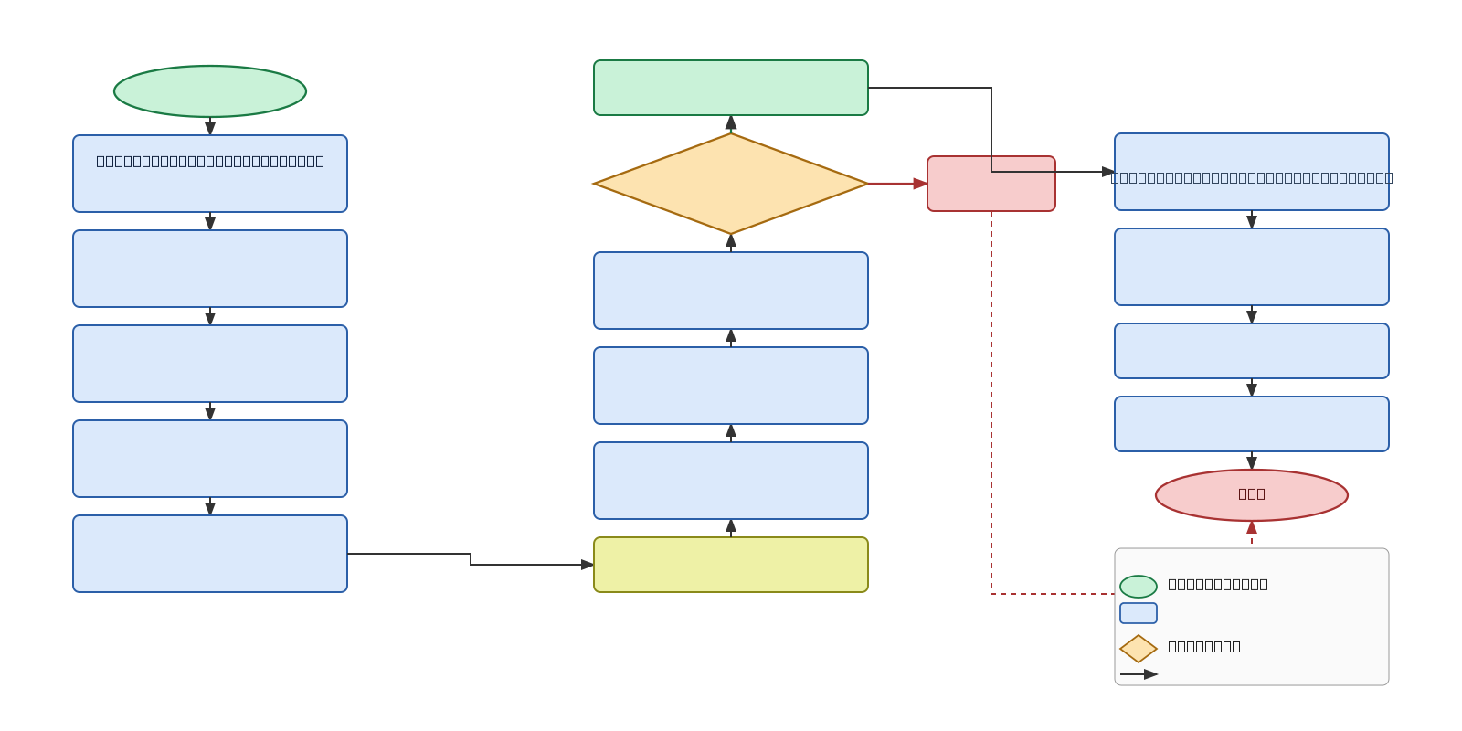
Flow Chart

Slide 8
Results
The proposed E-Commerce Product Entity-Resolution and Matching Platform successfully identifies and groups product listings that belong to the same real-world product, even when their names or descriptions differ. The system preprocesses product data, compares listings using Jaccard Similarity and Levenshtein Distance, and generates a weighted matching score to improve matching accuracy.
The Inverted Index reduces unnecessary comparisons and improves the efficiency of the matching process. The Union-Find algorithm successfully groups matching product listings into clusters, while a canonical product represents each cluster. The system can therefore organize duplicate listings from different sellers and support effective product and price comparison.
Overall, the results demonstrate that combining multiple DSA techniques provides a more efficient and reliable approach to product matching than simple keyword-based searching.

Slide 9
Hardware and Software requirements
Hardware Requirements :
  Processor: Intel Core i3 / AMD Ryzen 3 or above
  RAM: Minimum 4 GB, recommended 8 GB
  Storage: Minimum 10 GB of free space
  Display: 1366 × 768 resolution or higher
  Internet: Stable internet connection for development and data access
  Input Devices: Keyboard and mouse
Software Requirements :
  Operating System: Windows 10/11, Linux, or macOS
  Frontend: React.js, HTML, CSS, JavaScript
  Backend: Node.js with Express.js
  Database: MongoDB
  Programming Language: JavaScript
  Data Structures & Algorithms: Tokenization, Inverted Index, Jaccard Similarity, Levenshtein Distance, Weighted Matching, and Union-Find
  Development Environment: Visual Studio Code
  Version Control: Git and GitHub
  Web Browser: Google Chrome / Microsoft Edge

Slide 10
Conclusion
The E-Commerce Product Entity-Resolution and Matching Platform provides an efficient solution for identifying and matching similar products across different online stores. By using Data Structures and Algorithms such as tokenization, inverted indexing, Jaccard similarity, Levenshtein distance, weighted matching, and Union-Find, the system can handle variations in product names and descriptions and group related listings accurately.
The platform reduces duplicate product records and makes it easier to identify the same product from different sellers. It can also support price comparison by combining matching products into a common group. Overall, the proposed system demonstrates how DSA concepts can be applied to solve a real-world e-commerce problem while improving matching accuracy, search efficiency, and product comparison.

Slide 11
Future Scope
  AI Integration: Use AI to make product matching more accurate.
  Live Data: Get updated product prices and details directly from online stores.
  Better Text Matching: Use advanced language techniques to understand product names and descriptions better.
  More Products: Improve the system to handle a very large number of products.
  Price Tracking: Track price changes, discounts, and offers.
  Product Recommendations: Suggest similar or useful products to users.
  Image Matching: Match products using their images along with their names and descriptions.
  Mobile App: Develop a mobile application for easier product comparison.

Slide 12
Thank you

