Slide 1
CSE 579 KNOWLEDGE REPRESENTATION AND REASONING
PRISM
Representation-aware retrieval routing for structural mismatch in question answering.
Production: computed_ras
Research overlays: rescue, RAS_V3, RAS_V4
BM25 + Dense + KG + Hybrid
Problem
KRR approach
Contribution
Retrieval can fail when the representation does not match the query.
Reason over query structure, route adequacy, evidence, and trace.
An inspectable router across BM25, Dense, KG, and Hybrid.
Contributions: Ritik - production integration, demo, report, release package | Omkar - TBD | Vaishnavi - TBD | Moin - TBD
PRISM | CSE 579 Final Presentation
1 / 7

Slide 2
PROBLEM
One retriever cannot preserve every kind of structure.
A query can be answerable in the corpus but fail because the retrieval representation is inadequate.
Lexical
Semantic
Deductive
Relational
RFC numbers, identifiers, and code-like strings need exact matching.
Paraphrases and conceptual similarity need dense retrieval.
Class, property, and membership questions need structured graph evidence.
Bridge questions need fused text and structural evidence.
PRISM makes representation choice explicit, inspectable, and measurable.
Motivating example
The same corpus can contain the answer, but RFC-7231, climate-anxiety paraphrases, and mammal capability questions require different representations.
PRISM | CSE 579 Final Presentation
2 / 7

Slide 3
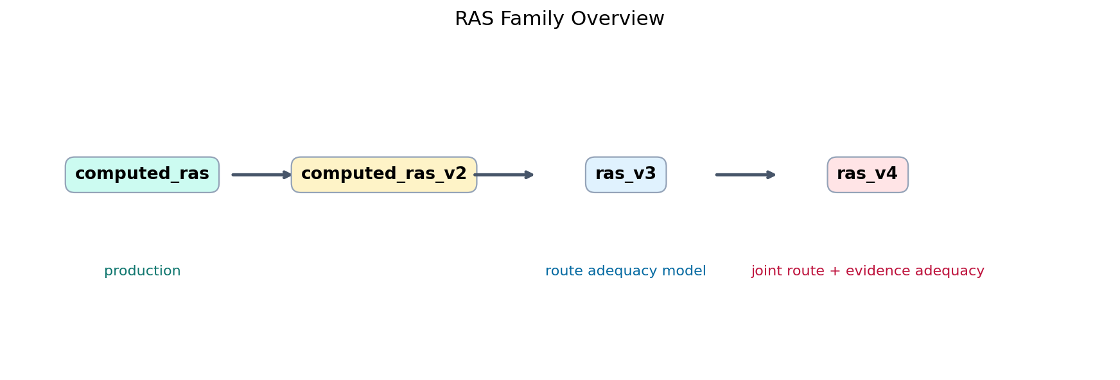
KRR INSIGHT
Structural mismatch is a representation adequacy problem.
The reasoning step is not only answer generation. PRISM first reasons about which representation can support the query.
1. Query
2. Route
3. Evidence
4. Trace
Extract lexical, semantic, deductive, and relational signals.
RAS scores BM25, Dense, KG, and Hybrid candidates.
Selected backend retrieves provenance-bearing support.
Answer cites evidence ids and exposes rationale.
This is the reasoning process behind the method: represent the query need, choose the adequate representation, then justify the answer with evidence.
PRISM | CSE 579 Final Presentation
3 / 7

Slide 4
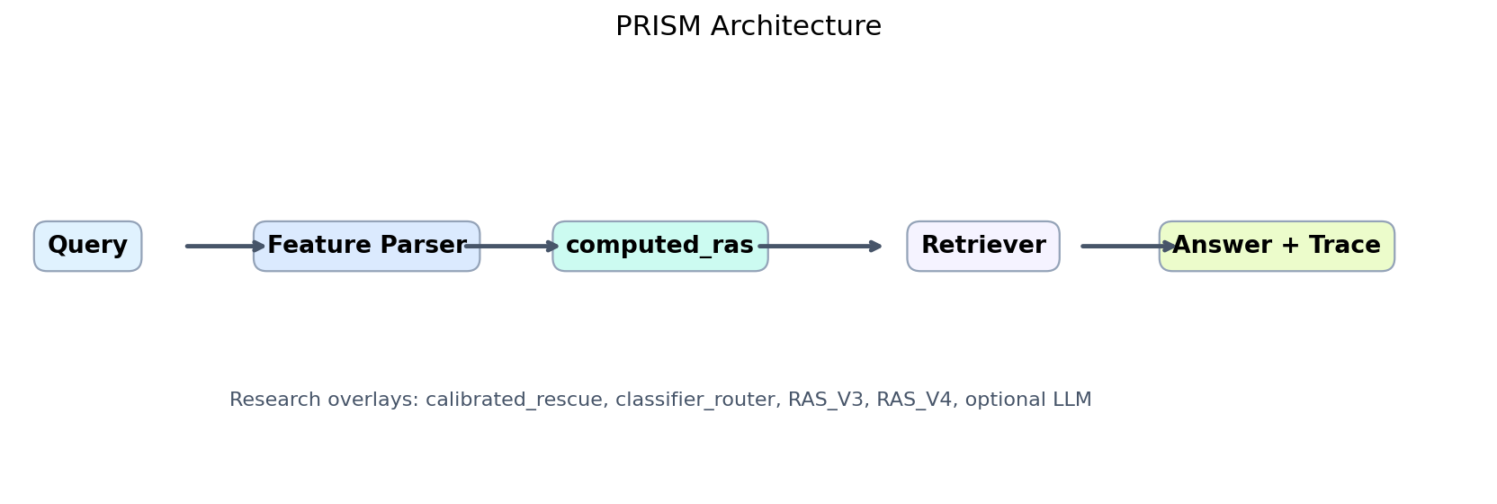
SYSTEM
PRISM architecture and RAS
Production
computed_ras is the default deterministic router.
RAS_V3
Interpretable route-adequacy model; analysis-only.
RAS_V4
Joint route-and-evidence adequacy model; analysis-only.
Calibrated rescue
Research/demo overlay strongest on adversarial answer accuracy.
Design choice: keep production deterministic and use research overlays to measure hard-case improvements without changing the default route policy.
PRISM | CSE 579 Final Presentation
4 / 7

Slide 5
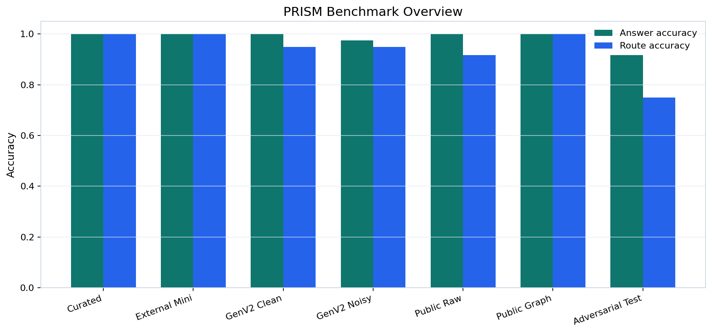
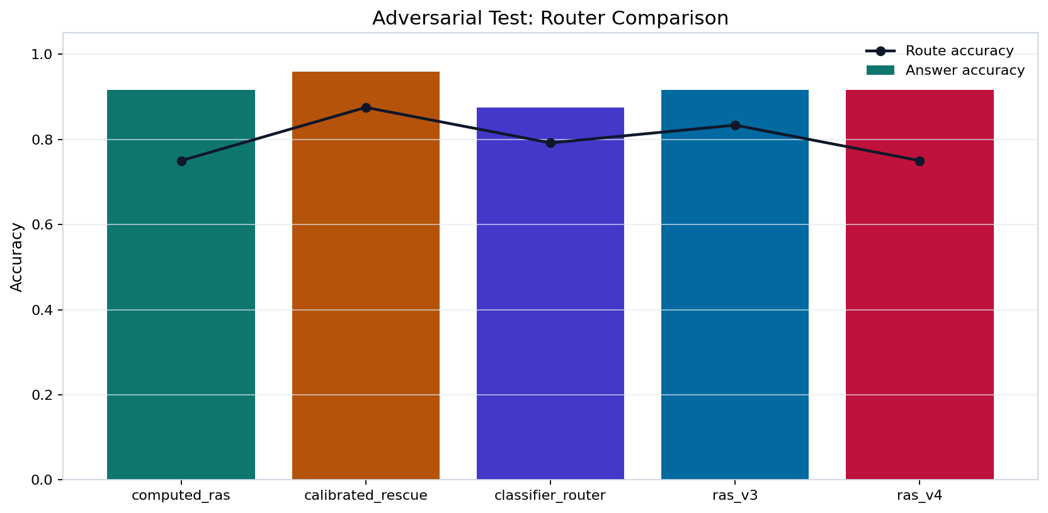
EVALUATION
Strong on stable layers, honest on hard cases.
80/80
1.000
0.917
0.958
Curated end-to-end
Public raw and public graph tests
computed_ras adversarial test answer
calibrated rescue adversarial test answer
Finding: representation-aware routing is stable on standard layers; hard ambiguity shows evidence rescue is complementary.
PRISM | CSE 579 Final Presentation
5 / 7

Slide 6
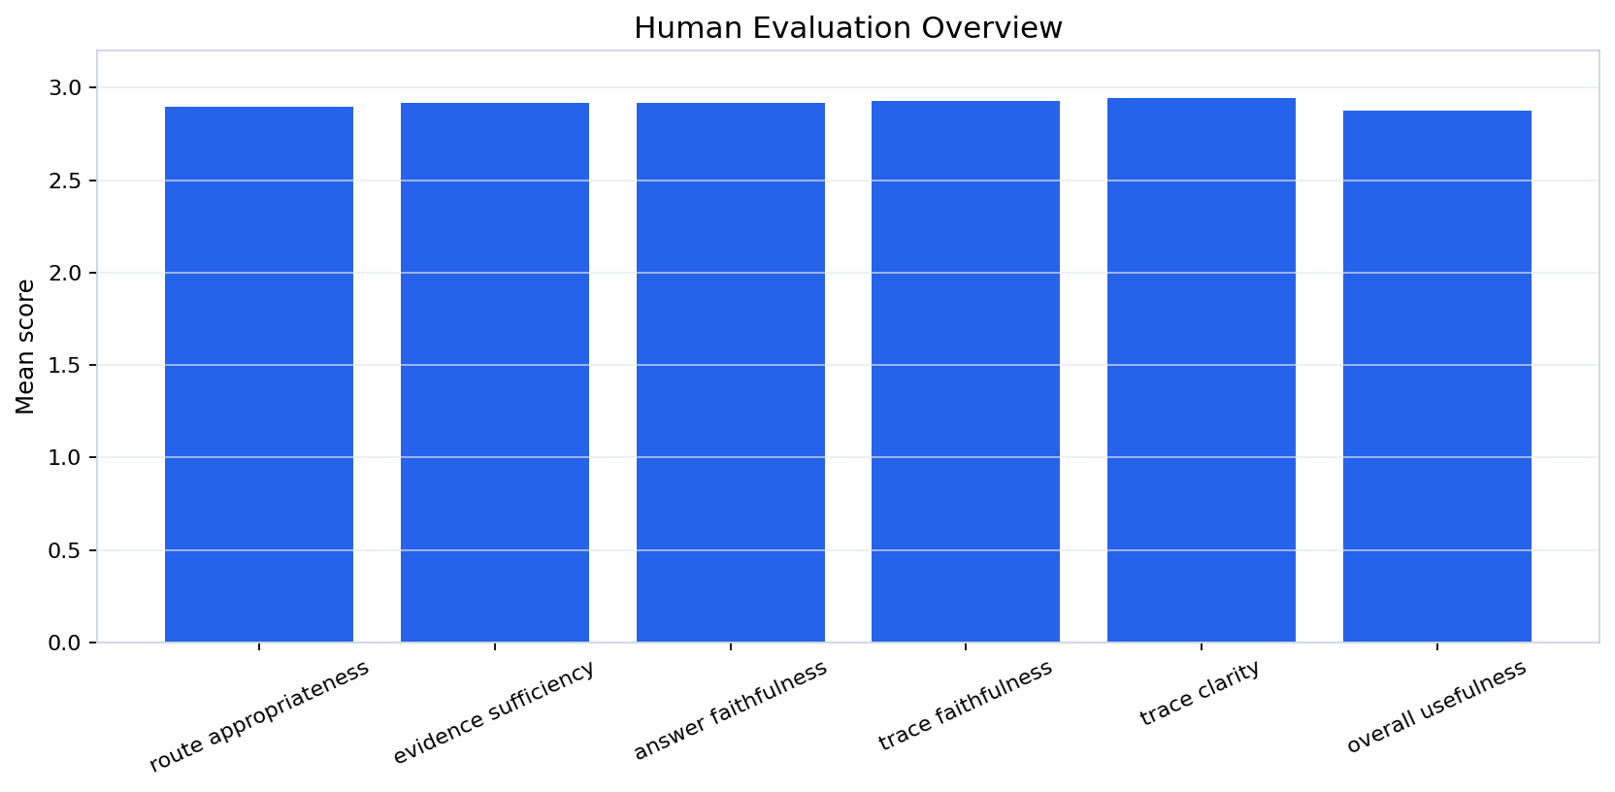
DEMO AND EVIDENCE
The UI exposes the full reasoning path.
Demo path: Executive Summary -> Guided Demo -> Demo / Query.
Canonical queries cover lexical, semantic, deductive, and relational retrieval.
Each run shows parsed features, route scores, selected backend, evidence ids, answer, and trace.
Human evaluation supports trace clarity and faithfulness, with small-study caveats.
Demo fallback
Benchmark-safe mode remains reproducible if optional open-corpus or LLM components are unavailable.
PRISM | CSE 579 Final Presentation
6 / 7

Slide 7
TAKEAWAYS
Takeaways, contributions, and limitations
Main contribution
Main result
Main limitation
Representation-aware routing across BM25, Dense, KG, and Hybrid.
Stable benchmark performance; calibrated rescue is strongest on hard adversarial answer accuracy.
Hard route-boundary cases still require better uncertainty and evidence adequacy.
Ritik
Omkar
Vaishnavi
Moin
Production integration, routing/demo stability, final report, release package, presentation deliverables.
TBD by teammate.
TBD by teammate.
TBD by teammate.
Final decision: production remains computed_ras. PRISM is bounded source-pack/local/open-corpus QA, not web-scale search.
Presentation target: finish in 5 minutes; each slide maps directly to problem, KRR approach, reasoning process, results, and contribution.
PRISM | CSE 579 Final Presentation
7 / 7

