Slide 1

Final Project: “Predicting Real estate prices”
Team Members:
Srivas Sathyanarayanan(200544678)
Anjana Kappadan(200573241)
Rithin Ravi(200567791)
Fousina Shaji (200575302)
This Photo by Unknown Author is licensed under CC BY

Slide 2
Problem Definition
Objectives :
Developed a machine learning model to predict real estate prices based on property features.
Goal: Our goal for this project was to create a machine learning model to predict real estate prices based on property features. Why does this matter? Accurate price predictions help buyers, sellers, and investors make smarter decisions. This project has real-world significance in improving market transparency and efficiency

Slide 3
Dataset Overview
For this project, we used a dataset called RealEstates.csv. It contained 147,536 rows and 14 columns, covering key property details like location, apartment size, number of bedrooms, and price in USD.
We did a lot of preprocessing, including handling missing values with median/mode imputation, removing duplicates and outliers, standardizing numerical features, and encoding categorical variables. This ensured the data was clean and ready for modeling.

Slide 4

EDA Findings
During exploratory data analysis, we discovered some interesting insights. For example:
There’s a strong positive correlation between apartment_total_area and price_in_USD.
The price distribution was skewed, suggesting the need for normalization.
Features like location had a significant impact on property prices.
We visualized these insights using heatmaps, histograms, and boxplots to understand the data better.

Slide 5
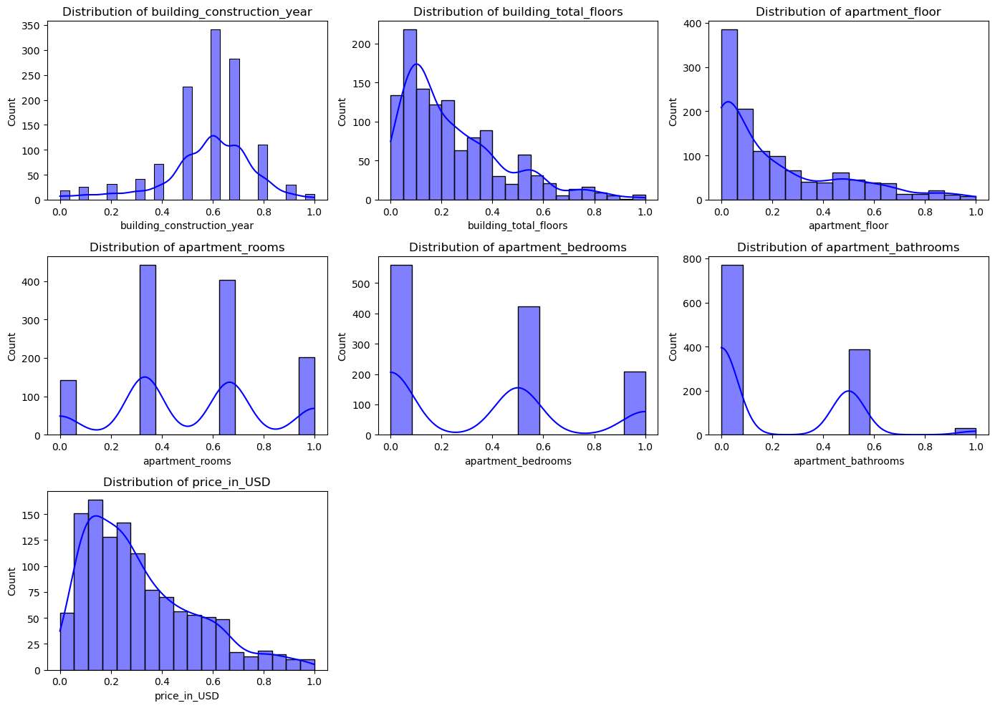
Visualization of Histograms:

Slide 6
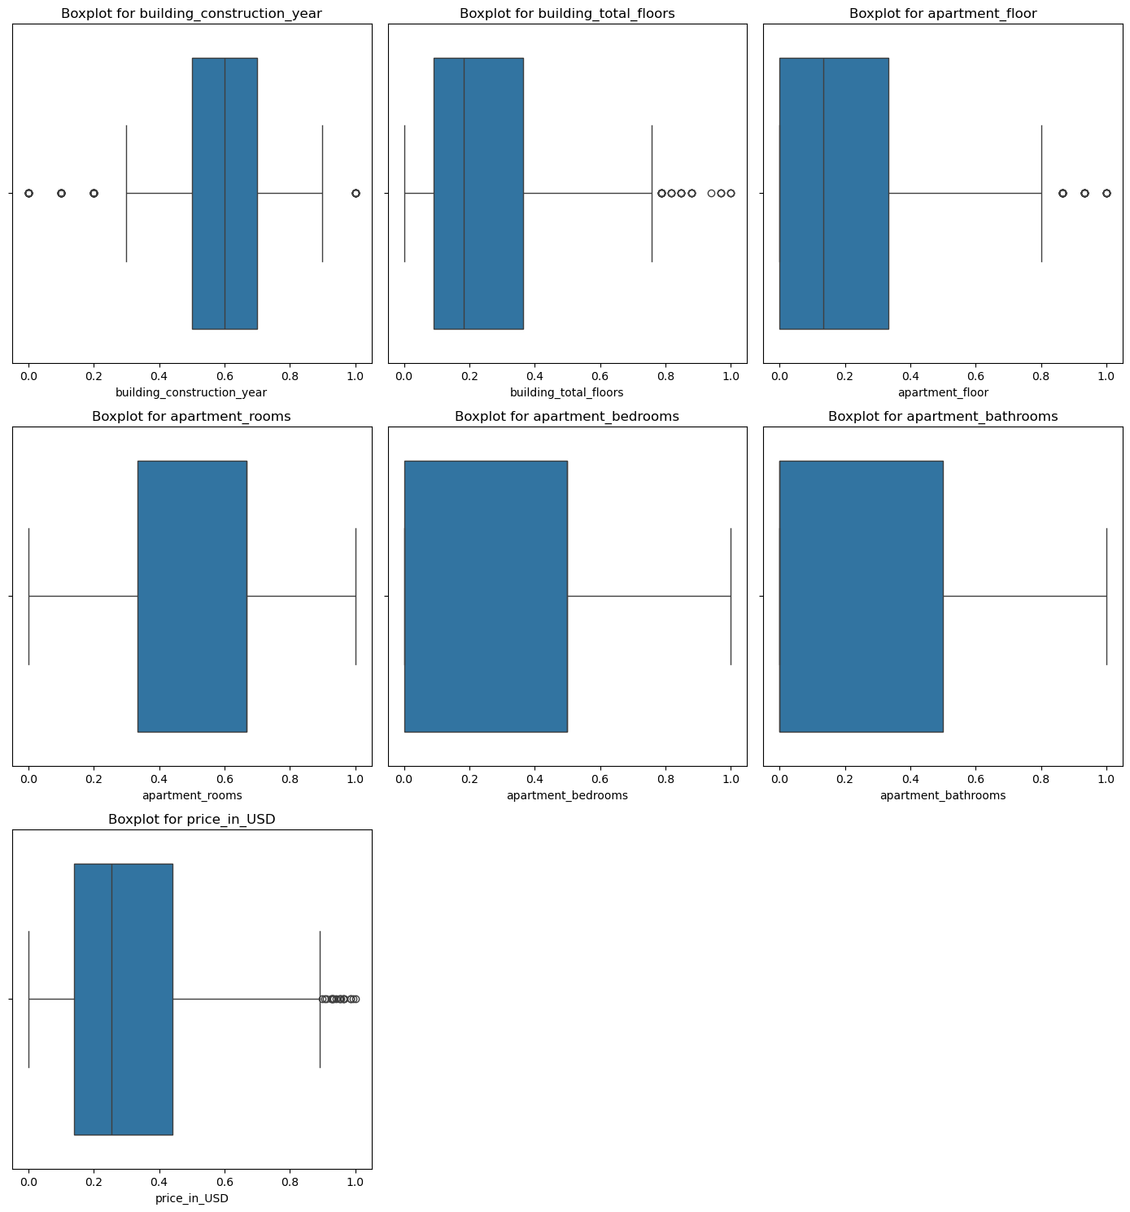
Visualization of Boxplots :

Slide 7
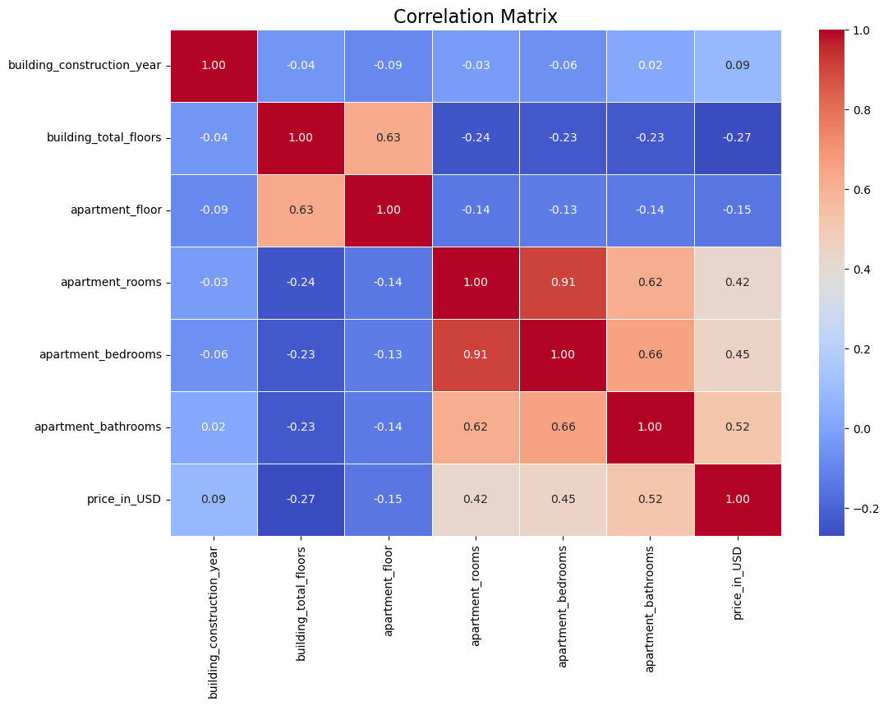
Correlation Heatmap :

Slide 8

Model Development
We trained three models for this project
Linear Regression, which served as our baseline.
Random Forest Regressor, which captured non-linear patterns effectively.
XGBoost Regressor, optimized for robust predictions.

Slide 9

Here is how the models performed:
Linear Regression had an R² of 0.1736.
Random Forest was the best with an R² of 0.7590.
XGBoost also performed well, with an R² of 0.7131.
Overall, Random Forest stood out as the most accurate model.

Slide 10
Hyperparameter Tuning
To further improve our results, we used GridSearchCV for hyperparameter tuning. For XGBoost, the best parameters were n_estimators = 200, learning_rate = 0.2, and max_depth = 7. This brought the MSE down to 0.0214.
Similarly, we tuned Ridge Regression by optimizing the alpha parameter. These adjustments made our models more precise and reliable."

Slide 11
Deployment
After building and fine-tuning our models, we deployed the Random Forest model using Flask. Here’s how the API works:
The /predict endpoint takes a JSON payload with property features.
It returns the predicted price in USD.
For example, if we input {\"features\": [120, 3, 2, 2020]}, the API responds with {\"prediction\": 275000}. This makes our model accessible for real-world applications and easy to integrate with other systems.

Slide 12
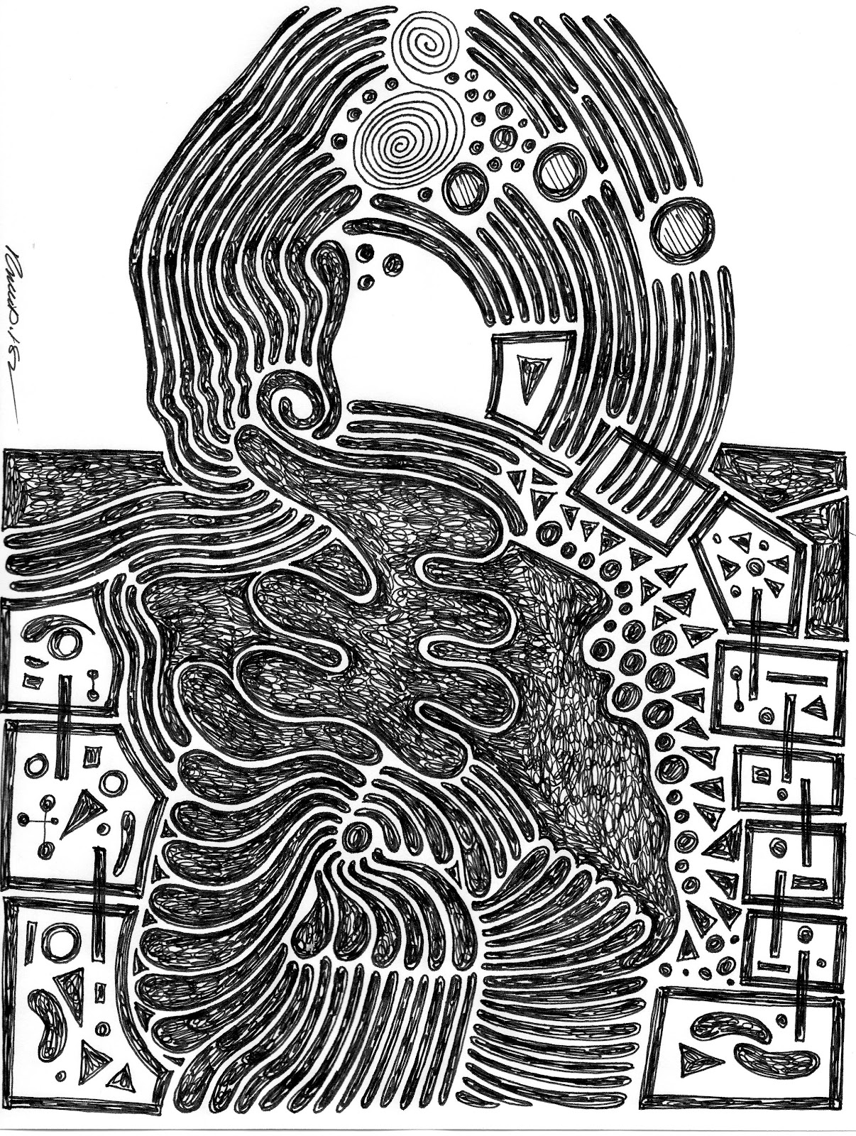
Conclusion
In conclusion, this project taught us a lot about handling real-world data, building predictive models, and deploying them for practical use. Our Random Forest model performed exceptionally well, and the Flask API enables real-time predictions.
Looking ahead, we could incorporate additional features like proximity to schools or crime rates and improve scalability for larger datasets. This project was a great learning experience, and I’m excited about its potential applications.
This Photo by Unknown Author is licensed under CC BY-SA

Slide 13

Thank You

