Slide 1

WEBSITE PHISHING DETECTION
Kajal - S20190020215 - Feature Extraction and ranking features
Chittoor Vamsi - S20190020208 - Applying ML models to the dataset
Rithik kumar -S20190020248 - Data preprocessing
Kajal , Chittoor Vamsi , Rithik kumar -Ranking features based on mutual information
Notes:
This template can be used as a starter file to give updates for project milestones.
Sections
Right-click on a slide to add sections. Sections can help to organize your slides or facilitate collaboration between multiple authors.
Notes
Use the Notes section for delivery notes or to provide additional details for the audience. View these notes in Presentation View during your presentation.
Keep in mind the font size (important for accessibility, visibility, videotaping, and online production)
Coordinated colors
Pay particular attention to the graphs, charts, and text boxes.
Consider that attendees will print in black and white or grayscale. Run a test print to make sure your colors work when printed in pure black and white and grayscale.
Graphics, tables, and graphs
Keep it simple: If possible, use consistent, non-distracting styles and colors.
Label all graphs and tables.

Slide 2
Problem statement / opportunity
Phishing Websites are duplicate Web pages created to mimic real Websites in-order to deceive people to get their personal information.
Because of the adaptability of their tactics with little cost Detecting and identifying Phishing Websites is really a complex and dynamic problem.
We have to use one or more of the classification algorithms to train a model on the phishing website data set.
And use it to identify Phishing websites.
Notes:
What is the project about?
Define the goal of this project
Is it similar to projects in the past or is it a new effort?
Define the scope of this project
Is it an independent project or is it related to other projects?
* Note that this slide is not necessary for weekly status meetings

Slide 3
Project Overview
Collect dataset containing phishing and legitimate websites from the open source platforms.
Write a code to extract the required features from the URL database.
Analyze and preprocess the dataset by using EDA techniques.
Divide the dataset into training and testing sets.
Run selected machine learning and deep neural network algorithms like SVM, Random Forest, Auto encoder on the dataset.
Write a code for displaying the evaluation result considering accuracy metrics.
Compare the obtained results for trained models and specify which is better.
Notes:
* If any of these issues caused a schedule delay or need to be discussed further, include details in next slide.

Slide 4
Brief Description of the features
Address Bar based Features
Domain of the url
IP address in url
‘@’ symbol in url
Length of url
Depth of url
Redirection ‘//’ in url
‘http/https’ in domain name
Using url shortening service
Prefix or suffix “-” in domain
Notes:
Duplicate this slide as necessary if there is more than one issue.
This and related slides can be moved to the appendix or hidden if necessary.

Slide 5
Domain based Features
DNS Record
Website Traffic
Age of Domain
End Period of Domain
Notes:
Duplicate this slide as necessary if there is more than one issue.
This and related slides can be moved to the appendix or hidden if necessary.

Slide 6
HTML and Java script based Feature
Iframe Redirection
Disabling Right click
Website forwarding
Status bar Customization
Notes:
Duplicate this slide as necessary if there is more than one issue.
This and related slides can be moved to the appendix or hidden if necessary.

Slide 7
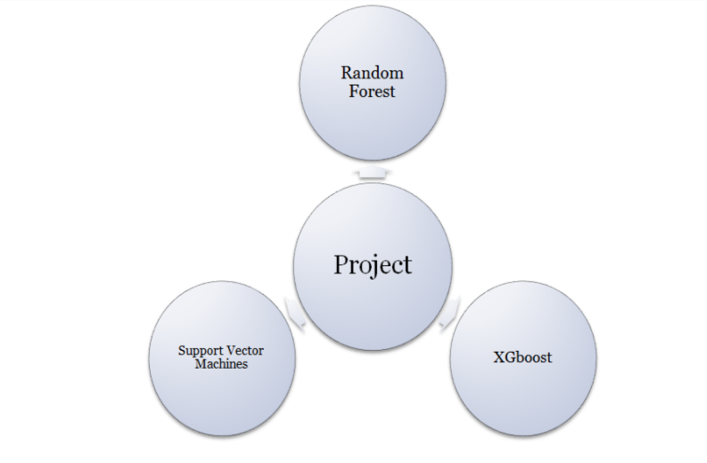
Machine Learning Models trained in our project
Notes:
What are the dependencies that affect the timeline, cost, and output of this project?

Slide 8
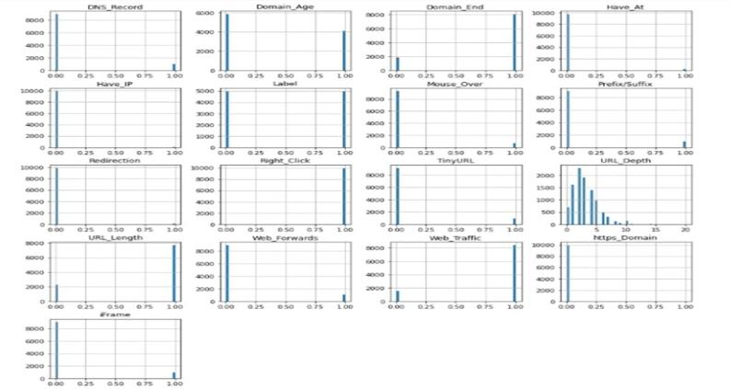
Experimental Results
Feature Distribution
Notes:
The following slides show several examples of timelines using SmartArt graphics.
Include a timeline for the project, clearly marking milestones, important dates, and highlight where the project is now.

Slide 9
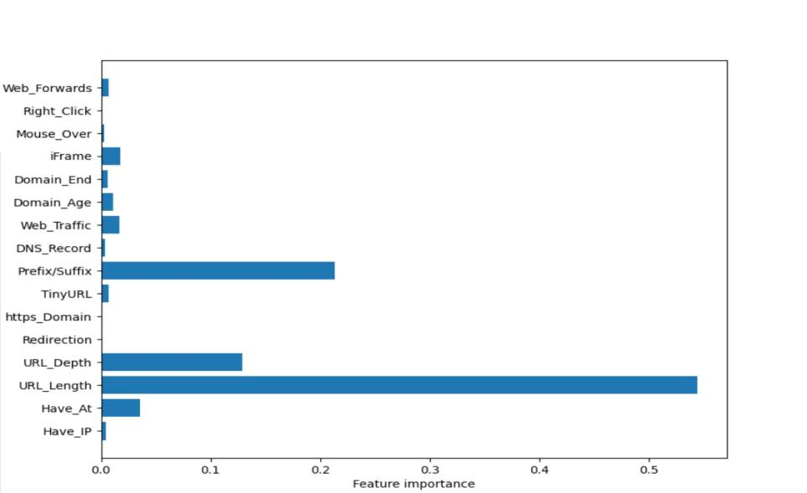
Feature Importance

Slide 10
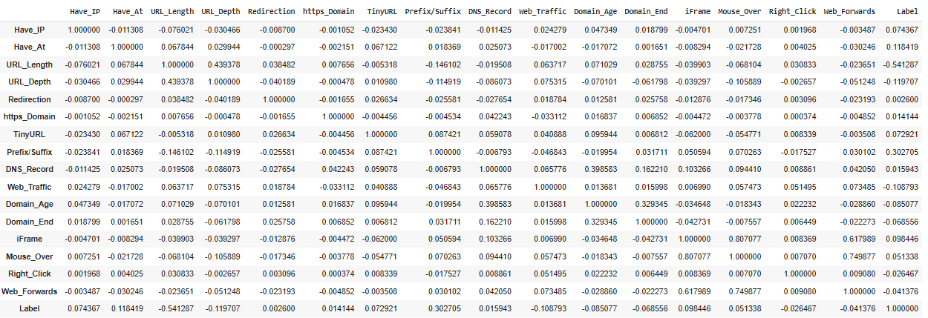
Correlation Matrix

Slide 11
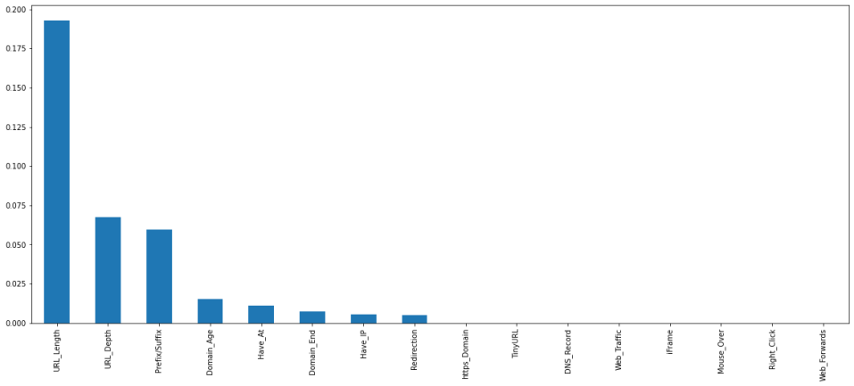
Ranking Features based on Mutual information

Slide 12
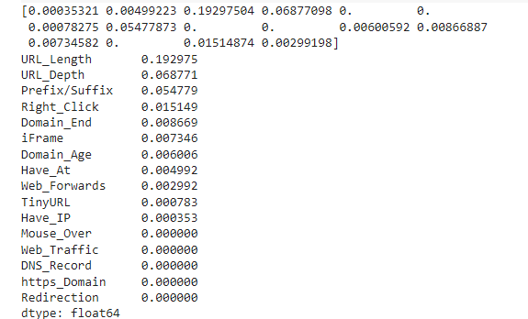
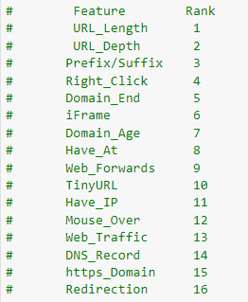

Slide 13

Model Accuracies

Slide 14

Conclusions
Best model – XGBoost
Correlation analysis didn’t helped us in this project .
Ranked features based on mutual information.
We can deploy the final model in real world applications.

Slide 15
References
https://www.unb.ca/cic/datasets/url-2016.html
https://www.malwarebytes.com/phishing
https://archive.ics.uci.edu/ml/datasets/Phishing+Websites#
https://en.wikipedia.org/wiki/Mutual_information

Slide 16


