Slide 1
Enterprise Resource Planning -ERP
Kevin Cowell
Natthawut Lertpitayakun
Isabelle Mertha
Xiaoguang You

Slide 2
What is ERP?
The practice of consolidating an enterprise’s planning, manufacturing, sales and marketing efforts into one management system.¹
Combines all databases across departments into a single database that can be accessed by all employees.²
ERP automates the tasks involved in performing a business process.¹
Sources:
1. http://www.cio.com/summaries/enterprise/erp/index.html, viewed September 19, 2002
2. CIO Enterprise Magazine, May 15, 1999.

Slide 3
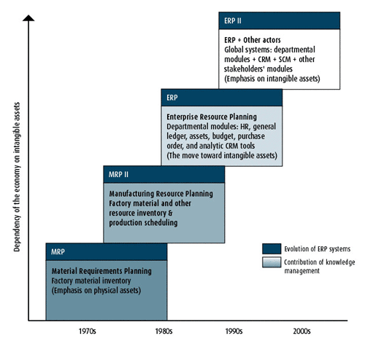
Evolution of ERP
Source: http://www.intelligententerprise.com/020903/514feat2_1.shtml, viewed September 19, 2002.

Slide 4
How Do ERP Systems Work?
Managers and
Stakeholders
Financial
Applications
Human
Resource
Management
Applications
Reporting
Applications
Sales and
Delivery
Applications
Central
Database
Manufacturing
Applications
Sales Force
And Customer
Service Reps
Back-office
Administrators
And Workers
Customers
Suppliers
Service
Applications
Employees
Human
Resource
Management
Applications
Inventory
And Supply
Applications
Source: Davenport, Thomas, “Putting the Enterprise into the Enterprise System”, Harvard Business Review, July-Aug. 1998.

Slide 5
ERP Components
Finance: modules for bookeeping and making sure the bills are paid on time. Examples:
  General ledger
  Accounts receivable
  Accounts payable
HR: software for handling personnel-related tasks for corporate managers and individual employees. Examples:
  HR administration
  Payroll
  Self-service HR
Manufacturing and Logistics: A group of applications for planning production, taking orders and delivering products to the customer. Examples:
  Production planning
  Materials management
  Order entry and processing
  Warehouse management
Source: http://www.computerworld.com/printthis/1998/0,4814,43432,00.html, viewed September 19, 2002.

Slide 6




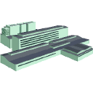


An ERP Example: Before ERP
Orders
Parts
Sends report
Customer
Demographic
Files
Sales Dept.
Customers
Checks for Parts
Calls back “Not in stock”
Accounting
Files
“We ordered the parts”
Accounting
Invoices
accounting
Sends report
Sends report
Ships parts
Vendor
Warehouse
Order is placed
with Vendor
“We Need parts #XX”
Inventory
Files
Purchasing
Files
“We ordered the parts”
Purchasing

Slide 7
An ERP Example: After ERP
Orders
Parts
Inventory Data
If no parts,
order is placed
through DB
Customers
Sales Dept.
Accounting
Financial Data exchange;
Books invoice against PO
Order is submitted
to Purchasing.
Purchasing record
order in DB
Database
Books inventory
against PO
Order is placed
with Vendor
Vendor
Warehouse
Purchasing
Ships parts
And invoices accounting

Slide 8




Who are the main ERP vendors?
Baan
JD Edwards
Oracle
PeopleSoft
SAP

Slide 9
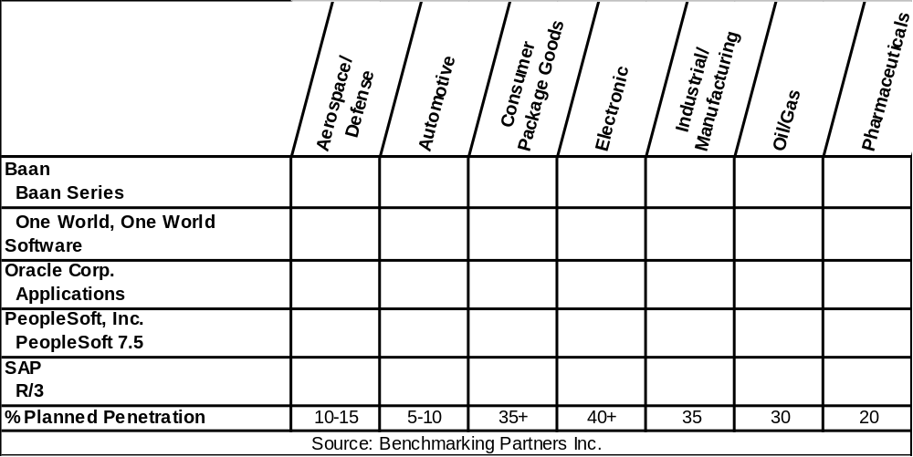
ERP Vendors and Industries They Serve

Slide 10
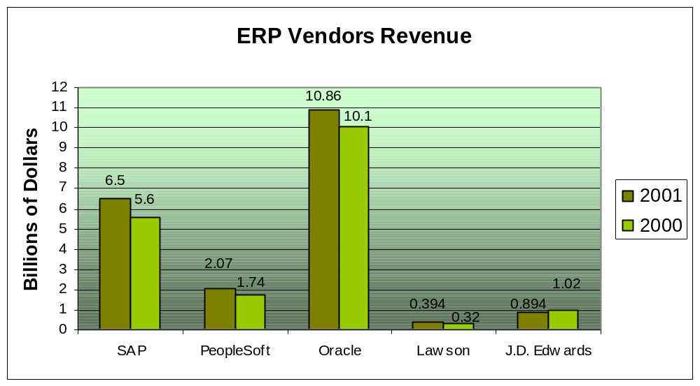
Revenue and Profits of Major ERP Vendors

Slide 11
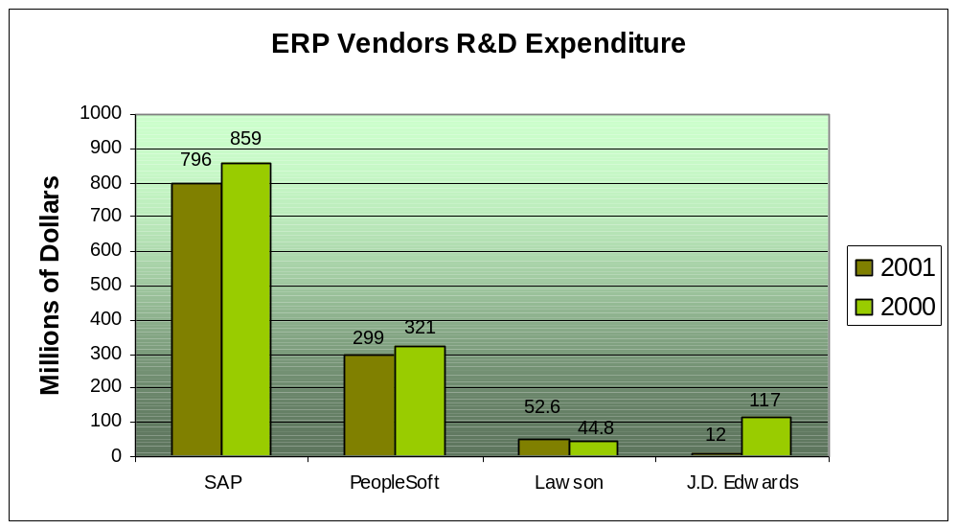
Revenue and Profits of Major ERP Vendors

Slide 12
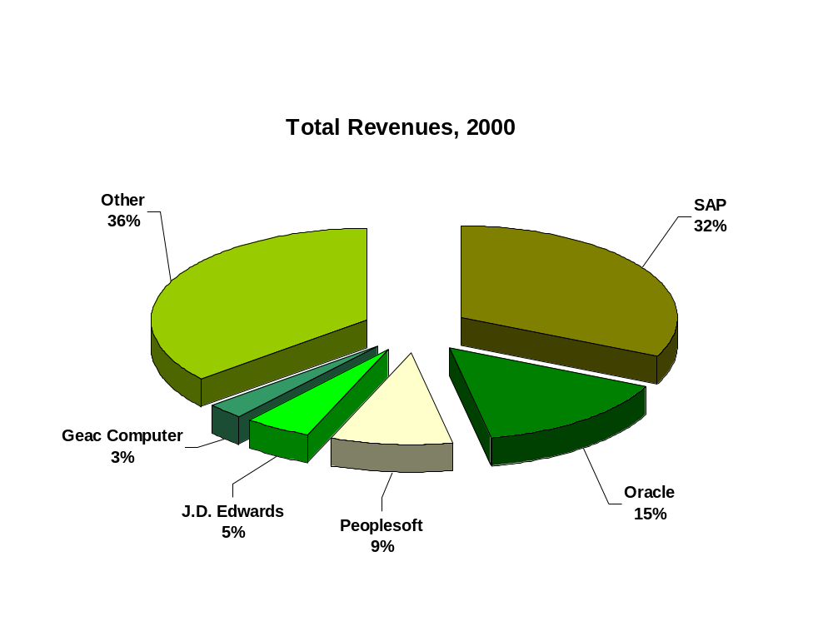
ERP Market
Source: AMR Research, 2001.

Slide 13
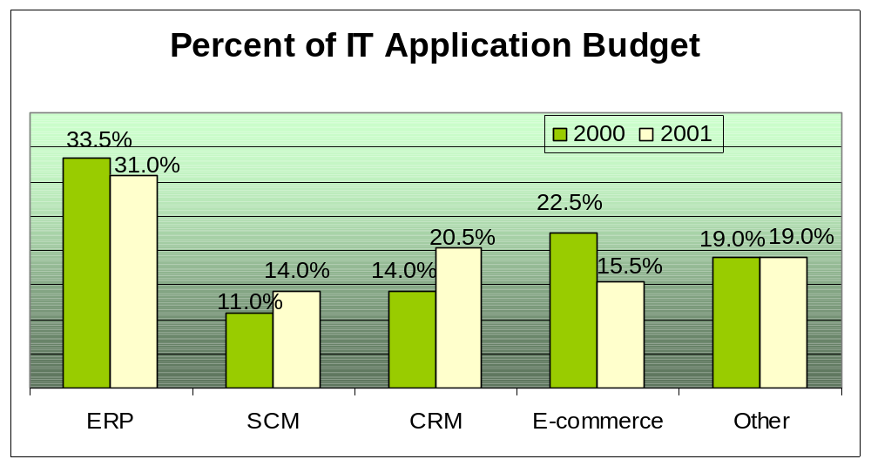
ERP Investments
Roughly 65% of companies surveyed already have ERP in place. Of those, many are still actively spending to upgrade existing systems and to take advantage of new web-oriented features.
Source:
AMR Research Survey of 686 companies with annual revenues ranging from <$50M to >$1B, October 2001.

Slide 14
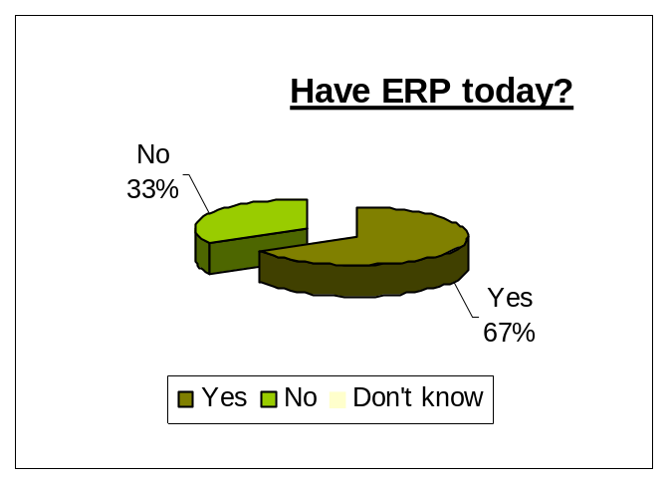
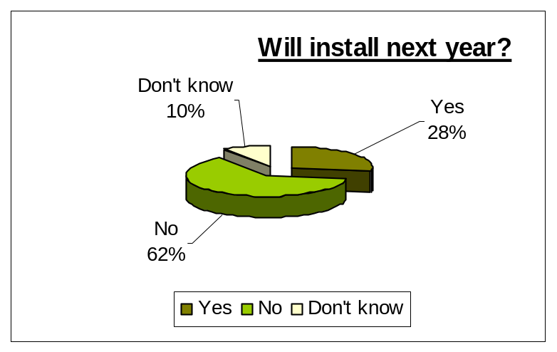
ERP Investments
n=666
Source: AMR Research Survey of 686 companies with annual revenues ranging from <$50M to >$1B, October 2001
n=232

Slide 15

Why ERP?
3 Major Reasons:
To integrate financial data.
To standardize manufacturing processes.
To standardize HR information.
Source: http://www.cio.com/summaries/enterprise/erp/index.html, viewed September 19, 2002.

Slide 16
ERP Project and Time
Real transformational ERP efforts will usually run between 1 to 3 years, on average.
Short implementations (3 to 6 months):
  small companies,
  implementation limited to a small area of the company, or
  the company only used the financial pieces of the ERP system.
The important thing is not to focus on how long it will take but to understand why you need ERP and how you will use it to improve your business.
Source: http://www.cio.com/summaries/enterprise/erp/index.html, viewed September 19, 2002.

Slide 17
Total Cost of Ownership of ERP
Total cost of ownership (TCO) is a model developed by Gartner Group to analyze the direct and indirect costs of owning and using hardware and software. TCO essentially helps a company determine whether it wins or loses from specific technology implementations.
Metagroup study among 63 companies surveyed showed that:
  the average TCO was $15 million (the highest was $300 million and lowest was $400k),
  the average TCO per user was $53,320.
Source: http://www.cio.com/summaries/enterprise/erp/index.html, viewed September 19, 2002.

Slide 18
Total Cost of Ownership of ERP
It also found that:
  it took 8 months after the system was in to see any benefits,
  but that the median annual savings from the system was $1.6 million per year.
Source: http://www.cio.com/summaries/enterprise/erp/index.html, viewed September 19, 2002.

Slide 19
Hidden Costs of ERP
Training
Integration and testing
Data conversion
Data analysis
Consultants
Replacing best and brightest staff after implementation
Implementation teams can never stop
Waiting for ROI
Post-ERP depression
Source: http://www.cio.com/summaries/enterprise/erp/index.html, viewed September 19, 2002.

Slide 20
Benefits of ERP Systems
Improving integration, flexibility
Fewer errors
Improved speed and efficiency
More complete access to information
Lower total costs in the complete supply chain
Shorten throughput times
Sustained involvement and commitment of the top management

Slide 21
Benefits of ERP Systems (cont’d)
Reduce stock to a minimum
Enlarge product assortment
Improve product quality
Provide more reliable delivery dates and higher service to the customer
Efficiently coordinate global demand, supply and production

Slide 22
Risks with ERP Implementation
Expensive (can costs 100 thousands to millions of dollars)
Time-consuming (can take months to years)
Great risk for the organization
Transfer of Knowledge
Acceptance with the company

Slide 23

Case Study
Nestlé USA
Notes:
Thanks for Kevin. I am going to introduce how an company implement its ERP Project and what lessons we can learn. Well, please put up your hand if you know about Nestle?

Slide 24
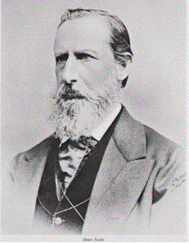

Nestlé Background
Found in 1866, Switzerland.
World's largest food company, # 50 in Fortune magazine’s
Globe 500
Nestlé USA was incorporated in 1990; Home Office in Glendale, CA.
33 manufacturing facilities, 6 distribution centers and 17sales offices around the country, 17,300 employees nationwide.
$ 11.1 billion in Sales (2001)
“…America's most admired Food Company for the fourth consecutive year” - Fortune Magazine, February 2001
Source: http://www.nestle.com/all_about/at_a_glance/index.html , viewed October 14, 2002, and
http://www.ir.nestle.com/4_publications/pdf/financial_report/final_2001/consolidated_accounts_2001.pdf, viewed October 14, 2002.
Notes:
Nestle was found in 1866 by Swiss pharmacist Henri Nestle.
Growth with time and acquisitions, nestle has become the largest food company in the world. It has over 200 million employees and 500 factories across North America, Brazil, UK, Asia and Australia. Total group consolidation sales revenue is over us$59 billion. It also be voted among the top 50 business in the world.
In the early of 20th century, Nestle operated factories in North America. Nestle USA was not incorporated until 1991. More than 17 thousand people work for Nestle USA in 6 distribution centers and 17 sales office. Sales exceeded US$ 11 billion in 2001. Hoe office of Nestle USA is located in Glendale, CA.

Slide 25



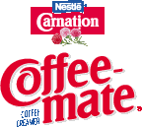














Nestlé's products and brands
Milk products, dietetic foods, infant foods,
chocolate and confections,
refrigerated and frozen items, ice cream, and pet foods
Source: Weller, Joe, “Introduction to Nestle in the USA”,
http://www.ir.nestle.com/home-frameset.asp?largeur=1024, viewed October 14,2002.
Notes:
Together with well-known brands, Nestle produces tens of products, including coffee, snack, waster, chocolate, juice, pet food, prepared food and infant food.
Have you found your favorite ?

Slide 26
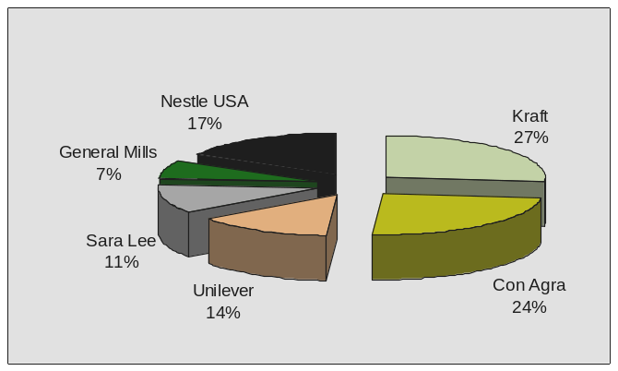
Competitive Market
USA Food Market in 2001
Source: Weller, Joe, “Introduction to Nestle in the USA”,
http://www.ir.nestle.com/home-frameset.asp?largeur=1024, viewed October 20,2002.
Notes:
Same as enterprises in other industries, Nestle USA challenges very severe competition in food and beverage market. From this Pie Chart, we can see Sales revenue of Nestle USA in 2001 accounts less than that of Kraft and Con Agra, Unilever, General Mills and Sara Lee are also its competitors.

Slide 27
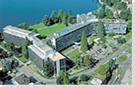
Organizational Chart
Joe Weller
Chairman & CEO
Jeri Dunn
CIO
Other Board members
Tom James
Dir. of Process change
Jose Iglesias
Dir. of IS
Dick Ramage
VP of supply chain
Ben Worthen, “ Nestlé's ERP Odyssey”, May 15, 2002 Issue of CIO Magazine
Notes:
In Nestle USA, CIO, one of the board members of Senior Management, reports to CEO. Some subdivisions reports to CIO. There are over 70 people working in that IT department

Slide 28
Business Challenges
After the brands were unified and reorganized into Nestle USA
in 1991,. Divisions still had geographically dispersed.
  For example, Nestle USA’s brands were paying 29 different prices for vanilla - to the same vendor.¹
  Nine different general ledgers and 28 points of customers entry.
Years of autonomous operation provided an almost “insurmountable hurdle”.
“… Nestle was the world’s NO. 1 food and beverage company– but one of the least efficient ”²
Source:
1. Ben Worthen, “ Nestlé's ERP Odyssey”, May 15, 2002 Issue of CIO Magazine;
2. “Nestle: An Elephant Dances”, http://www.businessweek.com/2000/00_50/b3711064.htm, viewed October 20, 2002.
Notes:
After its centralization in 1991, Nestle USA continued to function more like a holding company than a single entity. Divisions still had geographically dispersed offices and made their decisions.
For example, each factory arranged their orders of Vanila, one of raw material common used, from a same vendor for different prices. They didn’t contact each other before purchase. The whole company lost a strong purchasing power.
9 different general ledgers and 28 points of customer entry. It is not efficient.

Slide 29
Project Scope – “BEST”
Five SAP Modules – purchasing, financials,
sales and distribution, accounts payable and accounts receivable and Manugistics’ supply chain module
From October 1997 to 1st Quarter of 2000.
$210 million budget
50 top business executives and 10 senior IT professionals
Source: Worthen, Ben, “ Nestlé's ERP Odyssey”, May 15, 2002 Issue of CIO Magazine.
Notes:
In 1997, Nestle USA embarked on SAP project code-name Best (Business Excellence through systems technology). SAP modules reached the areas of purchase, financials, sales and distribution, accounts payable and accounts receivables. Together with Manugistics supply chain
Each would be deployed across every Nestle division. For instance, the purchasing group for confections would follow the same best practices and data as the purchasing group for beverages.
Budget was for US$210 million and is expected to finished around Year 2000. 50 top business executive and 10 senior IT professionals were involved in this project.

Slide 30
Project Objectives -
“One Nestle, under SAP”
Transforming the separate brands into
one highly integrated company.
Internal aligned and united, establishing a common business process architecture
Standardizing master data
Source: Worthen, Ben, “ Nestlé's ERP Odyssey”, May 15, 2002 Issue of CIO Magazine.

Slide 31
Process of SAP Implementation
The new business process confused
most of employees, then resistance grew into rebellion in 2000.
Reconstructed in June 2000 and completed in 2001.
Source: Worthen, Ben, “ Nestlé's ERP Odyssey”, May 15, 2002 Issue of CIO Magazine.
Notes:
Not only did workers not understand how to use the new system, they didn’t even understand the new process. And the divisional executives, who were just as confused as their employees and even angrier.
In addition, the Best project team had overlooked the integration points between the modules. All the purchasing departments now used common process, but their system was not integrated with the financial, planning or sales groups. A salesperson-----discount to a valuable customer--------but the account receivable have no idea.-----customers paid--- only partial paid in account receivable.
They started with business requirements reaching an end date, rather than trying to fit the project into a mold shaped by a predetermined end date. They also concluded they had to do a better job of making sure that they had support from key divisional heads and that all the employees knew exactly what changes were taking place, when, why, and how.

Slide 32
Conclusion of Nestlé Case
Changes and success
Common database and business processes lead to
more trustworthy demand forecast.
  A comprehensive account planning tool.
  Nestle can now forecast down to the redistribution center level.
  Nestle has improved forecast accuracy by 2%
Higher factories utilization
  fewer factories = big gains in factories Utilization
  Reduce inventory level
Source: Brownson, Jim, and Mitchell-Keller, Lori, Nestle USA,
Case study: supply chain: Nestle Integrated CRM and SCM Optimize Enterprise Effectiveness, http:www.dci.com/Brochure/crmny/sessions.asp?trackid=1190, viewed on November 06, 2002.

Slide 33
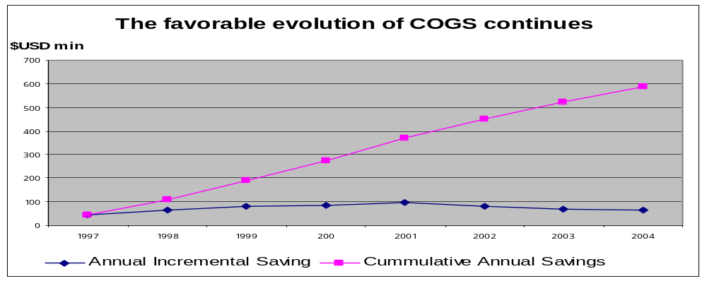
Conclusion of Nestlé Case
Saved $$$
  - With ERP in practice , $ 371 million has been saved until 2001.
371
586
Source: Weller, Joe, “Introduction to Nestle in the USA”,
http://www.ir.nestle.com/home-frameset.asp?largeur=1024, viewed October 20,2002.

Slide 34
Conclusion of Nestlé Case
Lessons learned by Nestlé
Don’t start a project with a deadline in mind.
Update your budget projection at regular intervals.
ERP isn’t only about the software.
“No major software implementation is really about the software.” Former Nestlé CIO Jeri Dunn says, “You are challenging their principles, their beliefs and the way have done things for many many years”
Keep the communication lines open.
Remember the integration points.
Source: Worthen, Ben, “ Nestlé's ERP Odyssey”, May 15, 2002 Issue of CIO Magazine.
Notes:
Lessons
Don’t start a project with a deadline in mind. Figure out the project requirements, then determine how long it will take to accomplish them
Update your budget projection at regular intervals. So many things happen during a long project that you will be lucky to stay on target during a particular year, let alone the life of the project. Frequently revising your numbers will help minimize troublesome surprise
ERP isn’t about the software. It is easy to put a new system in place. The hard part is changing the business process of the people who will use the system.
Nobody likes process change, particularly when they don’t know it is coming. Include in the planning the people whose processes you are changing. Keep the communication lines open while the project is in the works, and measure the level of acceptance before, during and after the rollout.
Remember the integration points. It isn’t enough to simply install new systems; you need to make sure that they can talk to each other.

Slide 35
Nestlé in the Future
The Global Business Excellence Program
Supported by SAP, contracted in June 2000 and by IBM in July 2002.
  To be completed by the end of 2005
  To save cost around CHF 3 billion, with benefits realized from 2003.
Source: http://www.idealliance.org/news/2002/mem0307.asp, viewed on November 1, 2002.
Notes:
Nestle group contracted with SAP in June 2000 for $200 million, the largest software sale in the ERP vendor in that moment. Nestle has been in the process of deploy my sap.com ERP application to each of its employees worldwide. To consolidate its information technology operations now based in more 100 sites, in five GLOBE data centers around the world.
Furthermore, In July 2002, Nestle chose IBM as the exclusive provider of servers, storage system and database software for its GLOBE data centers at the heart of Nestlé's comprehensive, worldwide business transformation initiative.
When the IBM infrastructure is fully implemented, Nestle employee will be able to access my sap.com via an internal, role-based portal customized by the functions of the employee’s job. Nestlé's trading partners and customers will be able to access the company through private and secured exchanged, expanding the business outside the company.
GLOBE is the most important project under way to prepare Nestle for the e-world

Slide 36


Case Study

Slide 37
What is Agilent Technologies?
Agilent Technologies is the world's leading designer, developer, and manufacturer of electronic and optical test, measurement and monitoring systems.
Separated from Hewlett Packard and became a public company in 1999
World HQ in Palo Alto, CA
Source: http://we.home.agilent.com,viewed, viewed November 3, 2002.

Slide 38
Around the World
Agilent has facilities in more than 40 countries and develops products at manufacturing sites in the U.S., China, Germany, Japan, Malaysia, Singapore, Australia and the U.K.
Approximately 37,000 employees throughout the world
Source: http://www.agilent.com/about/index.html, viewed November 3, 2002.

Slide 39
Products and Services
Agilent operates in three business groups:
Test and Measurement
  Test instruments and systems, automated test equipment.
Semiconductor Products
  Semiconductor solutions for wired and wireless communications, information processing.
Chemical Analysis
  Life sciences and analytical instrument systems.
Source: http://www.agilent.com/about/newsroom/features/2002june04_oneit.pdf, viewed November 3, 2002.

Slide 40
Agilent revenue for 2001
Test and Measurement: $5.4 billion
Semiconductor Products: $1.9 billion
Chemical Analysis: $1.1 billion
Total revenue: $8.4 billion
Source: http://investor.agilent.com, viewed November 3, 2002.

Slide 41
Agilent’s Customers
Served customers in more than120 countries around the world¹
Electronic component manufacturers
Pharmaceutical companies
Chemical companies
Communication companies²
Source:
1. http://www.agilent.com/about/index.html, viewed November 3, 2002;
2. http://www.agilent.com/about/newsroom/features/2002june04_oneit.pdf, viewed November 3, 2002.

Slide 42
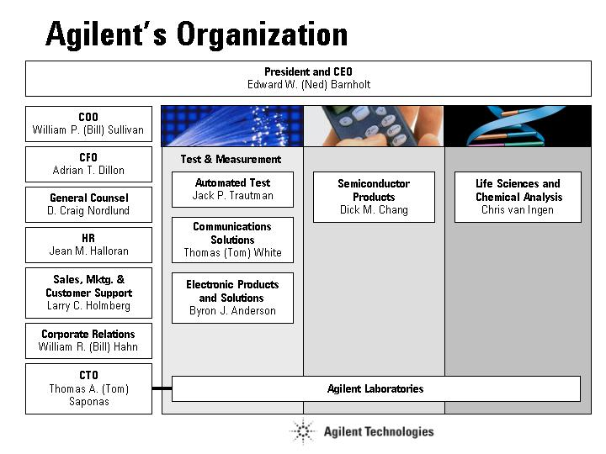
Source: http://www.agilent.com/about/newsroom/execs/org/index.html, viewed November 3, 2002.

Slide 43
Project Scope
Oracle’s li E-Business Suite software
Started September 2000 till 2004
Budget
roughly 100 Oracle consultants to install the program
Source: Songini, Marc L., “ERP effort sinks Agilent revenue” Computerworld, Framingham, August 26, 2002.

Slide 44
ERP Project Objective
“One IT” organization
Supply chain capability; for example,
- Suppliers
- Customers
Migrating 2,200 legacy applications that it inherited from HP to Oracle
Source: Gaither, Chris, “Watching Oracle For Signs Of Strength” Boston Globe, Boston, Mass., September 16, 2002.

Slide 45
One IT Project (Before)
IT spend was 8-10% of sales
    80% for business operations
    20% maint. & upgrading legacy systems
Further autonomy over the IT portfolio would have led to 50% cost increase
Source: http://www.agilent.com/about/newsroom/features/2002june04_oneit.pdf, viewed November 3, 2002.

Slide 46
One IT Project
Marty Chuck, CIO, developed a Vision for One IT organization in August 2000
Moved more than 2,500 IT professionals in the different site, regional and divisional IT organizations
Source:
http://www.agilent.com/about/newsroom/features/2002june04_oneit.pdf;
http://www.agilent.com/about/newsroom/features/2002june08_chuck.html, viewed November 3, 2002.

Slide 47
One IT Project Objective
To consolidate a large number of independent operating groups into a single worldwide IT function
To share information quickly and efficiently
To drive the operational costs down by more than 20%
To combine all IT budgets
Source: http://www.agilent.com/about/newsroom/features/2002june04_oneit.pdf, viewed November 3, 2002.

Slide 48
Changes in Supply Chain Process: Supplier
Migrating from all existing ERP systems to a single Oracle-based infrastructure system
The use of bar code for materials received from suppliers
The use of Evaluated Receipt Settlement (ERS)
Source: http://www.agilent.com/supplier/default.html, viewed November 3, 2002.

Slide 49
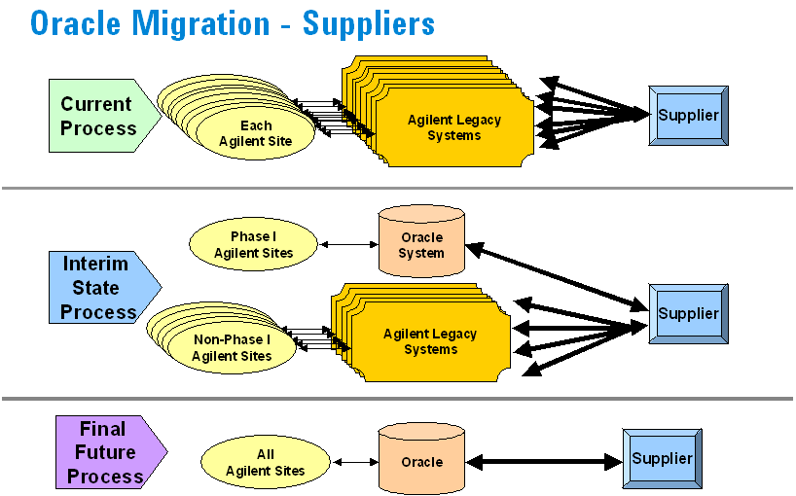
The process of migrating ERP
systems to Oracle
Source: http://www.agilent.com/supplier/generalinformation.shtml, viewed October 31, 2002.

Slide 50
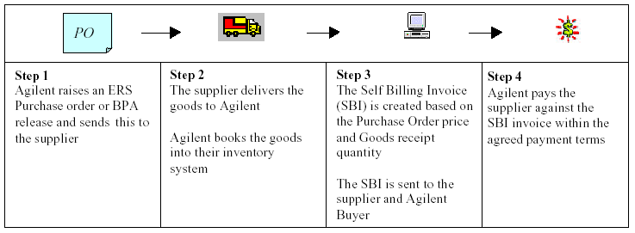
Evaluated Receipt Settlement (ERS)
An automated invoice and payment system
How does ERS work?
Source: http://www.agilent.com/supplier/downloads/ERS_supplier_guide.pdf, viewed November 3, 2002.

Slide 51
Changes in Supply Chain Process: Customers
Real-time information about inventory and order status
Easier to understand invoicing and pricing
Improved visibility on product delivery lead time
Source: http://www.tmintl.agilent.com/model/index.shtml, viewed November 3, 2002.

Slide 52
Troubles with Project Everest
Because of the consolidation of its 2,200 software systems to under 20, confusion meant lost order and revenue.
An $88 million reduction in third-quarter orders
Of that, $38 million was lost and $50 million will be pulled through the fourth quarter.
$105 million in lost revenue and $70 million in operating profit
Source: Shah, Jennifer B., “Agilent’s ERP Rollout Expensive Glitches” EBN; Manhasset, August 26, 2002.

Slide 53
Troubles with Project Everest
CFO Adrian Dillon said the problem was twofold:
Software bug
“As we began to hit sort of a 50 percent ramp of normal capacity, we began to get conflicts in priorities of systems instructions. When we had those conflicts that inevitably shut the system down.”
Source:
FD (Fair Disclosure) Wire, August 19, 2002 Monday, Transcript 081902ag.735, Q3 2002 Agilent Technologies Earnings Conference Call - Final; http://www.pressi.com/int/release/51627.html, viewed November 3, 2002, and Shah, Jennifer B., “Agilent’s ERP Rollout Expensive Glitches” EBN, Manhasset, August 26, 2002.

Slide 54
Troubles with Project Everest
Mistakes converting backlog.
“The other problem we had was converting backlog from legacy to new systems, especially for our highly configured products in our test and measurement operation.”
Extra $35 million to cover costs of ERP and CRM rollout.
Source:
Shah, Jennifer B., “Agilent’s ERP Rollout Expensive Glitches” EBN; Manhasset, Aug 26, 2002, and
http://www.pressi.com/int/release/51627.html, viewed November 3, 2002.

Slide 55
Lessons Learned by Agilent
ERP implementations are a lot more than software packages.
People, processes, policies and culture are all factors that should be taken into consideration when implementing a major enterprise system.
ERP disasters are often caused by a user company itself.
Source: Songini, Marc L., “ERP effort sinks Agilent revenue” Computerworld, Framingham, August 26, 2002.

Slide 56
Lessons Learned by Agilent
Study ERP well before implementation
“The disruptions after going live were more extensive than we expected” –CEO Ned Barnholt
Source: Songini, Marc L., “ERP effort sinks Agilent revenue” Computerworld, Framingham, August 26, 2002.

Slide 57
Best Practices and what ERP holds for the Future

Slide 58
ERP Implementation
Biggest IT project that most companies ever handle,
Changes the entire company, and
Has repercussions in all departments and divisions of the organization.
It is essential that all the key players understand the scope of the project.
This is an IT-Related Project.
Source: http://www.integratedsolutionsmag.com/articles/2000_03/000309.htm, viewed November 5, 2002.

Slide 59
Best Practices of ERP Implementation
A Business Strategy aligned with Business Processes
Top-Down Project Support and commitment
Change Management
Extensive Education and Training
Data Clean up and Data Integrity
Implementation is viewed as an ongoing process

Slide 60
Best Practices of ERP Implementation
A Business Strategy aligned with Business Processes
  Business strategy that will give you a competitive advantage
  Analyze and map your current business processes
  Develop your objectives
  Evaluate your business strategy and ERP plan before you commit to software acquisition and installation.
Source: http://www.rmdonovan.com/pdf/perfor8.pdf, viewed November 5, 2002.

Slide 61
Best Practices of ERP Implementation
Top-Down Project Support and commitment
  CEO¹
    support implementation costs
    champion the project, and
    demand full integration and cooperation.
  Most knowledgeable and valuable staff²
Sources:
1. M. Michael Umble, “Avoiding ERP Implementation Failure”, Industrial Management, Jan/Feb 2002;
2. http://www.integratedsolutinsmag.com/articles/2000_03/000309.htm, viewed November 5, 2002.

Slide 62
Best Practices of ERP Implementation
Change Management
  Changes in business procedures, responsibilities,
  work load.¹
  As a result, ERP implementations are times of high stress, long hours, and uncertainty.¹
  Mid-level managers must²
    facilitate continual feedback from employees,
    provide honest answers to their questions, and
    help resolve their problems.
Sources:
1. Yakovlev, I.V., “An ERP Implementation and Business Process Reengineering at a Small University”, Educause Quarterly, Number 2, 2002;
2. Umble, M. Michael, “Avoiding ERP Implementation Failure”, Industrial Management, Jan/Feb 2002.

Slide 63
Best Practices of ERP Implementation
Extensive Education and Training
  General education about the ERP system for everyone.
  Massive amount of end users training before and during implementation.
  Follow-up training after the implementation.
  10 to 15% of total ERP implementation budget for training will give an organization an 80% chance of a successful implementation.
Source: Umble, M. Michael, “Avoiding ERP Implementation Failure”, Industrial Management, Jan/Feb 2002.

Slide 64
Best Practices of ERP Implementation
Data Clean up and Data Integrity
  Clean-up data before cut-over.¹
  “Near enough is no longer good enough.”²
  To command trust, the data in the system must be sufficiently available and accurate.³
  Eliminate the old systems, including all informal systems.³
Sources:
1. http://www.bpic.co.uk/checklst.htm, viewed November 5, 2002;
2. http://www.projectperfect.com.au/info_erp_imp.htm, viewed November 5, 2002;
3. M. Michael Umble, “Avoiding ERP Implementation Failure”, Industrial Management, Jan/Feb 2002.

Slide 65
Best Practices of ERP Implementation
Implementation is viewed as an ongoing process
  Ongoing need for training and software support after implementation.
  Ongoing need to keep in contact with all system users and monitor the use of the new system.
  Ongoing process of learning and adaptation that continually evolves over time.
Source: Umble, M. Michael, “Avoiding ERP Implementation Failure”, Industrial Management, Jan/Feb 2002.

Slide 66
ERP Implementation Phases
4 Major Phases:
Concept/initiation
Development
Implementation
Closeout/Operation and maintenance
Source: “ERP Implementation and Project Management, Production and Inventory Management Journal, Alexandria, Third Quarter 2001, FC Weston Jr.

Slide 67
Conclusion
The benefits of a properly selected and implemented ERP system can be significant.
  An average, 25 to 30% reduction on inventory costs; 25% reduction on raw material costs.
  Lead-time for customers, production time, and production costs can be reduced.
BUT cost of implementing can be quite high and risks are great.

Slide 68
The Future of ERP

Slide 69
ERP II
Integrates the front and back office to enable an “information visibility” strategy that pushes the right information to the right people at the right time through the right communications channels.
A competitive strategy that integrates a centralized, core ERP system with highly specialized solutions.
In 2001, $4 billion (or 20%) of the $20 billion of total vendor revenue was spent on extensions to the ERP system. In 2006, AMR predicts this percentage will increase to 50%.
Source:
1. http://www.intelligententerprise.com/020903/514feat2_1.shtml, viewed September 19, 2002;
2. http://www2.cio.com/metrics/2002/metric381.html, viewed September 19, 2002.

Slide 70
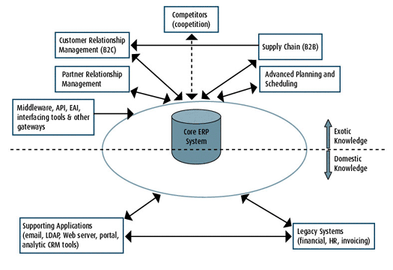
ERP II Architecture
Source: http://www.intelligententerprise.com/020903/514feat2_1.shtml, viewed September 19, 2002.

Slide 71
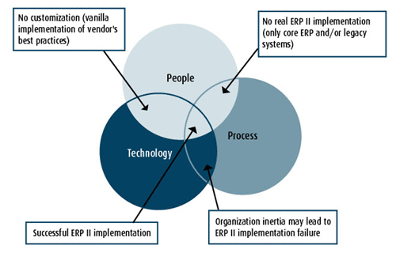
ERP II: A Revolutionary Change
Source: http://www.intelligententerprise.com/020903/514feat2_1.shtml, viewed September 19, 2002.

Slide 72
ERP II: A Revolutionary Change
Technology
  Technology goals aligned with internal
  business processes and those of diverse partners,
  customers, suppliers, and distributors.
Business Process
  Implementation cannot be made without a change of business processes.
People
  ERP II implementation success depends on the business community’s cultural acceptance of the system.
Source: http://www.intelligententerprise.com/020903/514feat2_1.shtml, viewed September 19, 2002.

Slide 73
Conclusion
To achieve competitive advantage in the global economy, organizations are extending their ERP system beyond the firm.
Future growth of the industry lies in adding extensions.
Integration, scalability and flexibility issues.
Source:
http://www.intelligententerprise.com/020903/514feat2_1.shtml, viewed September 19, 2002, and
Bartholomew, D., “Benefiting from the Boom”, Industry Week, Cleveland, July 2002.

Slide 74
End

