Slide 1
Shacira
Scalable
High performant
Data Acquisition
and Control
InfRAstructure

Slide 2
Shacira Components
Shacira Core Control Services (CCS)
Pure C++ based data acquisition and control components
Shacira GUI Framework
Qt based GUI framework
CCS interface is integrated

Slide 3
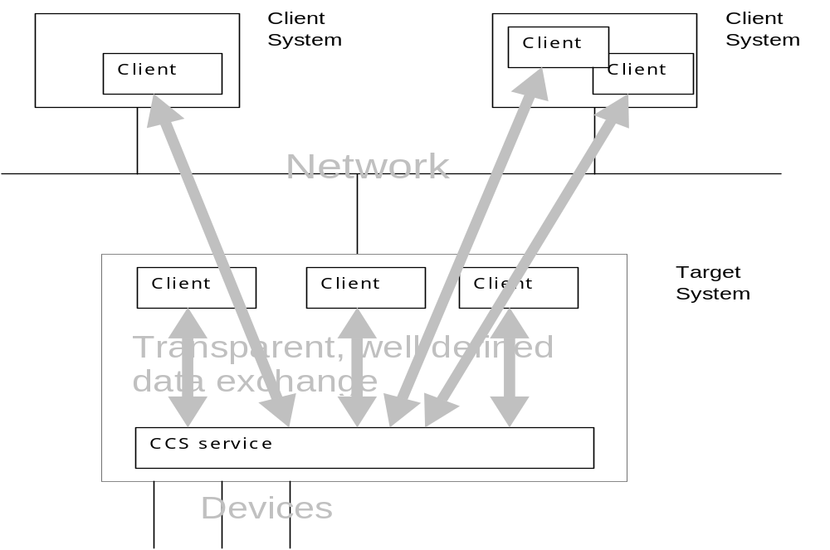
Shacira System Architecture

Slide 4
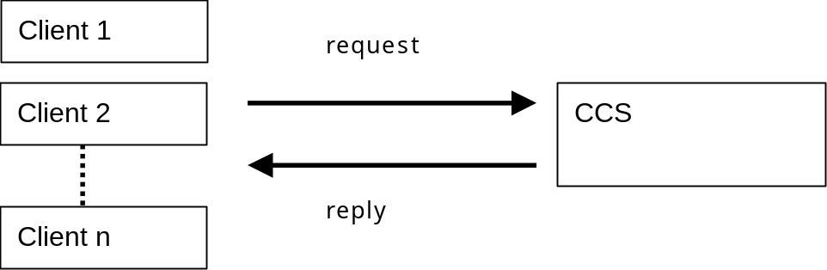
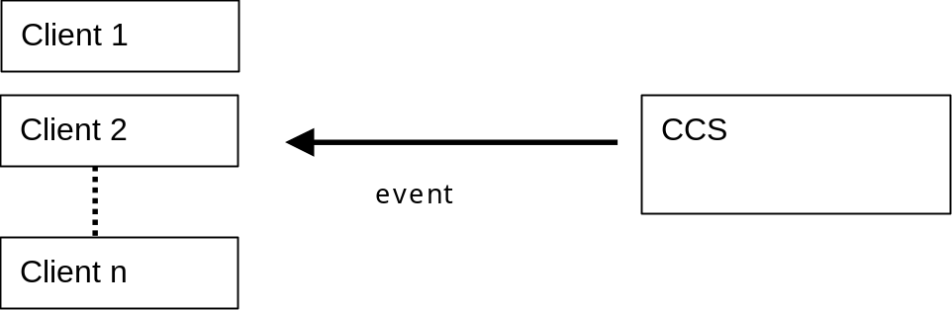
CCS communication mechanisms
Synchronous communication
(Client Server)
Asynchronous communication
(Events)

Slide 5
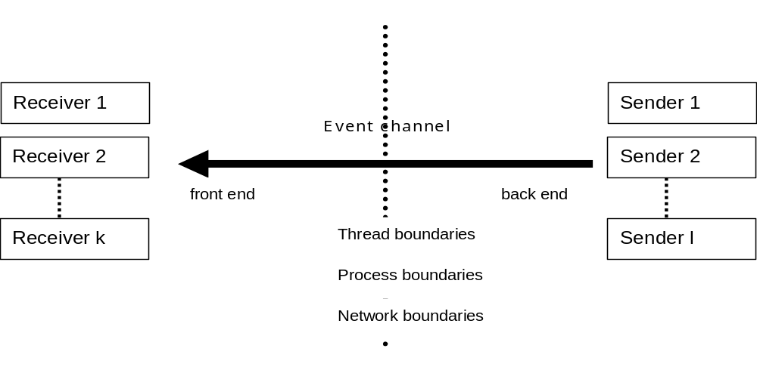
CCS Event Channels
The event channel model must conform to the following requirements:
  An event channel has a front end to receive data
  An event channel has a back end to send data
  An event channel can be used by arbitrary channel clients to send data (senders)
  An event channel can be used by arbitrary channel clients to receive (listen to) data (receivers)
  The number of senders is not restricted nor is the number of receivers
  Every event sent by a sender to the front end of the event channel is transmitted to every
  receiver listening to the back end of the event channel.

Slide 6
How to extend a CCS service?
Supplying a data model that describes an application specific view of
the data for an application
Supplying user functions that can be hooked into CCS service code
Implementing application specific device objects that implement data
exchange with peripheral or virtual devices
Implementing application specific program (task) objects that implement
cyclic functionality running in background

Slide 7
CCS User Function Integration
CCS User functions are C-style functions
User function calls are embedded as function references into CCS description code (Data Model or GUI descriptions)
User function declaration
  User functions are declared in the Data Model
Example:
long fact(long n)
User function reference
  User function references are placed at specific locations
  in the Data Model (Model functions) or in the GUI
  Description (GUI functions)
Example:
fact(500)

Slide 8
User Function Class
Model function classes
  Filter functions
  Conversion functions
  Limit functions
  Unit functions
GUI function classes
  Dark (blanking) functions
  Plausibility functions
  User functions
  Button functions
  Signal filter functions
  Slot functions

Slide 9
What is a Data Model?
A data model describes the data view of a specific CCS service
A data model describes type specific structural and dynamic parts of
the data offered by a CCS service in terms of data items that are called
variables
A data model is interpreted by the CCS service runtime system when
starting up to offer every CCS client data services such as reading,
writing or storing data
An Application programmer can describe a Data Model using the
description language SLANG (Shacira LANGuage)

Slide 10
What is a Variable Reference?
A variable reference denotes a specific data element of a structured
variable
A variable reference is built by specifying the variable name together
with concrete index specifications
In case of scalar variables a variable reference is identiical to the
variable name
Concrete indices can be specified as
constant values
variable references
function references
Examples:
matrix[index1][5]
matrix[fact(7)][5] matrix[fact(index2)][index2]

Slide 11
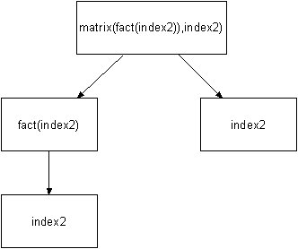
Tree representation of a Variable Reference

Slide 12
What is a Context?
The term Context is used to describe a concrete connection to a CCS
Service.
The C++ class cContext offers access to almost all services of a CCS
service
cContext objects have access to variables and serve as factory for
variable references
A pointer to the current connected context is supplied to almost all
application specific objects and user functions

Slide 13
What is a CCS Device Object?
A CCS Device Object has a well defined interface that is used to plug in
device specific specifications into a Data Model
A CCS Device Object is implemented through C++-Inheritance
Every application specific device object inherits from the base class
cDevice
Device objects can be easily created and exposed by integrating it into
the custom device factory.

Slide 14
Integration of application specific device functionality
Application specific device functionality can be implemented
through overloading a couple of virtual methods.
Overloading the virtual method cDevice::Read(..,)
This method reads data from the device
Overloading the virtual method cDevice::Write(..,)
This method writes data to the device

Slide 15
What is a CCS Program (task) Object?
A CCS Program Object is an object that executes application specific
functionality in background
A CCS Program Object is implemented through C++-Inheritance
Every application specific program object inherits from the base class
cProgram
Program objects can be easily created and exposed by integrating it
into the custom program factory.

Slide 16
Integration of application specific program functionality
Overloading the virtual method cProgram::Cycle()
This method is called cyclic by the CCS Service.
Overloading the virtual method cProgram::ExecuteUserCommand(..,)
This method can be called by every code that has access to the program
(for example within GUI user functions)
Overloading the virtual method cProgram::ProcessEvent(..,)
This method hooks to the occurrence of a CCS event
The event object is supplied as argument

