Slide 1
Shacira Qt GUI Framework
The Shacira Qt GUI Framework is used to implement graphical user
interfaces based on the C++ Qt GUI library
A Shacira GUI application is a CCS service client with graphical user
interface.
A Shacira GUI application should conform to the “thin client” model

Slide 2
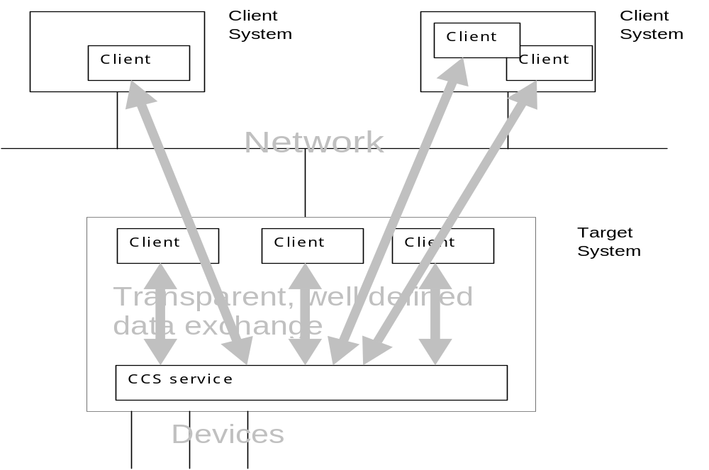
Shacira System Architecture

Slide 3
GUI Framework technology
The Shacira Qt GUI Framework offers Qt custom widgets to interface
with CCS service functionality
These custom widgets are called CWidget and they are implemented as
plugin for Qt Designer, a WYSIWYG layout tool for graphical user
interfaces
A Shacira GUI application should conform to the “thin client” model for
user interfaces

Slide 4
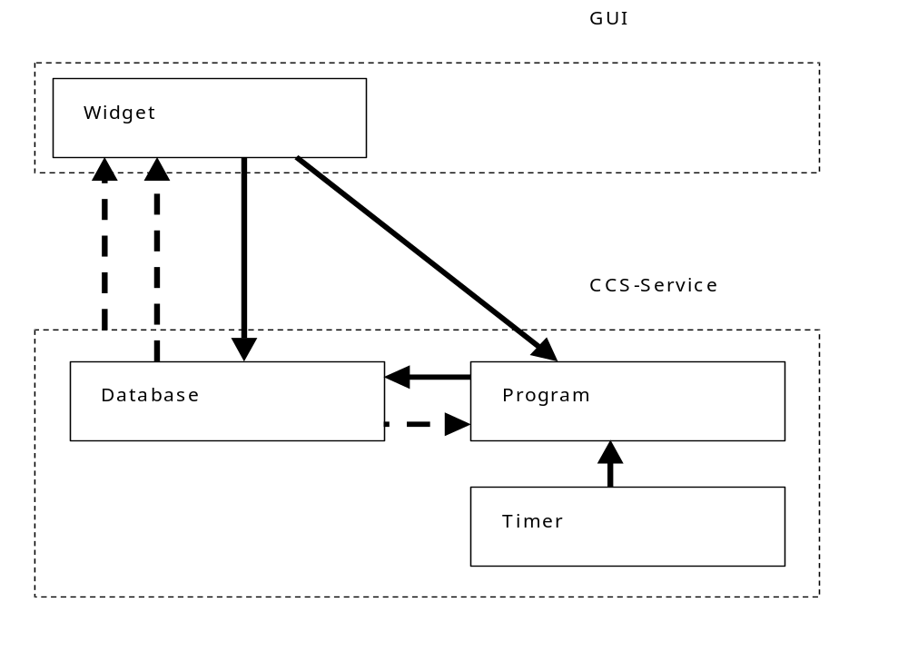
Information flow in a Shacira GUI Application

Slide 5
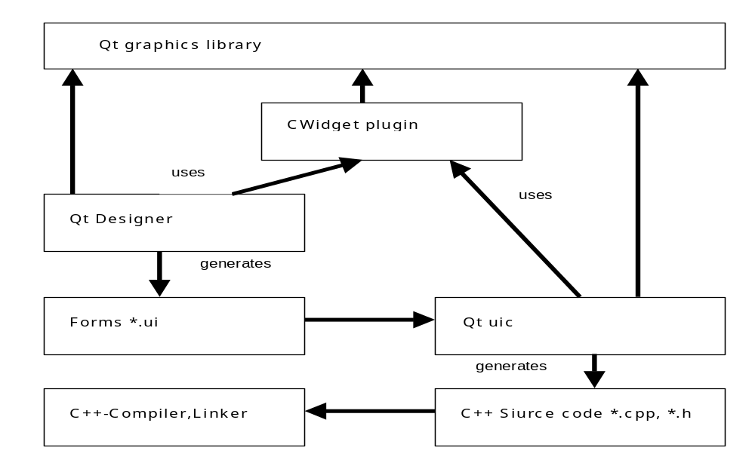
Framework Tool Chain

Slide 6
GUI Framework User Functions
Dark (blanking) functions are used to determine the visible state of a
widget (enabled, disable, hidden)
Plausibility functions are used to check the validity of user input
User functions are used to activate some functionality after a valid user
input
Button functions are used to activate some functionality when a button
is clicked
Signal filter and slot functions implement a mechanism to send
information from one CWidget to another

Slide 7
Dark (blanking) functions
A dark function is called cyclic or as consequence of a user input event
A dark function determines the visibility state of the associated CWidget
by returning an appropriate value
A dark function reference can be specified in the property
“DarkFuncRef” of a CWidget
The dark functionality is fully integrated with CWidget access
functionality that is also supplied by a CWidget

Slide 8
Dark functions return codes
elementFree: widget is not restricted in any way
elementDisabled: widget is visible but input is disabled
elementInvisible: widget is not visible

Slide 9
Plausibility check functions
A plausibility function is called after a has input data
A plausibility function checks the input for validity
A plausibility function communicates subordinate steps of the input
process to execute or to terminate

Slide 10
Plausibility functions return codes
actionProceed: input is valid proceed subordinate input process steps
actionReject: input is invalid terminate subordinate input process steps
actionIgnore: input is valid nevertheless terminate subordinate input
steps

Slide 11
User functions
A user function is called after the plausibility function is executed,
depending on the return value of the plausibility function
A user function executes some additional functionality associated with
the specific user input
A user function communicates subordinate steps of the input
process to execute or to terminate
For this purpose the same return code values as for plausibility
functions apply

Slide 12
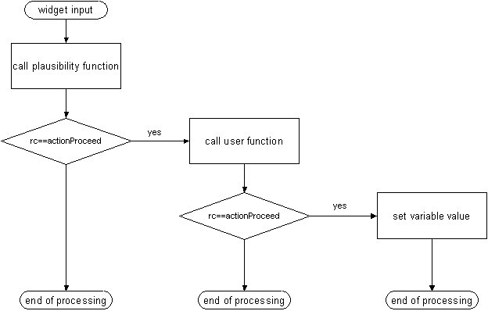
GUI Framework Input process

