Slide 1
Hybrid Parallelised Framework for the solution of PDEs on HPC Clusters
By:
NIKHIL GUPTA (B16023)
RITWIK SAHA (B16110)
Mentored By:
Dr. GAURAV BHUTANI
SCEE IIT MANDI

Slide 2
WORK DONE in ODD SEMESTER
Initial Aim :
Hybridize portions of PETSc to solve linear equations using both CPU and GPU, and benchmark the performance gains

Slide 3
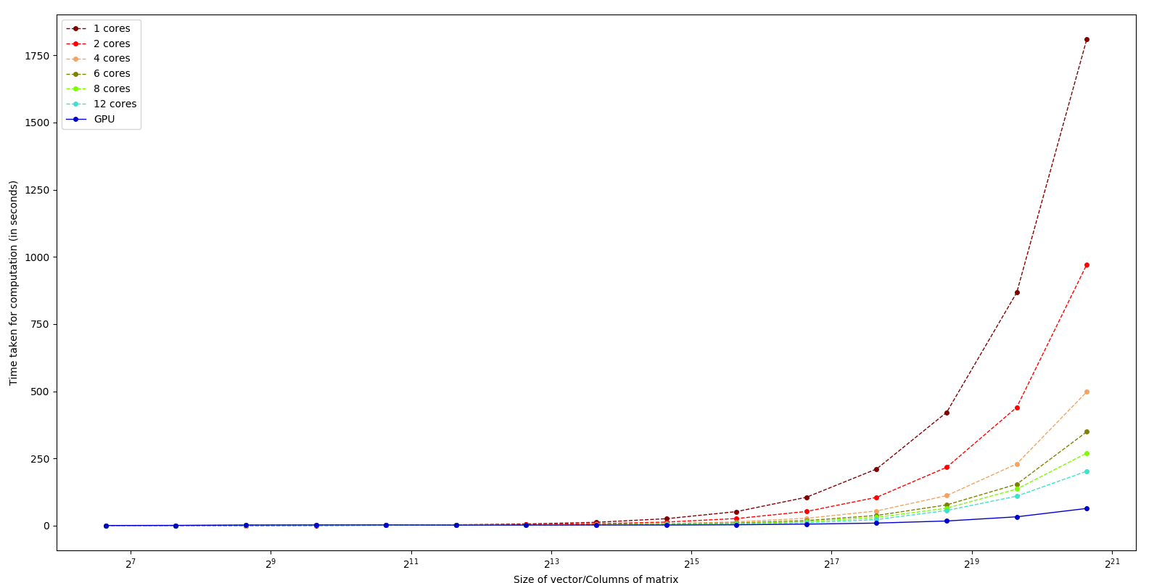
Benchmarks For CPU & GPU
We solved LE using KSP methods in PETSc on 1,2,4,6,8,12 cores (of HPC) and NVidia GTX-1050 GPU (of laptop)

Slide 4
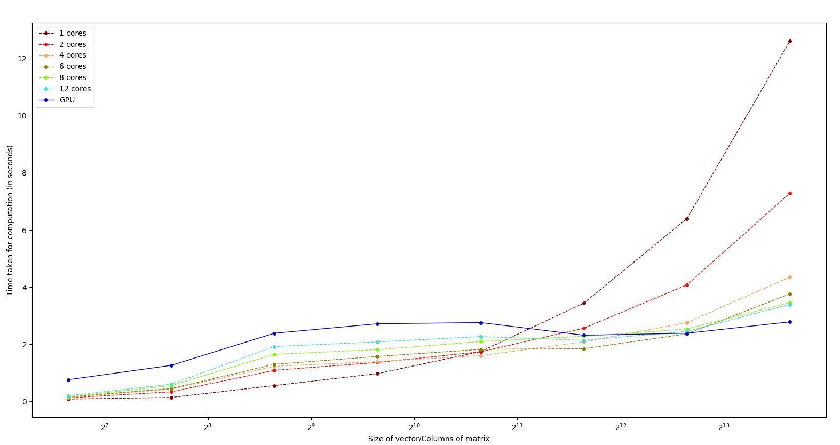
Benchmarks For CPU & GPU
However, the performance gains of using GPU was more pronounced as the dimension of vector/columns of matrix increases. In lower dimensions, various overheads take a toll on performance

Slide 5
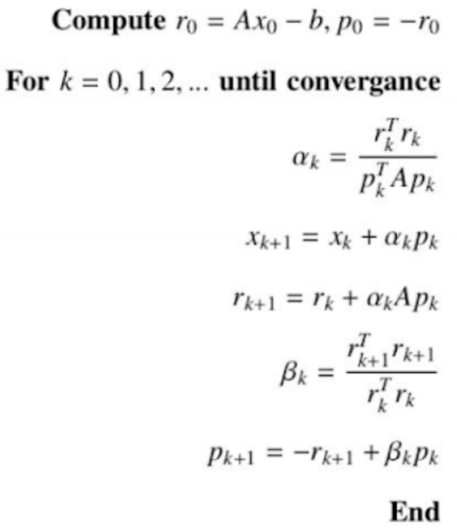
ATTEMPT AT HYBRIDIZATION
We implemented a naive version of conjugate gradient method, and hybridized it by allocating partial responsibilities of vector and matrices to CPU and GPU in specific “ratios”.
We were able to hybridize with GPU+single core of CPU, as GPU+multiple cores ran into deadlock problems.

Slide 6
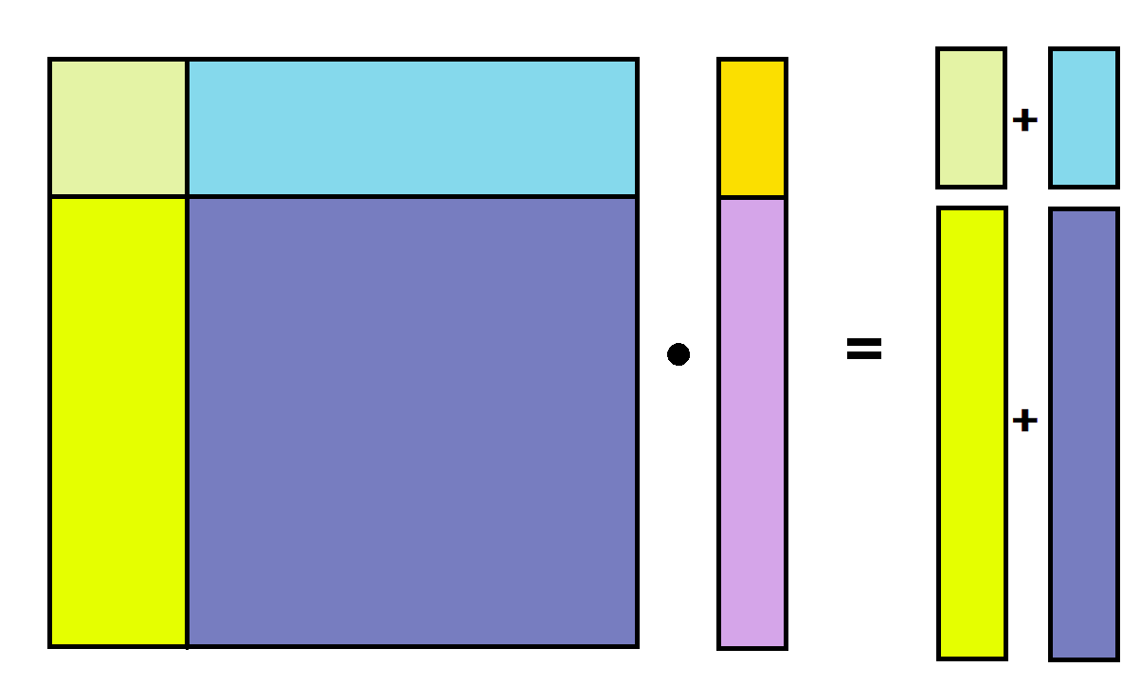
ATTEMPT AT HYBRIDIZATION
CPU
GPU
n1
n2
n1
CPU
GPU
CPU
n1
n2
CPU
GPU
GPU
n2
A
x
b
“ratio” means n1/(n1+n2)

Slide 7
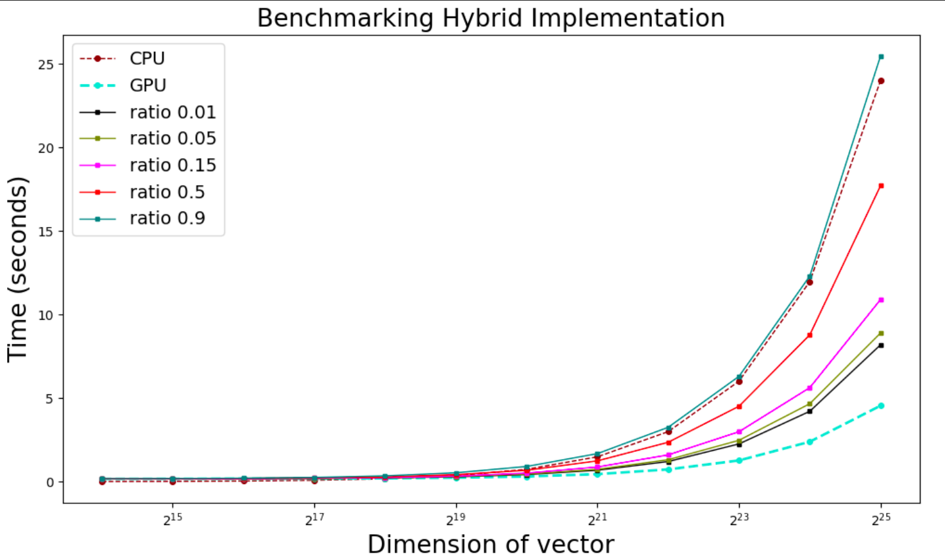
Hybridization benchmarks using different ratios

Slide 8
Conclusions
Contrary to expectations, a hybrid solver with 0.01 parts allocated to CPU and rest to GPU, performs worse than simple GPU implementation. Same is the case with all other ratios used.
Working in this direction may not be a viable option for rest of the project, given the conditions of the current pandemic and problems in collaborating seamlessly.
This part of the project can be passed on to future MTP takers, as lot of groundwork has been laid and, we pivoted towards running Fluidity on PETSc enabled with GPU.

Slide 9
WORK DONE in EVEN SEMESTER
Current Aim :
As the benchmarks did not yield promising results, we aimed to run Fluidity, a widely used fluid mechanics software to run on GPU, as it leverages PETSc.

Slide 10
What is Fluidity?
It is an open source computational fluid dynamics code.
It relies on PETSc to solve linear equations and other various libraries for different purposes.
Used by researchers around the globe and in IIT MANDI.
Does not support GPU accelerators.

Slide 11
Current AIM
Benefits
How?
To enable FLUIDITY to use GPU accelerators
Most of the modern Laptops and PCs contain GPU cards. Researchers will be able to run codes and simulations on these systems (exploiting the GPU) rather than relying on multicore HPC clusters.
Significant Speedup
From previous work, PETSc shows speedup when run on GPU.
Now, incorporate GPU compatible PETSc in FLUIDITY.

Slide 12
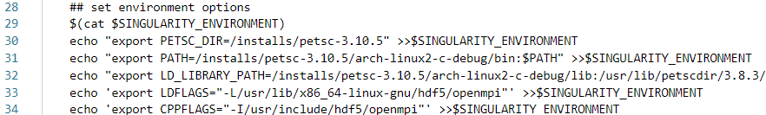
The challenges
Extremely outdated documentation
Multiple version specific dependencies
Simply providing the path of PETSC (GPU) in Fluidity build process does not work
Making changes in Fluidity Source code requires in depth understanding of the whole Fluidity codebase, which is out of the scope of project.

Slide 13
Phase 1 : Building Fluidity (vanilla fluidity on CPU-only PETSc)
We use singularity scripts to make singularity images for containerization. This is because HPC support singularity and there is no risk of damaging the work machine.
A lot of challenges were there in building fluidity from source as mentioned in the previous slide. But we received lot of support from the fluidity community.
As fluidity uses various Continuous Integration scripts for continuous testing, we were able to piece together various scripts to build fluidity.

Slide 14
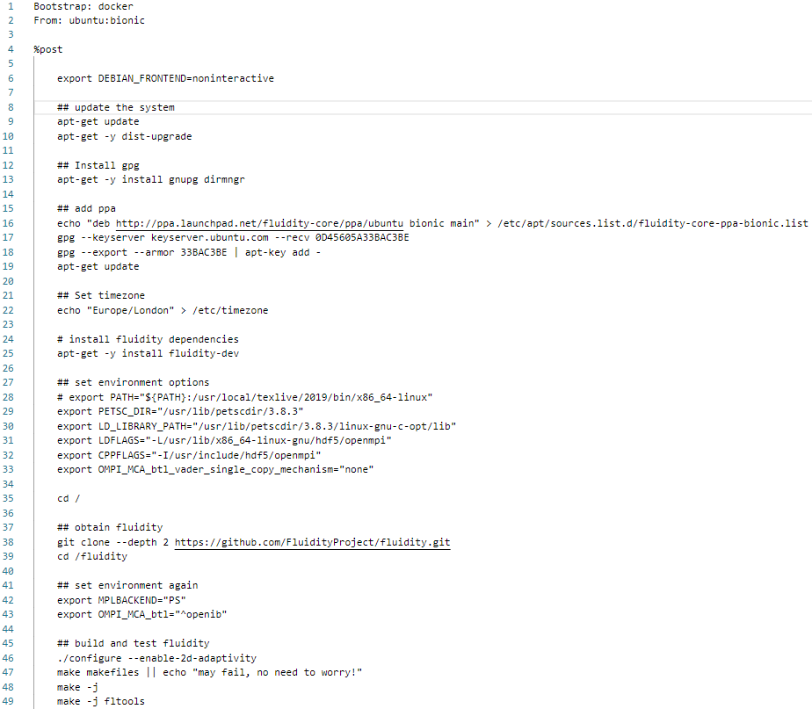
Phase 1
Singularity Script

Slide 15
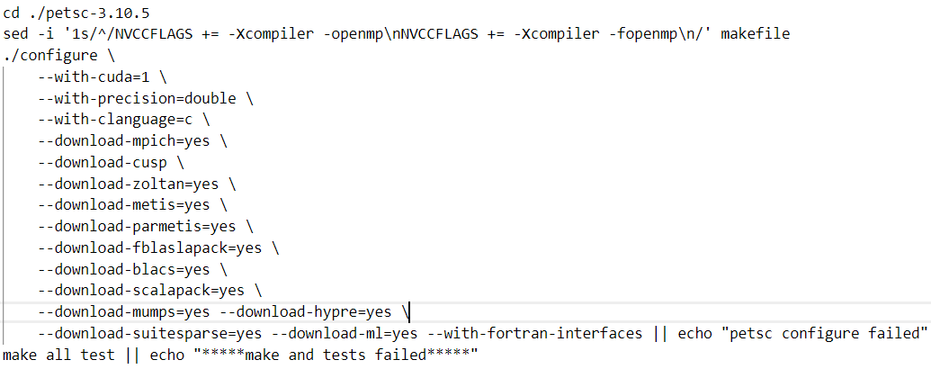
Phase 2 : Vanilla Fluidity on GPU-configured PETSc
We configured PETSc for GPU on top of CUDA-10.0 docker image provided by NVidia.
Then we tried to install Fluidity without any specific GPU only changes, and ran tests, and it worked(34 out of 1800 tests failed)
PETSc had to be downloaded with lot of options enabled, which took a fair bit of our research time. Paths had to be changed to point towards our custom PETSc installation.

Slide 16
Phase 3 : Changes in Fluidity :
To leverage GPU-enabled PETSc
As unchanged fluidity successfully ran in a GPU environment, we moved on to see what changes were needed to achieve our final objective

Slide 17
Phase 3 : Changes in Fluidity : Example -1
Directly changing directives to their CUDA equivalents, with few modifications
FILE : $FLUIDITY_DIR/femtools/Sparse_Tools_Petsc.F90
call MatCreateAIJ (MPI_COMM_SELF, urows, ucols, urows, ucols, PETSC_NULL_INTEGER, dnnz, 0 , PETSC_NULL_INTEGER, M, ierr )
call MatCreateAIJCUSPARSE (MPI_COMM_SELF, urows, ucols, urows, ucols, PETSC_DECIDE, dnnz, 0, PETSC_NULL_INTEGER, M, ierr )

Slide 18
Phase 3 : Changes in Fluidity : Example -2
Changing directives and PETSc types to their CUDA equivalents
FILE : $FLUIDITY_DIR/femtools/Petsc_Tools.F90
if (parallel) then call VecCreateMPI (MPI_COMM_FEMTOOLS, plength, ulength, vec , ierr ) else call VecCreateSeq (MPI_COMM_SELF, ulength, vec, ierr ) endif
if (parallel) then call VecCreate (MPI_COMM_FEMTOOLS, vec , ierr ) call VecSetType (vec, VECMPICUDA, ierr ) call VecSetSizes (vec , plength, ulength, ierr ) else call VecCreateSeqCUDA (MPI_COMM_SELF, ulength, vec , ierr) endif

Slide 19
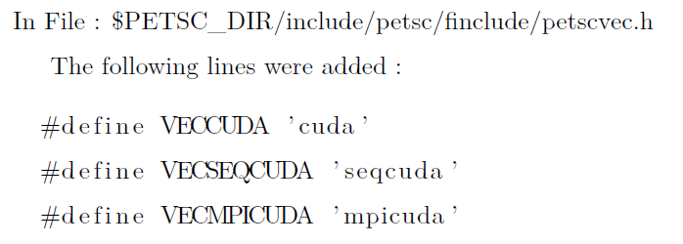
Phase 3 : Compiling changed Fluidity
After the changes, the Fluidity failed to build and compile.
Analyses of the errors :
Certain macros are not defined in FORTRAN libraries of PETSc. Thus, it was a PETSc specific bug. It is ironed out and reported to the PETSc project. The next releases of PETSc would not contain the bug.
Changes in the singularity scripts were made to include these macros during PETSc installation.

Slide 20
Phase 4 : Petsc(GPU) and FORTRAN
FORTRAN based code was benchmarked on PETSc(GPU) to make sure that FORTRAN works fine with PETSc, after the changes.
Simulations were carried out like previous semester.
KSP example used in previous sem(written in C) was hand-converted to FORTRAN.
Results show equal time taken by C and Fortran in PETSc run on GPU.

Slide 21
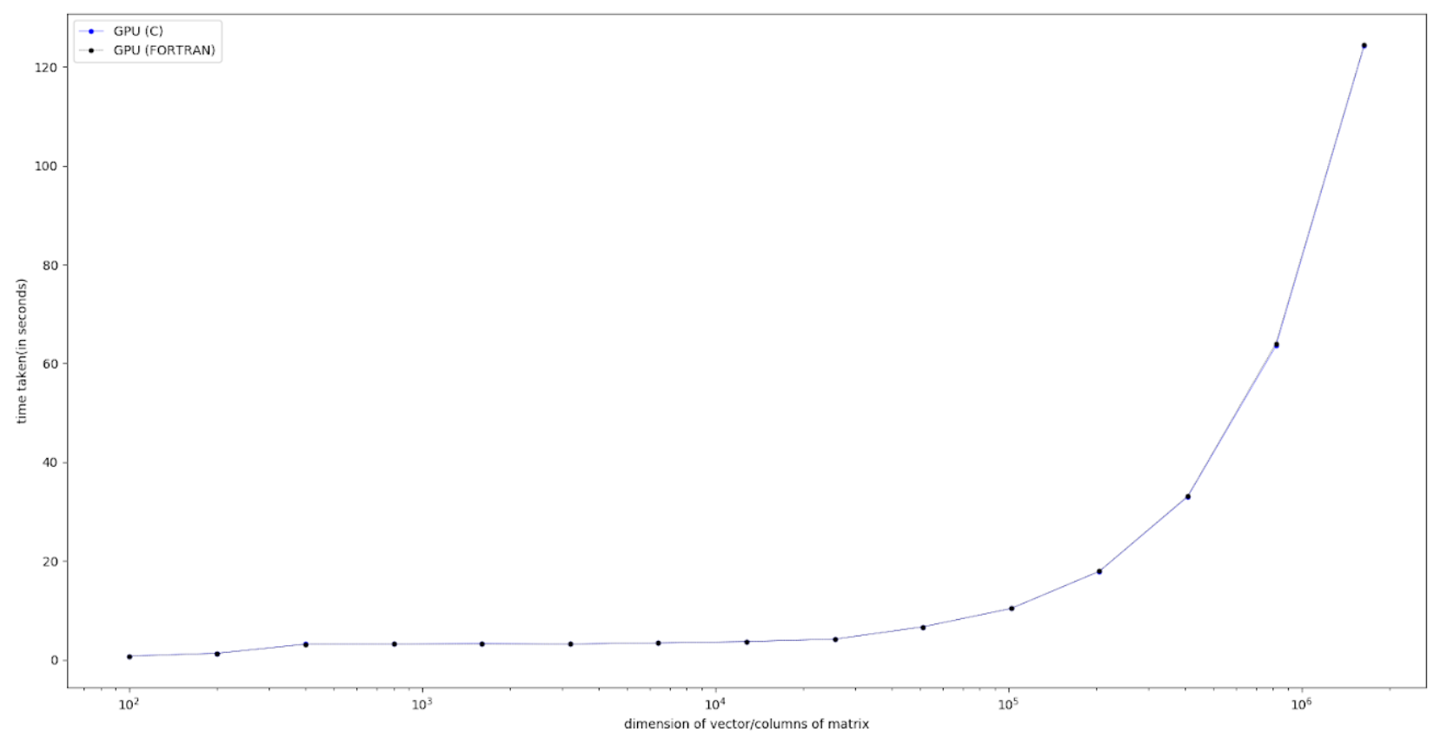
Phase 4 : Benchmarks For GPU(C) & GPU (FORTRAN)

Slide 22
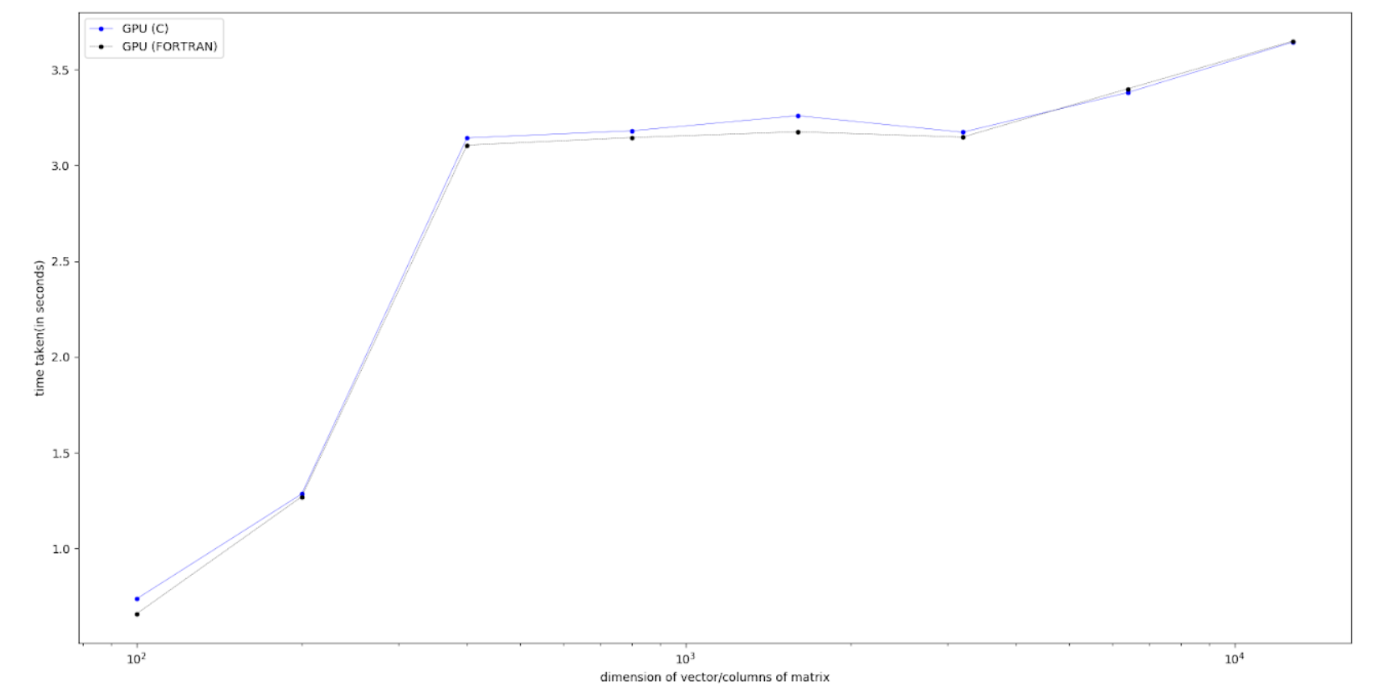
Phase 4 : Benchmarks For GPU(C) & GPU (FORTRAN)
We can conclude, that there is no appreciable difference between C and FORTRAN performance. Thus FORTRAN is working fine on PETSc (GPU).

Slide 23
RECAP : Benchmarks C codes : CPU vs GPU
We solved LE using KSP methods in PETSc on 1,2,4,6,8,12 cores (of HPC) and NVidia GTX-1050 GPU (of laptop)

Slide 24
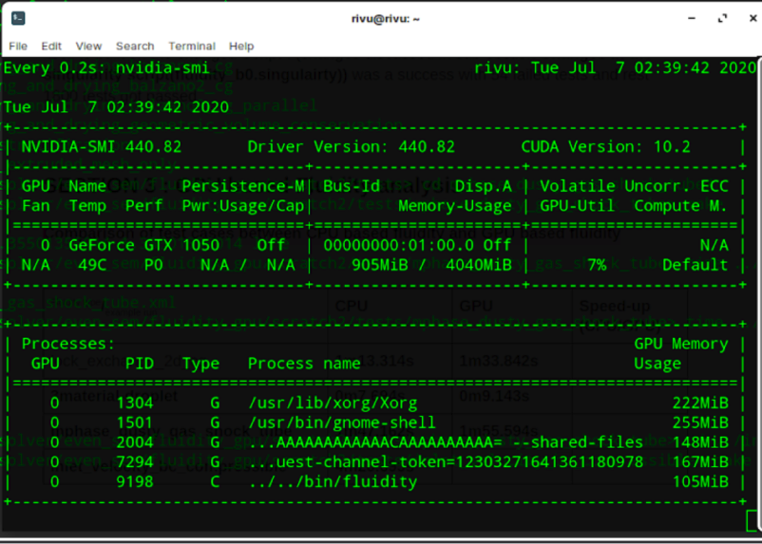
Phase 5 : Building and Running Fluidity
After the necessary changes in PETSc and FLUIDITY source code, fluidity was built successfully.
Few common tests were run and timing was noted
‘nvidia-smi’ command was used in the host system (outside the singularity environment) to confirm usage of GPU.
Increase in Memory usage and addition of process indicated that fluidity was consuming GPU accelerator.

Slide 25
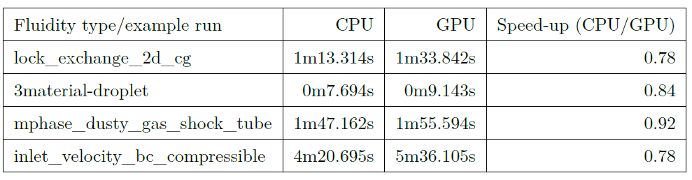
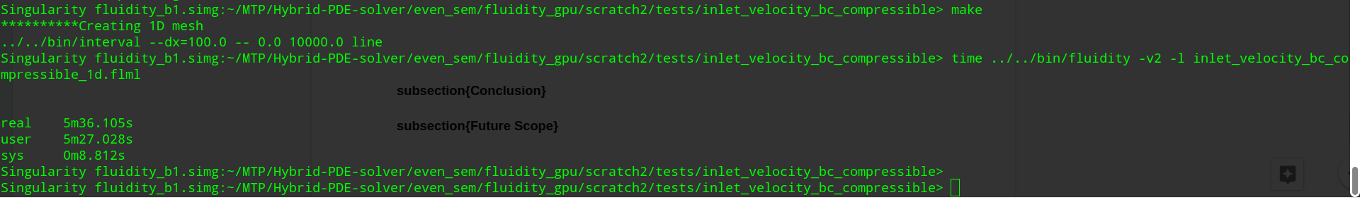
Phase 5 : Fluidity benchmarking results on CPU & GPU
Screenshot of a sample run for timing purposes
Various predefined examples were run with the same names as given in the table.

Slide 26
Observations
There is degradation in performance for all test cases.
Tests run on standard Fluidity take less time on single core as compared to GPU compatible Fluidity
Fluidity simulation is using the GPU card.
Against the intuition and the experimental results of previous semester
where significant efficiency in speed up is observed on using GPU accelerator.

Slide 27
Observations : Hypothesis
Hypothesis 1(more likely) :
All petsc directives were not converted to their respective CUDA versions
Few or all operations are still carried out in CPU and the excess time is due to the data transfer between the CPU and GPU.
Hypothesis 2 (less likely):
PETSC is efficiently running on GPU
Fluidity demands the values of the vectors and matrices time and again in CPU
Therefore excess data transfer overhead.
Hypothesis 3 (less likely):
Fluidity is not as dependent on PETSc as assumed
Incorporation of GPU compatible PETSc in Fluidity will not make huge difference.

Slide 28
Conclusions
The target to run the Fluidity library on GPU was achieved.
The target to achieve speedup could not be achieved.

Slide 29
Future Work
A significant amount of work needs to be done to first understand the Fluidity in depth and then change its source code for better performance gains.
All PETSC directives should be correctly changed to their CUDA versions in all the files of Fluidity source code.
Requires further understanding of PETSc nomenclature and code structure.

Slide 30
THANK YOU

