Slide 1
Analysis of OKCupid – Income group
Machine Learning Fundamentals
Tay Khek Yang – 2018/12/12

Slide 2
Contents
Exploration of Dataset
Statement of Question
Definition of New Columns
Comparison of 2 classification approaches
Comparison of 2 regression approaches
Conclusion

Slide 3
Exploration of Dataset
Codecademy - OKCupid sample data

Slide 4
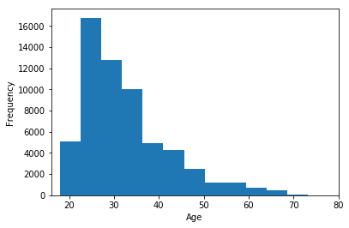
Age histogram (base data)
Some insight about
the age group of
OKCupid users in
the sample data

Slide 5
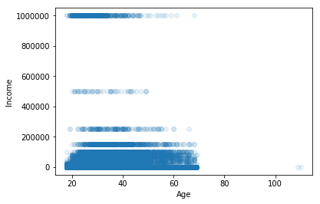
Age vs Income (base data)
Some insight about
the age vs income of
OKCupid users in
the sample data

Slide 6
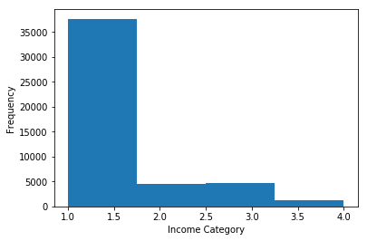
Income Groups (for base data)
Some insight about
the income group of
OKCupid users in
the sample data

Slide 7
Income Groups (for base data) cont’
Income Group | Range | Value | Note
No Income | -1 | 1 | An assumption is made here –where the value of “-1” indicates no income for the specific user
Low Income | 0 – 45 000 | 2 | Referring to links* referenced below
Mid Income | 45 000 – 135 000 | 3 | Referring to links* referenced below
High Income | 135 000 - Above | 4 | Referring to links* referenced below
*http://www.pewresearch.org/fact-tank/2018/09/06/are-you-in-the-american-middle-class
*https://www.cnbc.com/2018/09/26/how-many-americans-qualify-as-middle-class.html

Slide 8
Statement of Question
Codecademy - OKCupid sample data

Slide 9
Statement of Question
From a logical point of view – we believe that Age / Education / Job (type) impacts the income group which a OKCupid user will be in – We will then test whether this 3 categories can / will impact the income group?
We will predict and try to find out the income group of OKCupid users who refused / did not specify their job (type)

Slide 10
Definition of New Columns
New Columns | Full Name of Columns | Note
edu_cat | Education Category | Categorization of Education level of users
job_cat | Job Category | Categorization of Job type based on whether it is STEM or not. (We believe STEM job type is of higher value)
income_cat | Income Category | Categorization of Income based on Pew Research

Slide 11
New Columns – edu_cat
We aim to categorize education category based on the perceived difficulty (higher value for higher difficulty) of the education level which we are predefining as such:
Value | Definition
1 | Studying
2 | Graduated - High School
3 | Graduated - Degree
4 | Graduated - Masters
5 | Graduated - Law
6 | Graduated - Medicine
7 | Graduated - PHD
Some assumptions are made where education info is provided:
Attempting / Dropping out of Masters or Phd – assumes that user already graduated with degree (value of 3 assigned)
Graduating from Space Camp is considered graduated with degree
Attempting / Dropping out of all other types of level of education (besides Masters and Phd) presumes that user is still engaged in some form of studying

Slide 12
New Columns – edu_cat – cont’
“education” | edu_cat value | Note
graduated from college/university | 2
graduated from masters program | 3
working on college/university | 1 | Assume
working on masters program | 3 | Assume
graduated from two-year college | 2
graduated from high school | 2
graduated from ph.d program | 7
graduated from law school | 5
working on two-year college | 1
dropped out of college/university | 2 | Assume
working on ph.d program | 3 | Assume
college/university | 1
graduated from space camp | 3
dropped out of space camp | 1
graduated from med school | 6
working on space camp | 1
working on law school | 1
two-year college | 1
working on med school | 1
dropped out of two-year college | 1
dropped out of masters program | 3 | Assume
masters program | 4
dropped out of ph.d program | 3 | Assume
dropped out of high school | 1
high school | 1
working on high school | 1
space camp | 1
ph.d program | 3 | Assume
law school | 1
dropped out of law school | 1
dropped out of med school | 1
med school | 1

Slide 13
We aim to categorize jobs columns data (the jobs columns appears to indicate the sector of industry one is in) based on whether one is engaged in a job or not and if the job is Science, Technology, Engineering and Mathematics (STEM) based or not – assuming that STEM based jobs are higher value. The following are values we are predefining for the job categories
Value | Category | Note
1 | None | Non-working “jobs”
2 | Non-STEM | Non-STEM based job category
3 | STEM | STEM based job category
Some assumptions are made where job info is provided:
Anything marked under “other” or “rather not say” is a non-STEM job
New Columns – job_cat

Slide 14
Value | Category | Note
other | 2 | Assume
student | 1
science / tech / engineering | 3
computer / hardware / software | 3
artistic / musical / writer | 2
sales / marketing / biz dev | 2
medicine / health | 3
education / academia | 2
executive / management | 2
banking / financial / real estate | 2
entertainment / media | 2
law / legal services | 2
hospitality / travel | 2
construction / craftsmanship | 2
clerical / administrative | 2
political / government | 2
rather not say | 2 | Assume
transportation | 2
unemployed | 1
retired | 1
military | 2
New Columns – job_cat – cont’

Slide 15
We aim to categorize the income levels to the various 4 main income category as explained earlier – the follow table are to highlight again the point we discussed before.
Income Group | Range | Value | Note
No Income | -1 | 1 | An assumption is made here –where the value of “-1” indicates no income for the specific user
Low Income | 0 – 45 000 | 2 | Referring to links* referenced below
Mid Income | 45 000 – 135 000 | 3 | Referring to links* referenced below
High Income | 135 000 - Above | 4 | Referring to links* referenced below
Some assumptions are made where income info is provided:
Anything with value of -1 is in reference to No income (most likely a student / retiree etc.)
The following are links referenced to define Income Group ranges
*http://www.pewresearch.org/fact-tank/2018/09/06/are-you-in-the-american-middle-class
*https://www.cnbc.com/2018/09/26/how-many-americans-qualify-as-middle-class.html
New Columns – income_cat

Slide 16
Comparison of 2 classification approaches
Codecademy - OKCupid sample data

Slide 17
2 classification approaches
There are 2 main classification approaches which is used in this project
KNeighborsClassifier
KMeans++

Slide 18
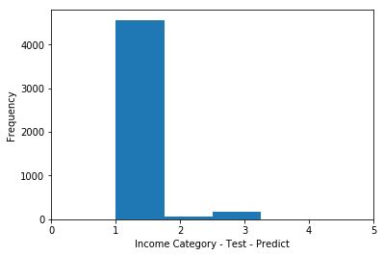
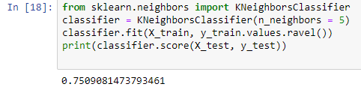
KNeighboursClassifier
We were able to predict and have up to 3 types of income categories using this approach – It appears to have difficulty predicting for the “high income” category
We are getting quite good scores when n_neighbors is set to 5 (0.7509081473793461)

Slide 19
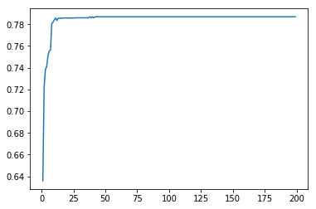
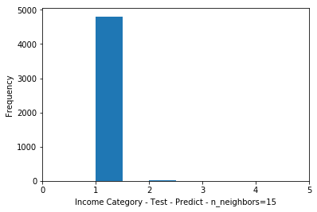
KNeighboursClassifier cont’
Score value can be set higher if the n_neighbors is set to a higher value (up to 25) – Running with higher n_neighbors values has diminishing returns as per scoring comparison (0-200 tested – takes ~ 2 minutes to complete)
When score values go up – the income categories become reduced to 2 types only being predicted (i.e. “No Income” and “Midde Income”) – e.g. n_neighbors=15

Slide 20
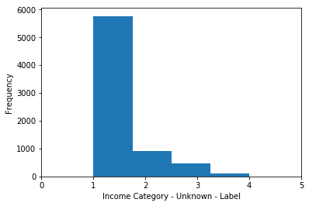
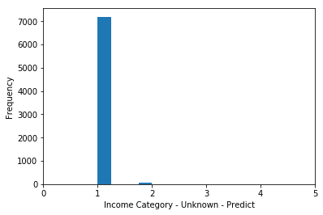
KNeighboursClassifier cont’
By working only on entries which the job value is defined as “other” and “rather not say” – at n_neighbors = 5, we have a similar looking – but missing “Low Income” and “High Income” group
We have an accuracy score on the unknown values of 0.7939920077166873

Slide 21
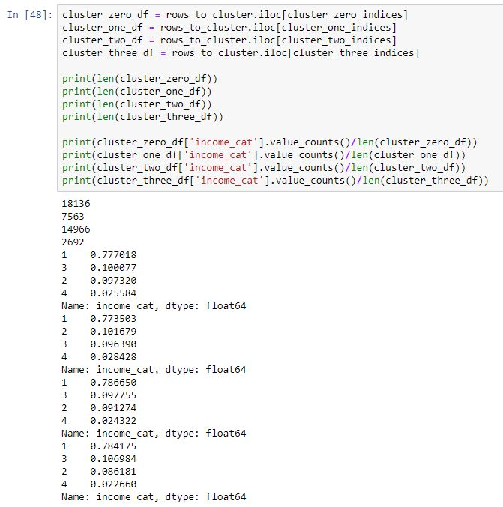
KMeans++
We were able to predict mainly 4 clusters – although the don’t appear to be clearly divided as expected based on income category
Based on the length of each cluster we could assume
Cluster 0 – No Income
Cluster 1 – Low Income
Cluster 2 – Mid Income
Cluster 3 – High Income

Slide 22

KMeans++ cont’
The score on KMeans++ is very far off as compared to KneighboursClassifier

Slide 23
Comparison of 2 regression approaches
Codecademy - OKCupid sample data

Slide 24
Conclusion
Codecademy - OKCupid sample data

Slide 25
Conclusion
Machine Learning using KNeighboursClassifier and KMeans++ is quite straight forward, fast and simple to use
Referring to the sample data and method of categorization used in this project – KNeighboursClassifier is more accurate to be used vs KMeans++
Better method of categorization can be considered
Consider categorizing additional entries for Finance perhaps as this is one industry that pays probably better than STEM
Additional fields which ideally can be obtained
Total amount of years working (More experience may mean higher chance of higher income category – a good indicator)
Size of company worked at in terms of staff (Bigger company may generally indicate higher pay?)

