Slide 1
Analysis of OKCupid – Income group
Machine Learning Fundamentals
Tay Khek Yang – 2018/12/12

Slide 2
Contents
Exploration of Dataset
Statement of Question
Definition of New Columns
Comparison of 2 classification approaches
Comparison of 2 regression approaches
Conclusion

Slide 3
Exploration of Dataset
Codecademy - OKCupid sample data

Slide 4
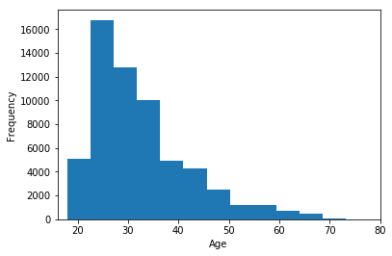
Age histogram (base data)
Some insight about
the age of OKCupid
users in sample data

Slide 5
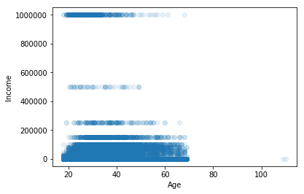
Age vs Income (base data)
Some insight about
the age vs income of
OKCupid users in
the sample data
Note: A lot of -1s of
Income is skewing data

Slide 6
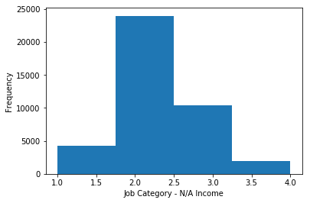
N/A Income observation
Observation of various
job categories* which we
expect some valid income
value – but we are getting
-1 (which is invalid or
N/A)
We can conclude that
quite a huge number of
users are not sharing
their income with
OKCupid
*Details regarding job categorization is covered in later slide: “New Columns – job_cat“

Slide 7
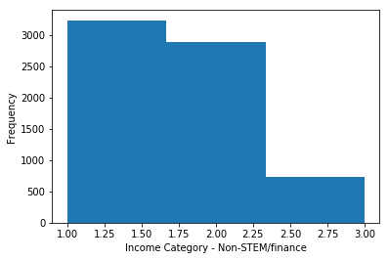
Income Groups (non-STEM / Finance)
Income Category of
non-STEM / Finance
job types

Slide 8
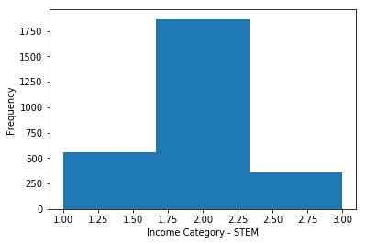
Income Groups (for STEM)
Income Category of
STEM job types

Slide 9
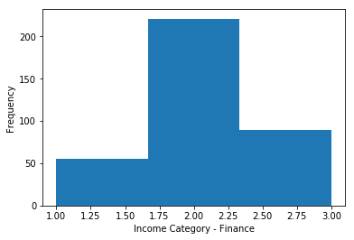
Income Groups (for Finance)
Income Category of
Finance job types

Slide 10
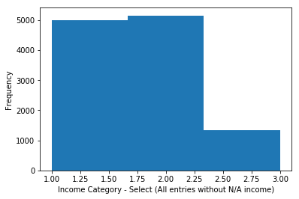
Income Groups (for selected data)
Income Category of
selected data (all entries
Without N/A income)

Slide 11
Income Groups (for selected data) cont’
Income Group | Range | Value | Note
Low Income | 0 – 45 000 | 2 | Referring to links* referenced below
Mid Income | 45 000 – 135 000 | 3 | Referring to links* referenced below
High Income | 135 000 - Above | 4 | Referring to links* referenced below
*http://www.pewresearch.org/fact-tank/2018/09/06/are-you-in-the-american-middle-class
*https://www.cnbc.com/2018/09/26/how-many-americans-qualify-as-middle-class.html

Slide 12
Statement of Question
Codecademy - OKCupid sample data

Slide 13
Statement of Question
From a logical point of view – we believe that Age / Education / Job (type) impacts the income group which a OKCupid user will be in – We will then test whether this 3 categories can / will impact the income group?
We will predict and try to find out the income group of OKCupid users who refused / did not specify their job (type)

Slide 14
Definition of New Columns
New Columns | Full Name of Columns | Note
edu_cat | Education Category | Categorization of Education level of users
job_cat | Job Category | Categorization of Job type based on whether it is STEM or not. (We believe STEM job type is of higher value)
income_cat | Income Category | Categorization of Income based on Pew Research

Slide 15
New Columns – edu_cat
We aim to categorize education category based on the perceived difficulty (higher value for higher difficulty) of the education level which we are predefining as such:
Value | Definition
1 | Studying
2 | Graduated - High School
3 | Graduated - Degree
4 | Graduated - Masters
5 | Graduated - Law
6 | Graduated - Medicine
7 | Graduated - PHD
Some assumptions are made where education info is provided:
Attempting / Dropping out of Masters or Phd – assumes that user already graduated with degree (value of 3 assigned)
Graduating from Space Camp is considered graduated with degree
Attempting / Dropping out of all other types of level of education (besides Masters and Phd) presumes that user is still engaged in some form of studying
Ideally – we should have a status of education info where the user is at, rather than, what the users is attempting (or not)

Slide 16
New Columns – edu_cat – cont’
“education” | edu_cat value | Note
graduated from college/university | 2
graduated from masters program | 3
working on college/university | 1 | Assume
working on masters program | 3 | Assume
graduated from two-year college | 2
graduated from high school | 2
graduated from ph.d program | 7
graduated from law school | 5
working on two-year college | 1
dropped out of college/university | 2 | Assume
working on ph.d program | 3 | Assume
college/university | 1
graduated from space camp | 3
dropped out of space camp | 1
graduated from med school | 6
working on space camp | 1
working on law school | 1
two-year college | 1
working on med school | 1
dropped out of two-year college | 1
dropped out of masters program | 3 | Assume
masters program | 4
dropped out of ph.d program | 3 | Assume
dropped out of high school | 1
high school | 1
working on high school | 1
space camp | 1
ph.d program | 3 | Assume
law school | 1
dropped out of law school | 1
dropped out of med school | 1
med school | 1

Slide 17
We aim to categorize jobs columns data (the jobs columns appears to indicate the sector of industry one is in) based on whether one is engaged in a job or not and if the job is Science, Technology, Engineering and Mathematics (STEM) or Finance based or not – assuming that STEM / Finance based jobs are higher value. The following are values we are predefining for the job categories
Value | Category | Note
1 | None | Non-working “jobs”
2 | Non-STEM-Finance | Non-STEM / Finance based job category
3 | STEM | STEM based job category
4 | Finance | Finance based job category
Some assumptions are made where job info is provided:
Anything marked under “other” or “rather not say” is a non-STEM / Finance job
Finance is considered as slight higher value than STEM
New Columns – job_cat

Slide 18
Value | Category | Note
other | 2 | Assume
student | 1
science / tech / engineering | 3
computer / hardware / software | 3
artistic / musical / writer | 2
sales / marketing / biz dev | 2
medicine / health | 3
education / academia | 2
executive / management | 2
banking / financial / real estate | 4
entertainment / media | 2
law / legal services | 2
hospitality / travel | 2
construction / craftsmanship | 2
clerical / administrative | 2
political / government | 2
rather not say | 2 | Assume
transportation | 2
unemployed | 1
retired | 1
military | 2
New Columns – job_cat – cont’

Slide 19
We aim to categorize the income levels to the various 4 main income category as explained earlier – the follow table are to highlight again the point we discussed before.
Income Group | Range | Value | Note
Low Income | 0 – 45 000 | 2 | Referring to links* referenced below
Mid Income | 45 000 – 135 000 | 3 | Referring to links* referenced below
High Income | 135 000 - Above | 4 | Referring to links* referenced below
Some assumptions are made where income info is provided:
Anything with value of -1 is in reference to No income (most likely a student / retiree etc.)
The following are links referenced to define Income Group ranges
*http://www.pewresearch.org/fact-tank/2018/09/06/are-you-in-the-american-middle-class
*https://www.cnbc.com/2018/09/26/how-many-americans-qualify-as-middle-class.html
New Columns – income_cat

Slide 20
Comparison of 2 classification approaches
Codecademy - OKCupid sample data

Slide 21
2 classification approaches
There are 2 main classification approaches which is used in this project
KNeighborsClassifier
KMeans++

Slide 22
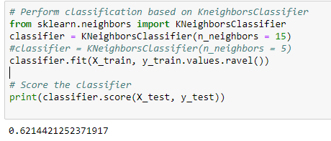
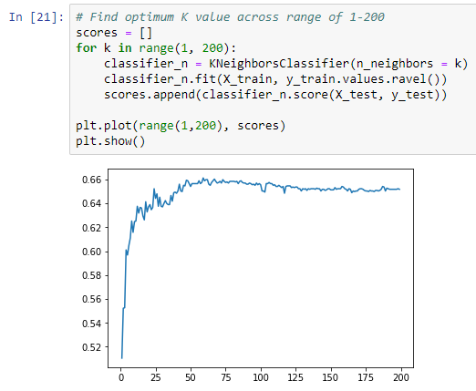
KNeighboursClassifier
We are getting quite good scores when n_neighbors is set to 15(0.6214421252371917)
Score value can be set higher if the n_neighbors is set to a higher value (up to 25) – Running with higher n_neighbors values has diminishing returns as per scoring comparison (0-200 tested – takes ~ 2 minutes to complete)

Slide 23
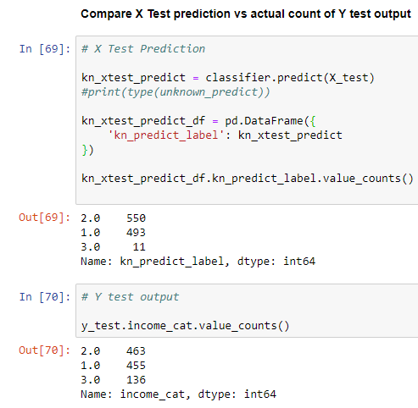
KNeighboursClassifier cont’
In comparison of X Test prediction vs actual count of Y test output – we can observe the following:
The classifier appears to have difficulty predicting entries with High Income
The general count looks similar with the income category for all selected dataset with Income information i.e.
Low and Middle Income are much bigger in number vs High Income
Middle Income is slightly more than Low income

Slide 24
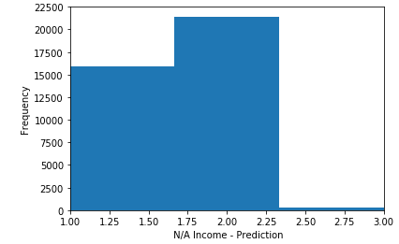
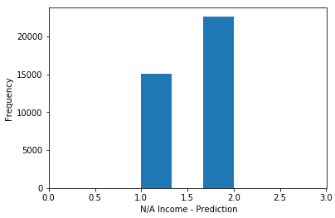
KNeighboursClassifier (on N/A Income)
When running KneighboursClassifier on N/A income users
We were able to predict and have up to 3 types of income categories using this approach –
The general count looks similar with the income category for all selected dataset with Income information i.e.
Low and Middle Income are much bigger in number vs High income
Middle Income is slightly more than Low income
High Income is smaller
When score values go up higher (e.g. 100) – the income categories become reduced to 2 types only being predicted (i.e. “No Income” and “Midde Income”) – e.g. n_neighbors=100 due to difficulty to clearly predict High Income users

Slide 25
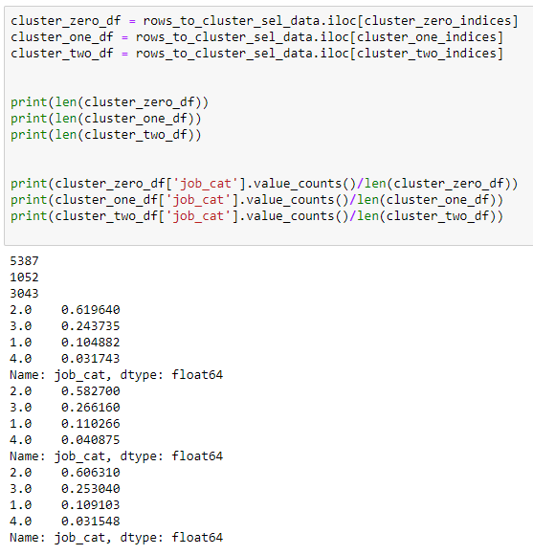
KMeans++
We were able to predict mainly 4 clusters – although they don’t appear to be clearly divided as expected based on income category
Based on total number entries of cluster zero / one / two - we conclud
cluster_zero ~ middle income
cluster_one ~ low income
cluster_two ~ high income
Observations based on job category
The amount of finance job category (4) is higher from low income (cluster_one) - to middle income ( cluster_zero ) - to high income (cluster_two)
We can see the inverse above the relationship mentioned above for the non finance / non STEM job category (2)
Based on the two points above – we can kind of get that relationship from earlier slide (Exploration of Data - Income Groups (for STEM) & Income Groups (for Finance))

Slide 26

KMeans++ cont’
The score on KMeans++ is very far off as compared to KneighboursClassifier

Slide 27
Comparison of 2 regression approaches
Codecademy - OKCupid sample data

Slide 28
2 regression approaches
There are 2 main regression approaches which is used in this project
LinearRegression
K-Nearest Neighbors Regressor

Slide 29
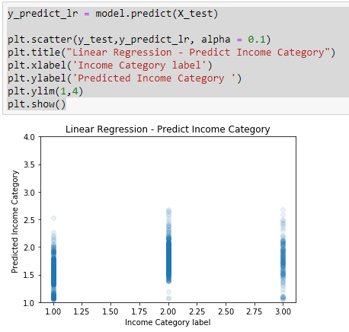
Linear Regression
We compare the Income Category vs Predicted Income Category - we have the following observations
Low Income category predictions have about half of the entries in the Middle Income Category
Middle Income category prediction is scattered quite accurately in a 0.5 range around the value of 2 (Middle Income Category)
There is zero accuracy for High income category prediction.

Slide 30
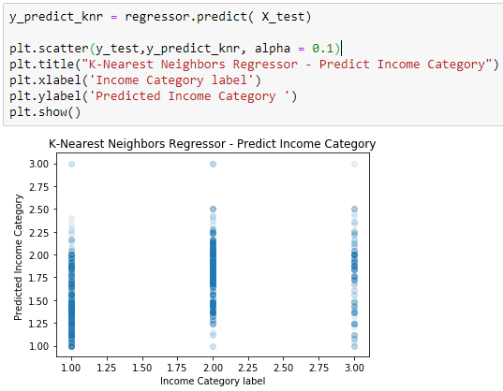
K-Nearest Neighbors Regressor
We compare the Income Category vs Predicted Income Category - we have the following observations
Low Income category predictions have more than half of the entries in the Middle Income Category
Middle Income category prediction is scattered quite accurately in a 0.5 range around the value of 2 (Middle Income Category)
There is some entries with High income category prediction - but accuracy is low

Slide 31
Conclusion
Codecademy - OKCupid sample data

Slide 32
Conclusion
Machine Learning using KNeighboursClassifier and KMeans++ is quite straight forward, fast and simple to use
Referring to the sample data and method of categorization used in this project – KNeighboursClassifier is more accurate to be used vs KMeans++
Better method of categorization can be considered
Consider categorizing based on age in 5 or 10 years intervals
Additional fields which ideally can be obtained
Total amount of years working (More experience may mean higher chance of higher income category – a good indicator)
Size of company worked at in terms of staff (Bigger company may generally indicate higher pay?)

