Slide 1

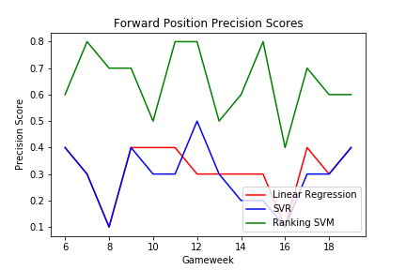
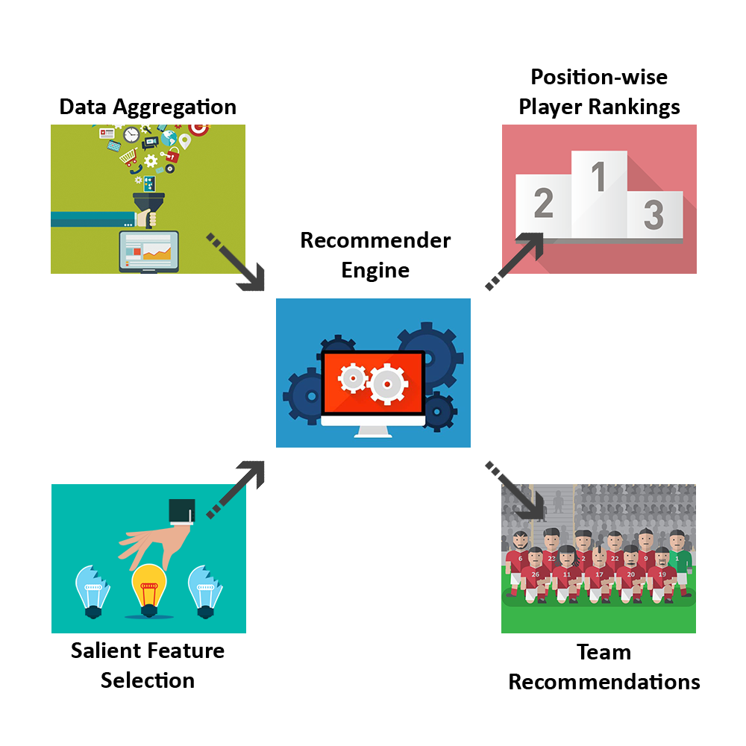
Recommendation on Fantasy League - ROFL
Shubham Bhargava, Snehil, Vaibhav Rawat, Tushar Turkar
Department of Computer Science & Engineering, Texas A&M University
Introduction
Fantasy football league emulates the experience of English Premier League wherein participants assemble a team of players under certain budget constraints and score points based on how well those players performed.
The aim of the game is to score as many points as possible. The scoring is done based on factors such as goals scored, assists, clean sheets, penalties, fouls, wins / losses, etc.
Methodologies
Player’s performance is predicted by factors such as player’s current trend, past season’s performances, explicit and implicit factors. We train our model on 2016-17 data with above factors and test our model on 2017-18 ranking the players in each game-week according to category further used for building specific team configurations.
Players are ranked by assigning scores with Regression methods, SVR, and Bayesian Ridge models. Pairwise comparison of players is done using Ranking-SVM.
Motivation
The motivation of this project is to help soccer fans make informed decisions. Since our algorithms has no biases towards players, it helps bring lesser known players who are projected to perform well into limelight by taking into consideration unique intrinsic features and current player form.
As soccer fans and budding data scientists, we plan to tackle this optimization problem of selecting players to get maximum score by proposing a recommender engine that provides position-wise rankings of the players (FWD, MID, DEF, GLK) that are expected to bring users more points in the upcoming fixtures.
Key Takeaways
Ranking SVM outperformed Regression and SVR based approaches as it computes pairwise results.
Players’ current trend has most impact on predicting next game-weeks performance as compared to player’s past seasons’ performance. Implicit features like ICT (Influence, Creativity and Threat), Bonus have little effect in improving the precision score.
Dataset & Architecture
Dataset for season 2016-17 and current season has been obtained from Fantasy Premier League website. Dataset includes both explicit (goals scored, assists, etc.) and implicit (play-making, creativity, etc.) features and past history performances for about 700 players in 20 teams across 38 game-weeks per season and up to past 8 seasons’ history data.
Player position and team data has been scraped from FoxSports soccer stats website and integrated into the main data repository.
Ethical Impacts
This tool unintentionally coaxes people to indulge in online wagers indirectly and spoils the spirit of the sport by recommending better strategies.
While the system has no biases towards the players, it tends to rate players based on their recent performances, which can be detrimental to new players.
Related Work and References
Fantasy Football Fix suggests customized transfers, player projected points, etc. based on past statistics.
Fantasy Football Geek and Scout post news, game analysis, current player rankings, tips and tricks, etc.

