Slide 1
HelpTree : Plant Disease Classification
NAC Tech Team

Slide 2
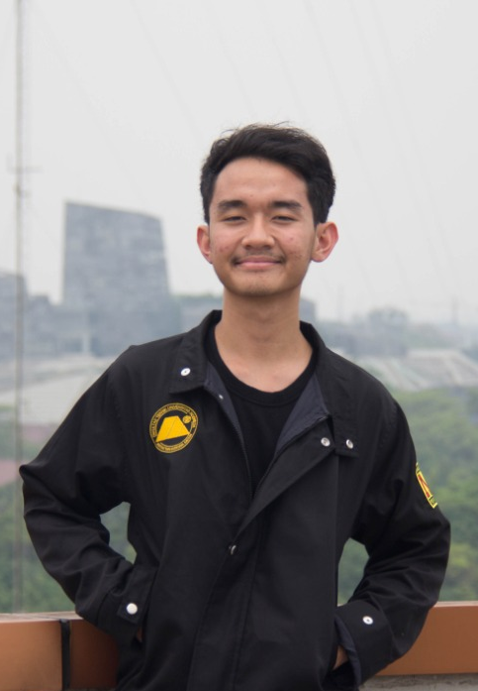
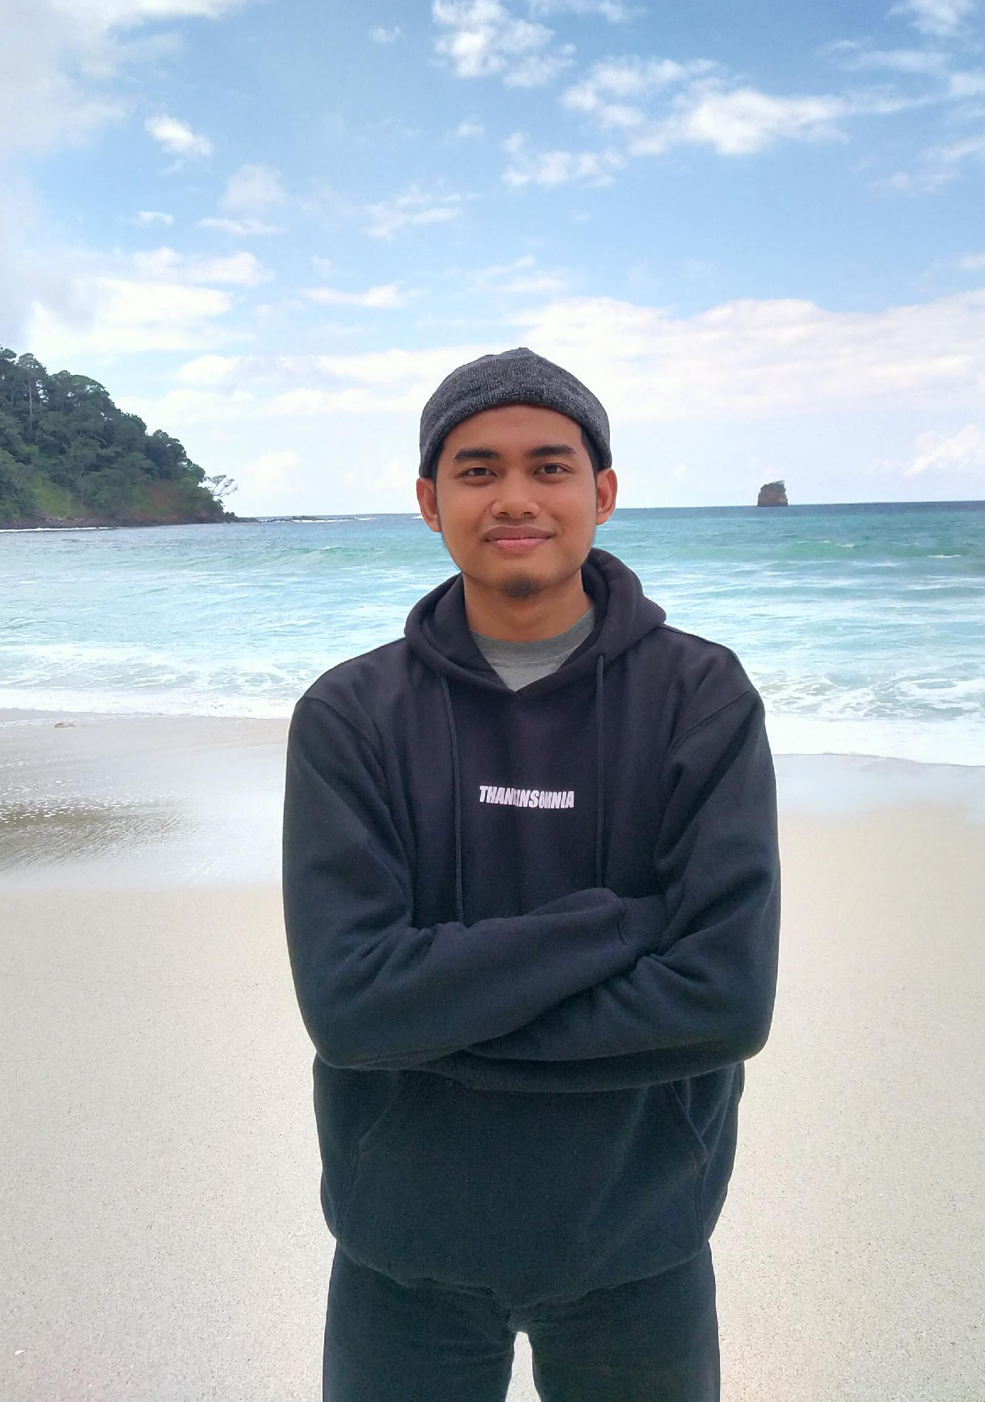
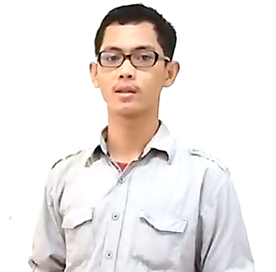
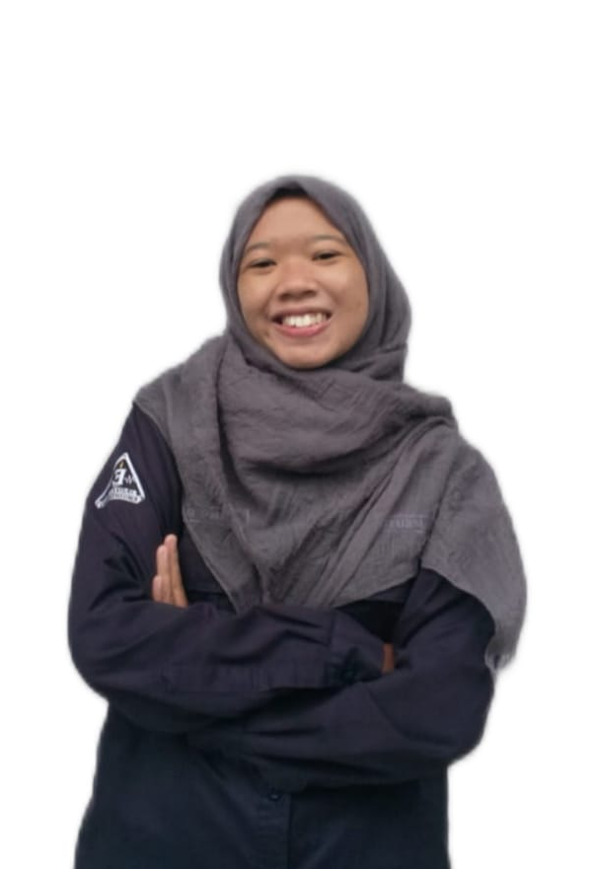

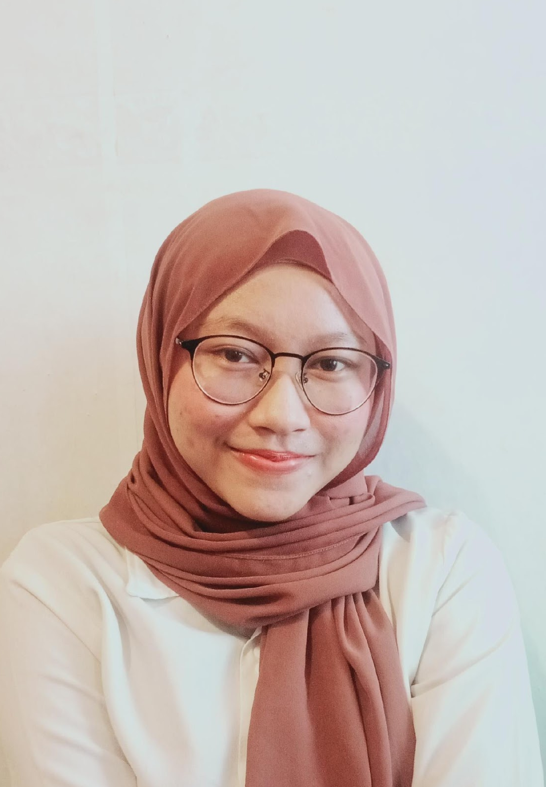
NAC Tech Team
Irfan Rahadi K.
M. Ilhamsyah
Aqilarik Nugra R.
Rivaldo Marta
Meutia Khairiyah
Annisa Nurjanah

Slide 3
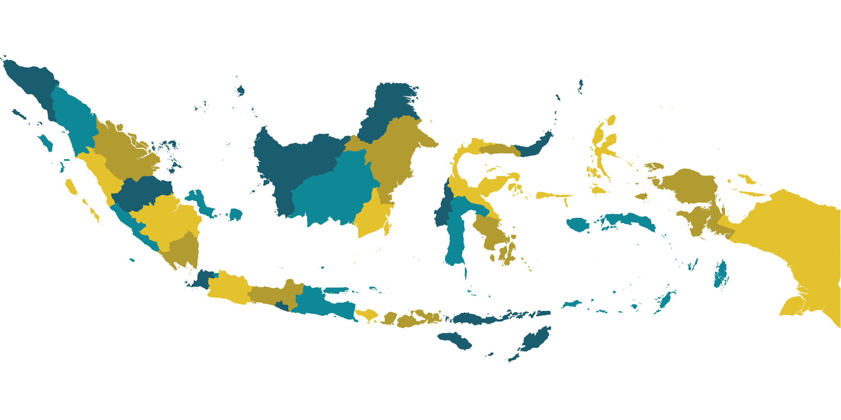
Indonesia
More than 33 million farmers in Indonesia in 2020 (Badan Pusat Statistik)
Every year, crop failure is always something to be dreaded about. plant disease is one of the biggest contributors to this can happen
Early in 2021 chili farmers in Mojokerto, lost up to 40% due to plant disease outbreaks
"It has been harvested three times and the conditions are like this, many chili plants are damaged by Anthracnose so they must be harvested quickly so that they do not spread to other plants," - Arik Susanto (Indonesian Farmer)
Source: Surya.co.id
Notes:
Dialog 1 : Every year, crop failure is always something to be dreaded about. plant disease is one of the biggest contributors to this can happen
Dialog 2 : "It has been harvested three times and the conditions are like this, many chili plants are damaged by Anthracnose so they must be harvested quickly so that they do not spread to other plants," - Arik Susanto (Indonesian Farmer)
Source: Surya.co.id

Slide 4

HelpTree
Helping Indonesian farmers get their income back
Reduce the harmful effects of disease on crops.
Notes:
Indonesia is an agricultural country, and every year farmers are always faced with diseases in
plants that cause crop failure and then suffer losses. Besides, there are many more problems
about this such as plant lovers. so we are moved to help farmers in overcoming disease attacks in
plants using machine learning so that they do not suffer more losses. Therefore our goal is How
to help farmers reduce the harmful effects of disease on crops.

Slide 5
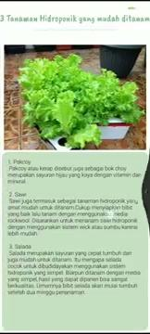
Demo Application
This is the prototype that our team is already working on
Notes:
Our apps is consist by 3 features. There are ambil gambar for prediction, konsultasi for chatbot and the list of article
The first session we try to use ambil gambar, so we can select the picture from Gakery or takin picture with kamera and when you have done to select it , click the prediction. So your app can identify the picture you take.
If you click temukan solusi it means you will be connected to chatbot. The chat bot will give the solution based on prediction.
And for konsultasi will be connected with chat bot
The last is the article. It will display articles related to the field of crops
in addition we make display information about the developer and also about the application.

Slide 6
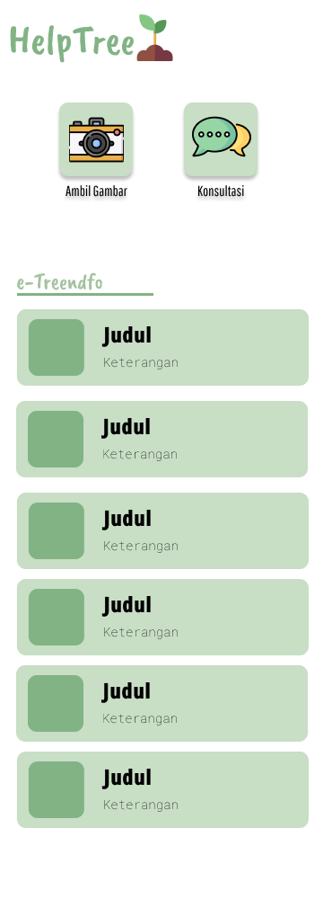
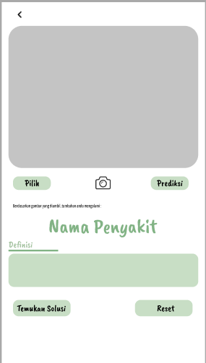
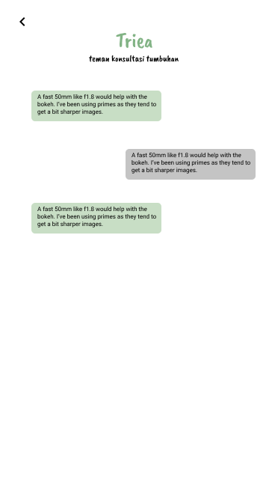
Mockup
Notes:
And this is our Mockup. There are Home Activty, Takepicture activity and Chatbot activity

Slide 7
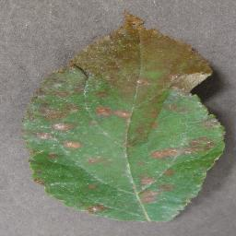
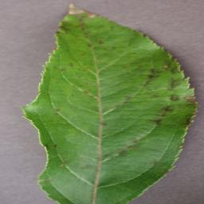
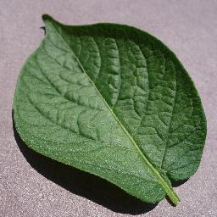
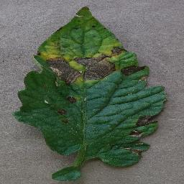
Our Model Machine Learning
12 types of plants | 38 classes

Slide 8
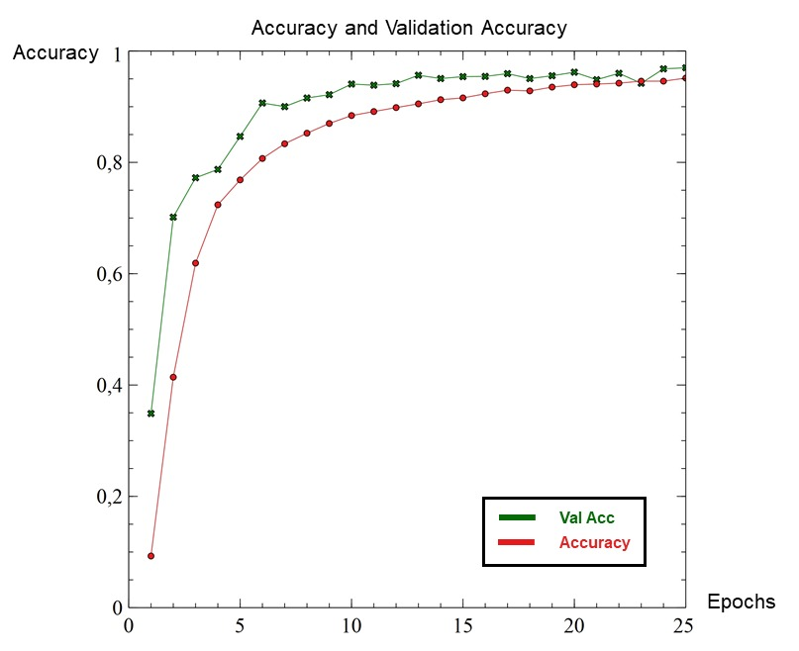
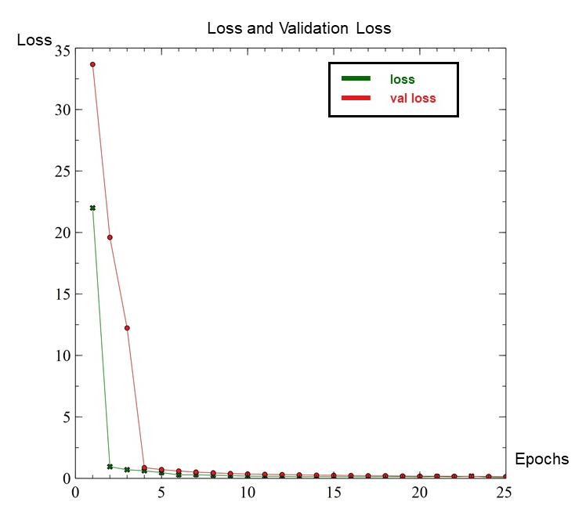
Accuracy and Loss
Accuracy = 95% Loss = 0.14
Validation Accuracy = 96% Validation Loss = 0.08

Slide 9
Implementation and Improvement
Android
Machine Learning
Cloud Computing
Creating an Android Application as a basic platform for the solutions we created. Connect Machine Learning Model using TFLite and Connect API Chatbot with LoopJ
Create a Deep Learning Model using Tensorflow, optimize the accuracy to more than 90% and convert the model into TFlite
Build a chatbot using Query Expansion and LSTM Networks methods. To process user input and provide response to android users, an API was built that was deployed on GCP's VM Instance. Most of the user input can be responded well by the chatbot.

Slide 10
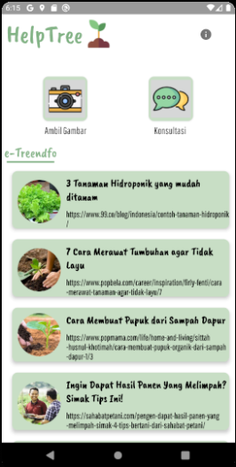
Result
This is the prototype form of the application that we have designed together

Slide 11
Business Model
Key Partner
- Farm Shop
Key Activities
- Providing farm kit to farmers
- Plant disease diagnosis
Value Proposition
- Provide information and tools for farmers to identify plant diseases and treat them
Customer Relationship
- Promo for early users
- Discount voucher for the first transaction
Customer Segments
- Indonesian citizens
- Farmer
- Age: 18-45
- Plant Lovers
- Have a farm
- Have plant collection
Key Resources
- Internet Access
- Android Device
Channels
- Mobile Apps
Cost Structure
- Server
- System Maintenance
- Employe salary
Revenue Stream
- Subscription
- Farm kit sales
- Consultation

Slide 12
THANKS!
Please keep this slide for attribution

Slide 13
Resources
Did you like the resources on this template? Get them for free at our other websites
VECTOR
Pollution on human body infographic
Healthcare and medical Pack
Medical services Pack
Human Uterus

