Slide 1

Assessing Global Suitability for a Novel Nut Tree
EcoCrop-based climate suitability modelling in Portugal, Peru, Vietnam and Tanzania
Climate Risk Assessment
Case Study - C
Submitted by,
Md. Nashid Kamal Sifat
Spatial System and Society, Crop Suitability Modelling, 2026

Slide 2

PROJECT BACKGROUND
A grain-replacing tree crop, piloted across four countries
A biotech company from Netherlands has developed a nut-producing tree that yields 4 to 8 times more than maize or wheat, is more nutrient-dense, and sequesters carbon, but takes 4 years to first production. The task is to Identify where, and what percentage of national area, this tree could be grown, as a pilot across Portugal, Peru, Vietnam and Tanzania, using its lab-derived environmental tolerances.
Brief Climate Context of the four selected countries
Portugal
Peru
Mediterranean climate, hot, dry summers with a structural rainfall gap of several months. And mild, wet winters. Agriculture is dominated by drought-tolerant tree crops olives, cork oak, vineyards, citrus precisely because few crops can sustain continuous moisture through the dry season
Extraordinary climatic diversity in one country, coastal desert, high Andes with cold, thin air, and Amazon lowlands with hot, humid, heavy rainfall and no real dry season. the Amazon basin provinces have tropical, consistently-wet profile, while coastal desert and high-altitude Andean provinces are too dry and too cold.
Vietnam
Tanzania
North-to-south climatic gradient, the north has a distinct cool winter (sometimes <15°C), while the south is tropical but has a pronounced dry season (Nov–April). Lâm Đồng, sits in the Central Highlands, a cooler, wetter upland pocket atypical of the rest of the country
Mostly semi-arid to sub-humid savanna climate with a pronounced dry season across most of the country. Kagera, borders Lake Victoria in the northwest, which creates a distinct lake-effect humid microclimate wetter and more consistent than the rest.

Slide 3
METHODOLOGY
EcoCrop limiting-factor model (Recocrop, R)
Crop environmental thresholds (as supplied by the company)
Duration (days) | Ktmp (°C) | Tavg (°C) | Rainfall (mm/mo)
230 | -4 | 12 | 80
NA | 1 | 15 | 155
200 | Inf | 27 | 279
340 | Inf | 36 | 535
Note on scope
Soil pH thresholds were not supplied by the company for this novel species, so pH was excluded as a limiting factor, suitability here reflects climate (temperature + rainfall) constraints only.
We are going to use statistical analysis using the Recocrop model with R studio (R) to identify which locations are the most suitable (Highly Suitable or Suitable Marginally suitable or Not Suitable) for this pilot project and deliver statistical data table of the probable hotspots for the project to be piloted, along with some maps to identify the zones.
Data sources:
Climate data: WorldClim v2.1 (2.5 arc-min monthly precipitation & temperature)
https://canvas.utwente.nl/courses/19086/pages/week-3-te1-dot-a-climate-risk-assessment?module_item_id=655382
Soil pH: SoilGrids (0–5cm pH) · geoBoundaries administrative units
https://canvas.utwente.nl/courses/19086/pages/week-3-te1-dot-a-climate-risk-assessment?module_item_id=655382
Boundary Shapes: Administrative Boundaries
https://gadm.org/download_country.html
Modelling: Recocrop (R) EcoCrop model.
Used Software: R Studio, QGIS
Libraries: Recocrop, raster, terra, rasterVis, dplyr, rgbif, sp,

Slide 4
RESULTS
National suitability is heavily concentrated in Peru
Reading the result
Peru: 38.3% the region driven by the Amazon basin (Loreto, Amazonas), which is warm and consistently wet year-round.
Portugal: 0% as Mediterranean summer drought breaks the 230-day continuous-rainfall requirement.
Vietnam & Tanzania: < 0.3% here suitability is limited to a handful of humid highland pockets.

Slide 5
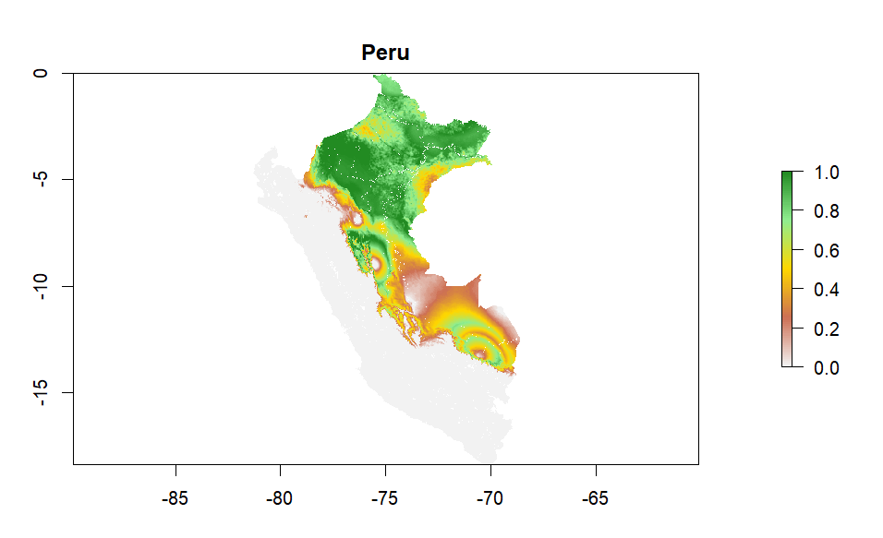
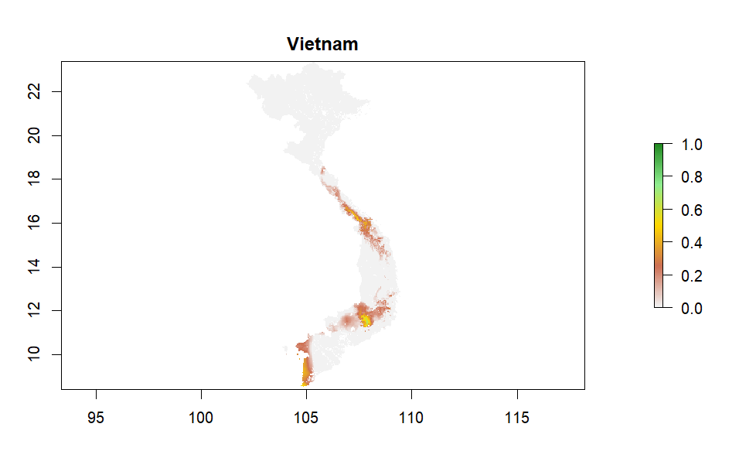
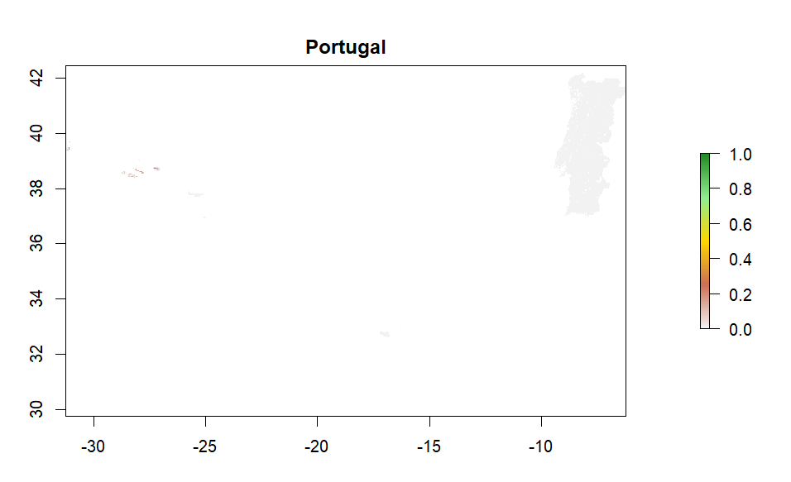
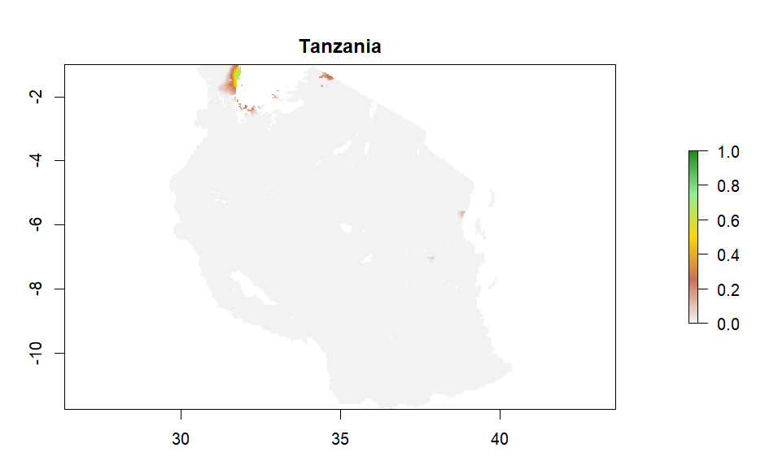
RESULTS
Crop suitability maps for all 4 countries (0–1 scale)

Slide 6
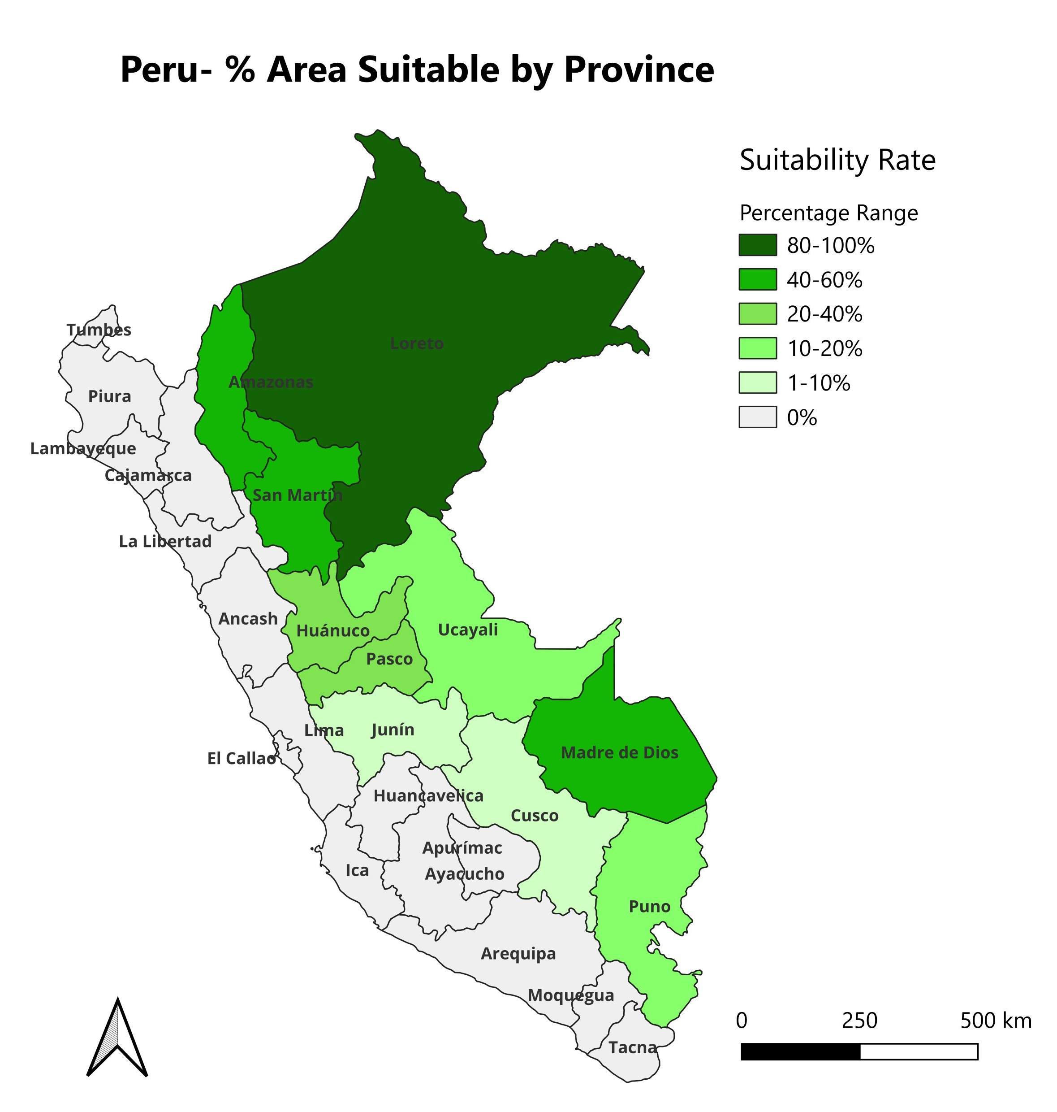
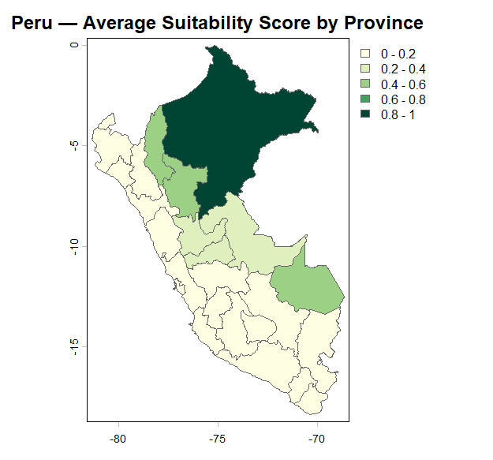
RESULTS
Peru's Amazon-basin regions dominate top suitable provinces across all four countries in terms of land cover and suitability score; Portugal returns no suitable provinces ;Vietnam and Tanzania shows negligible results to conduct a pilot project.
Provincial hotspots

Slide 7
RESULTS
Provincial hotspots as per land cover
Province | Country | % area suitable | Avg Suitability Score | Suitability Status
Loreto | Peru | 97.5% | 0.84 | Highly Suitable:
Amazonas | Peru | 50.8% | 0.48 | Suitable
Madre de Dios | Peru | 46.6% | 0.45 | Suitable
San Martín | Peru | 40.1% | 0.43 | Marginally Suitable
Huánuco | Peru | 30.8% | 0.25 | Marginally Suitable
Pasco | Peru | 22.6% | 0.29 | Marginally Suitable
Ucayali | Peru | 18.3% | 0.34 | Marginally Suitable
Puno | Peru | 10.6% | 0.1 | Not Suitable
Junin | Peru | 8.5% | 0.14 | Not Suitable
Cusco | Peru | 6.2% | 0.12 | Not Suitable
Lâm Đồng | Vietnam | 8.4% | 0.21 | Not Suitable
Bình Thuận | Vietnam | 1.3% | 0.03 | Not Suitable
Kagera | Tanzania | 2.9% | 0.05 | Not Suitable
Suitability Scale
Highly Suitable: 0.75 to 1.00
Suitable: 0.5 to 0.75
Marginally Suitable: 0.25 to 0.5
Not Suitable: 0 to 0.25

Slide 8
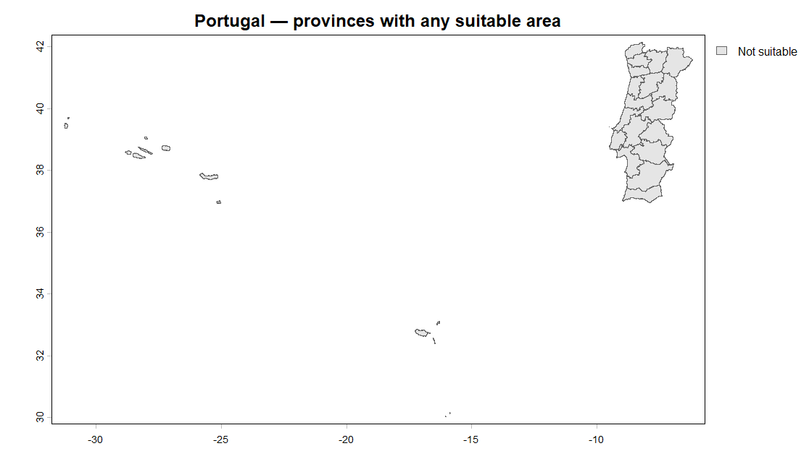
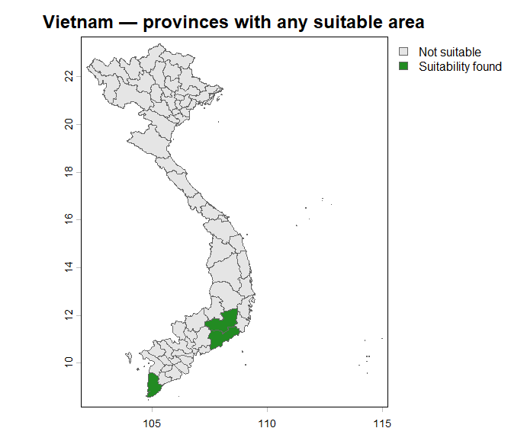
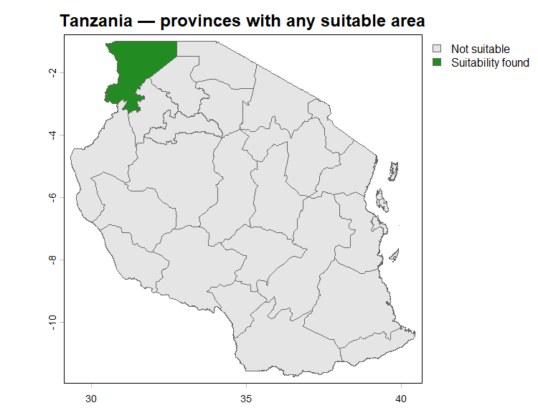
RESULTS

Slide 9
Conclusions & Recommendations
1
Peru is the clear priority for piloting this tree, the Amazon basin (Loreto, Amazonas, Madre de Dios) offers the only substantial suitable area with the proper suitability score (0.5-1.0), found as per the table and the graph. Our recommendation would be to choose Loreto because for a Pilot project a highly suitable land has the highest probability of success and avoid loss of investments. Besides the amount of land suitable in this region is the highest.
2
Amazonas and Madre de Dios are also good candidates, but they may require slightly better management or minor interventions as they were categorized as Suitable. We can also advice to add San Martin with special consideration as this region has almost the score to be suitable with a big portion of land. As this score is an average there is obviously more suitable region than the average for this province.
Portugal shows no climatically suitable mainland area under the tree's given tolerances. Its Mediterranean dry-summer regime is the limiting factor, not soil or temperature.
3
Vietnam and Tanzania offer only small, scattered highland or lake-basin pockets but their suitability score results poor ending up in the not suitable zone.
4

Slide 10
Thank You

