Slide 1
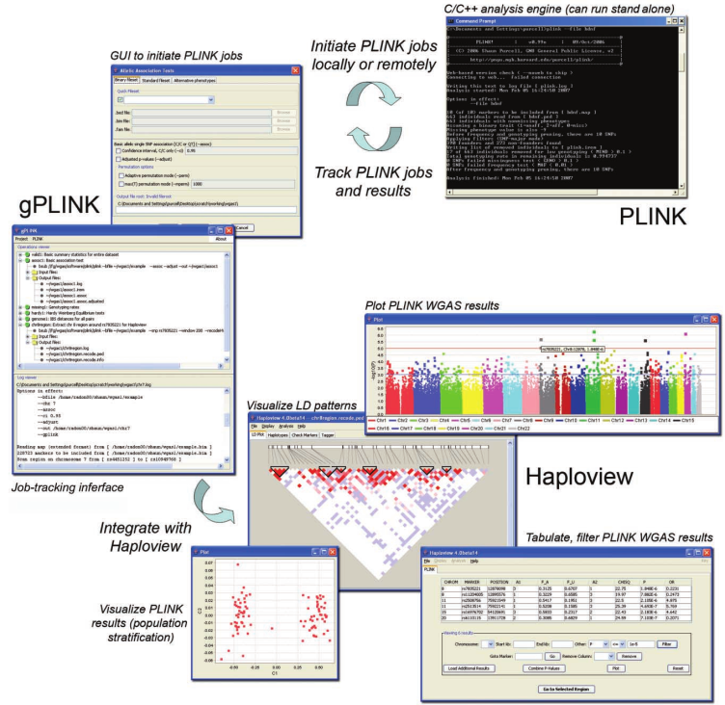


PLINK, PLINK/SEQ, and Hail
Tools for the analysis of genetic variation at the genome level
Presentation for Rivas Lab
10-17-2016

Slide 2
PLINK
Analysis of genotype/phenotype data
At the level of genetic variation
Commands
Input: PED and MAP files
Five Domains
plink --file data --pheno pheno.raw --assoc --maf 0.05 --out plinko

Slide 3
PLINK
Data management
Recoding, reordering, merging, subsetting…
Summary Stats
Missingness
By individual and by SNP
Clustering samples by missingness
Testing for non-random misses (LD-based)
Allele frequency data
Sex check
Population Stratification
Clustering based on identity-by-state (IBS)
Permutation tests for between groups
Similarity matrices
Outlier detection

Slide 4
PLINK
Association Analysis
Many standard tests offered ( e.g. Fisher’s exact test, case/control association..)
Linear and logistic modeling
Multiple testing correction (Bonferroni, Sidak, FDR)
Identity by descent (IBD) estimation
Prunes to SNPs believed to be in LE then builds a HMM to generate IBD values

Slide 5
PLINK/SEQ
Software package:
PLINK
Additional data handling tools (VCF)
Bundled with commonly used reference data
R package

Slide 6
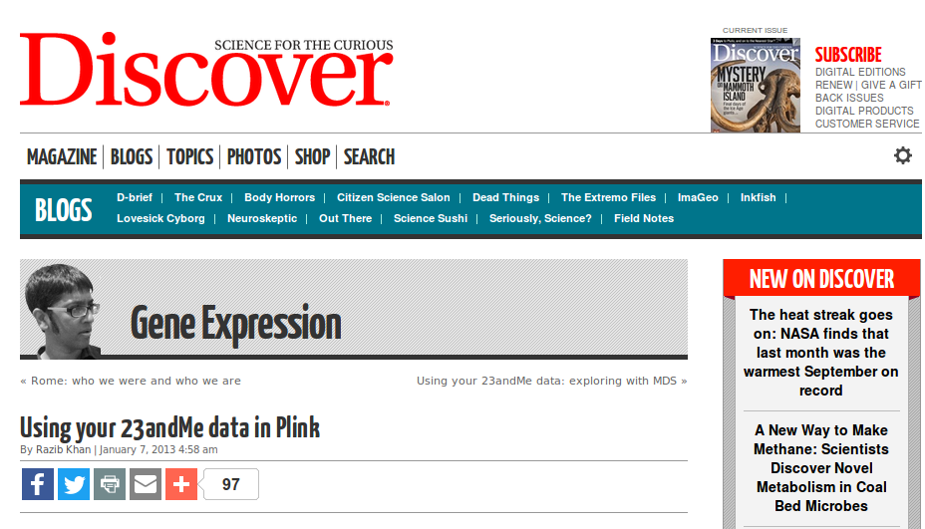
PLINK 2
Optimized for speed
Inputs: Common file types supported (bed, vcf, bcf, 23andMe, and others)
Removes dataset size limits
Same 5 domains with additional tools

Slide 7
Hail
Under active development
Makes use of plink2
Input: VCF files
Interfaces with R to allow plotting
Variant annotation and association analysis based on Plink2 methods

Slide 8
Summation
PLINK2 and Hail offer the most functionality
Both are under active development
Fast association analysis of huge datasets
PLINK is the basis for these tools

Slide 9
Rotation Project
“Finite mixture models for quantifying functional effects of standing genetic variation in humans”
STAN
Variation
Splice Sites
Enhancer
GTEx
Mixture
Model

