Slide 1

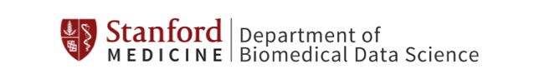
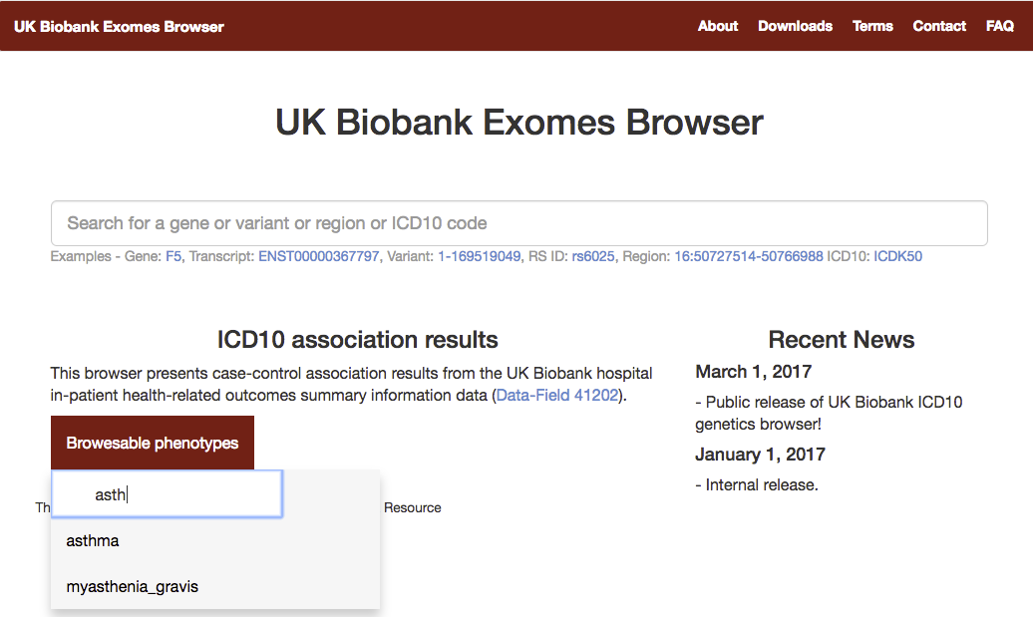
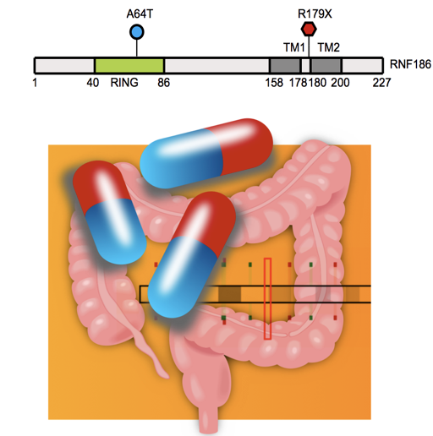
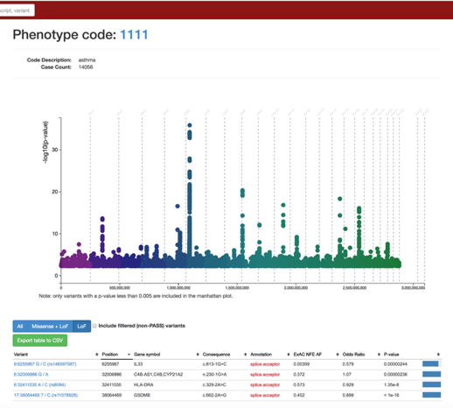
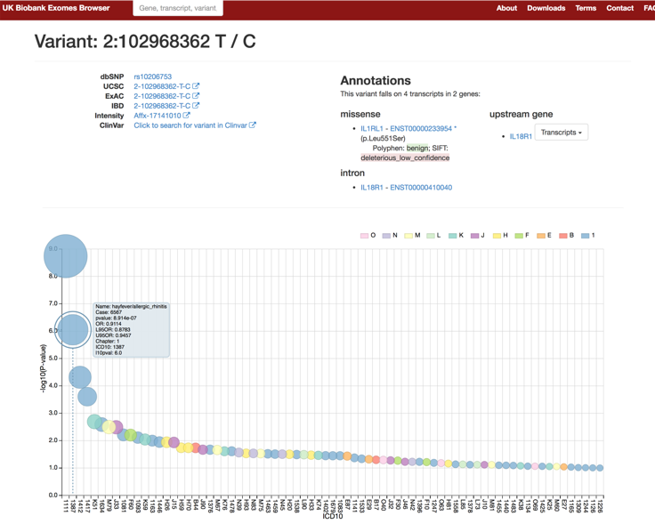
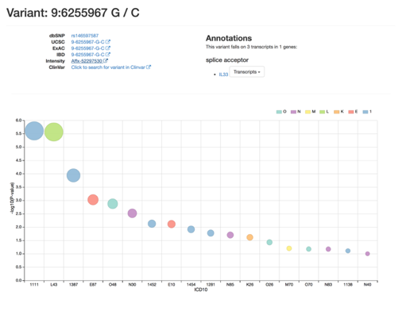
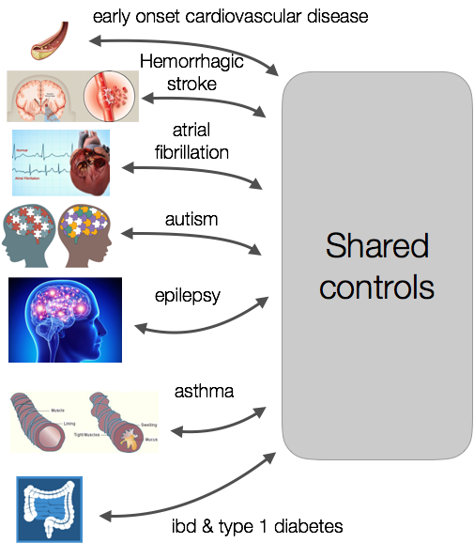
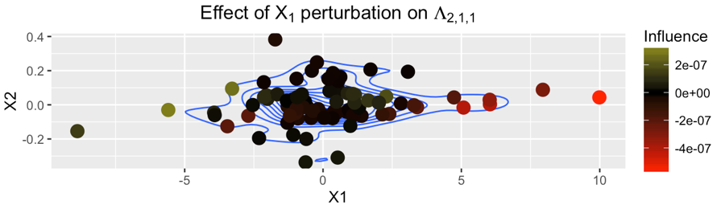
Rivas Lab: Translating Biomedical Data into Meaningful Discoveries
Christopher DeBoever^{1,2}, Adam Lavertu³, Antonio Edward Lindsey³, Greg McInnes³, Mamie Wang³, Oliver Bear Don’t Walk IV³, Yosuke Tanigawa³, Manuel Rivas¹
¹Department of Biomedical Data Science, Stanford University, ²Department of Genetics, Stanford University, ³Biomedical Informatics, Stanford University
High-dimensional Methods Development and Optimization
Technologies for Integrated Learning Healthcare Systems
Rivas Lab Scientific Themes
Generating effective therapeutic hypotheses
Genetic epidemiology
High-dimensional methods development and optimization
Healthcare technologies
Visit us at rivaslab.stanford.edu
Web Resources
ALTUD: AnaLysis of Text and speech
for understanding Disease
System for automatic recording, archiving, and tagging of clinical observations and notes designed to feed into a variety of inference algorithms.
Generating Effective Therapeutic Hypotheses
Data Storage
Clinical note upload
Raw file conversion
Text parsing
Query
Disease prevalence inference
Data
Clinical notes
Demographics
Genome
Extracting meaning
ICD10 tagging
Disease progression
Causal analysis
Algorithms
Topic modeling
Recurrent neural networks
SVM
Splice variant in CARD9 causes premature truncation of protein and strongly protects against the development of Crohn’s disease and ulcerative colitis (p < 10⁻¹⁶).
Protective loss-of-function variant in RNF186 found to confer protection against ulcerative colitis (3-fold protective effect).
Protective loss-of-function variant in IL33 found to confer protection against asthma (2-fold protective effect) identified in UK Biobank data.
Public-facing website for exploring genome-wide association results for hundreds-thousands of phenotypes from the UK Biobank
Search by variant, gene, region, or phenotype of interest
Genetic association summary statistics, quality control information
Portal for applying novels statistical models like MRP.
Haplotype Inference and Genome Compression
Combining genetic, biomarker, environmental, and clinical outcomes data with statistical methods and tools to uncover protective modifiers of disease risk. We seek to identify protective genetic variants, which reveal a process that is safe (naturally occur in healthy adults) and effective (proven to reduce risk of disease).
High-dimensional Methods
Can we estimate haplotypes online and use them to compress personal genomes?
Can we use compressed personal genomes to perform inference for hundreds of thousands to millions of genomes?
Large-scale Genetic Association Studies
MRP: Statistical framework for rare variant association studies
Perform meta-analyses across variants, phenotypes, and studies
Assess heterogeneity of effects
Identify protective protein-truncating variants
Develop efficient methods for genome sequencing studies using admixed and diverse samples.
Focus on rare coding variation.
Participating in NHGRI’s Genome Sequence Program, UK Biobank, and more.
Robustness analysis using Linear Response Variational Bayes method for mixture models

