Slide 1



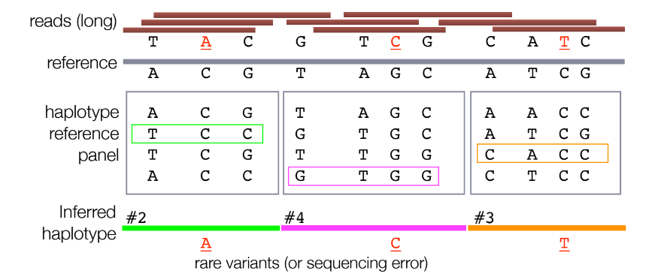
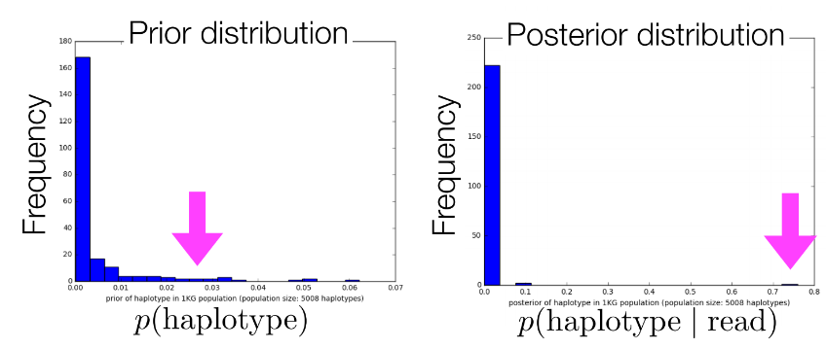
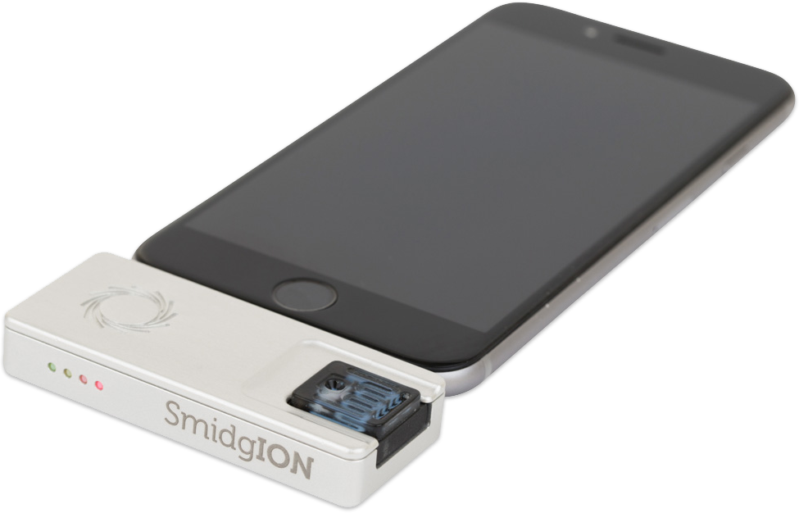
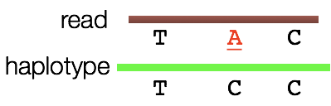
Compressed representation of personal genomes and its application for real-time haplotype inference
Yosuke Tanigawa¹, Manuel Rivas²
¹Biomedical Informatics, Stanford University, ²Department of Biomedical Data Science, Stanford University
Abstract
Recent advancements in sequencing and genotyping technologies enabled characterization of personal genomes for millions of individuals. However, the current de facto analysis pipeline is not scalable in terms of both data storage cost and computation time. Here, we present a novel compressed representation of personal genomes with an aid of large-scale population reference. We demonstrate that our approach can (1) reduce the storage space by orders of magnitude and (2) accelerate statistical inference. As an application, we demonstrate a method to perform real-time inference of haplotypes from long-read sequencing data. We hope our approach facilitates biomedical findings from personal genomes of large-scale populations.
[Method] Compact representation of personal genome
Personal genome = haplotype indices + personal rare variants
Population reference captures most of the common variants
Long-reads contain multiple polymorphic sites
Prior : Maximum Likelihood Estimate
Likelihood : Binomial model - : # of polymorphic sites - : # of mismatches - : error rate
We can estimate error rate - : mismatch rate on non-polymorphic sites
[Preliminary Results] Rapid haplotype inference
Our Bayesian approach can infer haplotype with a few reads
Data: Nanopore consortium NA12878
Population reference: 1000 genome project phase 3
Example read: chr20; 30kb long regions; 15 SNPs
Prior probability of the correct haplotype = 0.0263
Posterior probability of the correct haplotype = 0.7596
Only one read is sufficient to find the correct haplotype
Research Questions
Can we infer haplotypes of personal genomes on the fly with portable sequencers?
What would be the compact & efficient representation of personal genomes?
How can people share personal genomes with researchers while maintaining participants’s privacy?
Oxford Nanopore Technologies
SmidgION
Future prospects
Explicitly model linkage-disequilibrium (LD) structure
Build an end-to-end pipeline
Validate on external dataset (e.g. UK Biobank population)

