Slide 1

Some things you should know about TensorFlow

Slide 2
What does the library do?
User represents computations as graphs
Description of computations (declarative approach)
Nodes (ops) ( n tensors -> ops -> m tensors)
Programs have two phases (Construction, Execution)
Handles all the lower-level details
Parallelization
Ops
Tensor transformations

Slide 3
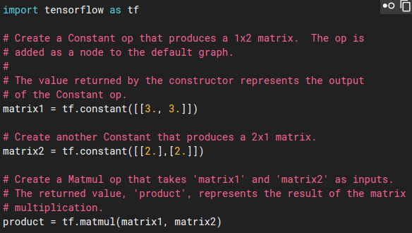
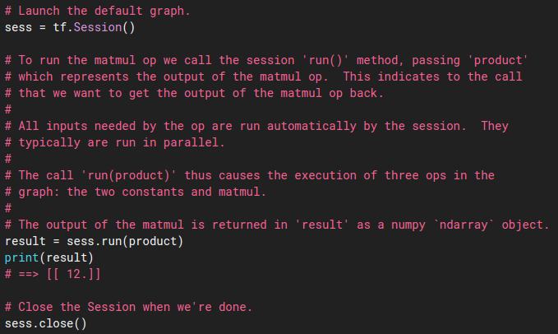
Example Code:
CONSTRUCTION
EXECUTION

Slide 4
What makes TensorFlow special?
Languages: C, C++, Go, and Python*
Parallel friendly
CPUs, GPUs (Code is similar)
Can be run in interactive mode
Jupyter friendly
Highly flexible (create custom ops)
Ascending to dominance
Many support libraries
Fast compilation times

Slide 5
What makes Tensorflow special?
TensorBoard
suite of visualization tools
Evaluate structure
https://www.tensorflow.org/how_tos/graph_viz/
Evaluate performance
Google Muscle

Slide 6
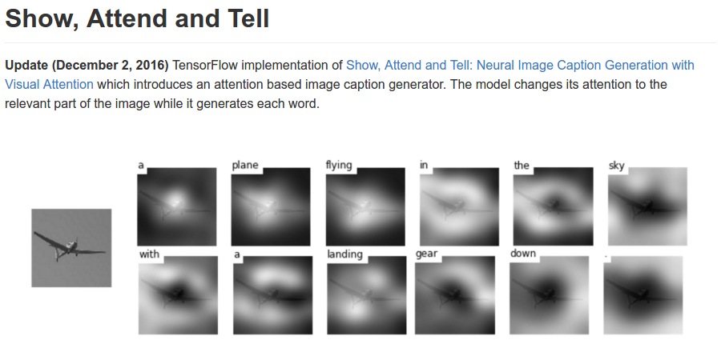
Use cases:
Mostly image and audio processing
Classic Neural Network Problems

Slide 7
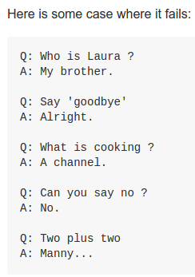
Use cases:
Implementation of HMMs (Viterbi Algorithm)
Chatbot (limited success)

Slide 8
MORE!
https://github.com/jtoy/awesome-tensorflow
Collection of everything you could ever want to know about TensorFlow
https://www.tensorflow.org/tutorials/
Main website (beginner and advanced tutorials)
https://www.usenix.org/conference/osdi16/technical-sessions/presentation/abadi
Associated paper

