Slide 1
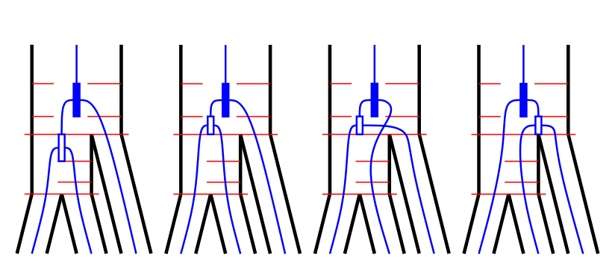











$${V0}_{3}^{2}$$
$${V1}_{1}^{2}$$
$${V2}_{1}^{2}$$
$${V3}_{1}^{2}$$
$$T_{2}$$
$$T_{1}$$
$$τ_{ABC}$$
$$t_{2}$$
$$t_{1}$$
$$τ_{AB}$$
$$t_{0}$$

