Slide 1
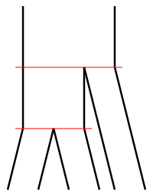










$$Q_{ABC}$$
$$τ_{ABC}$$
$$Q_{AB}$$
$$τ_{AB}$$
$$Q_{C}$$
$$Q_{A}$$
$$Q_{B}$$
$$A$$
$$B$$
$$C$$

