Slide 1


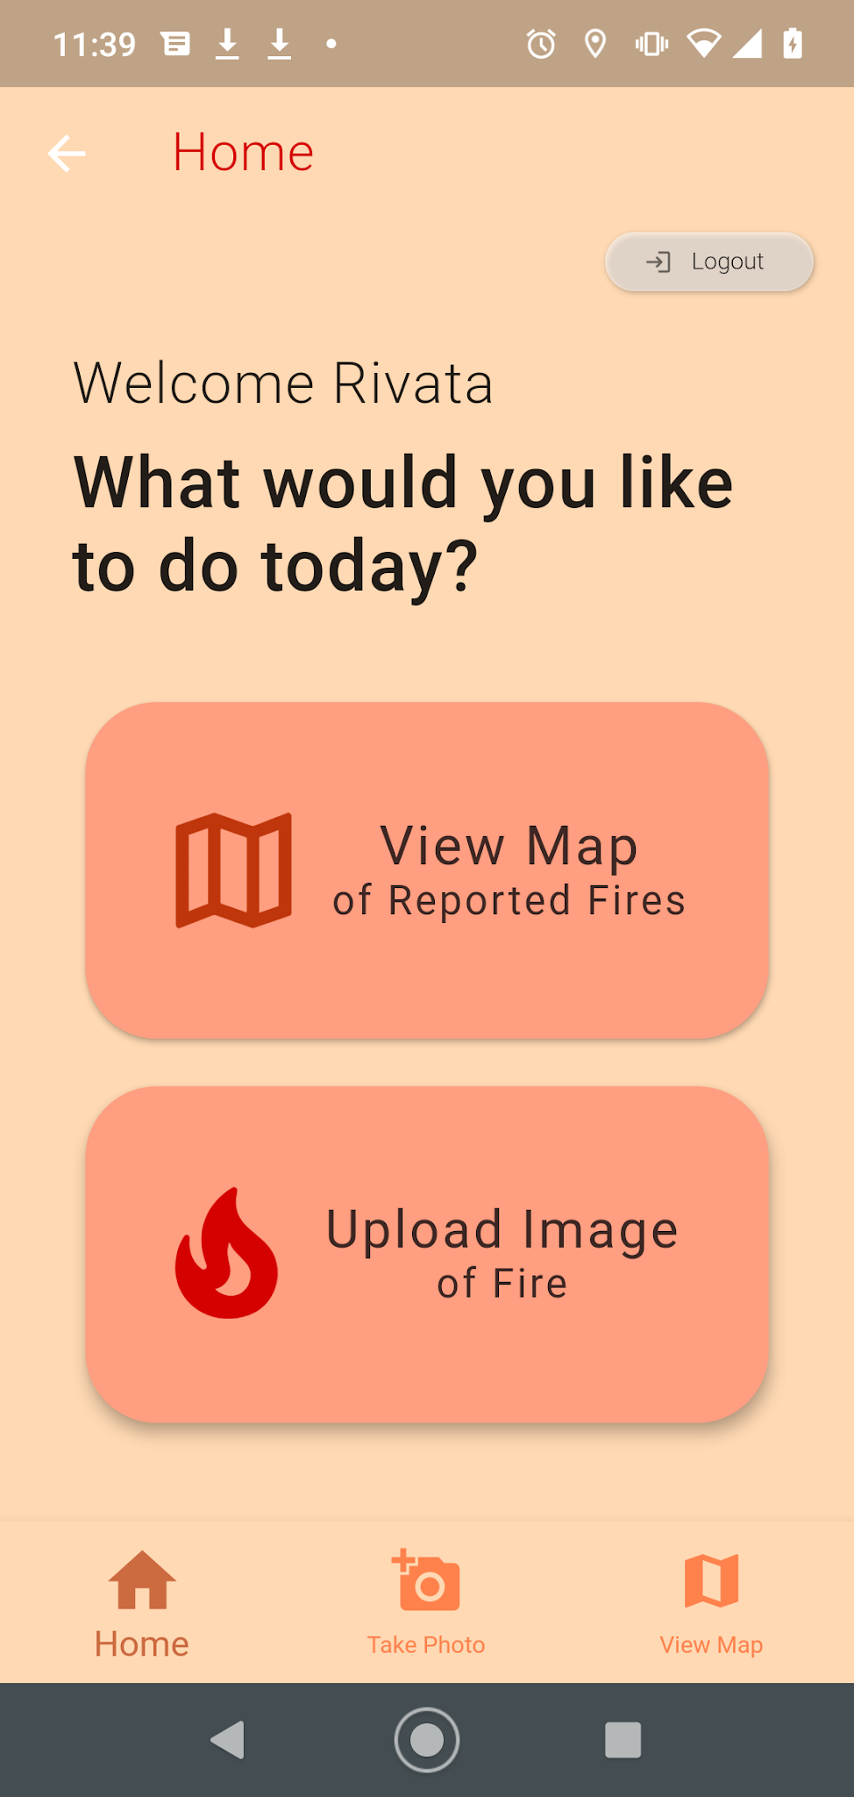
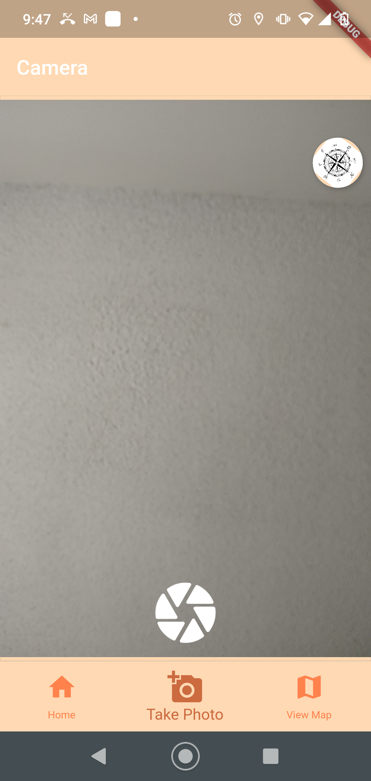

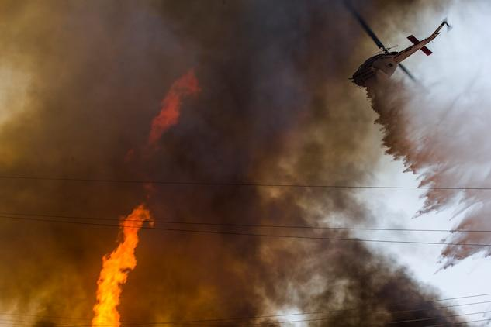
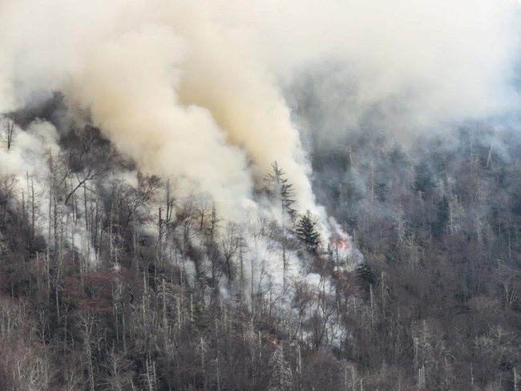
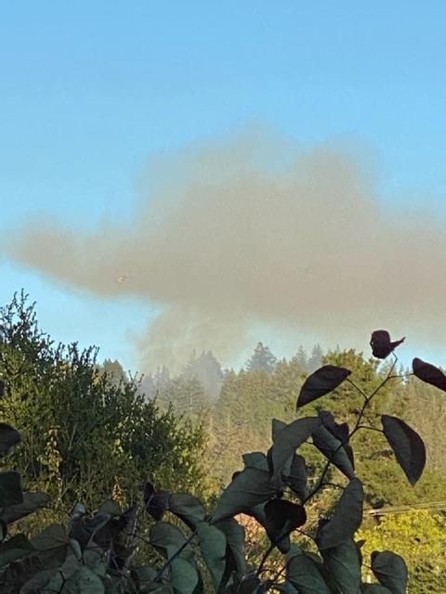
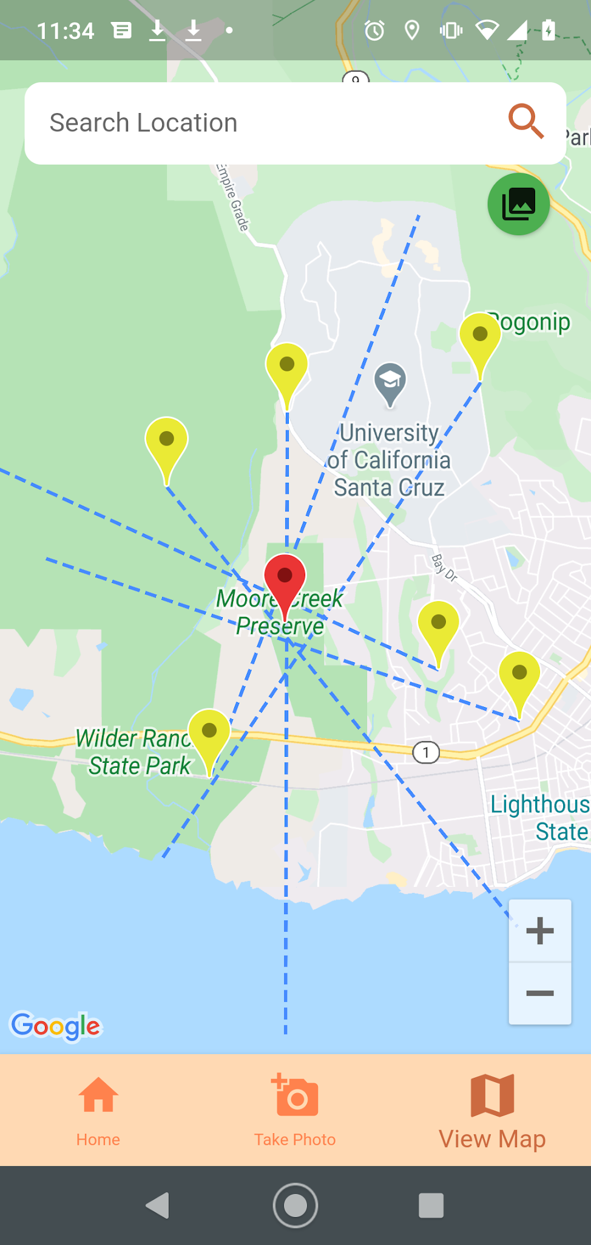
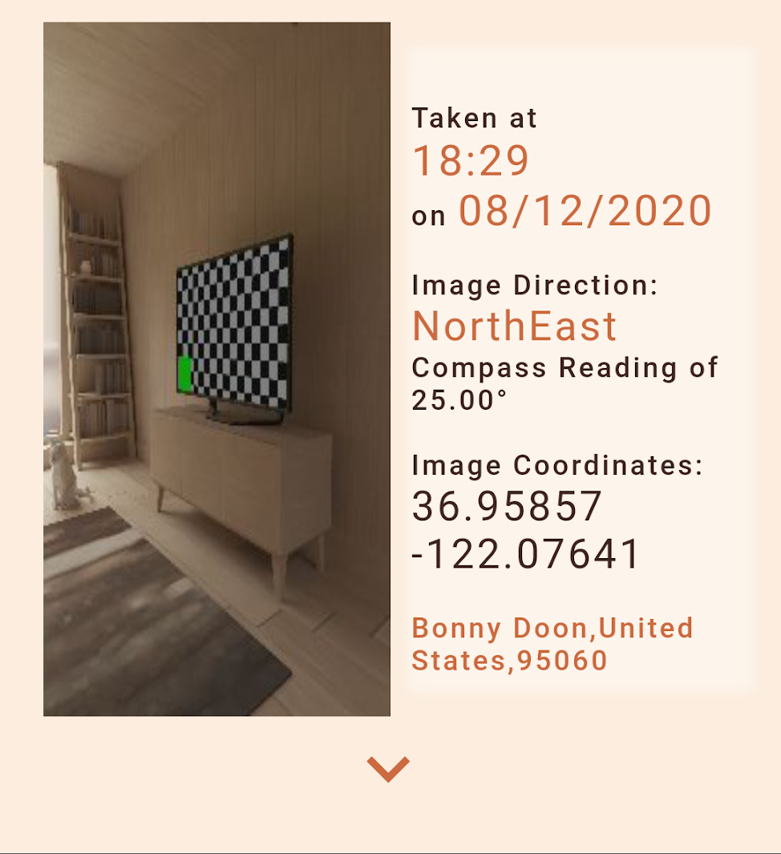

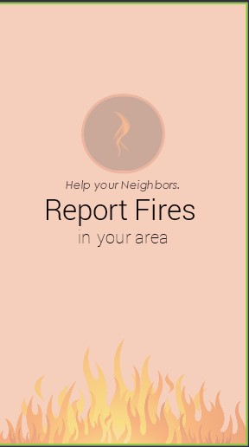

Incident Reporting
Rivata Dutta, Atticus Jones, Ulysses Uribes
CSE 115D
Fall 2020
Features
Overview
Future Vision
We created a mobile app that can be used to pinpoint the location of fires. Users take a picture of a fire, and we gather the compass and location data, to create vectors on a map. When many users upload images, we can use this data to find the likely point of a fire.
Distinguish Between Multiple Incidents. Current app does not have any image recognition functionality.
Increase Accuracy. Phone compass’ are not 100% precise. . In the future, we would have user’s capture multiple images from the same location and average the compass reading to get better accuracy. Increase functionality for First Responders. If implemented on a large scale, this app would be incredibly beneficial to respondents AND the general population.
Architecture
Firebase database
Calculate Intersection Points between Images
Anonymous Login - Protect your identity while uploading images.
Capture/Upload Image of Fire.Take a picture of a fire in your visibility.
vc
Image Compass Data
Image Location Data
(Latitude,
Longitude) Vector traveling in Camera Direction
Technology
Load Images from Firebase
‘Incident-Reporting’ was created with a Flutter front-end and developed with Google Cloud Services for functionality. Firebase was the backend service used to store our anonymous users, user images, and image data. App was designed and prototyped on JustinMind.
vc
Flutter & Dart Front-end
View Map of Reported Fires & Fire Location - Also view the fire images taken in your area.
vc
Capture Image
Fire Location. Google Maps API.
Special Thanks to...
Richard Jullig, Patrick Mantey,
Akila De Silva, Rob Wormald

