Slide 1
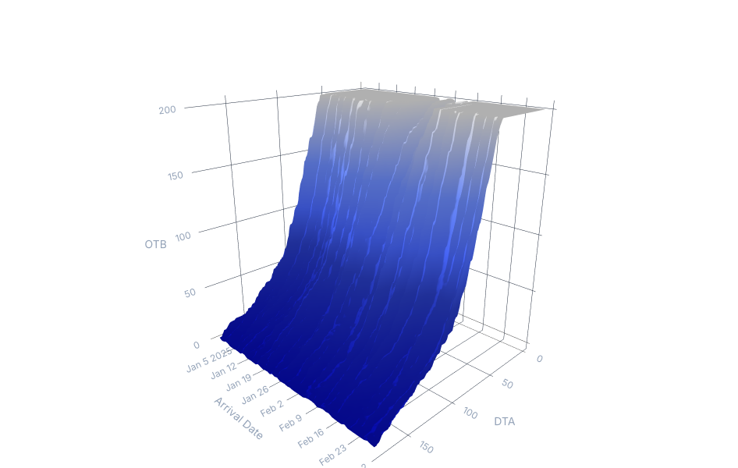




Arrival Date
DeepPace-Sim v3:
The Simulation
Mechanism
Architectural Specifications & Functional Composition
DTA

Slide 2









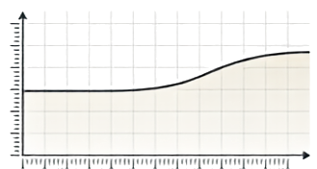
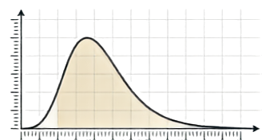
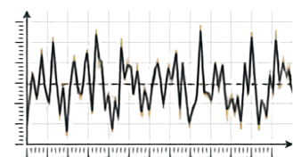


The Core Engine: Composing the Booking Curve
v(p,d, k) = lambda(p,d) * s(p,d,k) * zeta(p,d,k)
Demand Level (lambda)
Pace Shape (s)
Pace Shock (zeta)
Module: demand.py
Module: pace.py
Module: pace.py
A stylized probability curve summing to 1. The systematic booking timeline.
A jagged noise wave with mean 1. The specific date's deviation.
A flat baseline warped by multiplier lenses. Defines total expected room-nights.
Sum = 1
Mean 1
Output: v(k) [Booking Intensity] -> flows to curve.py (Increment & Capacity)
Gemini Notebook

Slide 3




















The Property Universe (config.py)
Sandbox: 60 properties | 5 archetypes | 1,096 arrival dates
Archetype Matrix
Archetype
Capacity
Base
Demand
ADR
Character
Urban Business
Resort
Airport
Convention
Suburban Select
120-320
180-420
90-200
300-650
80-160
0.936
0.884
1.014
0.845
0.910
180-320
260-620
120-190
200-380
110-165
Tue/Wed peak, dead weekends, Dec collapse
Fri/Sat + summer/holiday peak
Flat seasonality
Event-driven spikes (1.45-2.20x)
Mild everything
Gemini Notebook

Slide 4












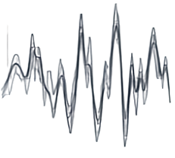
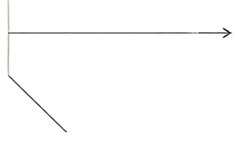



Demand Intensity (lambda): The Multiplicative Stack
Holiday Inversion (H)
Factor Stack Diagram
Christmas multiplies Urban by 0.28x, but Resort by 1.50x.
Insight: Punishes models learning one global holiday effect.
H
(Holiday)
Baseline Demand
lambda (Gross Demand Intensity)
Y
(Yearly smooth)
M
(Monthly step)
W
(Day-of-Week)
D
(Month-end)
epsilon
(Noise)
The Mood Factor (epsilon)
AR(1) over weekly innovations (phi = 0.93, sigma = 0.09).
Starts at stationary variance (0.245) to prevent artificial forecasting accuracy in early weeks.
Gemini Notebook

Slide 5













The Regime Signal & Compression Pivot
The load-bearing expected wash correction.
lambda
(Gross Demand)
Multiply by
(1 - 0.24)
Divide by Capacity (C)
Clip at
[0, 1.3]
occ_expected
(Mean: 0.717)
Design Philosophy:
occ_expected is the ONLY channel connecting demand to pace shape. archetype does NOT directly enter the pace function. If it did, models could simply memorize archety instead of learning to read the booking surface.
Gemini Notebook

Slide 6
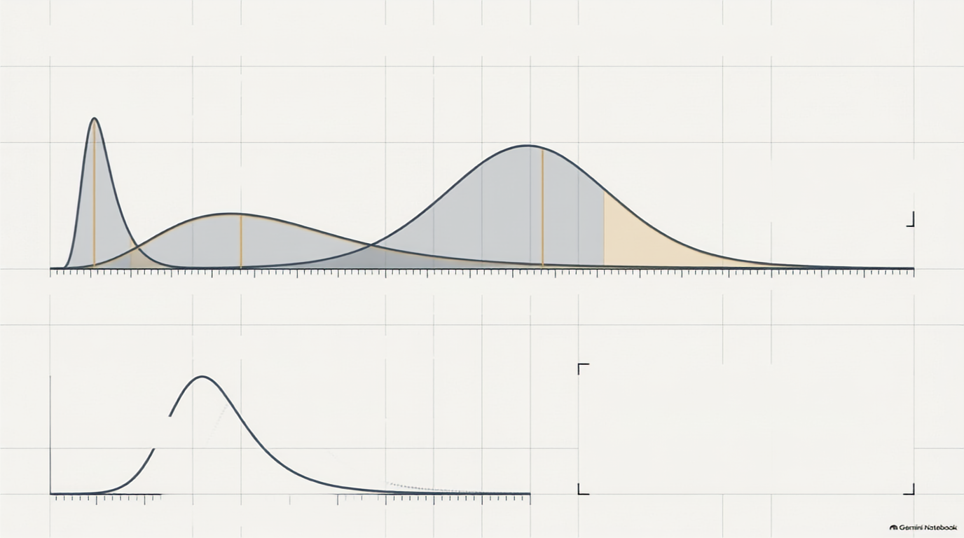
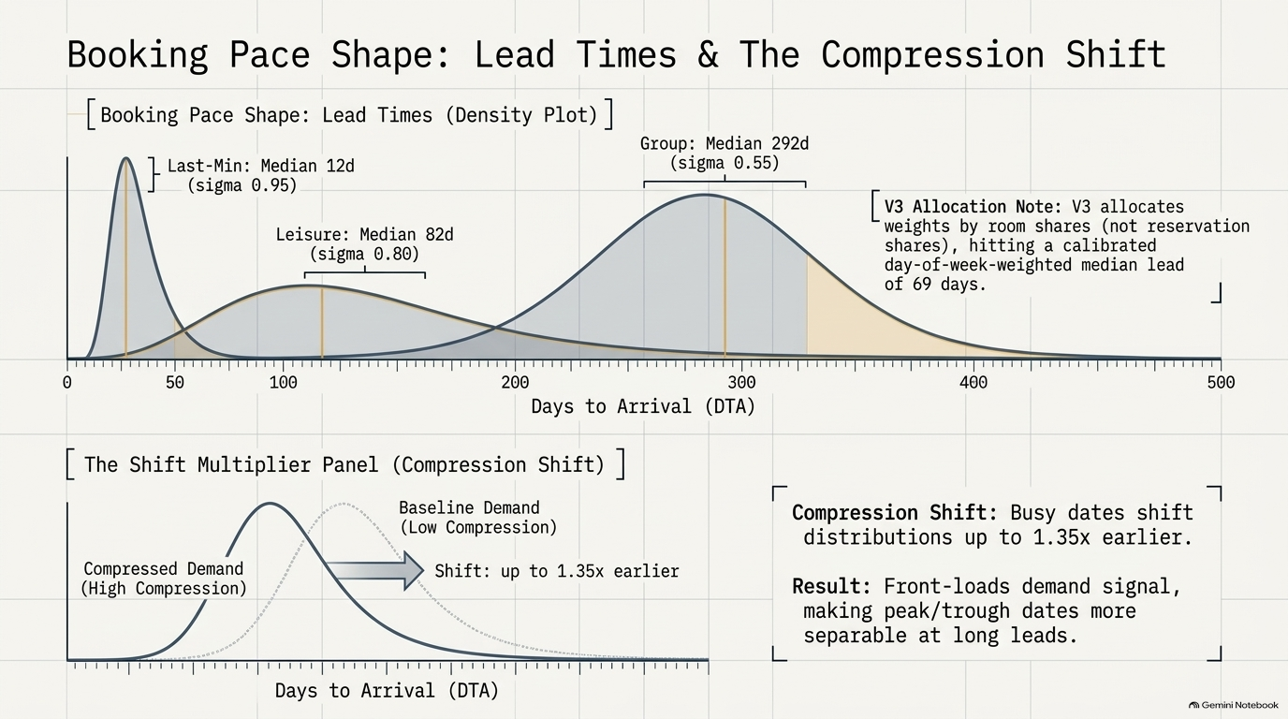

Slide 7


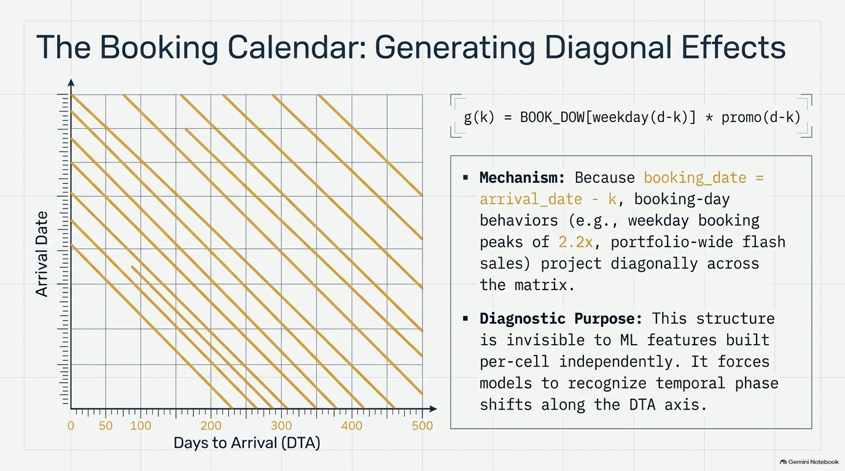



































The Booking Calendar: Generating Diagonal Effects
g(k) = BOOK_DOW[weekday(d-k)] * promo(d-k)
▪︎ Mechanism: Because booking_date = arrival_date - k, booking-day behaviors (e.g., weekday booking peaks of 2.2x, portfolio-wide flash sales) project diagonally across the matrix.
▪︎ Diagnostic Purpose: This structure is invisible to ML features built per-cell independently. It forces models to recognize temporal phase shifts along the DTA axis.
Arrival Date
Gemini Notebook

Slide 8





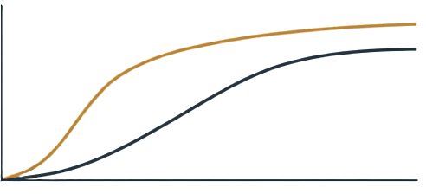



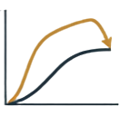







The Pace Shock (zeta): The Forecastability Dial
No Renormalization
0.80
V3 chosen state
How far it deviates from lambda
DeviationMagnitude (sigma_z)
Wrong approach:
Forcing the end of the curve to drop to conserve mass. This makes early pace compensatory and destroys forecastability.
How long deviation is visible early
W3 approach:
Total moves with the field. Running hot early predicts finishing high. E[zeta] = 1 is maintained via a mathematical correction, not mass conservation.
240 days
Correlation Length (1)
Gemini Notebook

Slide 9

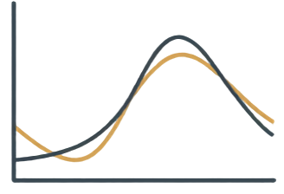
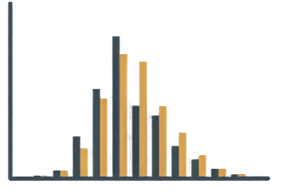





From Intensity to Curve: Increment & Irducible Noise
Negative Binomial Draw
v(k)
gross(k)
(Continuous Booking Intensity)
(Discrete Bookings)
The phi = 4.0 dispersion Engine
var/mean = phi
Why? It acts as a surrogate for unsimulated batch arrivals (group blocks).
It separates unforecastable batch noise (NegBin) from forecastable demand level (AR(1) shocks), raising the error floor equally for all models.
Gemini Notebook

