Slide 2
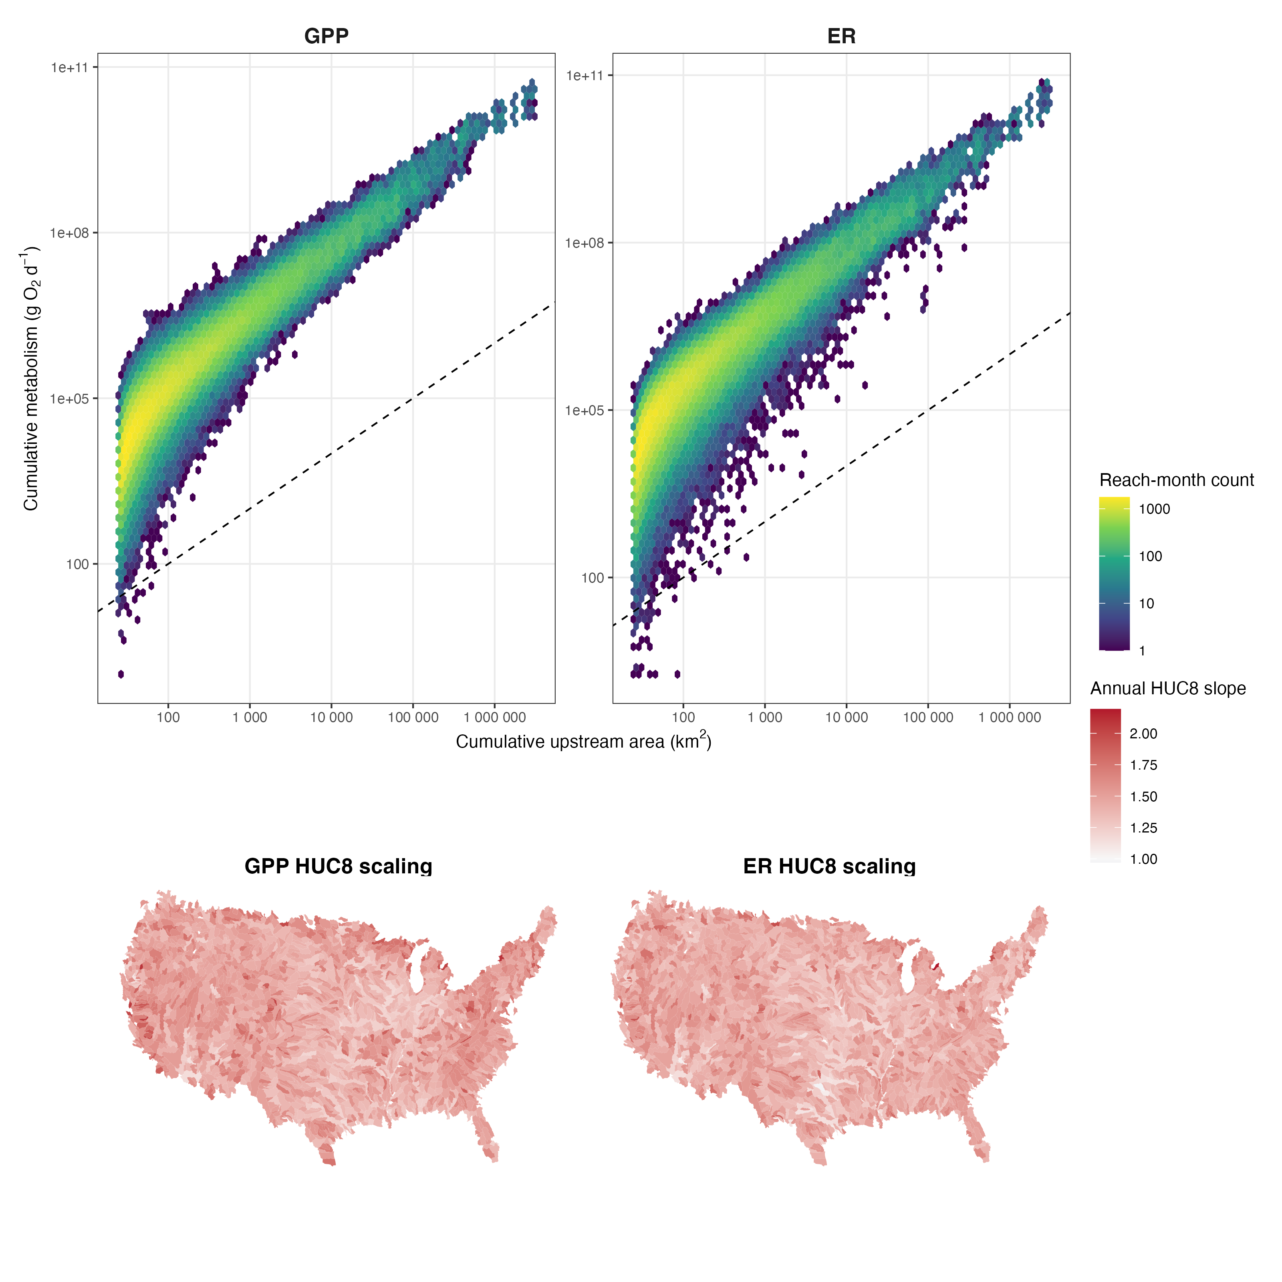
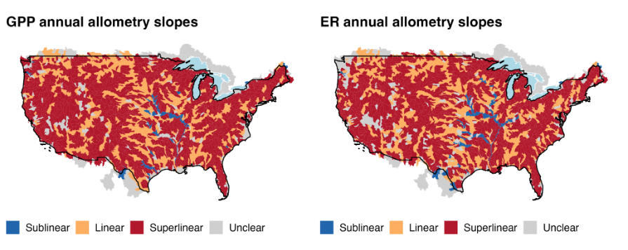
Key point 1: metabolism allometry is consistently super-linear across CONUS
CONUS-level scaling patterns
Scaling is consistently super linear
  Some variability across conus (color-coding by category might be better – need to bootstrap for confidence intervals)
  cool how similar this looks to the JGR paper in terms of pattern
No visually clear delineations geographically

Slide 3
Y – cumulative GPP / watershed area
X = upstream area
Our data are observed, but NOT fitting a best fit line
Median slope/intercept for log-cumulative rate / log-cumulative area (1.5, 2)
Feed vectors into slopes/intercepts -> one rate per area (g O2/d)
Normalize vector to area
Plot – it should curve up (because m>1) – gives us our theoretical space
Plot B – our actual data – compare our patterns
M = 1.25
M = 1
M = 0.75

Slide 4
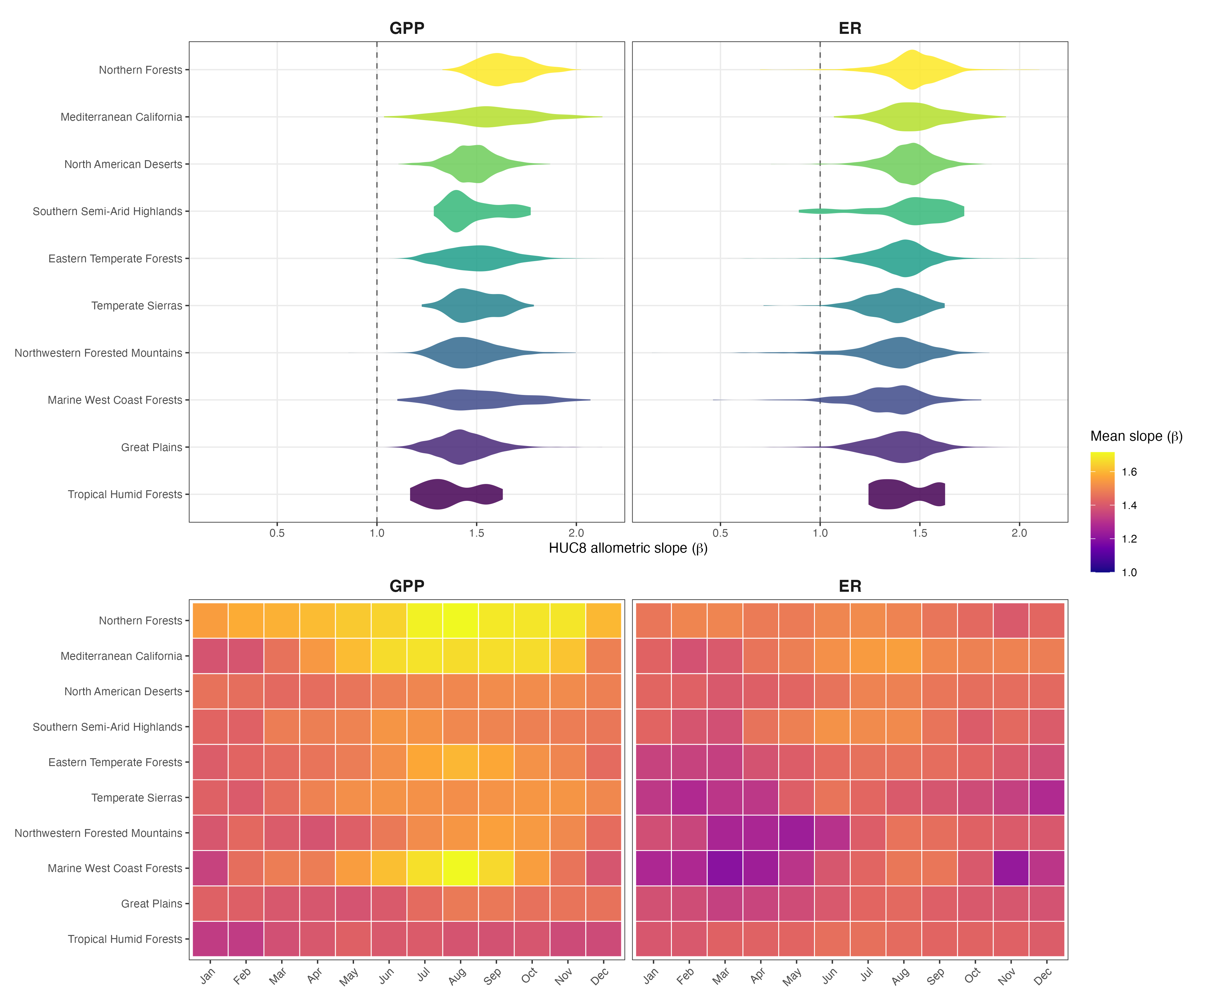
Key point 2: metabolism allometry is relatively consistent across ecoregions but varies through time
Do scaling behaviors differ between ecoregions?
Kinda, but not a ton
What about ecoregion and time?
  more interesting, plenty to discuss here I think

Slide 5
Based on best available estimates,
Consistent superlinear, which means the bigger, the more impactful (per unit area)

Slide 6
Split 1
Training
Split 2
Test
Split 3
Split 4
Split 5
Time

Slide 7
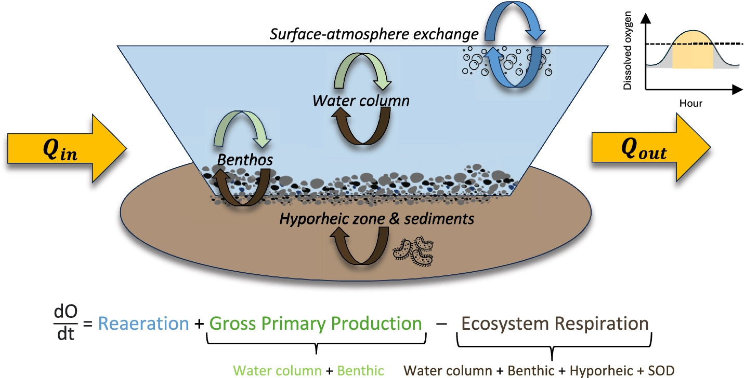
ER – respiration
ERwc – water column ER (one off measures)
ERtot – DO sensors (continuous)
ERsed = ERtot - ERwc
ERwc
ERtot
ERsed

Slide 8
fiberglass
fiberglass

Slide 9
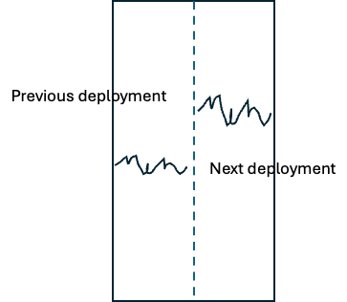
Previous deployment
Next deployment

